Slide 1
Lab 9 HW5 Discussion
Crop Sci. 545
Spring 2020

Slide 2
Problem 1
Genotype
Matrix
Simulated phenotype
GWAS
Power vs. FDR
Remember to account for mapping resolution window!
PCA (top 3 comps.)

Slide 3
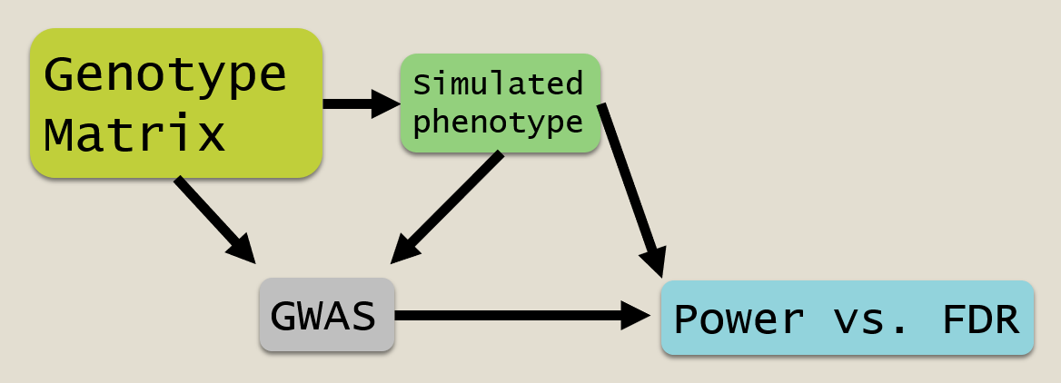
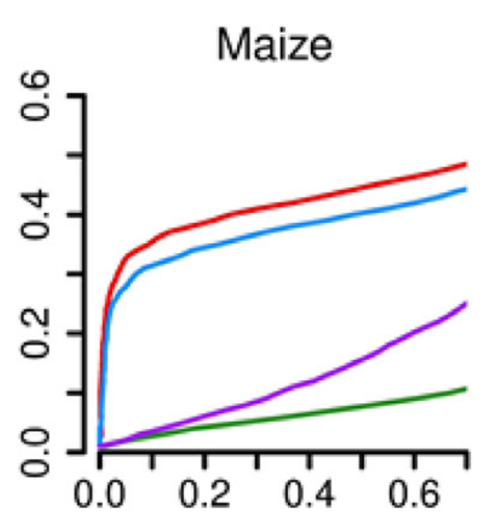
Problem 2-3
Heritability 0.75
Heritability 0.5
Each line is the mean Power/FDR for a given heritability
Heritability 0.25

Slide 4
Problem 4
GWAS Method 1
GWAS Method 2
Each line is the mean Power/FDR for a given heritability
GWAS Method 3

Slide 5
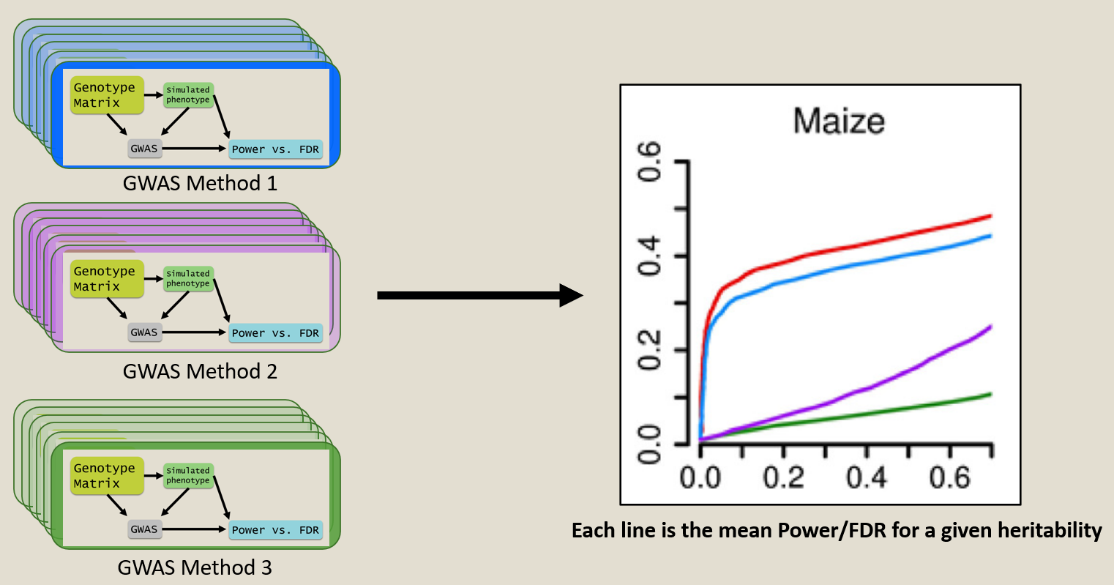
Problem 5
Genotype
Matrix
Simulated phenotype
Altered
Genotype
GWAS
Power vs. FDR
Remember to account for mapping resolution window!
PCA (top 3 comps.)

