Slide 1
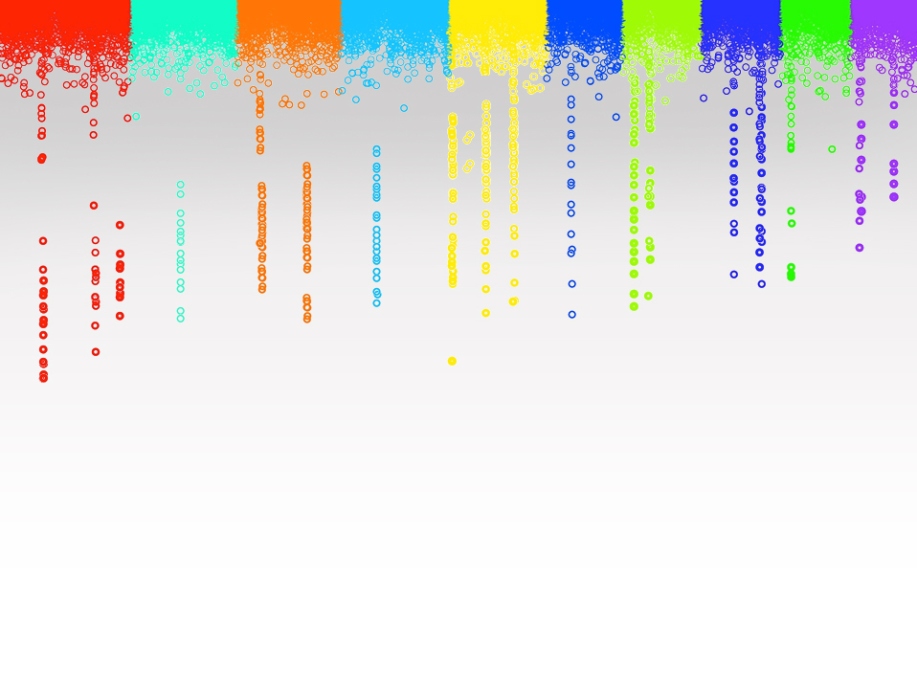
Statistical Genomics
Programming in R
Matthew McGowan
Washington State University

Slide 2
Current and future needs
"By 2018, the US alone could face a shortage of 1.5 million managers and analysts with the know-how to investigate big data to make effective decisions"
-McKinsey Global Institute, 2014 report

Slide 3
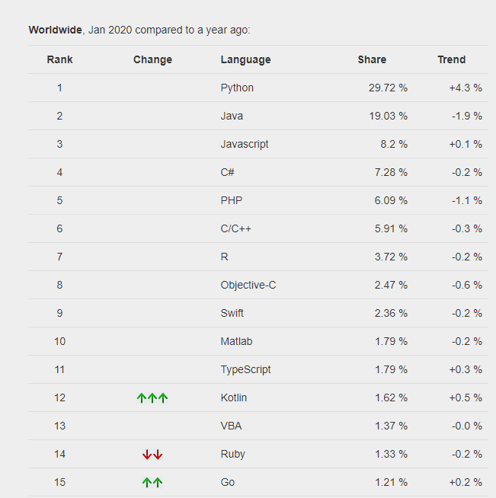
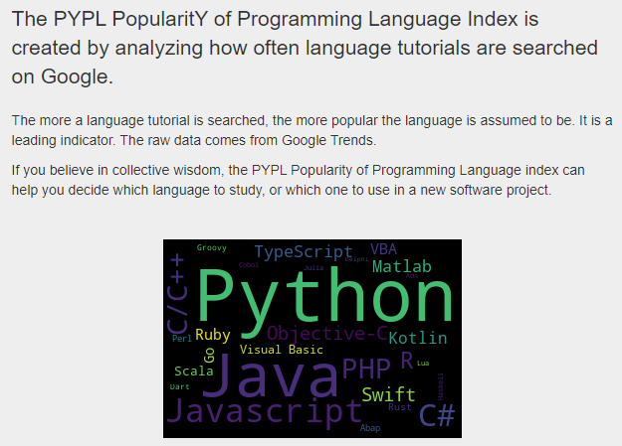
R You Ready for R?
http://pypl.github.io/PYPL.html

Slide 4
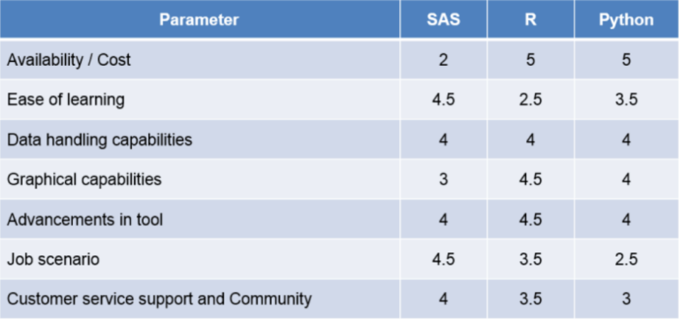
R You Ready for R?
http://www.analyticsvidhya.com/blog/2014/03/sas-vs-vs-python-tool-learn/

Slide 5
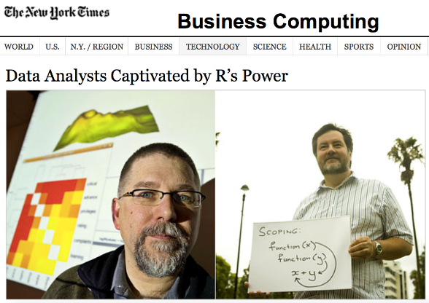
Robert Gentleman and Ross Ihaka
Start with S in 1996
Open source
Open packages

Slide 6
Variables and Operators
variable1 <- 0
variable2 = 1
variable3 <- variable1 + variable2
vector1 <- c(1,2,3,4,5,6,7,8,9,10)
string1 <- ‘variables can also be words’
string2 <- “quote type doesn’t matter unless they are nested”

Slide 7
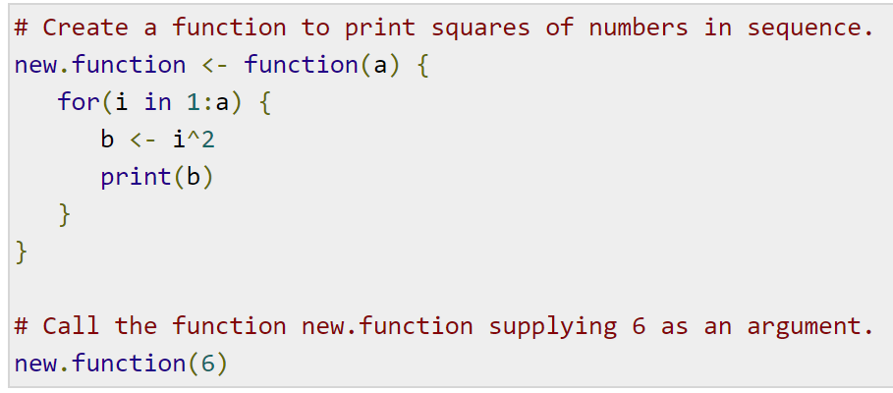
Functions ‘do’ things
Operators are really just a special kind of function!

Slide 8
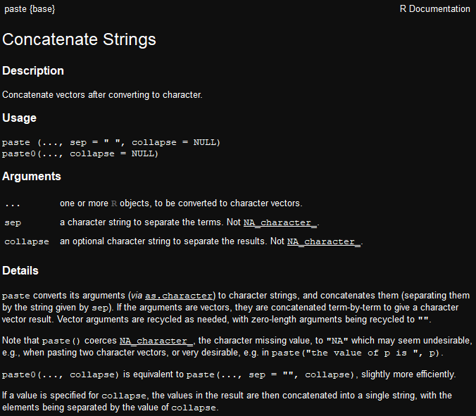
?help is incredibly useful
Use the ? feature to get a help page for any function

Slide 9
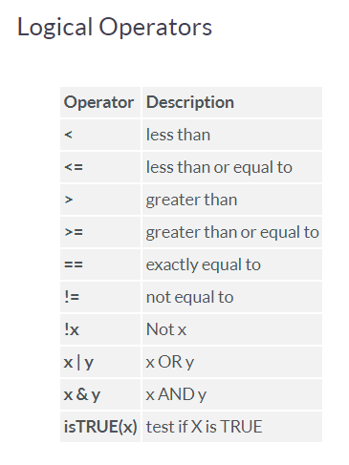
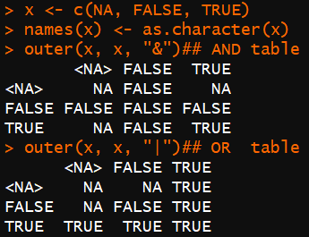
Logicals

Slide 10
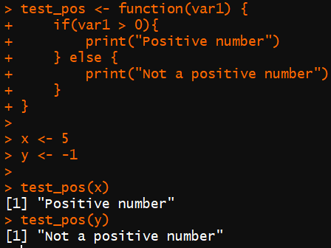
IF
if (expression)
{
Do Something
} else
{
Do a different thing
}

Slide 11
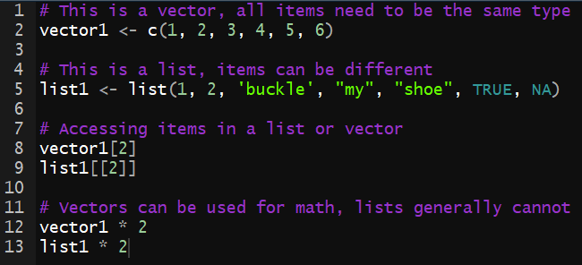
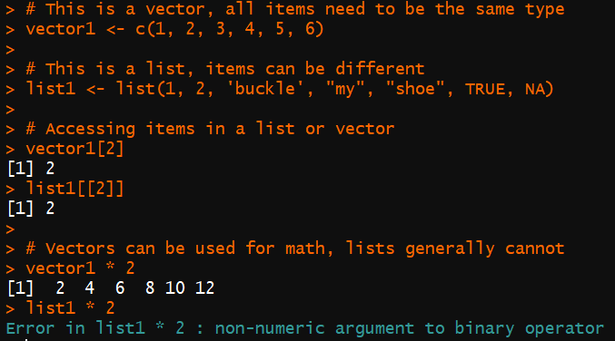
Lists and Vectors
This is a .R source file
This is the console when running each line from the source file

Slide 12
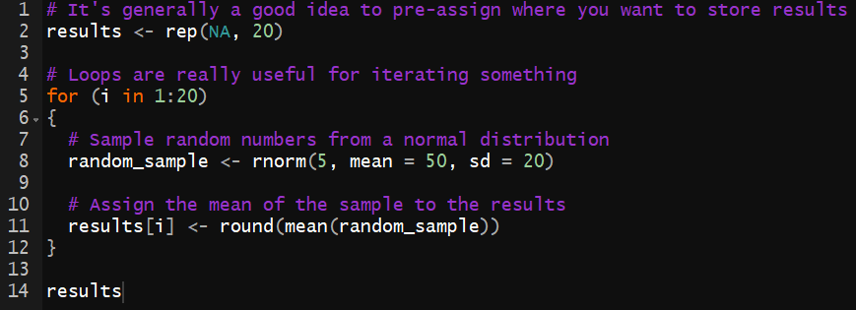
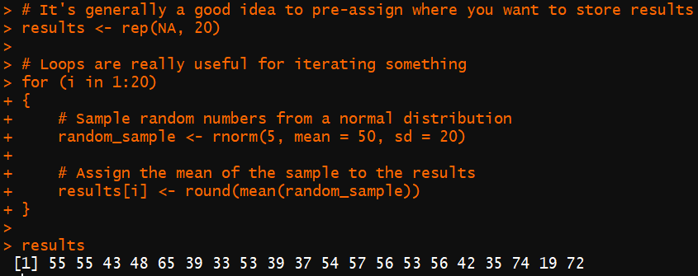
FOR Loops
for (item in vector)
{
do_something(item)
}

Slide 13
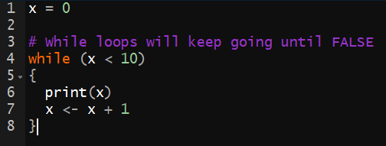
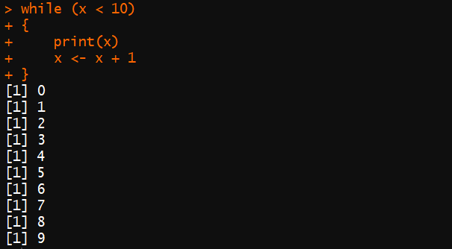
WHILE Loops
while (expression is true)
{
keep_iterating()
}

Slide 14
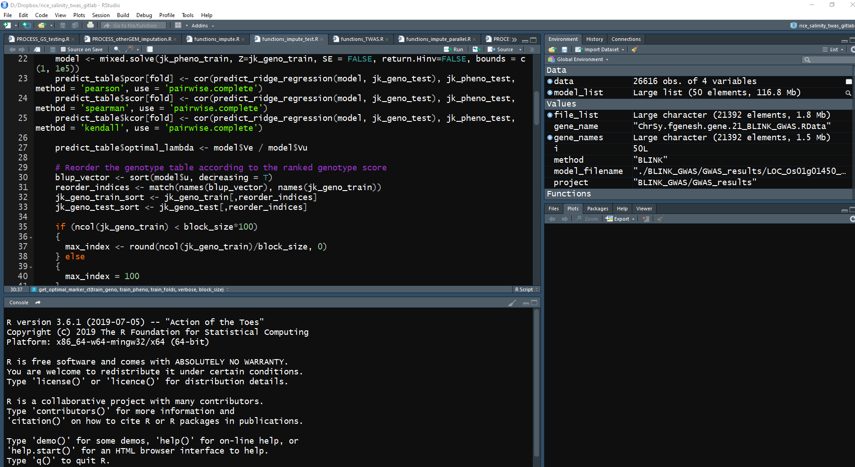
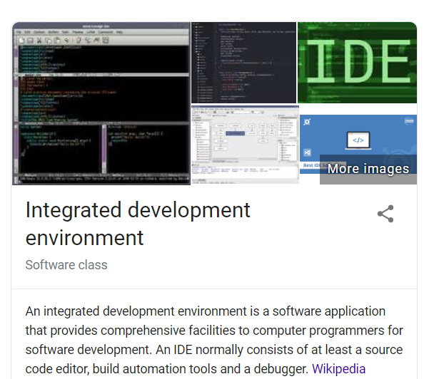
Rstudio is an IDE for R
https://rstudio.com/products/rstudio/download/#download

Slide 15
Packages
Collection of functions
~8000 on CRAN (Comprehensive R Achieve Network)
install.packages("mypackages")
library("mypackages")

Slide 16
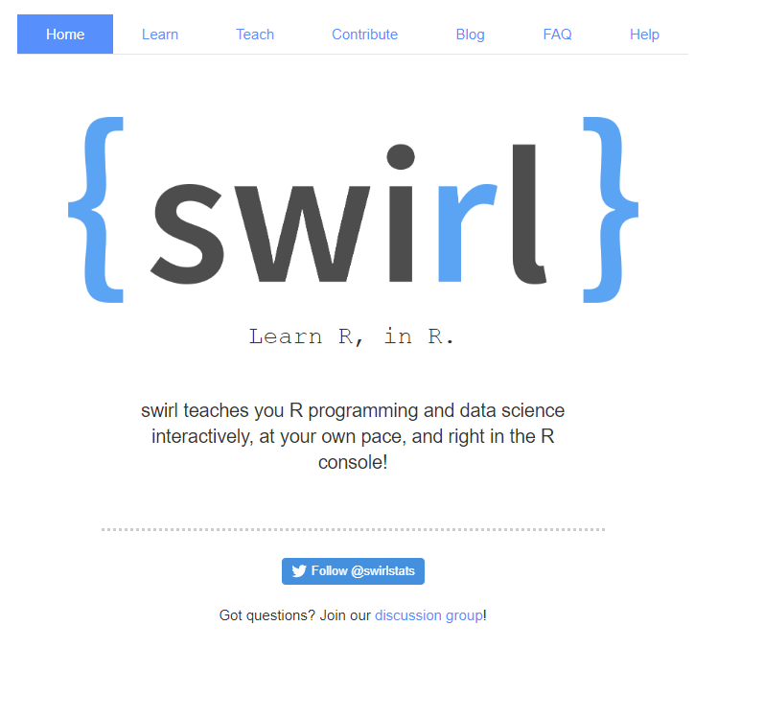
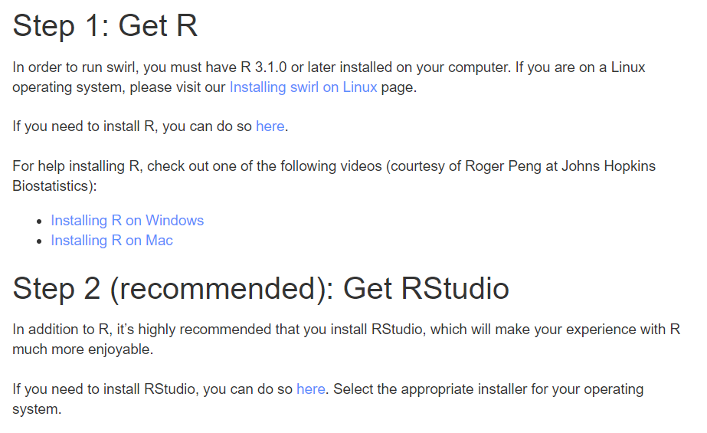
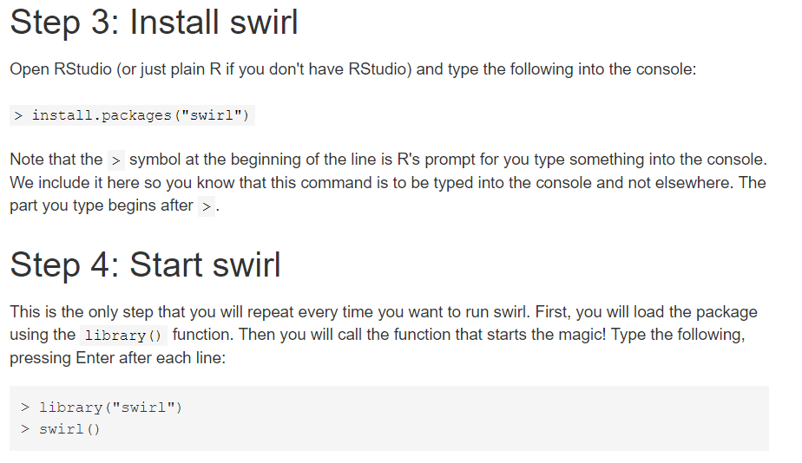
‘swirl’ is a great beginner friendly learning package

Slide 17
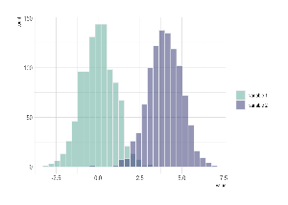
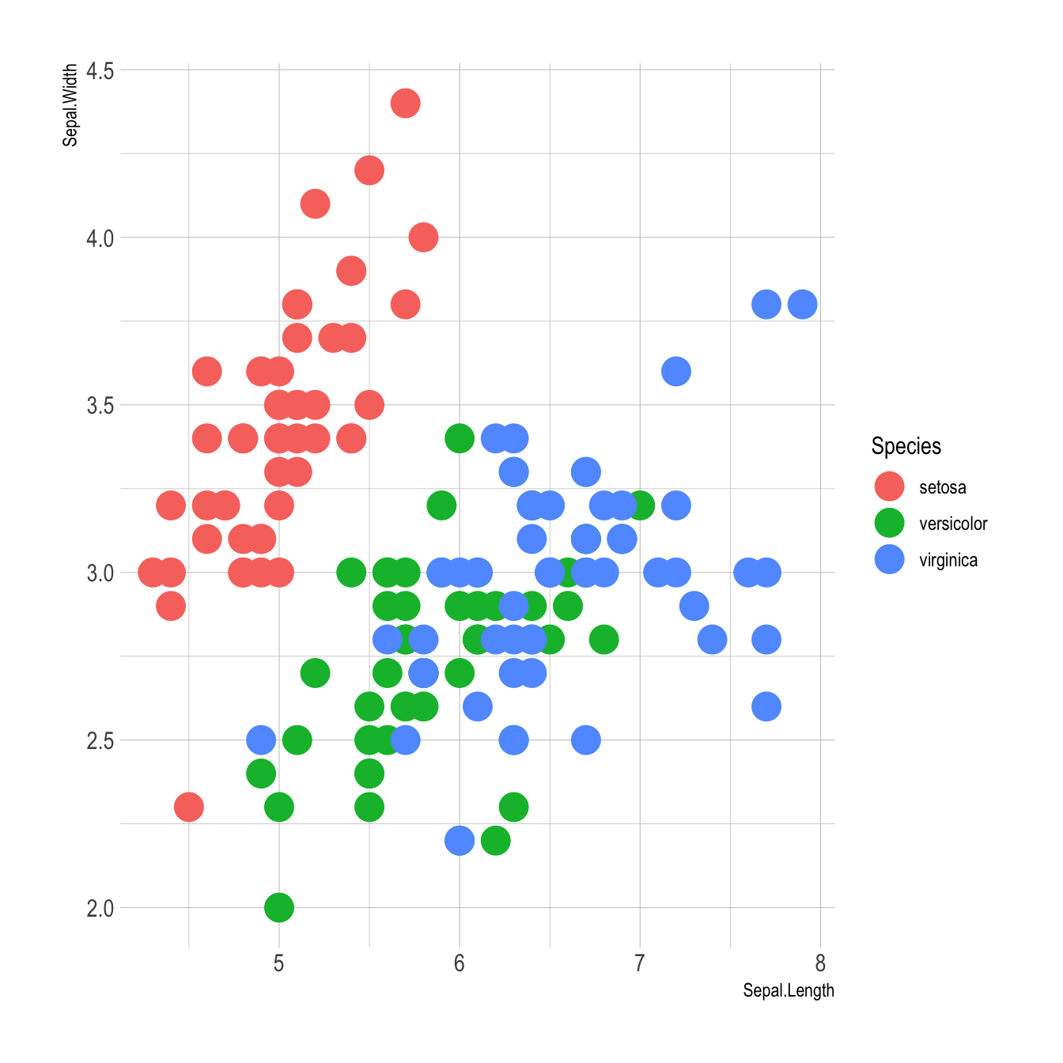
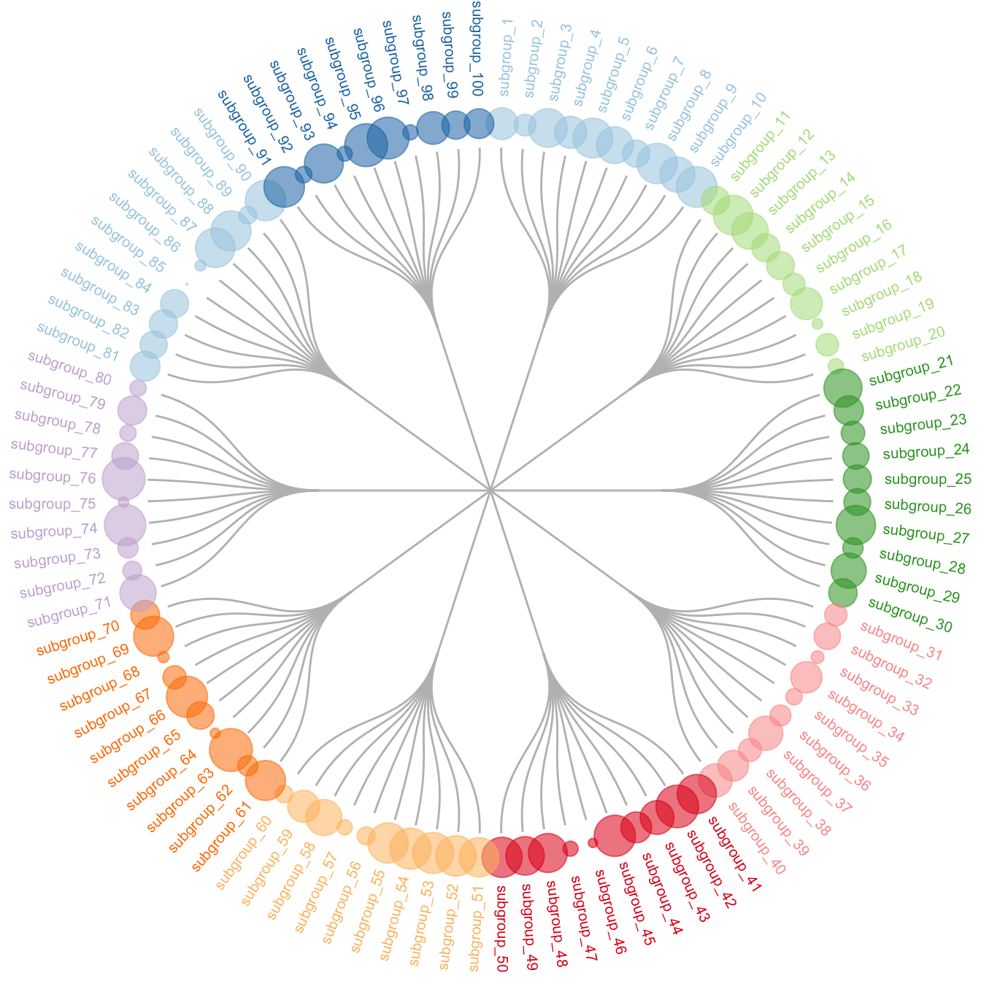
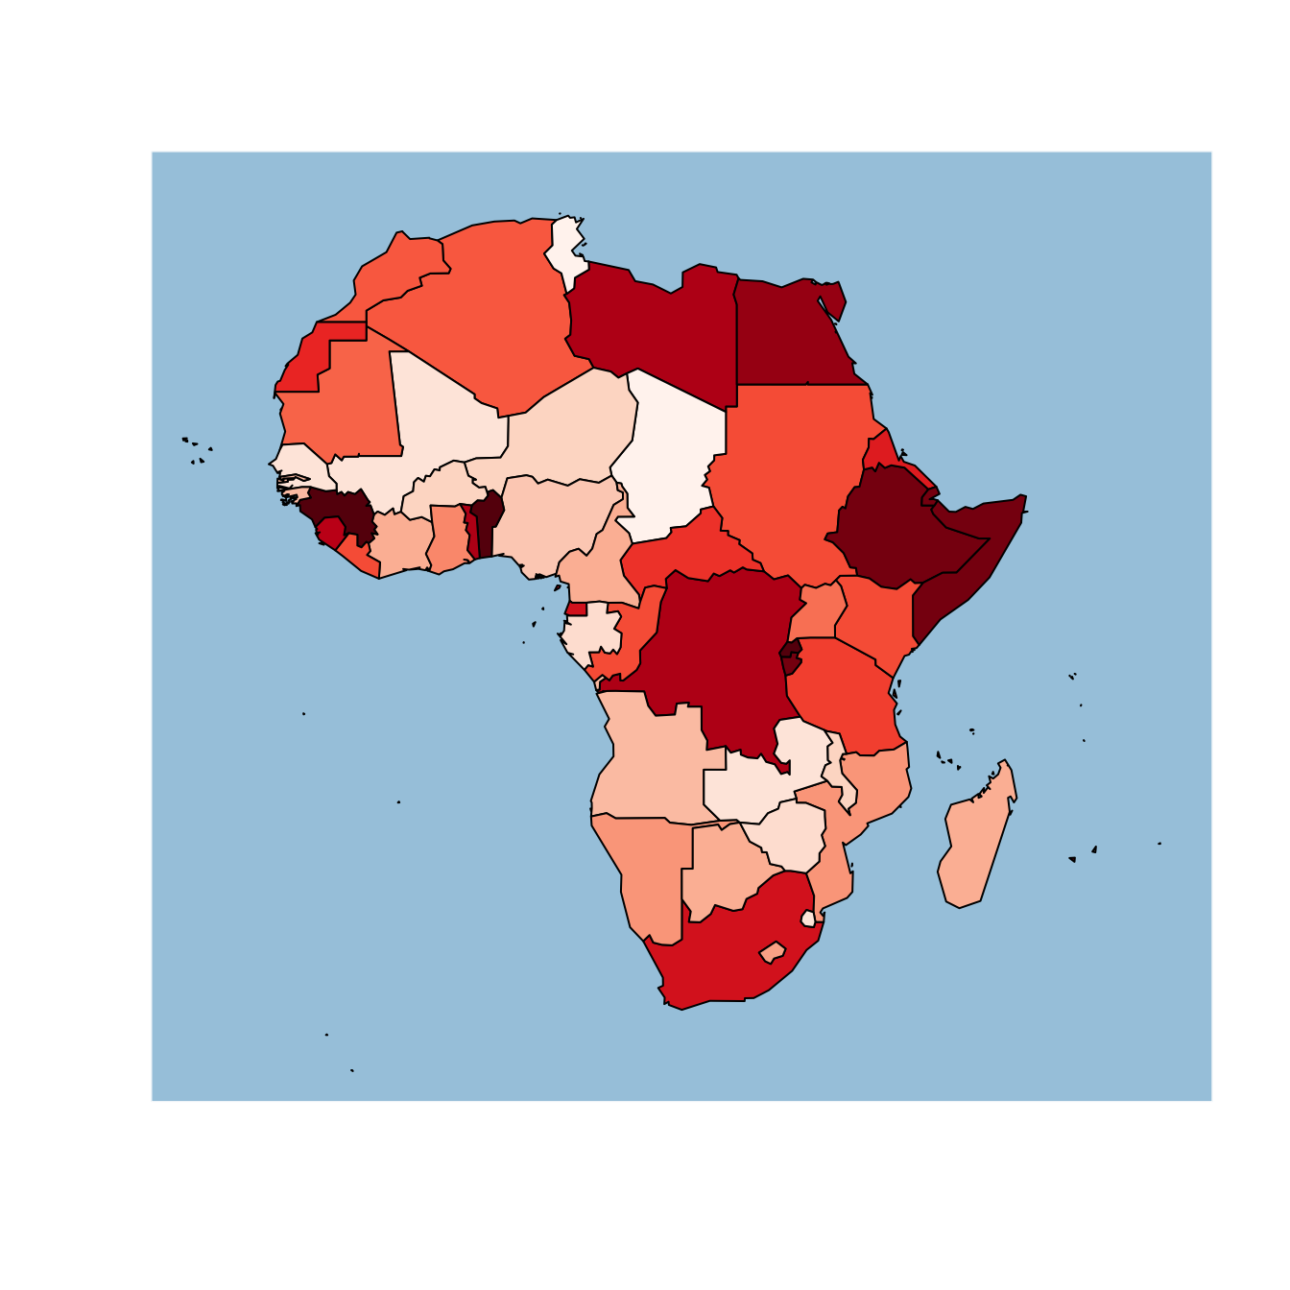
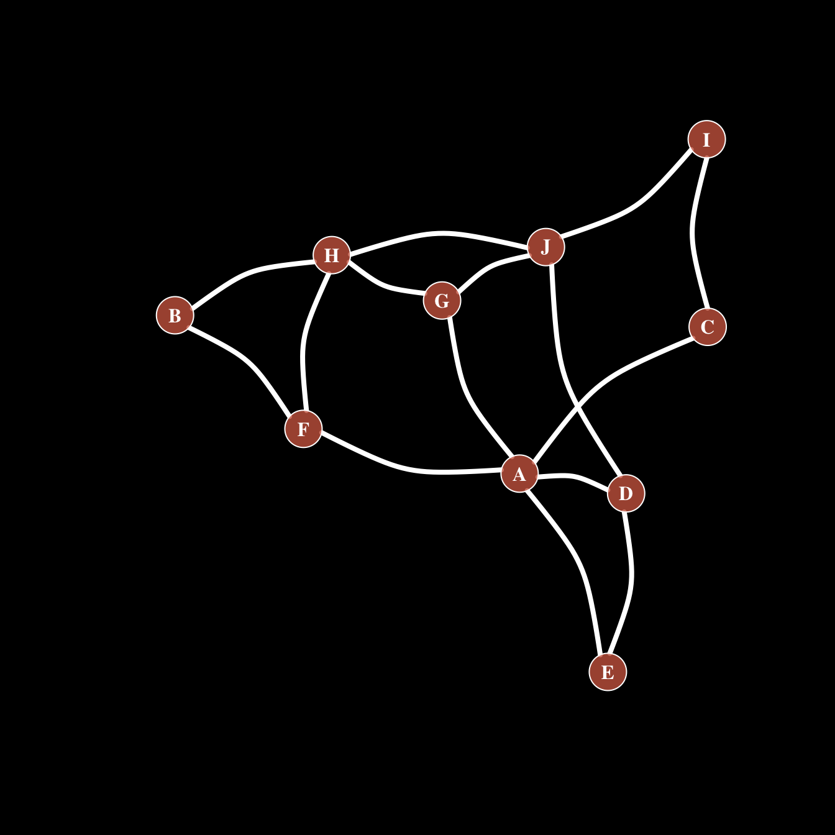
R has many plotting libraries
https://www.r-graph-gallery.com/
https://www.data-to-viz.com/

Slide 18
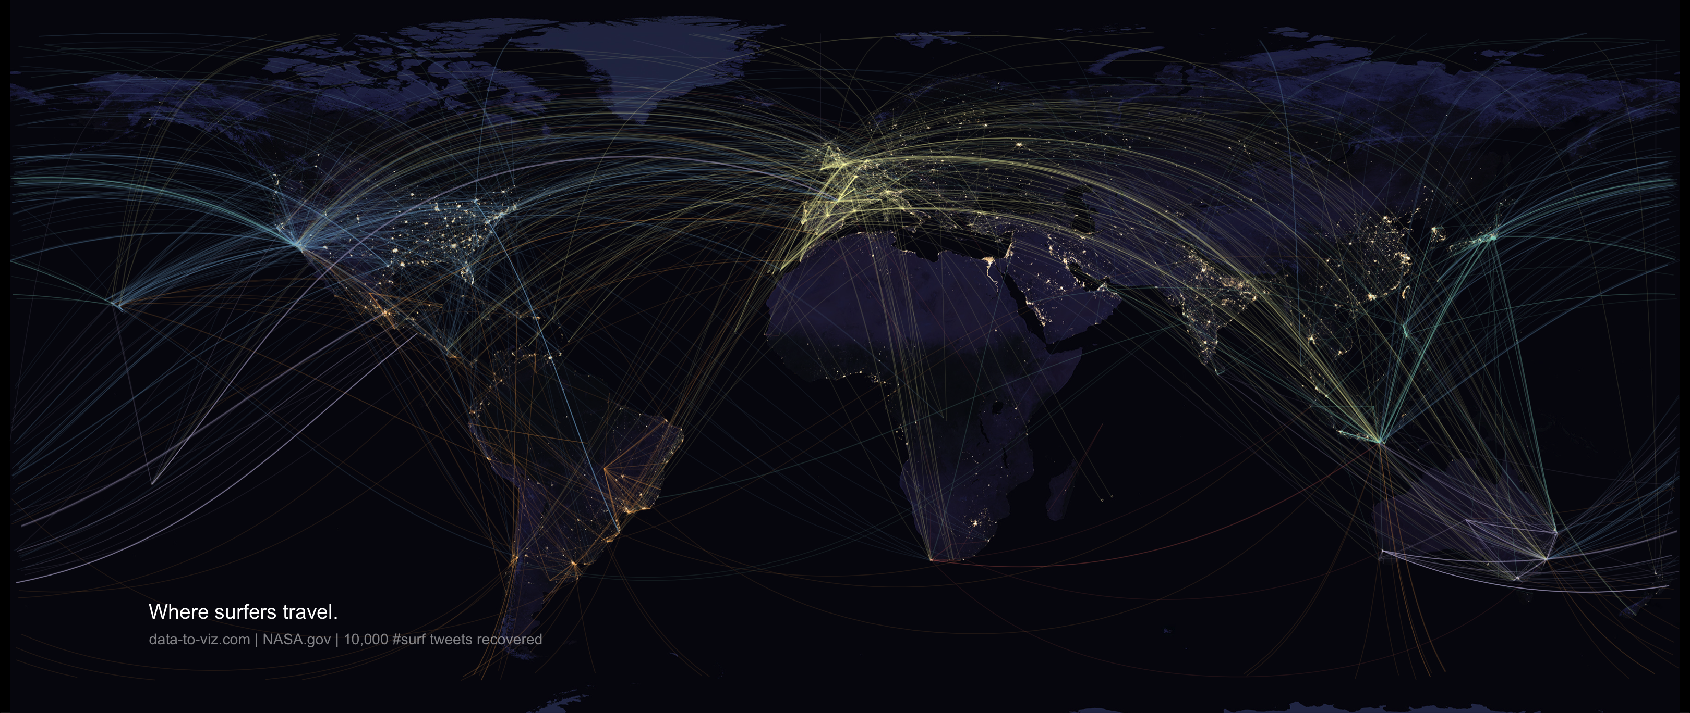
With enough skill, R can generate amazing graphs!

Slide 19
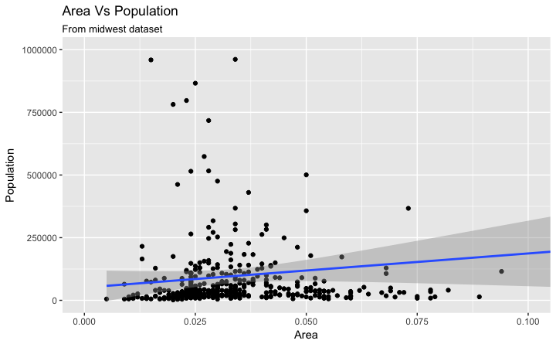
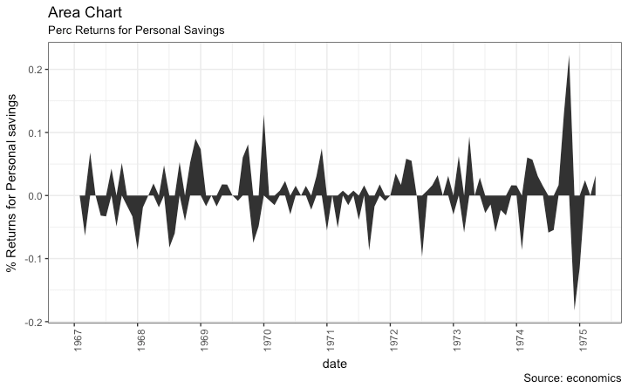
ggplot2 is the best one to start learning
http://r-statistics.co/Complete-Ggplot2-Tutorial-Part1-With-R-Code.html

Slide 20
http://zzlab.net/

Slide 21
R Example Crash-course
Install base R
Install Rstudio
Install the ‘swirl’ package
Within ‘swirl’, install the ‘R Programming’ course
Work through all 15 sections
Install the ‘ggplot2’ library
Work through the ‘ggplot2’ tutorial

