Slide 1


Statistical Genomics
Lecture 8: Linkage
Zhiwu Zhang
Washington State University

Slide 2
Outline
Linkage and recombination
Hardy-Weinberg principle
LD measurements
  D
  D’
  R2
  Causes of LD
LD decay

Slide 3
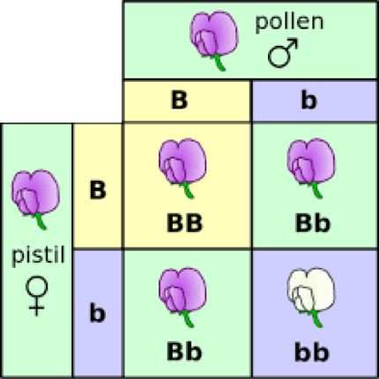
George Mendel
Law of Inheritance: Segregation and Independent

Slide 4
Sex chromosome & Linkage
Thomas Hunt Morgan
(Nobel Prize 1933)
Fly Room at Columbia University

Slide 5
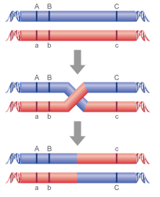
Recombination
recombination rate (r): proportion of recombined
r=1%: centi-Morgan

Slide 6
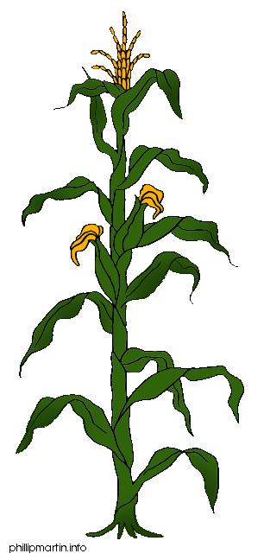
Linkage analysis
Parents
X
F1
F1 gametes
F2 Phenotype
Here lies my QTL
F2 Genotype

Slide 7
Genetics
Breed A
Breed B
M
D
m
d
M
D
m
d
F1
r
M
D
m
d
BCA
F2
M
D
M
D
M
?
M
?
m
?
M
?
m
?
M
?
m
?
m
?

Slide 8
Probability
BCA
M
D
M
D
 | D | d
MM | n1 | n2
Mm | n3 | n4
M
?
m
?
P(?=D | MM)=1-r
P(?=D | Mm)=r
P(?=d | MM)=r
P(?=d | Mm)=1-r
P= r^{(n2+n3)} (1-r)^{(n1+n4)}

Slide 9
Mapping: vary r to maximize P
P= r^{(n2+n3)} (1-r)^{(n1+n4)}
 | D | d
MM | 25 | 25
Mm | 25 | 25
 | D | d
MM | 35 | 15
Mm | 15 | 35
 | D | d
MM | 45 | 5
Mm | 5 | 45
 | D | d
MM | 50 | 0
Mm | 0 | 50

Slide 10
Multiple markers
M1
M2
M3
M4
Gene
M5
r1
r2
r3
r4
r5
P1
P2
P3
P4
P5
P= P1*P2*P3*P4*P5

Slide 11
Multiple markers
M1
M2
M3
M4
Gene
M5
r1
r2
r3
r4
r5
P1
P2
P3
P4
P5
P= P1*P2*P3*P4*P5

Slide 12
Multiple markers
M1
M2
M3
M4
Gene
M5
r1
r2
r3
r4
r5
P1
P2
P3
P4
P5
P= P1*P2*P3*P4*P5

Slide 13
Multiple genes
M1
M2
Gene
M3
M4
Gene
M5
Population
Single marker to multiple marker
Binary trait to quantitative trait
Single gene to multiple gene
Re-map markers
…

Slide 14
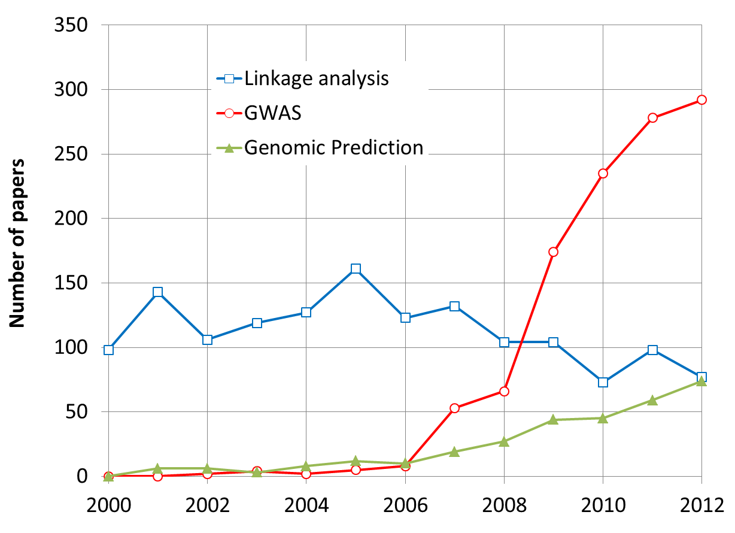
By May 31, 2013

Slide 15
Linkage disequilibrium (association)
 | AA | TT | SUM
Herbicide Resistant | 35 | 5 | 40
Non herbicide Resistant | 35 | 25 | 60
SUM | 70 | 30 | 100
Observed
 | AA | TT | SUM
Herbicide Resistant | 28 | 12 | 40
Non herbicide Resistant | 42 | 18 | 60
SUM | 70 | 30 | 100
Expected
49/28+49/12+49/42+49/18=9.72
1-pchisq(9.72,1)
0.0018

Slide 16
The Hardy–Weinberg principle
Allele and genotype frequencies in a population will remain constant from generation to generation in the absence of other evolutionary influences.
These influences include non-random mating, mutation, selection, genetic drift, gene flow and meiotic drive.
f(A)=p, f(a)=q, then f(AA)=p², f(aa)=q², f(Aa)=2pq

Slide 17
Linkage equilibrium
Random join between alleles at two or more loci
P_{AB}=P_{A}P_{B}
D(ifference)=0

Slide 18
Linkage Disequilibrium (LD)
Loci and allele | A | a | B | b
frequency | .6 | .4 | .7 | .3
Gametic type | AB | Ab | aB | ab
Observed | 0.5 | 0.1 | 0.2 | 0.2
Frequency equilibrium | 0.42 | 0.18 | 0.28 | 0.12
Difference | 0.08 | -0.08 | -0.08 | 0.08
D =P_{AB}-P_{A}P_{B} =P_{ab}-P_{a}P_{b}
=-(P_{Ab}-P_{A}P_{b}) =-(P_{aB}-P_{a}P_{B})

Slide 19
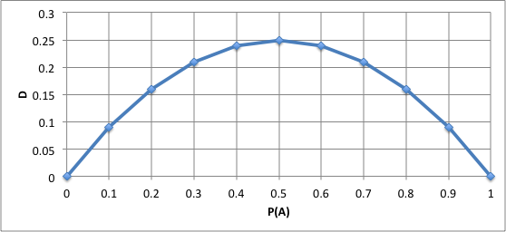
D depends on allele frequency
Vary even with complete LD
P_{Ab}=P_{aB}=0
P_{AB}=1-P_{ab}=P_{A}=P_{B}
D=P_{A}-P_{A}P_{A}

Slide 20
Property of D
Deviation between observed and expected
Extreme values: -0.25 and 0.25
Non LD: D=0
Dependency on allele frequency

Slide 21
D’
Lewontin (1964) proposed standardizing D to the maximum possible value it can take:
D’=D/D_{Max} =0.08/0.18=0.44
D_{max}: the maximum D for given allele frequency
D_{max}= min(P_{A}P_{B}, P_{a}P_{b}) if D is negative, or min(P_{A}P_{b}, P_{a}P_{B}) if D is positive
Range of D’: -1 to 1

Slide 22
R²
Hill and Robertson (1968) proposed the following measure of linkage disequilibrium:
r² (Δ²)=D²/(P_{A}P_{B}P_{a}P_{b})
Square makes positive
The product of allele frequency creates penalty for 50% allele frequency.
Range: 0 to 1

Slide 23
Causes of LD
Mutation
Selection
Inbreeding
Genetic drift
Gene flow/admixture

Slide 24
Mutation and selection
mutation
A____Q
Generation 1
A____q
A____q
A____q
A____q
A____q
A____q
Generation 2
A____q
A____Q
Selection
A____Q
A____q
A____q
A____q
Generation 3
A____Q
A____Q
Selection
A____Q
A____q
A____Q
A____q

Slide 25
Change in D over time
c: recombination rate
D_{t}=D₀(1-c)^{t}
t=log(D_{t}/D₀)/log(1-c)
if c=10%, it takes 6.5 generation for D to be cut in half
1Mb=1cM,
if two SNPs 100kb apart,
c=1% / 10 = 0.001
It takes 693 generations for D to be cut in half

Slide 26
Human out of Africa
https://arstechnica.com/science/2015/12/the-human-migration-out-of-africa-left-its-mark-in-mutations/

Slide 27
Change in D over time
c=.01
c=.05
c=.1
c=.25

Slide 28
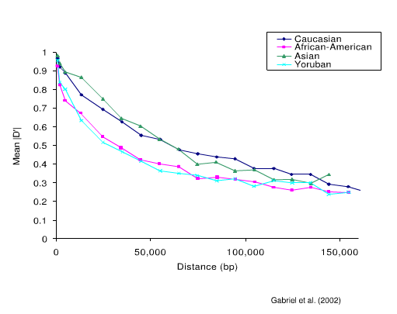
LD decay over distance

Slide 29
Highlight
Trait-marker association
Hardy-Weinberg principle
Linkage an recombination
LD measurements
  D
  D’
  R2
  Causes of LD
LD decay

