Slide 1


Statistical Genomics
Lecture 27: Bayesian methods
Zhiwu Zhang
Washington State University

Slide 2
Outline
Modeling prediction
Bayesian likelihood for genomic prediction
Gibbs sampling
Bayesian implementation
Bayesian alphabet

Slide 3
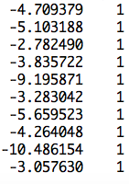
Marker assisted selection
Least Square Error (LSE)
observation
mean
SNP1 | SNP2 | … | SNP4 | SNP5
b1 | b2 | … | b4 | b5
0 | 1 | … | 2 | 0
2 | 2 | … | 0 | 2
2 | 0 | … | 2 | 2
0 | 2 | … | 0 | 0
b0
]
[
b=
y
x1
x2
x5
x6
x0
]
[
X=
y = x₀b₀ + x₁b₁ + x₂b₂ + ... + x₅b₅ + e

Slide 4
More markers
Small n and big p problem
observation
mean
SNP1 | SNP2 | … | SNPp-1 | SNPp
g1 | g2 | … | gp-1 | gp
0 | 1 | … | 2 | 0
2 | 2 | … | 0 | 2
2 | 0 | … | 2 | 2
0 | 2 | … | 0 | 0
μ
]
[
b=
y
x1
x2
xp-1
xp
x0
]
[
X=
y = x₀μ + x₁g₁ + x₂g₂ + ... + x_{p}g_{p} + e

Slide 5

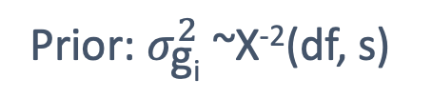
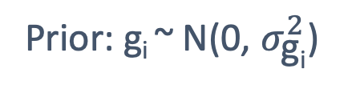
Modeling prediction
LASSO
Least Square Error
Sum(|b|)<t
y = x₀b₀ + x₁b₁ + x₂b₂ + ... + x_{p}b_{p} + e
$$σ_{e}^{2}/σ_{g}^{2}$$
RR: -2Ln(L)
Likelihood: -2Ln(L)
Prior: g_{i} ~ N(0, $σ_{\text{g}\text{i}}^{2}$)
Prior: $σ_{\text{g}\text{i}}^{2}$~X⁻²(df, s)
Bayesian likelihood
(Posterior)
BIC: -2Ln(L) + Ln(n)p

Slide 6
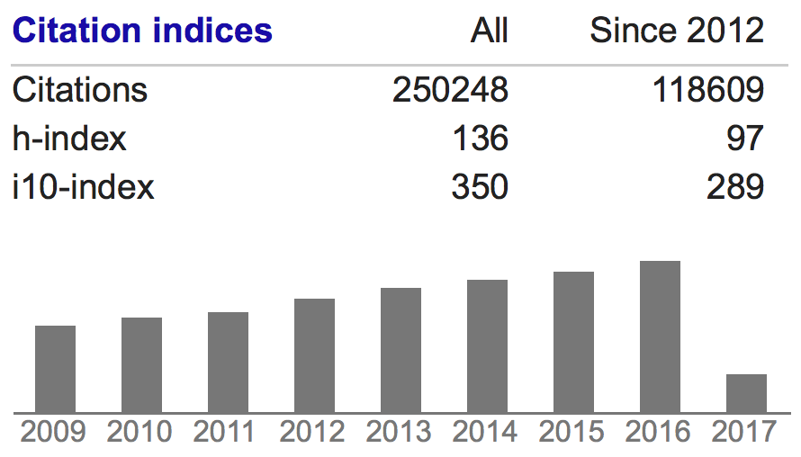
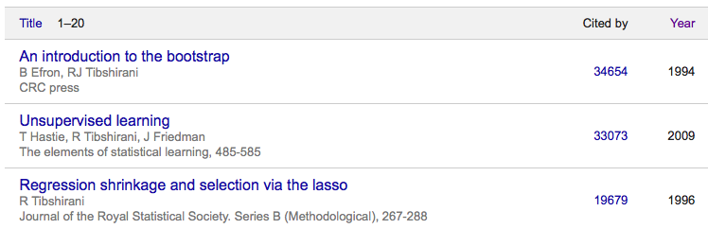
LASSO
Least Absolute Shrinkage and Selection Operator
Robert Tibshirani

Slide 7


Pioneers of Bayesian methods
https://www.youtube.com/watch?v=RovnCsda-zQ

Slide 8
Treat markers as random effects with identical independent distribution (iid)
EMMA
Ridge Regression/BLUP
N(0, I σ_{g}²)
y=x₁g₁ + x₂g₂ + … + x_{p}g_{p} + e

Slide 9
Control of unknown parameters
Prior distribution
N(0, I σ_{g1}²)
N(0, I σ_{g2}²)
…
N(0, I σ_{gp}²)
y=x₁g₁ + x₂g₂ + … + x_{p}g_{p} + e

Slide 10
Bayes A
σ_{gi}²~X⁻²(v, S)
Hyper parameters
Differnt
N(0, I σ_{g1}²)
N(0, I σ_{g2}²)
…
N(0, I σ_{gp}²)
y=x₁g₁ + x₂g₂ + … + x_{p}g_{p} + e

Slide 11
Bayes B
σ_{gi}²~X⁻²(v, S)
Zero
π
1−π
Different
N(0, I σ_{g1}²)
N(0, I σ_{g2}²)
…
N(0, I σ_{gp}²)
y=x₁g₁ + x₂g₂ + … + x_{p}g_{p} + e

Slide 12
Bayes Cpi
σ_{g}²~X⁻²(v, S)
Zero
π
1−π
Common
N(0, I σ_{g1}²)
N(0, I σ_{g2}²)
…
N(0, I σ_{gp}²)
y=x₁g₁ + x₂g₂ + … + x_{p}g_{p} + e

Slide 13

Bayesian LASSO
$a_{}^{b_{}^{\text{x}}}$
Double Exponential
Differnt
N(0, I σ_{g1}²)
N(0, I σ_{g2}²)
…
N(0, I σ_{gp}²)
y=x₁g₁ + x₂g₂ + … + x_{p}g_{p} + e

Slide 14
Bayes alphabet
Method | marker effect | Genomic Effect Variance | Residual variance | Unknown parameter
Bayes A | All SNPs | X⁻²(v,S) | X⁻²(0,-2)
Bayes B | P(1-π) | X⁻²(v,S) | X⁻²(0,-2) | π
Bayes Cπ | P(1-π) | X⁻²(v,S) | X⁻²(0,-2) | π
BayesianLASSO | All SNPs | Double exponential effects | X⁻²(0,-2) | λ, t

Slide 15
Bayesian likelihood
P(g_{i}, σ_{gi}², σ_{e}² v, s | y) =
P(y | g_{i}, σ_{gi}², σ_{e}² v, s) P(g_{i}, σ_{gi}², σ_{e}² v, s)
Gibbs sampling

Slide 16
Gibbs sampling
Josiah Willard Gibbs
Described by Stuart and Donald Geman in 1984
Difficult
Joint distribution of x and y
Starting values of x and y
Marginal distribution of x given y
Easy
Marginal distribution of y given x

Slide 17
Example
r=75%
?
x=rnorm(10000)
y=rnorm(10000)
plot(x,y)

Slide 18
Example
gibbs=function (n=10000, r=.75, sd=1)
{
mat=matrix(ncol = 2, nrow = n)
x=-50
y=50
mat[1, ]=c(x, y)
for (i in 2:n) {
x=rnorm(n=1, mean=r*y, sd=1)
y=rnorm(n=1, mean=r*x, sd=1)
mat[i, ]=c(x, y)
}
mat
}
n= 10000
bvn<-gibbs(n,.75, sd=1)
cor(bvn)
batch=5000
ndisp=1000
xlim=c(min(bvn[,1]),max(bvn[,1]))
ylim=c(min(bvn[,2]),max(bvn[,2]))
for(i in 1:n){
if(i==1)plot(bvn[i,1],bvn[i,2],xlim=xlim,ylim=ylim,pch=20,col="red")
if(i<ndisp&i>1)points(bvn[i,1],bvn[i,2],pch=20)
if(i>ndisp)points(bvn[i,1],bvn[i,2],col=floor(i/batch)+1)
if(i<ndisp)Sys.sleep(1/i)
if(i==ndisp)Sys.sleep(2)
if(floor(i/batch)*batch==i) Sys.sleep(1)
}
x=-5
y=5
Starting values
x=rnorm(n=1, mean=.75*y, sd=1)
y=rnorm(n=1, mean=.75*x, sd=1)

Slide 19
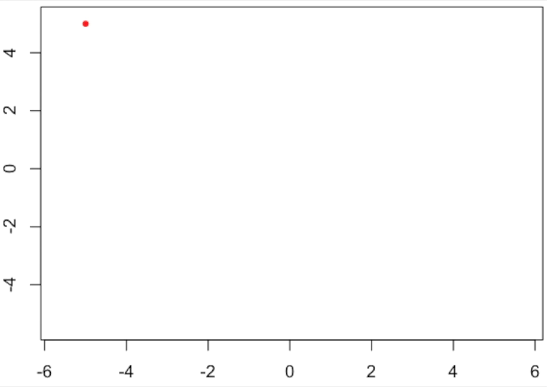
Gibbs sampling

Slide 20
Converge of Markov chain Monte Carlo (MCMC)
Start
Burn in
Converge
par(mfrow=c(3,1), mar = c(3,4,1,1))
plot(bvn[1:1000,1],type="b")
lines(bvn[1:1000,2],col="red")
plot(bvn[100:1000,1],type="b")
lines(bvn[100:1000,2],col="red")
plot(bvn[801:1000,1],type="b")
lines(bvn[801:1000,2],col="red")

Slide 21
Break the pattern by sampling
mySample=sample(100:10000,9900)
bvn2=bvn[mySample,]
par(mfrow=c(3,1), mar = c(3,4,1,1))
plot(bvn2[1:1000,1],type="b")
lines(bvn2[1:1000,2],col="red")
plot(bvn2[100:1000,1],type="b")
lines(bvn2[100:1000,2],col="red")
plot(bvn2[801:1000,1],type="b")
lines(bvn2[801:1000,2],col="red")

Slide 22
Correlations
block=10
n= 1000000
bvn<-gibbs(n,.75, sd=1)
block=10
s=n/block
r=matrix(0,s,1)
for (i in 1:s) {
fregment=seq( ((i-1)*block+1),i*block)
x= bvn[fregment,]
r[i,]=cor(x[,1],x[,2])
}
par(mfrow=c(1,2), mar = c(3,4,1,1))
plot(r)
hist(r)
block=100

Slide 23
Outline
Modeling prediction
Bayesian likelihood for genomic prediction
Gibbs sampling
Bayesian implementation
Bayesian alphabet

