Slide 1


Statistical Genomics
Lecture 28: Bayesian Tools
Zhiwu Zhang
Washington State University

Slide 2
Outline
BAGS
BLR/BGLR

Slide 3
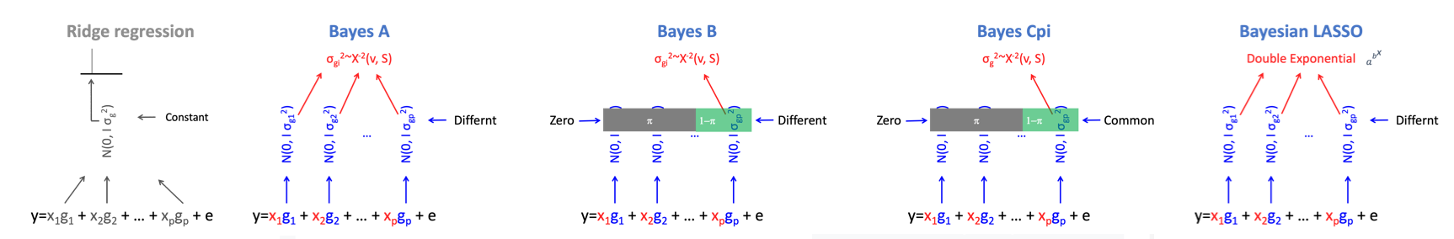
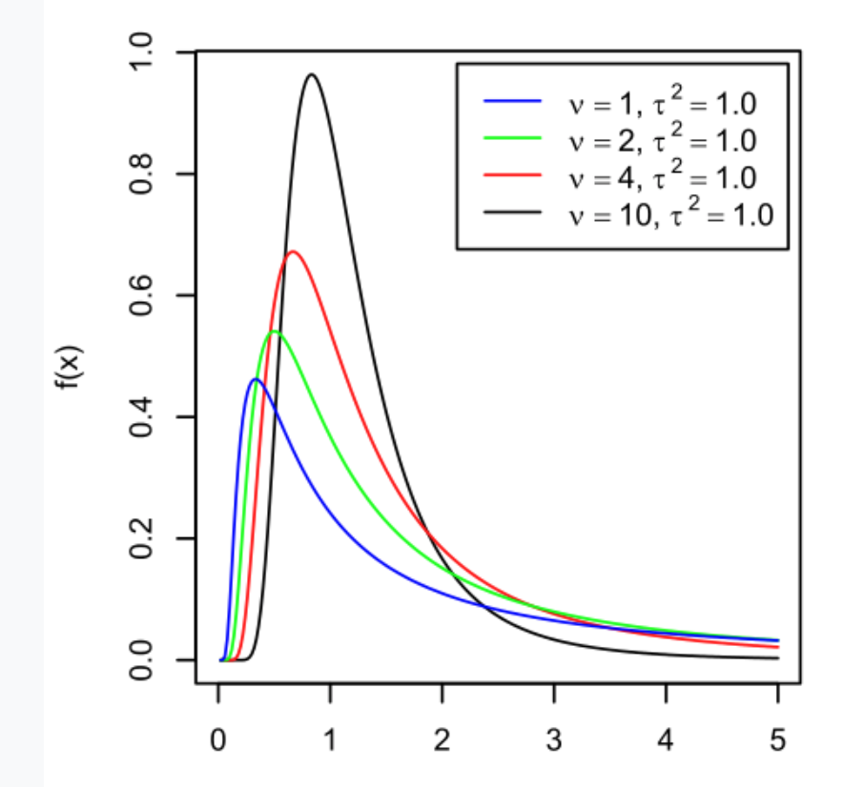
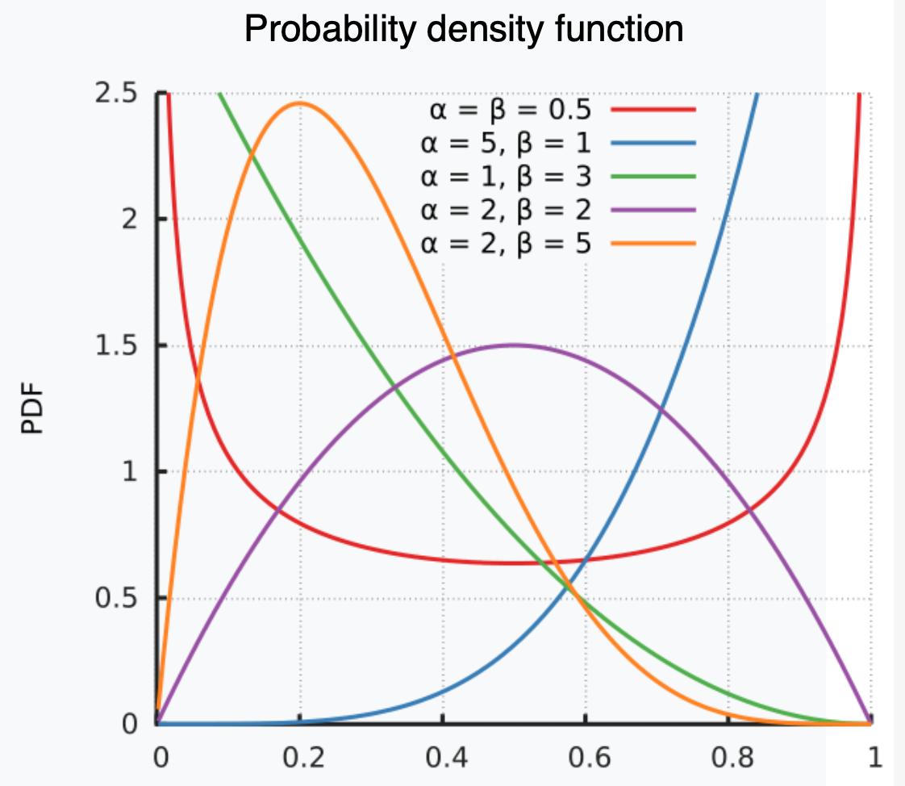
Bayesian alphabet
Variances: Scaled chi-square distribution (v, τ² )
π : Beta distribution (α,β)
DF
Shape (S)

Slide 4
Visualize Bayesian alphabet
Constant
Variance
Ridge Regression
Variance
Bayes A
Variance
Bayes B
π
1−π
Variance
Bayes CPi
π
1−π
Markers

Slide 5
Bayesian likelihood
P(g_{i}, σ_{gi}², σ_{e}² v, s | y) =
P(y | g_{i}, σ_{gi}², σ_{e}² v, s) P(g_{i}, σ_{gi}², σ_{e}² v, s)
Gibbs sampling

Slide 6
BAGS (Implementation of Bayesian methods in R)
Bayesian Alphabet for Genomic Selection (BAGS)
source("http://www.zzlab.net/sandbox/BAGS.R")
Based on the source code originally developed by Rohan Fernando (http://taurus.ansci.iastate.edu/wiki/projects)
Intensively revised
Methods: Bayes A, B and Cpi

Slide 7
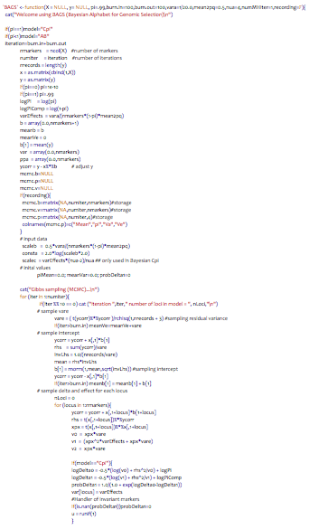
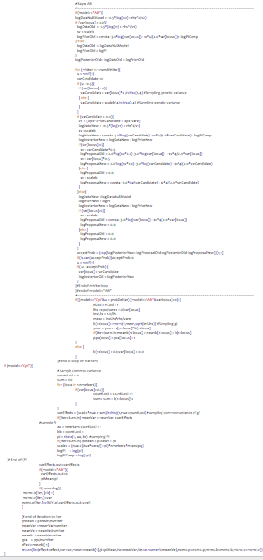
BAGS.R
varCandidate = var[locus]*2 /rchisq(1,4)
vare = ( t(ycorr)%*%ycorr )/rchisq(1,nrecords + 3)
varEffects = (scalec*nua + sum)/rchisq(1,nua+countLoci)
b[1+locus]= rnorm(1,mean,sqrt(invLhs))
b[1] = rnorm(1,mean,sqrt(invLhs))
pi = rbeta(1, aa, bb)

Slide 8
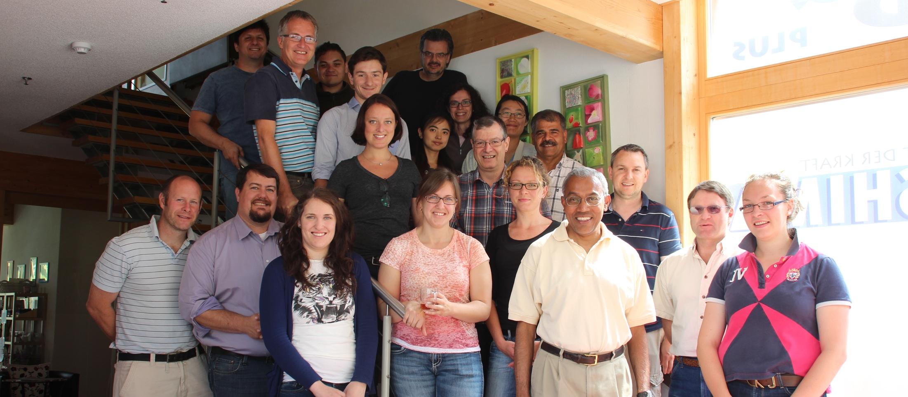
http://taurus.ansci.iastate.edu/wiki/projects
Rohan Fernando
Dorian J Garrick
Jack C M Dekkers

Slide 9
Input
G: numeric genotype with individual as row and marker as column (n by m).
y: phenotype of single column (n by 1)
pi: 0 for Bayes A, 1 for Cpi and between 0 and 1 for Bayes B
burn.in: number iterations not used
burn.out: number iterations used
recording: T or F to return MCMC results

Slide 10
Output
$effect: The posterior means of marker effects (m elements)
$ var: The posterior means of marker variances (m elements)
$ mean: The posterior mean of overall mean
$ pi: The posterior mean of pi
$ Va: The posterior mean of variance of SNP effects (CPi)
$ Ve: The posterior mean of variance of residual effects

Slide 11
Output of MCMC with t iterations
$mcmc.p: The posterior samples of four parameters (t by 4 elements)
  $ mean: The posterior mean of overall mean
  $ pi: The posterior mean of pi
  $ Va: The posterior mean of variance of SNP effects (Cpi)
  $ Ve: The posterior mean of variance of residual effects
$mcmc.b: The posterior samples of marker effects (t by m elements)
$mcmc.v: The posterior samples of marker variances (t by m elements)

Slide 12
Set up GAPIT and BAGS
rm(list=ls())
source("http://www.zzlab.net/GAPIT/GAPIT.library.R")
source("http://www.zzlab.net/GAPIT/gapit_functions.txt")
#Prepare BAGS
source('http://zzlab.net/sandbox/BAGS.R')

Slide 13
Data and simulation
#Import demo data
myGD=read.table(file="http://zzlab.net/GAPIT/data/mdp_numeric.txt",head=T)
myGM=read.table(file="http://zzlab.net/GAPIT/data/mdp_SNP_information.txt",head=T)
myCV=read.table(file="http://zzlab.net/GAPIT/data/mdp_env.txt",head=T)
X=myGD[,-1]
taxa=myGD[,1]
index1to5=myGM[,2]<6
X1to5 = X[,index1to5]
GD.candidate=cbind(as.data.frame(taxa),X1to5)
set.seed(99164)
mySim=GAPIT.Phenotype.Simulation(GD=GD.candidate,GM=myGM[index1to5,],h2=.5,NQTN=20, effectunit =.95,QTNDist="normal",CV=myCV,cveff=c(.2,.2),a2=.5,adim=3,category=1,r=.4)
myY=mySim$Y
set.seed(99164)
nfold=5
sets=sample(cut(1:nrow(myY ),nfold,labels=FALSE),nrow(myY ))
training=myY[,c(1,2)]
test_index=sets==1
training[test_index,2]=NA
testing=cbind(myY[test_index,c(1,2)], mySim$u[test_index])

Slide 14
Run GAPIT
myGAPIT5 <- GAPIT(
Y=training,
GD=myGD,
GM=myGM,
PCA.total=3,
CV=myCV,
model="gBLUP",
file.output=F
)
myY=mySim$Y
colnames(myY)=c("Taxa","Trait1")
PCA=myGAPIT5$PCA
pcEnv=cbind(myCV,PCA[,-1])
gapit5=merge(myY,myGAPIT5$Pred[,c(1,3,5,8)],by.x="Taxa",by.y="Taxa")
acc.GAPIT=cor(gapit5[gapit5[,3]!=1,2],gapit5[gapit5[,3]!=1,5])
fit.GAPIT=cor(gapit5[gapit5[,3]==1,2],gapit5[gapit5[,3]==1,5])
acc.GAPIT
fit.GAPIT
0.3315054
0.9362512

Slide 15
GWAS

Slide 16
RUN BAGS with different model
niter=200
m=ncol(X)
GR=myGD[!test_index,-1];YR=as.matrix(mySim$Y[!test_index,2])
GI=myGD[test_index,-1];YI=as.matrix(mySim$Y[test_index,2])
#Bayes A:
myBayes=BAGS(X=GR,y=YR,pi=0,burn.in=100,burn.out=100,recording=T)
#Bayes B:
myBayes=BAGS(X=GR,y=YR,pi=.95,burn.in=100,burn.out=100,recording=T)
#Bayes Cpi:
myBayes=BAGS(X=GR,y=YR,pi=1,burn.in=100,burn.out=100,recording=T)
par(mfrow=c(2,2), mar = c(3,4,1,1))
plot(myBayes$mcmc.p[,1],type="b")
plot(myBayes$mcmc.p[,2],type="b")
plot(myBayes$mcmc.p[,3],type="b")
plot(myBayes$mcmc.p[,4],type="b")

Slide 17
Bayes Cpi
A, B, or Cpi?
Overall mean
Pi
Va
Ve

Slide 18
Bayes B
A, B, or Cpi?
Overall mean
Pi
Va
Ve

Slide 19
Bayes A
A, B, or Cpi?
Overall mean
Pi
Va
Ve

Slide 20
Visualizing MCMC
myVar=myBayes$mcmc.v
av=myVar
for (j in 1:m){
for(i in 1:niter){
av[i,j]=mean(myVar[1:i,j])
}}
ylim=c(min(av),max(av))
plot(av[,1],type="l",ylim=ylim)
for(i in 2:m){
points(av[,i],type="l",col=i)
}

Slide 21
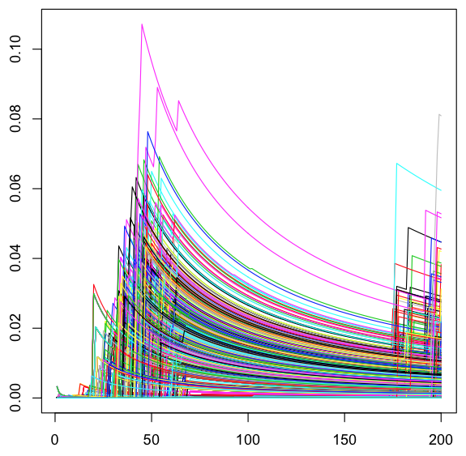
Changes of cumulative averages
Variance
Iteration

Slide 22
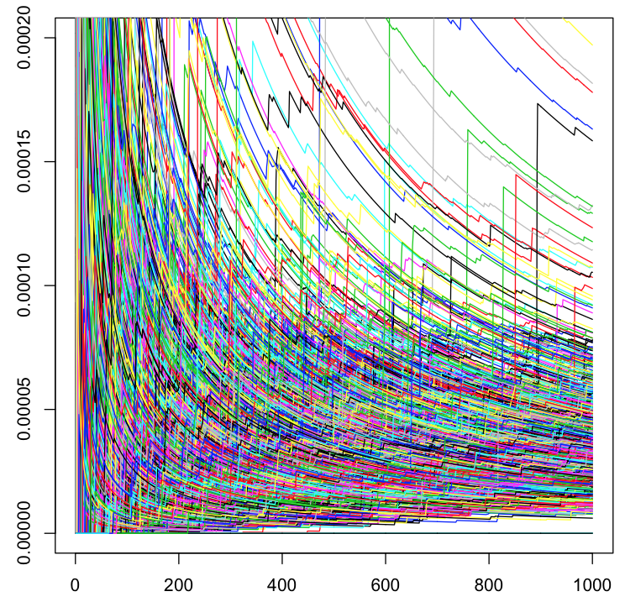
1,000 iterations
New stars
Variance
Iteration

Slide 23
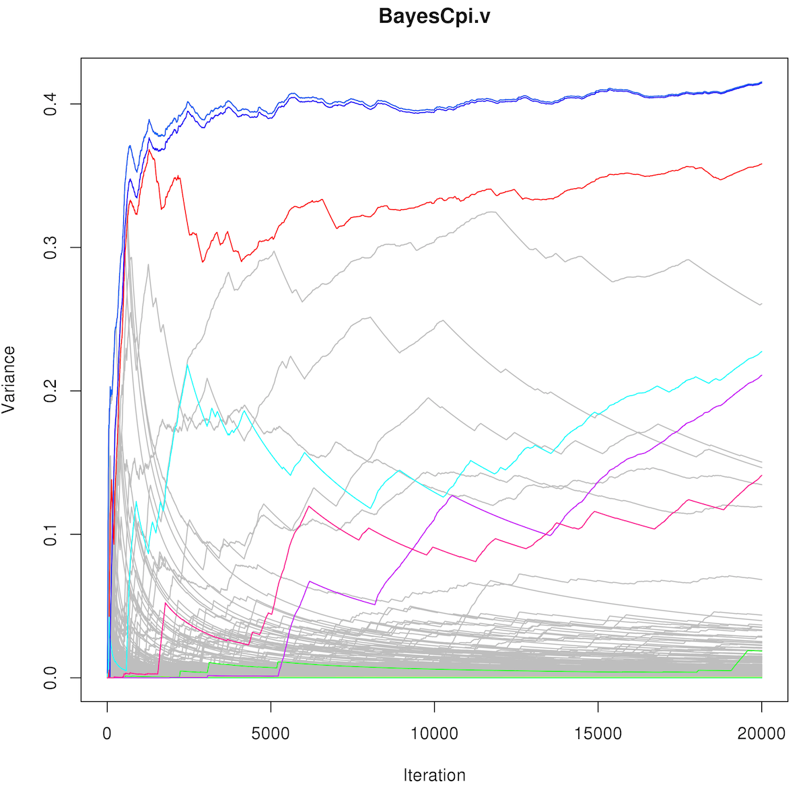
20,000 iterations are still not enough!
QTNs in colors
going up
non-QTNs in gray
going down

Slide 24
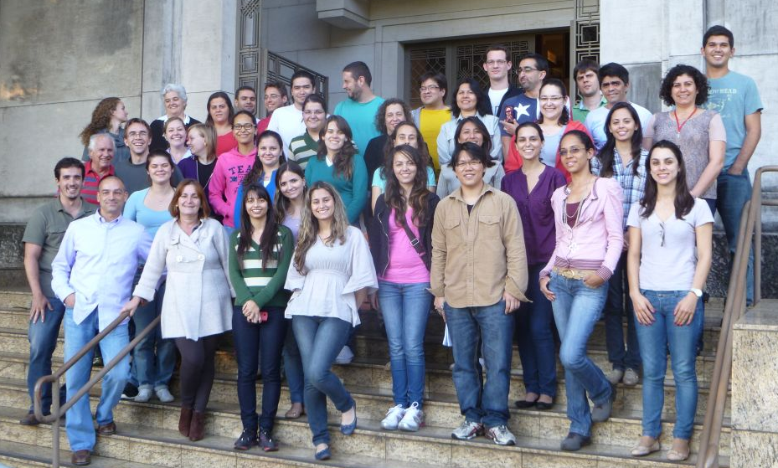
BLR and BGLR
Daniel Gianola
Gustavo
de los Campos
Jose Crossa
Guilherme Rosa
https://en.wikipedia.org/wiki/Daniel_Gianola
http://www.lce.esalq.usp.br/arquivos/aulas/2013/LCE5713/

Slide 25
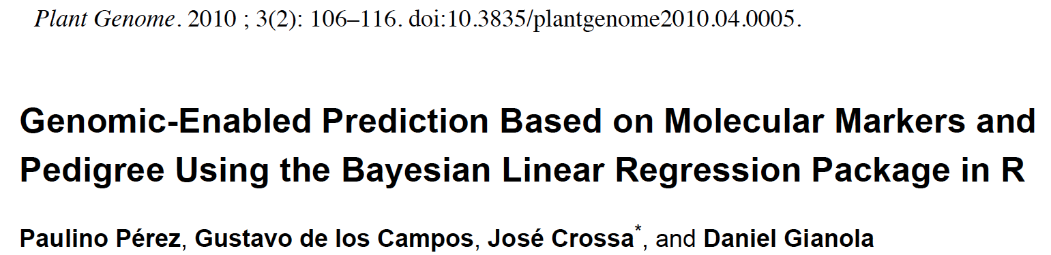
Papers of BLR and BGLR
Genome-Wide Regression & Prediction with the BGLR Statistical Package
Paulino Pérez and Gustavo de los Campos
GENETICS Early online July 9, 2014; https://doi.org/10.1534/genetics.114.164442

Slide 26
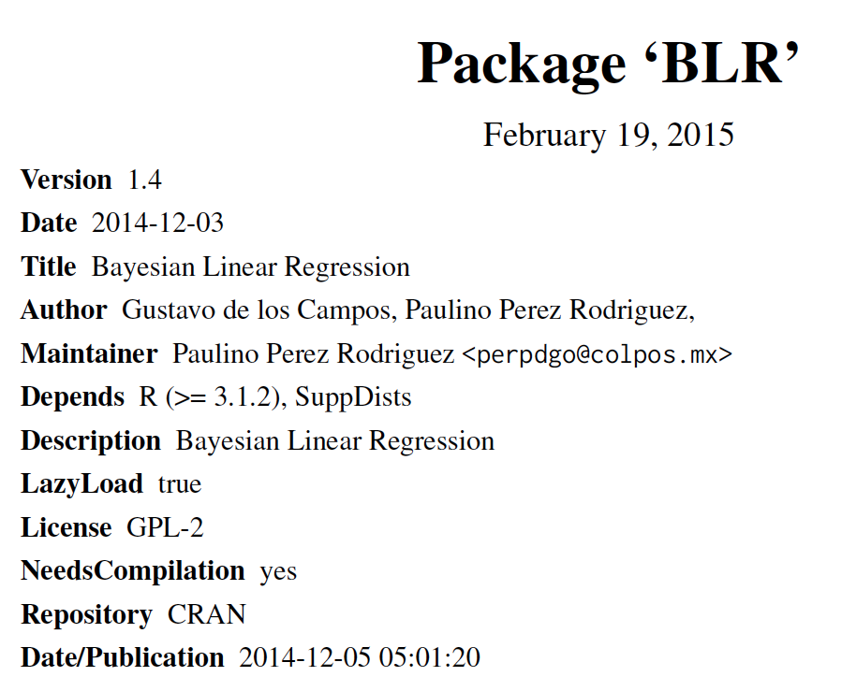
#install.packages("BLR")
library(BLR)

Slide 27
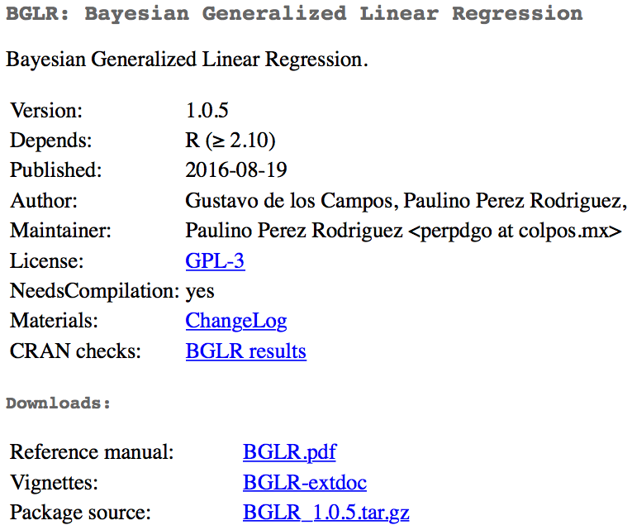
#install.packages("BGLR")
library(BGLR)

Slide 28
Model in BLR
Breeding values
(gBLUP)
Intercept
Fixed effects
(MAS)
Bayeian LASSO
(Bayes)
random regression
(Ridge regression)

Slide 29
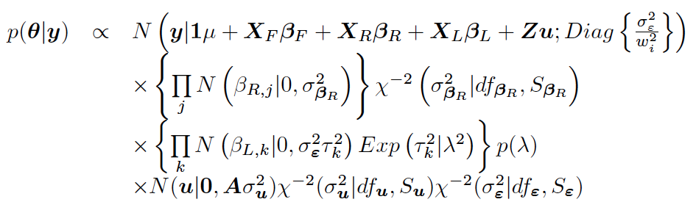
Bayesian likelihood

Slide 30
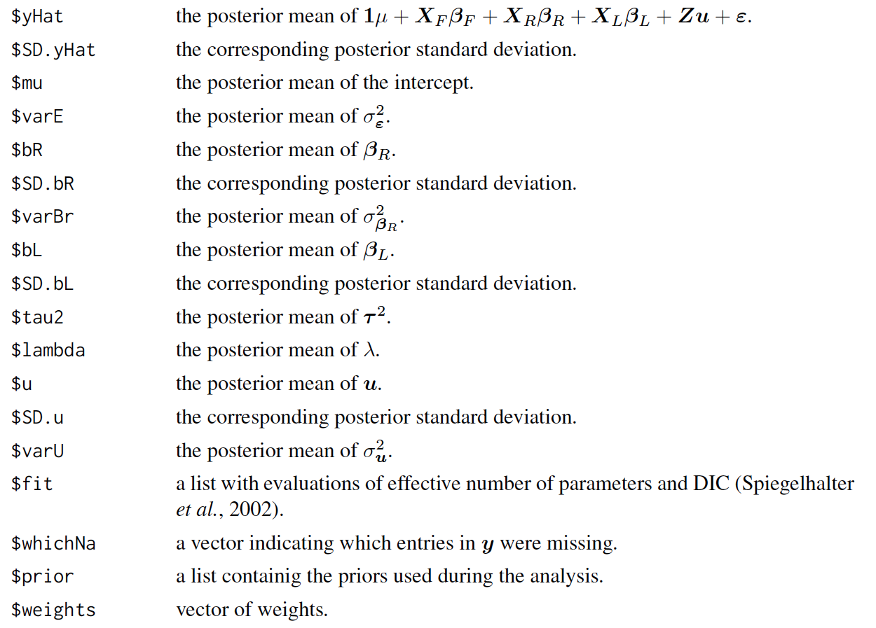
BLR output

Slide 31
Run BLR
#install.packages("BLR")
library(BLR)
nIter=2000 #### number of iteration
burnIn=1500 #### burnin a part of iteration
myBLR =BLR(y=as.matrix(myY[!test_index,2]),
XF=pcEnv[! test_index,-1],
XL=as.matrix(myGD[! test_index,-1]),
nIter=nIter,
burnIn=burnIn)
pred.inf=as.matrix(myGD[test_index,-1])%*%myBLR$bL
pred.ref=as.matrix(myGD[!test_index,-1])%*%myBLR$bL
accuracy <- cor(myY[test_index,2],pred.inf)
modelfit <- cor(myY[! test_index,2],pred.ref)
accuracy
modelfit
0.3460928
0.8923029

Slide 32
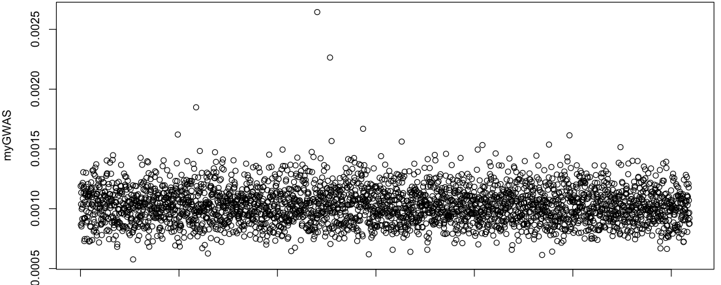
GWAS
myGWAS=myBLR$tau2
plot(myGWAS)
myP=1/(exp(myGWAS))
myGI.MP=cbind(myGM[,-1],myP)
GAPIT.Manhattan(GI.MP=myGI.MP,seqQTN=mySim$QTN.position)

Slide 33
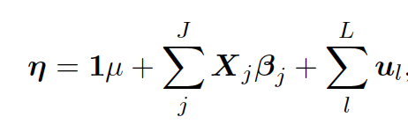
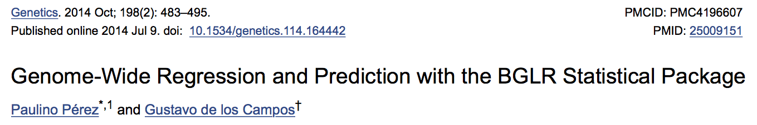
BGLR model
Markers
Individuals

Slide 34
Run BGLR
#install.packages("BGLR")
library(BGLR)
nIter=2000 #### number of iteration
burnIn=1500 #### burnin a part of iteration
myBGLR =BGLR(y=as.matrix(myY[! test_index,2]),
ETA=list(list(X=pcEnv[! test_index,-1],model='FIXED', saveEffects=TRUE),
list(X=as.matrix(myGD[! test_index,-1]),model='BRR', saveEffects=TRUE)
#list(X=as.matrix(myGD[! test_index,-1]),model='BL', saveEffects=TRUE)
#list(X=as.matrix(myGD[! test_index,-1]),model='BayesA', saveEffects=TRUE)
#list(X=as.matrix(myGD[! test_index,-1]),model='BayesB', saveEffects=TRUE)
),
nIter=nIter,
burnIn=burnIn)
pred.inf=as.matrix(myGD[test_index,-1])%*%myBGLR$ETA[[2]]$b
pred.ref=as.matrix(myGD[! test_index,-1])%*%myBGLR$ETA[[2]]$b
accuracy <- cor(myY[test_index,2],pred.inf)
modelfit <- cor(myY[! test_index,2],pred.ref)
accuracy
modelfit
0.3337361
0.8778146

Slide 35
GWAS
myGWAS=abs(myBGLR$ETA[[2]]$b)
plot(myGWAS)

Slide 36
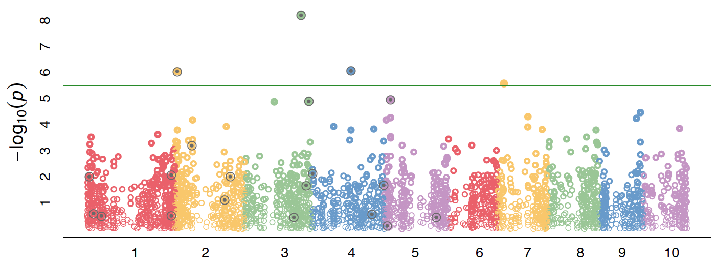
Visualization by GAPIT
myP=1/(exp(100*myGWAS))
myGI.MP=cbind(myGM[,-1],myP)
GAPIT.Manhattan(GI.MP=myGI.MP,seqQTN=mySim$QTN.position)
GAPIT.QQ(myP)

Slide 37
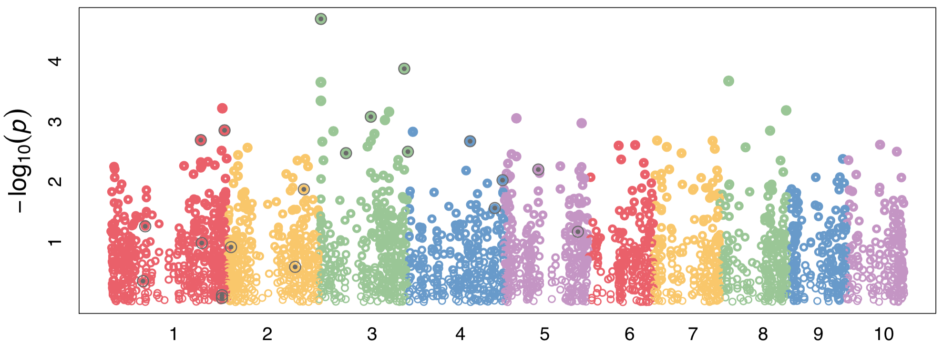
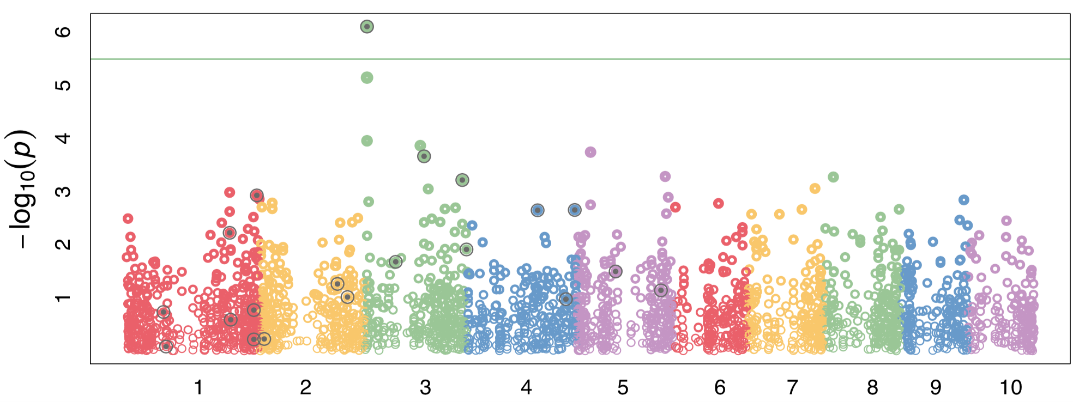
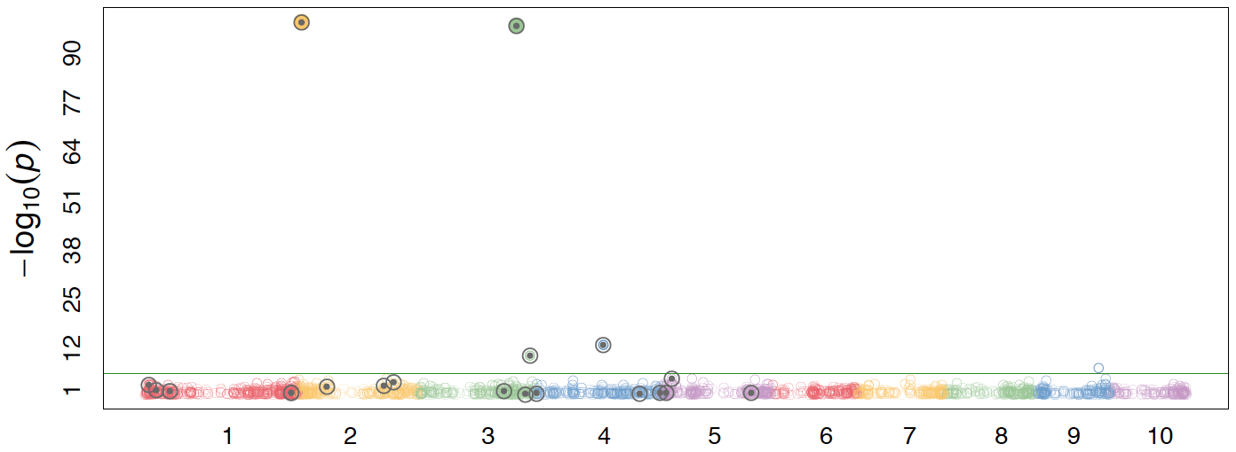
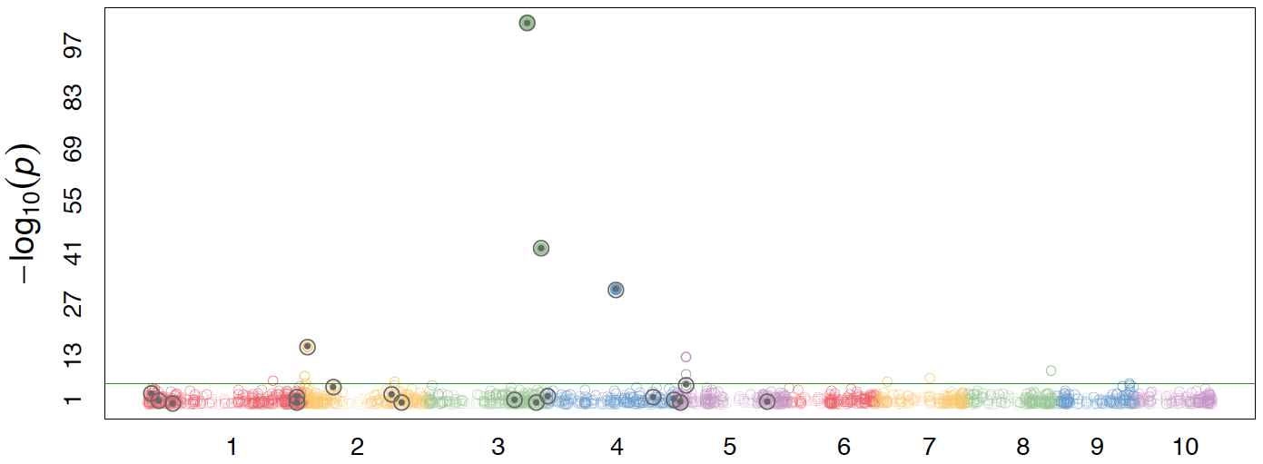
Comparison
Method | Testing | Training
RR | .33 | .87
BL | .40 | .88
BayesA | .41 | .92
BayesB | .45 | .88
But each time accuracy and prediction is different !!

Slide 38
Outline
BAGS
BLR/BGLR

