Slide 1
Lab 12: gBLUP
Crop545
Spring 2021

Slide 2
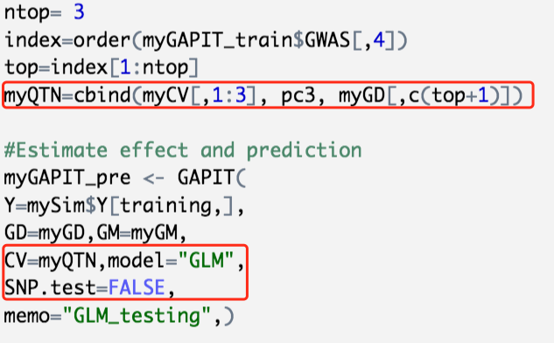
MAS by GAPIT

Slide 3
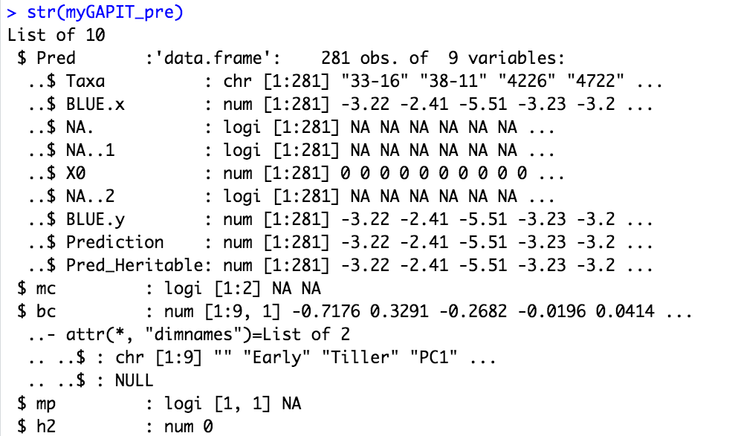
MAS by GAPIT

Slide 4
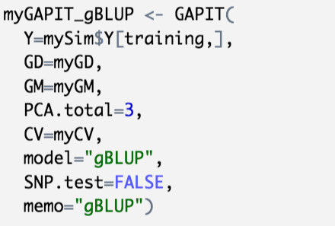
gBLUP by GAPIT

Slide 5
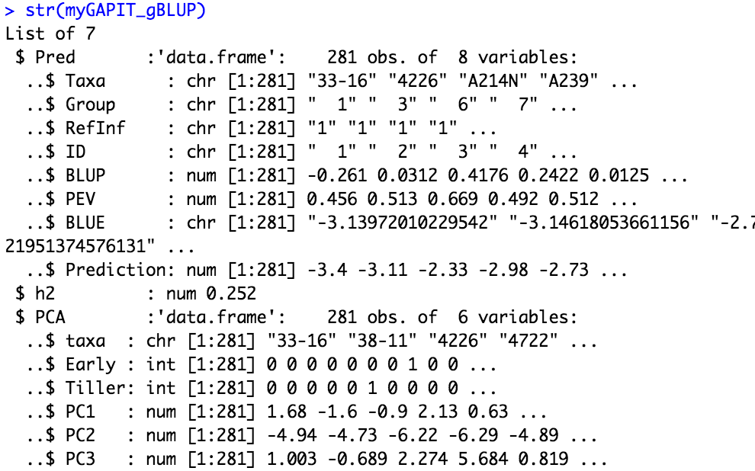
gBLUP by GAPIT

