Slide 1
Lab 14: Bayesian Genomic Selection
Crop545
Spring 2021

Slide 2
The core operation consists of 4 steps
Format data
Define model
Gibbs sampling and MCMC
Prediction

Slide 3
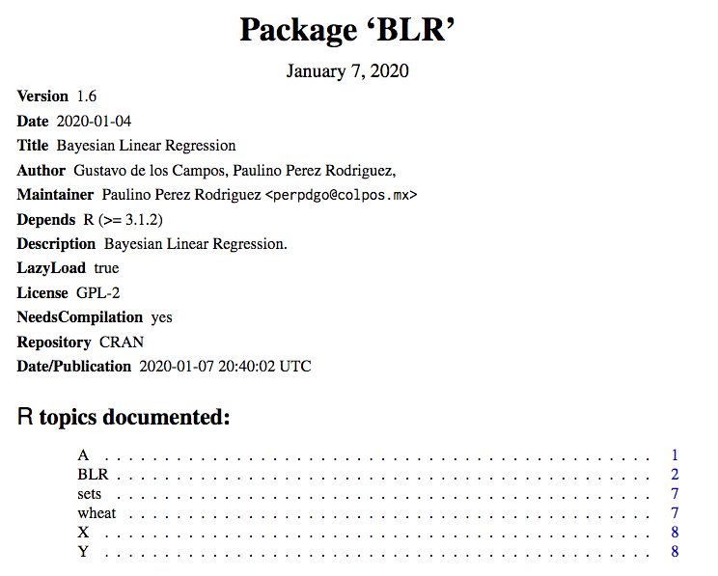

Slide 4
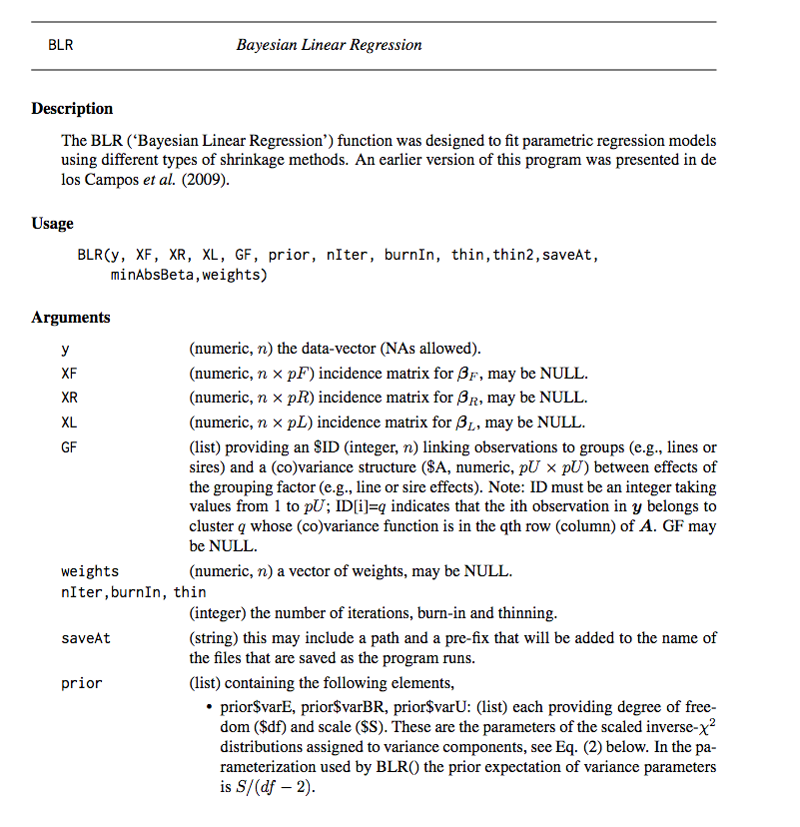
https://cran.r-project.org/web/packages/BLR/BLR.pdf

Slide 5
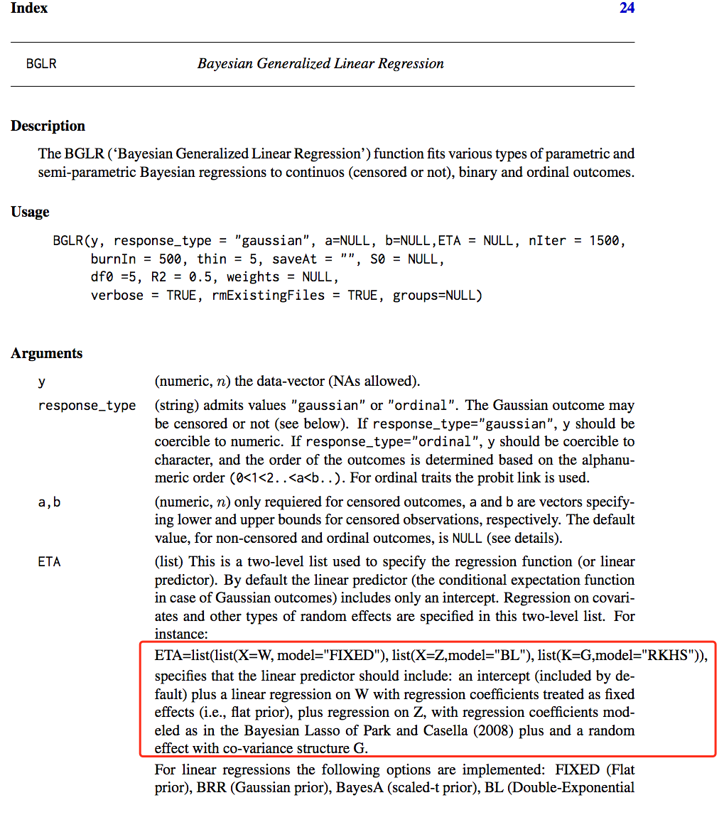
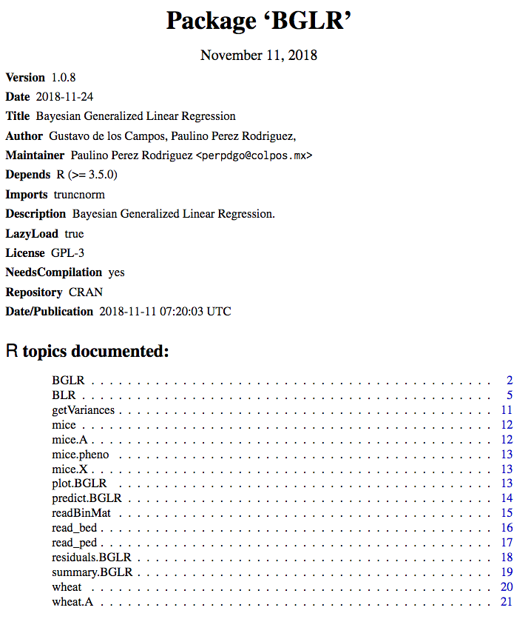
https://cran.r-project.org/web/packages/BGLR/BGLR.pdf

Slide 6
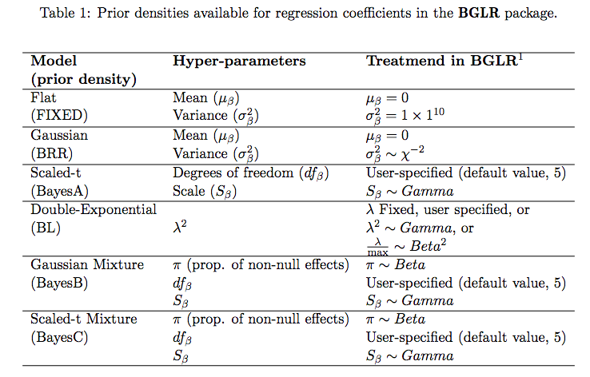
https://cran.r-project.org/web/packages/BGLR/vignettes/BGLR-extdoc.pdf

Slide 7
