Slide 1
Lab 2: Distribution and Statistical inference
Crop545
Spring 2021

Slide 2
Agenda
Using R markdown in RStudio
Lecture code of Distribution and Statistical inference
Swirl

Slide 3
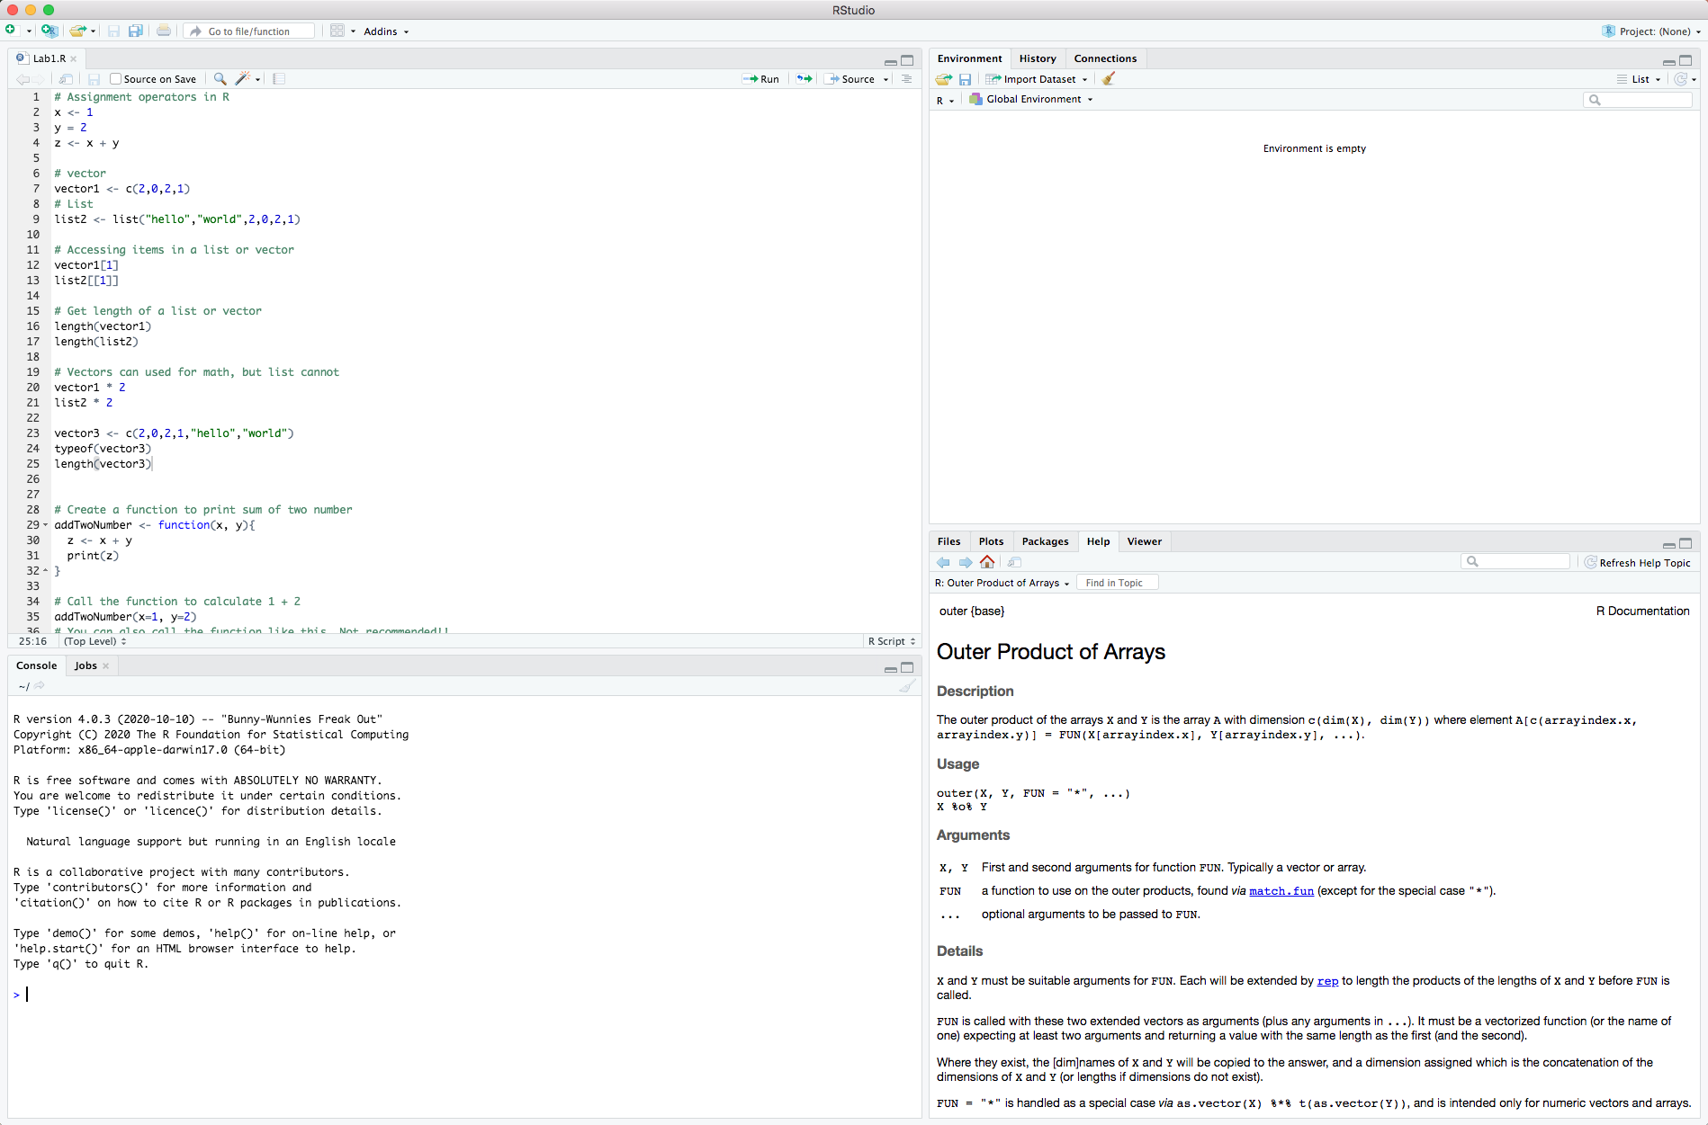
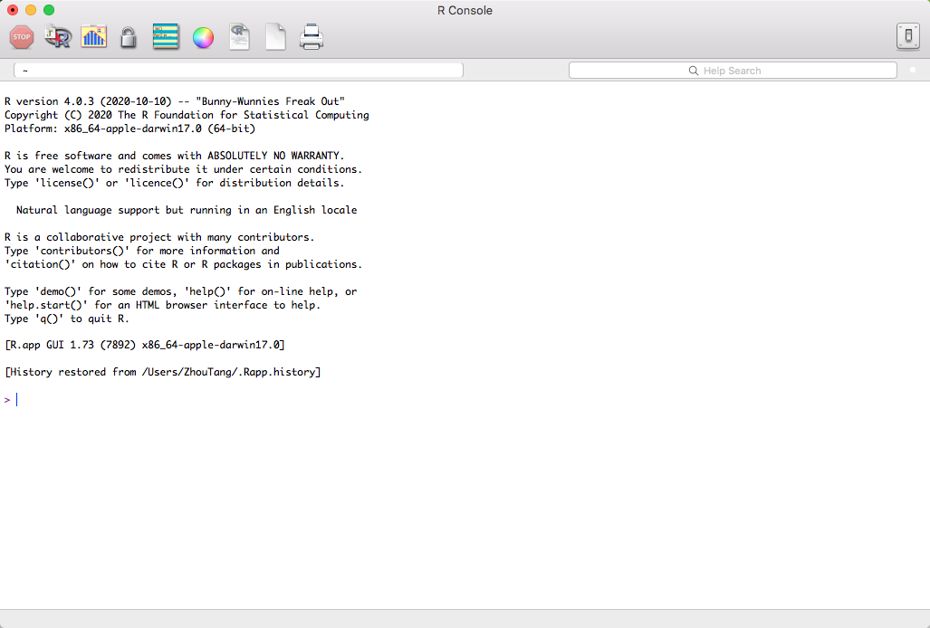
Let’s write R code
Download and install R
https://cran.r-project.org/
Download and install Rstudio
https://rstudio.com/products/rstudio/download/#download

Slide 4
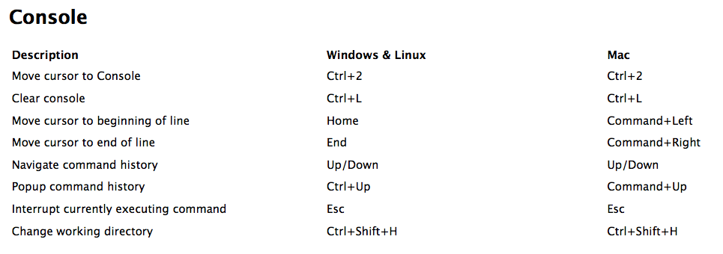
Keyboard Shortcuts

Slide 5
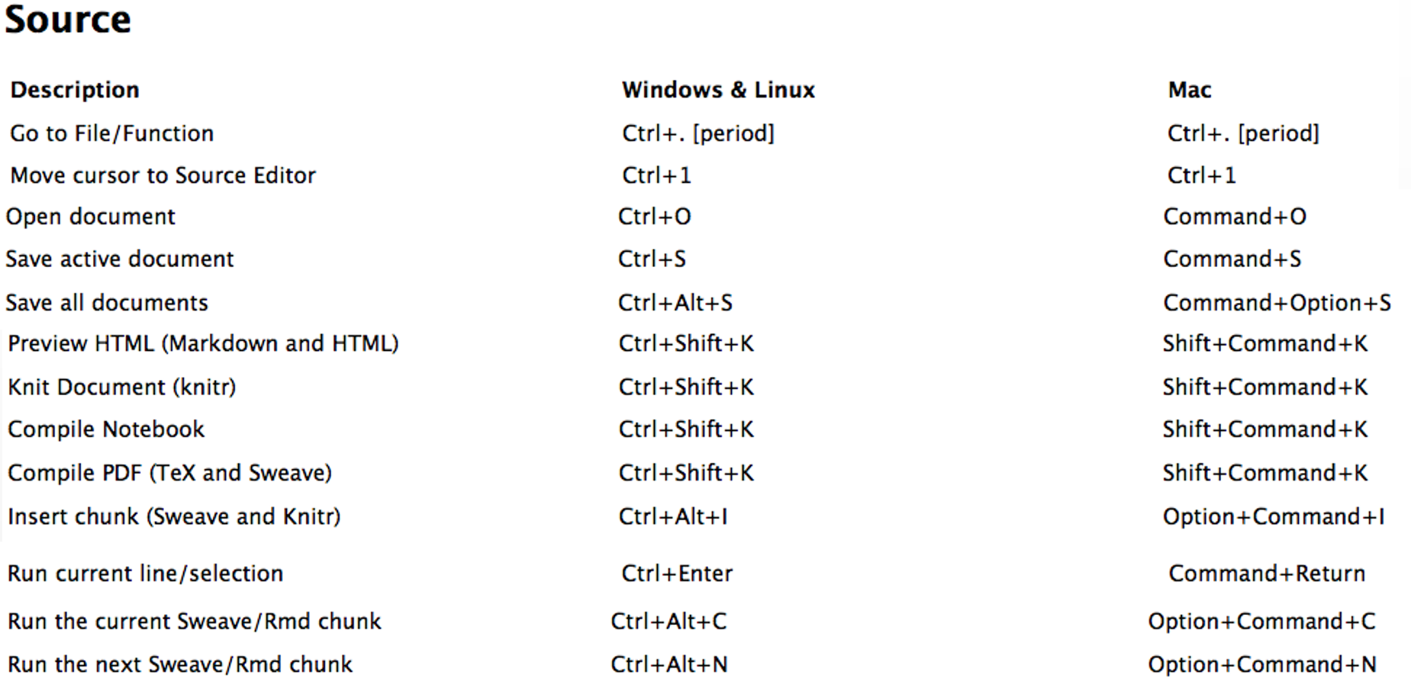
Keyboard Shortcuts

Slide 6
Distribution functions
Binomial
Normal distribution
Poisson
Chi square
F distribution
t distribution

Slide 7
Distribution diagram
B(n,p)
λ=np
t(n)
N(0,1)
P(λ)
x/X²
sum x^2
over n
F(n1,n2)
X²₁/n₁ /
X²₂/n₂
X²(n)

Slide 8
Distribution features
Features | B(n,p) | P(λ) | N(0,1) | X2(n) | F(n1,n2) | T(n)
Mean | np | λ | 0 | n | n2/(n2-2) | 0
Variance | np(1-p) | λ | 1 | 2n |  | n/(n-2)
Range | >=0 | >0 | (-∞,∞) | >0 | >0 | (-∞,∞)
Symmetry | N | N | Y | N | N | Y

Slide 9
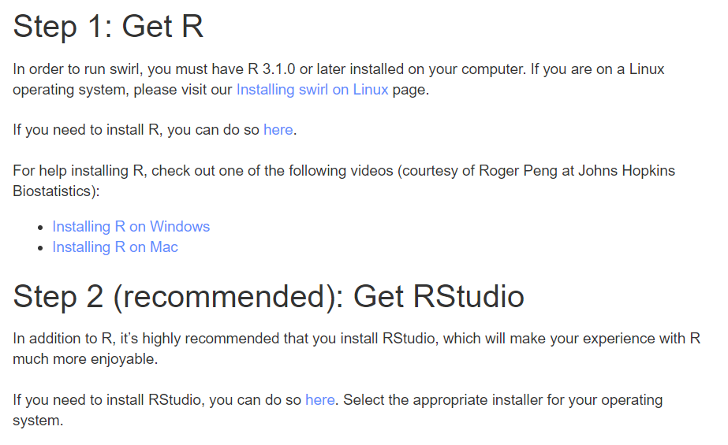
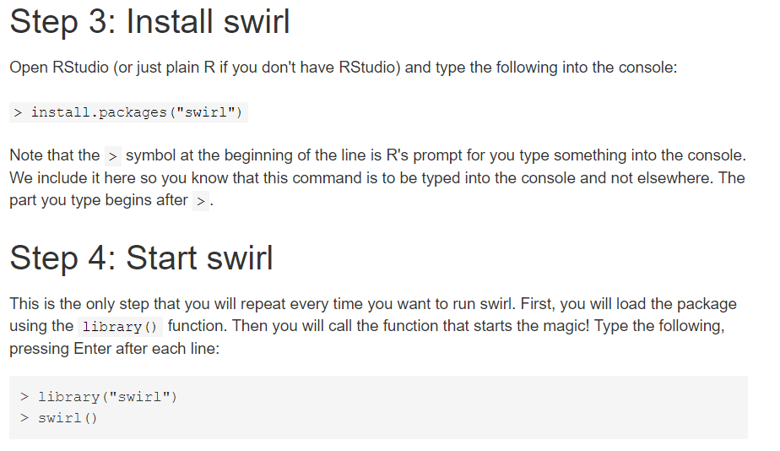
Let’s learn basic R
Basic R in the swirl (https://swirlstats.com/)

