Slide 1
Lab 5: Phenotype simulation & GWAS by correlation
Crop545
Spring 2021

Slide 2
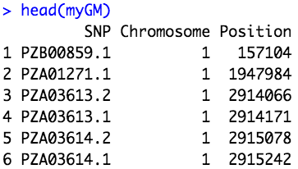
Phenotype simulation
Phenotype = genetic + residual
Sampling QTN
Sample()

Slide 3
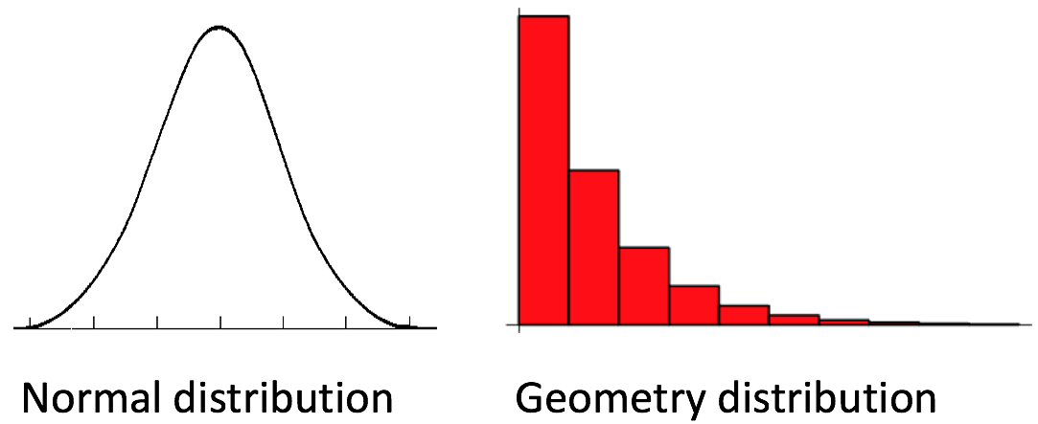
Phenotype simulation
Phenotype = genetic + residual
2. QTN effects
rnorm(NQTN,0,1)
alpha^(1:NQTN)

Slide 4
Phenotype simulation
Phenotype = genetic + residual
3. QTN * QTN effects
4. var(genetic effect)
5. Heritability

Slide 5
Phenotype simulation
Demonstration 1: Phenotype simulation with ‘G2P’

Slide 6
GWAS by correlation
Demonstration 2: GWAS by correlation

