Slide 1
Lab 9: Different Models in GAPIT
Crop545
Spring 2021

Slide 2
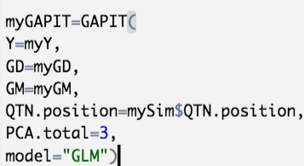
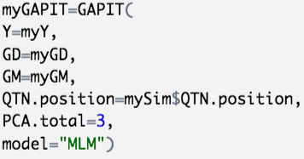

Slide 3
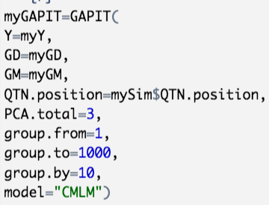
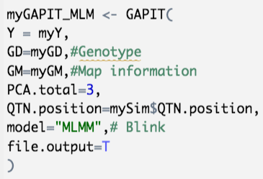

Slide 4
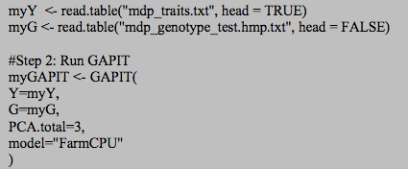
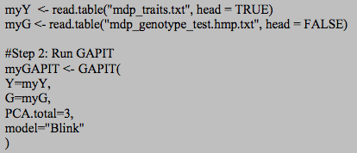
Q: What is the difference between GLM, MLM, CMLM and MLMM?

Slide 5
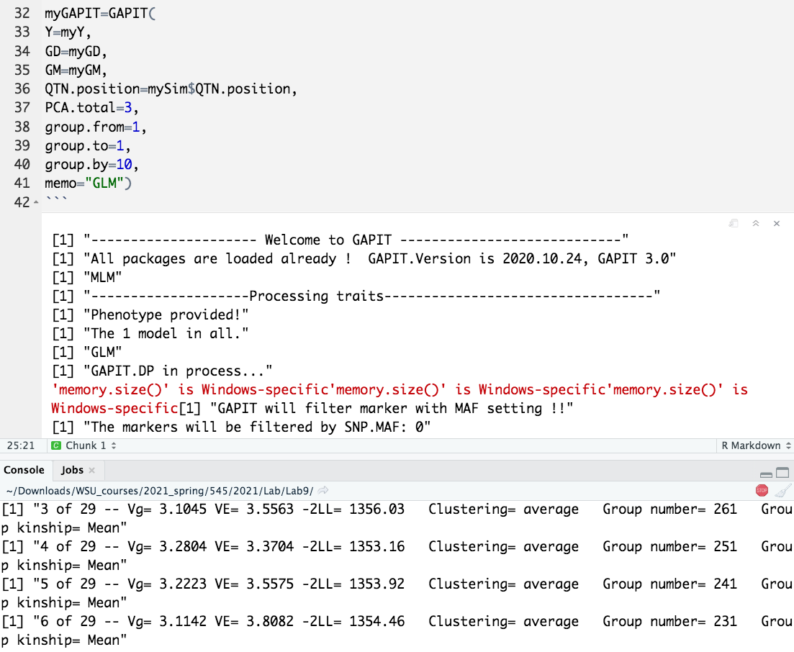
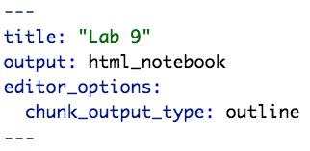


Slide 6
Create your own package in RStudio
install.packages("devtools")
devtools::has_devel()
install.packages("roxygen2")
Install package from github
library(devtools)
install_github(”githubAccount/repositoryName")

Slide 7
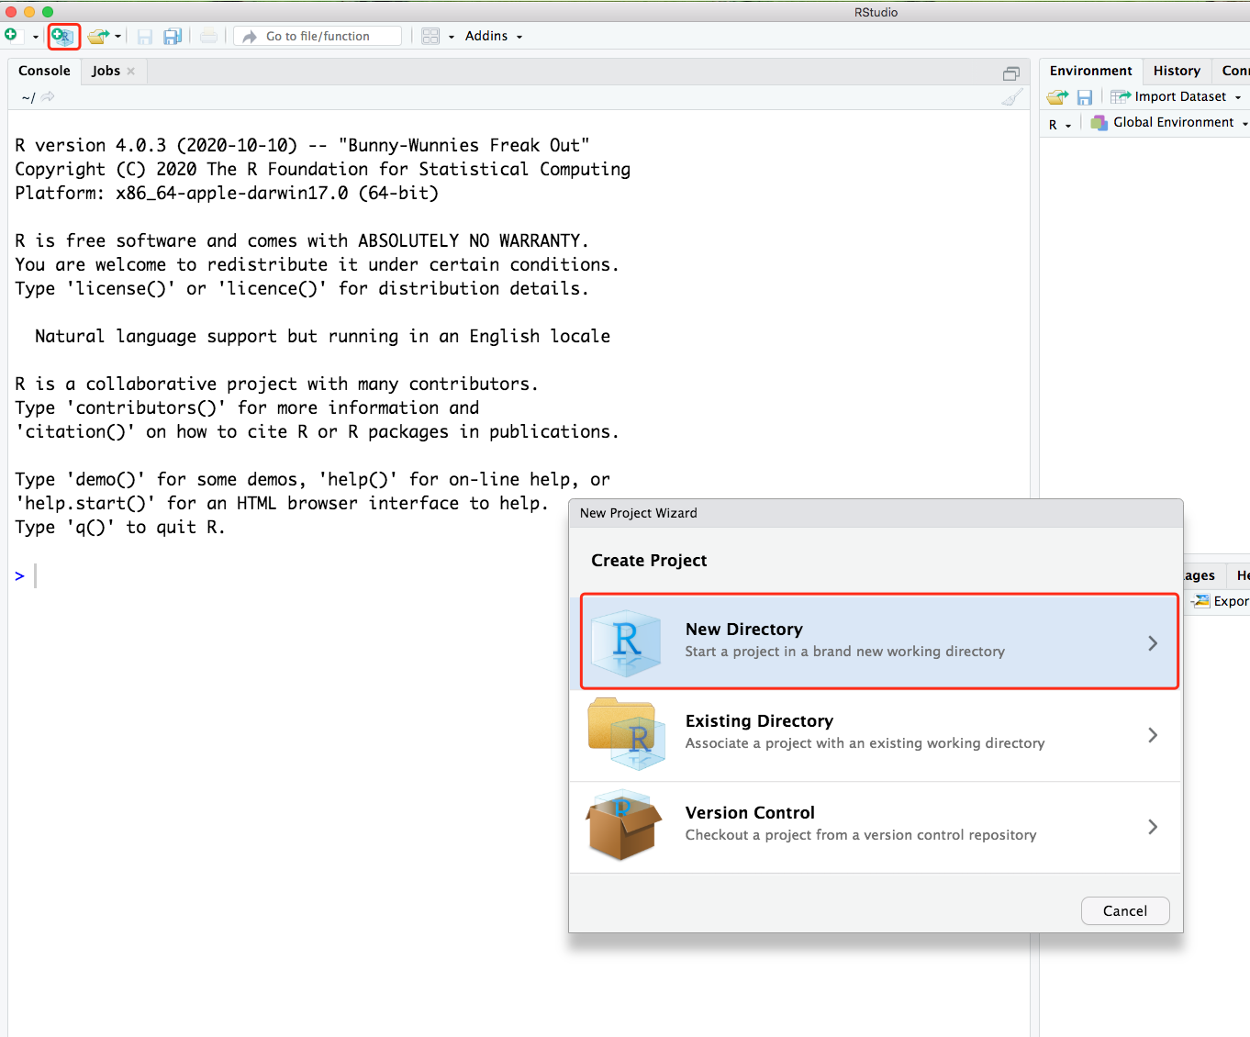
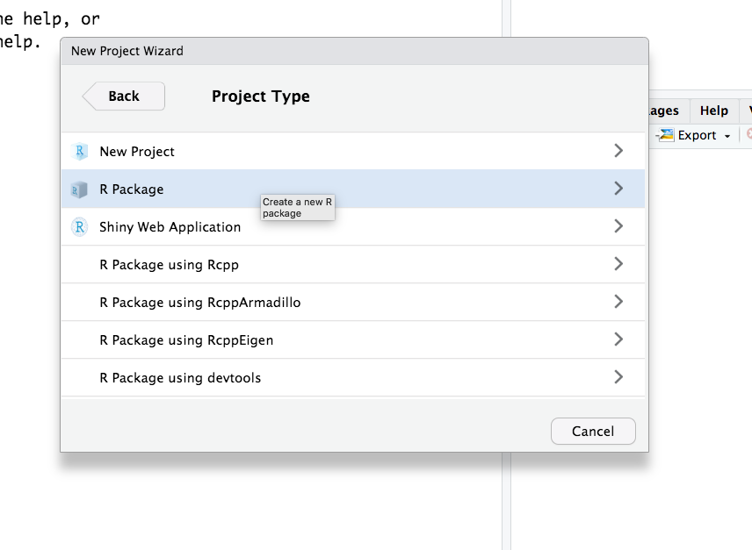

Slide 8
