Slide 1


Statistical Genomics
Lecture 00: GWAS
Zhiwu Zhang
Washington State University

Slide 2
Summary of GWAS methods
Property | COR | GLM | MLM | CMLM | ECMLM | SUPER | MLMM | FarmCPU | BLINK
Multiple maker loci | N | N | N | N | N | N | Y | Y | Y
Fixed effect model | NA | Y | Y | Y | Y | Y | Y | Y | Y
Random effect model | NA | N | Y | Y | Y | Y | Y | Y | N
Trait specific K | NA | NA | N | Y | Y | Y | N | Y | NA
K optimization | NA | NA | N | N | Y | N | N | N | NA
Testing marker specific K | NA | NA | N | N | N | Y | N | N | NA
Iteration | N | N | N | N | N | N | Y | Y | Y
Converge | NA | NA | NA | NA | NA | NA | % of Va | Marker cofactors | Marker cofactors
Optimization | NA | LSE | -2LL | -2LL | -2LL | -2LL | -2LL | -2LL | BIC

Slide 3
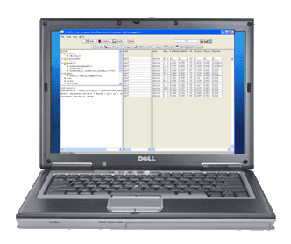
Demonstration
t-Test
GLM
MLM
CMLM
SUPER
MLMM
FarmCPU
BLINK

Slide 4
Import GAPIT/data and simulation
source("http://zzlab.net/GAPIT/GAPIT.library.R")
source("http://www.zzlab.net/GAPIT/gapit_functions.txt")
#Import demo data
myGD=read.table(file="http://zzlab.net/GAPIT/data/mdp_numeric.txt",head=T)
myGM=read.table(file="http://zzlab.net/GAPIT/data/mdp_SNP_information.txt",head=T)
#Simultate 10 QTN on the first half chromosomes
X=myGD[,-1]
index1to5=myGM[,2]<6
X1to5 = X[,index1to5]
taxa=myGD[,1]
setwd("~/Desktop/temp")
set.seed(99164)
GD.candidate=cbind(taxa,X1to5)
mySim=GAPIT.Phenotype.Simulation(GD=GD.candidate,GM=myGM[index1to5,],h2=.75,NQTN=20, effectunit =.95,QTNDist="normal")

Slide 5
ttest
#GWAS by GAPIT
myGAPIT=GAPIT(
Y=mySim$Y,
GD=myGD,
GM=myGM,
QTN.position=mySim$QTN.position,
PCA.total=0,
model="GLM",
memo="ttest")

Slide 6
GLM
#GWAS by GAPIT
myGAPIT=GAPIT(
Y=mySim$Y,
GD=myGD,
GM=myGM,
QTN.position=mySim$QTN.position,
PCA.total=3,
model="GLM",
memo="GLM")

Slide 7
MLM
#GWAS by GAPIT
myGAPIT=GAPIT(
Y=mySim$Y,
GD=myGD,
GM=myGM,
QTN.position=mySim$QTN.position,
PCA.total=3,
model="MLM",
memo="MLM")

Slide 8
CMLM
#GWAS by GAPIT
myGAPIT=GAPIT(
Y=mySim$Y,
GD=myGD,
GM=myGM,
QTN.position=mySim$QTN.position,
PCA.total=3,
group.from = 1,
group.to = 1000,
group.by = 100,
model="CMLM",
memo="CMLM")

Slide 9
SUPER
#GWAS by GAPIT
myGAPIT=GAPIT(
Y=mySim$Y,
GD=myGD,
GM=myGM,
QTN.position=mySim$QTN.position,
PCA.total=3,
model="SUPER",
memo="SUPER")

Slide 10
MLMM
#GWAS by GAPIT
myGAPIT=GAPIT(
Y=mySim$Y,
GD=myGD,
GM=myGM,
QTN.position=mySim$QTN.position,
PCA.total=3,
model="MLMM",
memo="MLMM")

Slide 11
FarmCPU
#Compare FarmCPU#Installation of required R package (once for a computer, details see FarmCPU user manual.)
# install.packages("bigmemory")
# install.packages("biganalytics")
#Import library (each time to start R)
library(bigmemory)
library(biganalytics)
require(compiler) #for cmpfun
source("http://www.zzlab.net/FarmCPU/FarmCPU_functions.txt")#web source code
myFarmCPU= FarmCPU(Y=mySim$Y, GD=myGD, GM=myGM )
myP=as.numeric(myFarmCPU$GWAS$P.value)
myGI.MP=cbind(myGM[,-1],myP)
GAPIT.Manhattan(GI.MP=myGI.MP,seqQTN=mySim$QTN.position)
GAPIT.QQ(myP)

Slide 12
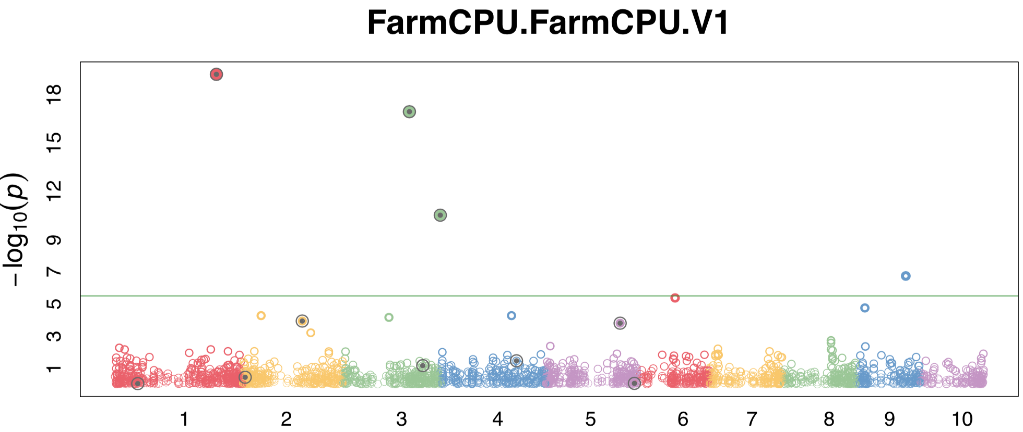
FarmCPU
myGAPIT_MLM <- GAPIT(
Y=mySim$Y,
GD=myGD,#Genotype
GM=myGM,#Map information
PCA.total=0,
QTN.position=mySim$QTN.position,
model="FarmCPU",
memo ="FarmCPU")

Slide 13
BLINK C
myY=mySim$Y
colnames(myY)=c("taxa", "SimPheno")
myGD1=t(myGD[,-1])
write.table(myY,file="myData.txt",quote=F,row.name=F,col.name=T,sep="\t")
write.table(myGD1,file="myData.dat",quote=F,row.name=F,col.name=F,sep="\t")
write.table(myGM,file="myData.map",quote=F,row.name=F,col.name=T,sep="\t")
#run blink
system("~/Desktop/temp/blink_mac --file myData --max_loop 10 --numeric --gwas")
#Extract p values
result<- read.table("SimPheno_GWAS_result.txt", head = TRUE)
myP=as.numeric(result[,5])
myGI.MP=cbind(myGM[,-1],myP)
GAPIT.Manhattan(GI.MP=myGI.MP,seqQTN=mySim$QTN.position)
GAPIT.QQ(myP)

Slide 14
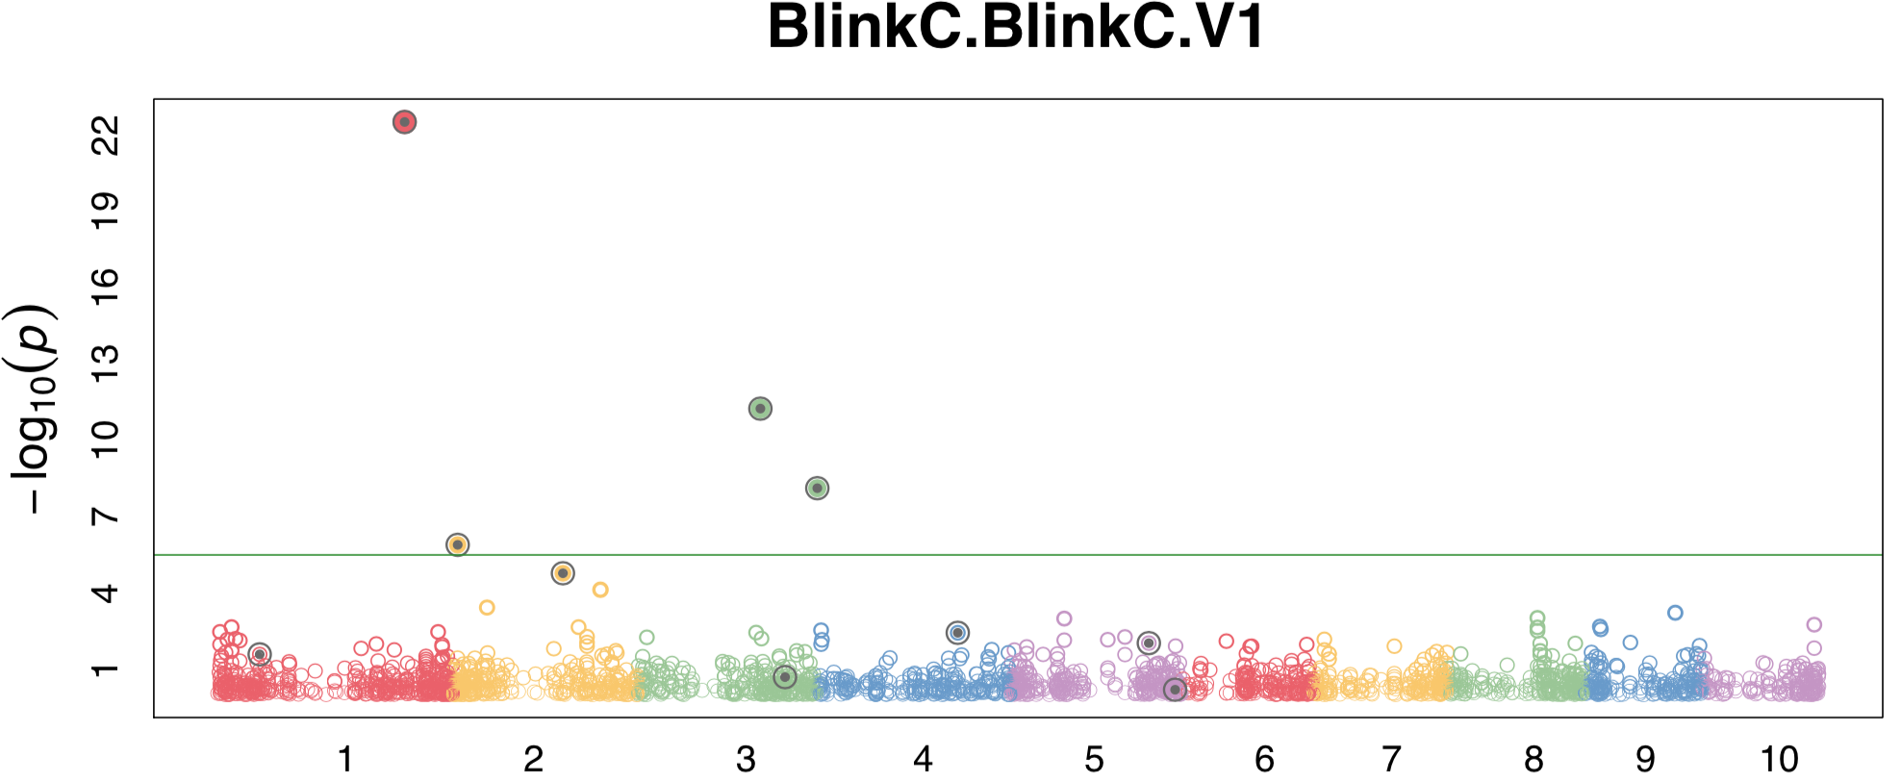
BLINKC in GAPIT
myGAPIT_MLM <- GAPIT(
Y=mySim$Y,
GD=myGD,#Genotype
GM=myGM,#Map information
PCA.total=0,
QTN.position=mySim$QTN.position,
model="BlinkC",
memo="BlinkC")

Slide 15
BLINK R
if(!require(devtools)) install.packages("devtools")
if(!require(BLINK)) devtools::install_github("YaoZhou89/BLINK")
myBlink=Blink(
Y=mySim$Y,
GD=t(myGD[,-1]),GM=myGM,
maxLoop=10,time.cal=T,
QTN.position=mySim$QTN.position)

Slide 16
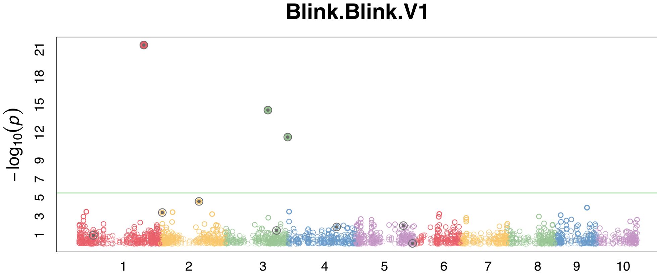
BLINKR in GAPIT
myGAPIT_MLM <- GAPIT(
Y=mySim$Y,
GD=myGD,#Genotype
GM=myGM,#Map information
PCA.total=0,
QTN.position=mySim$QTN.position,
model="Blink",
memo="Blink")

Slide 17
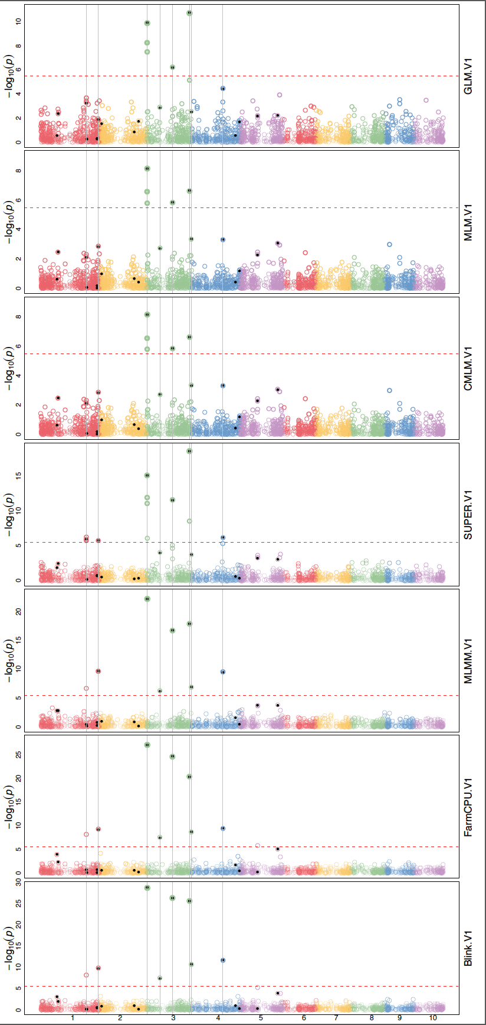
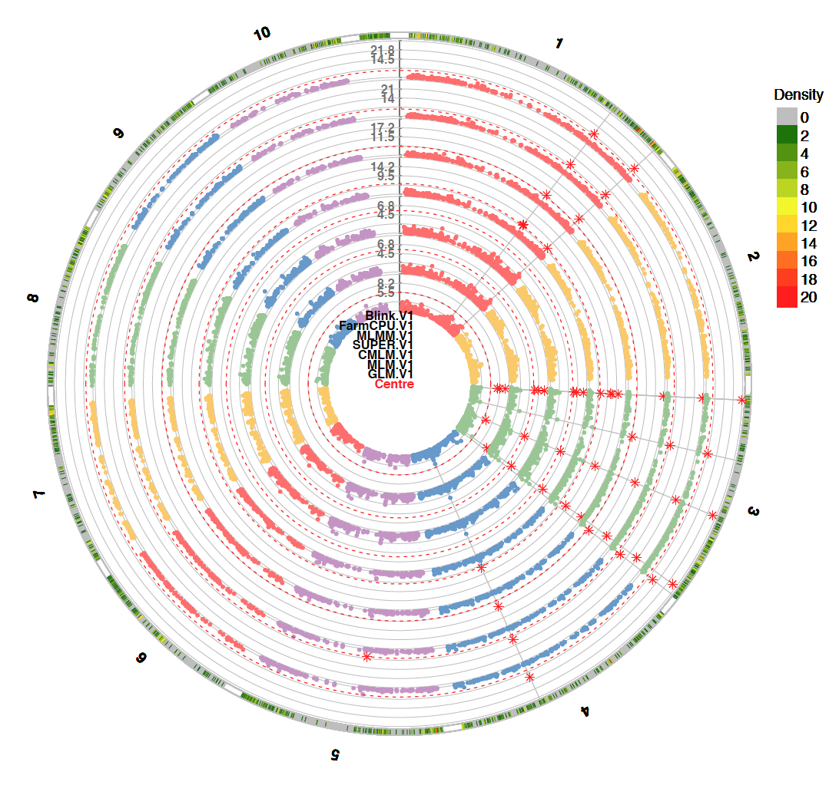
Multiple methods
myGAPIT_MLM <- GAPIT(
Y=mySim$Y,
GD=myGD,#Genotype
GM=myGM,#Map information
PCA.total=3,
QTN.position=mySim$QTN.position,
model=c("GLM", "MLM", "CMLM", "SUPER", "MLMM", "FarmCPU", "Blink"),
Multiple_analysis=TRUE,
file.output=T)

