Slide 1


Statistical Genomics
Lecture 3: Distribution of random variables
Zhiwu Zhang
Washington State University

Slide 2
Outline
Distributions: Bernoulli, Binomial, Normal, X2, t, and F
Relationship
Characteristics (mean, variance, range, and symmetry)

Slide 3
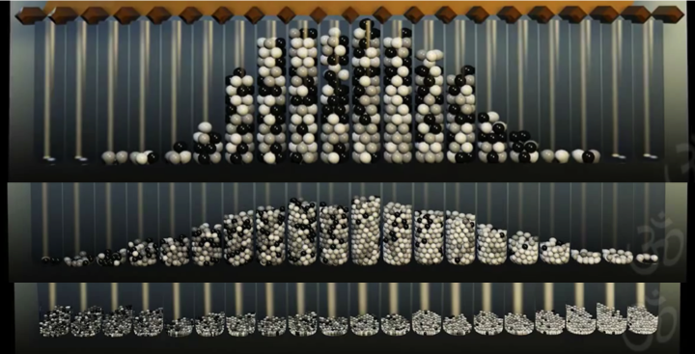
Galton Board

Slide 4
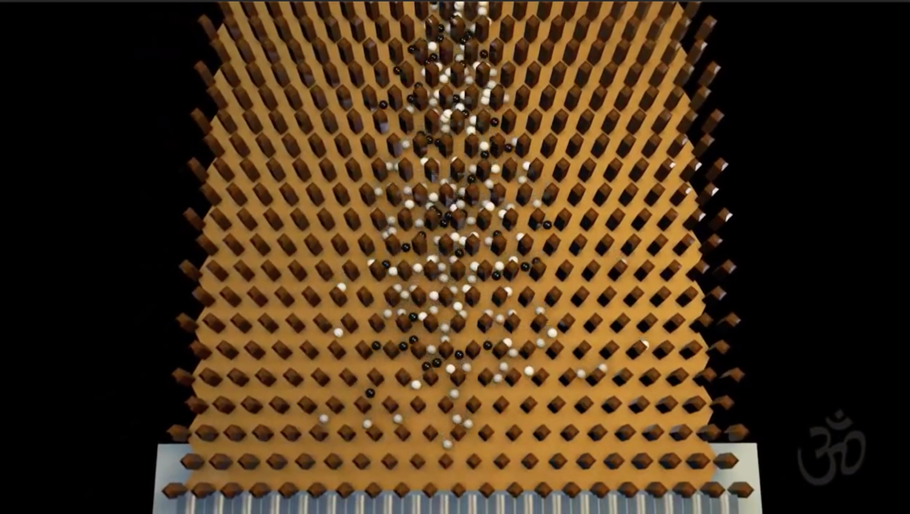
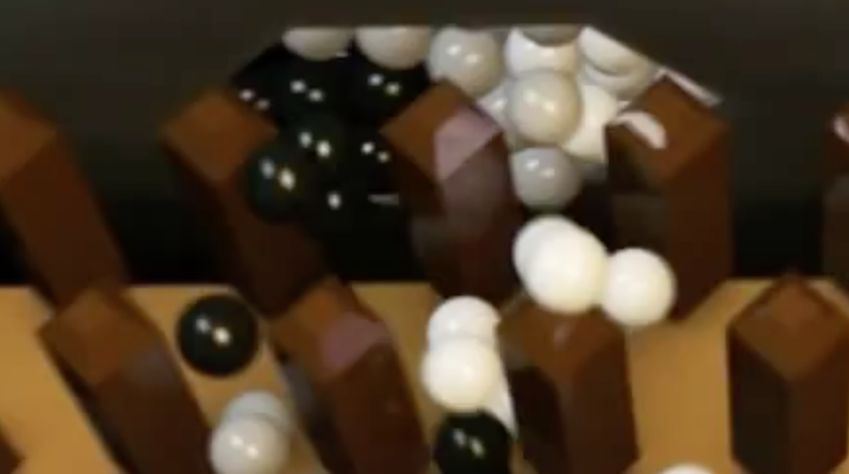
0 | 1 | 2 | 3 | 4 | 5 | 6 | 7 | 8 | 9

Slide 5
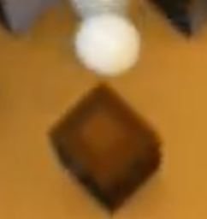
Bernoulli distribution
Named after Swiss mathematician Jacob Bernoulli
A single event (Bernoulli trial) has successful rate of p.
Two outcomes: 1 (success) and 0 (fail)
P(1)=p and P(0)=1-p
Mean: p
Variance: p(1-p)
Notation: b(p)

Slide 6
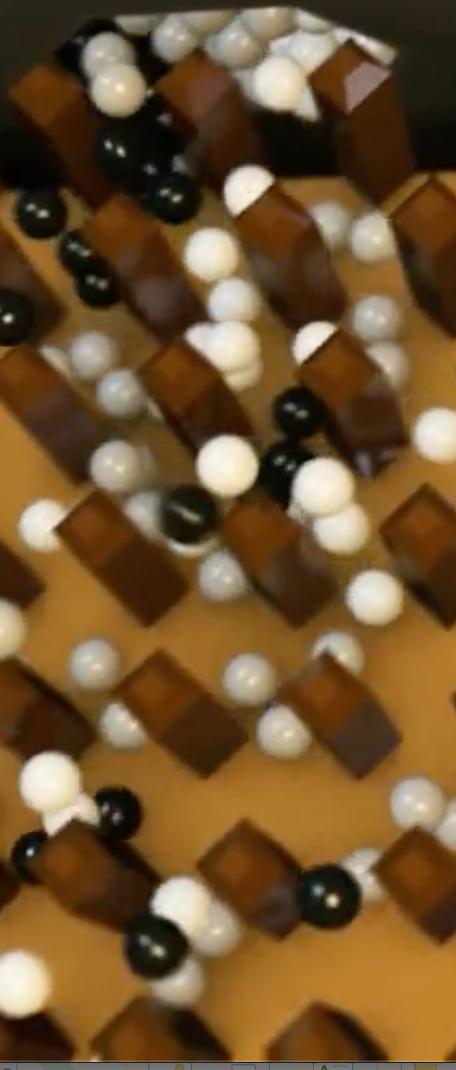
Binomial distribution
Multiple (n) Bernoulli trials each has success rate of p.
The total number of success is a random variable, x
Range from zero to n.
The probability is c(n, x)p^{x}(1-p)^{(n-x)} ,where c(n, x) is number of combinations of choosing x from n.
Notation: B(n, p)

Slide 7
Binomial distribution
Mean=np
Variance=np(1-p)
>=0
Symmetric only if p=.5
When n is large, binomial is close to normal distribution

Slide 8
Binomial distribution and Galton board
x~B(n, p)
n trials each with p successful rate.
The total number of successes is a random variable, x
p=0.5,
Left-fail
Right-success
x=rbinom(10000,5,0.5)
1
n=1
n=2
1
2
1
n=3
1
3
3
1
n=4
1
4
6
4
1
n=5
1
5
10
10
5
1
0
1
2
3
4
5
Outcome

Slide 9
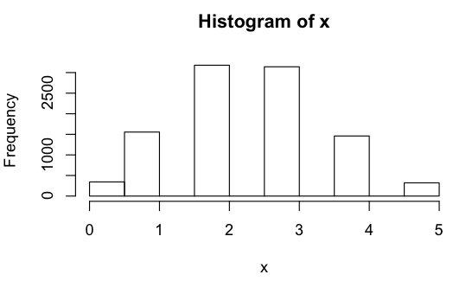
Binomial in R
p=.5
n=5 #number of layers/trials
k=10000 #number of balls
x=rbinom(k, n, p)
hist(x)

Slide 10
Different probability and trials
p=.4
n=200 #number of layers/trials
k=10000 #number of balls
x=rbinom(k, n, p)
hist(x)

Slide 11
Standardization
mean=n*p
var=n*p*(1-p)
z=(x-mean)/sqrt(var)
hist(z)

Slide 12
Plot on density
d=density(z)
par(mfrow=c(2,1),mar = c(3,4,1,1))
plot(d)
plot(d)
polygon(d, col="red", border="blue")
Area sum to one

Slide 13


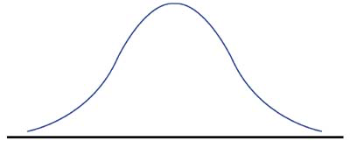
Normal distribution
Binomial distribution with large n
Bell shape
Probability Density Function: Exponential
Notation: N(mean, variance)
-infinity to +infinity
symmetric

Slide 14
Standard normal distribution
Mean of zero and variance of one
Notation: N(0,1)
Map between deviation and probability
68% of data
95% of data
99.7% of data
-3
-2
-1
0
1
2
3

Slide 15
Normal distribution in R
x=rnorm(k, mean=mean,sd=sqrt(var))
hist(x)

Slide 16
Binomial vs. Normal
x=rbinom(k, n,p)
d=density(x)
plot(d)
mean=n*p
var=n*p*(1-p)
x=rnorm(k, mean=mean,sd=sqrt(var))
d=density(x)
plot(d)

Slide 17
What is the probability of x=80?
Binomial: c(200,80)x.4⁸⁰x.6²⁰
Normal distribution: zero

Slide 18
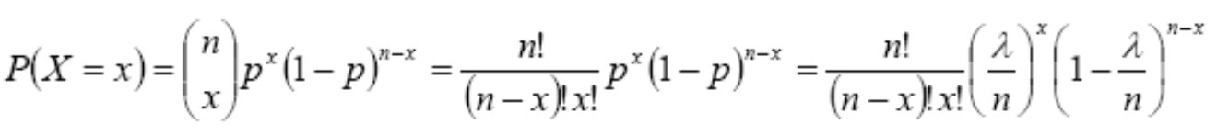
Poisson distribution
Special case of binomial distribution: p close to zero and n close to infinity so that λ=np reach constant
Mean= Var = λ
range >=0

Slide 19
Poisson distribution in R
par(mfrow=c(2,2),mar = c(3,4,1,1))
lambda=.5
x=rpois(k, lambda)
hist(x)
lambda=1
x=rpois(k, lambda)
hist(x)
lambda=5
x=rpois(k, lambda)
hist(x)
lambda=10
x=rpois(k, lambda)
hist(x)

Slide 20
Approximation by binomial
n=10
n=100
n=1000
par(mfrow=c(3,3),mar = c(3,4,1,1))
k=10000 #number of Gaton boards
p=c(.5, .05, .005)
n=c(10,100,1000)
for (pi in p){
for (ni in n){
x=rbinom(k, ni,pi)
hist(x)
}}
quartz()
lambda=5
x=rpois(k, lambda)
hist(x)
p=.5
p=.05
p=.005
x=rpois(k, lambda)
x=rbinom(k, n, p)

Slide 21
Distribution derived from normal distribution
Square
x
-0.0827
-0.5546
-1.9096
1.0000
-1.0723
-0.0288
-0.9039
0.5654
0.0130
1.0197
…
y
0.0068
0.3076
3.6467
1.0000
1.1498
0.0008
0.8171
0.3197
0.0002
1.0398
…
Normal
distribution
?
k=10000
x=rnorm(k,0,1)
hist(x)
y=x^2
hist(y)

Slide 22
Two normal distribution variables
x1 square | x2 square
0.0068 | 0.0351
0.3076 | 1.2007
3.6467 | 5.0488
1.0000 | 0.0052
1.1498 | 0.7752
0.0008 | 2.3219
0.8171 | 0.2415
0.3197 | 0.1693
0.0002 | 0.8089
1.0398 | 0.0044
… | …
x1 | x2
-0.0827 | -0.1874
-0.5546 | -1.0958
-1.9096 | -2.2470
1.0000 | -0.0720
-1.0723 | -0.8805
-0.0288 | -1.5238
-0.9039 | -0.4914
0.5654 | 0.4114
0.0130 | -0.8994
1.0197 | -0.0666
… | …
y=sum
0.0420
1.5083
8.6955
1.0052
1.9251
2.3227
1.0586
0.4890
0.8091
1.0442
…
k=10000
x1=rnorm(k,0,1)
x2=rnorm(k,0,1)
y=x1^2 + x2^2
mean(y)
var(y)
hist(y)
n=2

Slide 23
Chi square (x2) distribution
If x_{i}~N(0, 1) , then y=sum(x_{i}²)~X²(n)
Mean=n
Var=2n
range >=0
Non symmetric
n=2
n=2
k=10000
x=rnorm(k*n,0,1)
x2=x^2
xm=matrix(x2,k,n)
y=rowSums(xm)
mean(y)
var(y)
hist(y)
n=5
n=100

Slide 24
Chi square distribution in R
par(mfrow=c(2,2),mar = c(3,4,1,1))
x=rchisq(k,2)
d=density(x)
plot(d)
x=rchisq(k,5)
d=density(x)
plot(d)
x=rchisq(k,100)
d=density(x)
plot(d)
x=rchisq(k,1000)
d=density(x)
plot(d)
Chi square distribution becomes normal distribution with large n with mean of n and var of 2n

Slide 25
F distribution
If U~X²(n₁), V~X²(n₂)
F=(U/n₁)/ (V/n₂) ~ F (n₁, n₂)
Mean=n₂/(n₂-2)
Variance=
range >=0
Non symmetric
par(mfrow=c(2,2),mar = c(3,4,1,1))
x=rf(k,1, 100)
hist(x)
x=rf(k,1, 10000)
hist(x)
x=rf(k,10, 10000)
hist(x)
x=rf(k,10000, 10000)
hist(x)

Slide 26
t distribution
If z~N(0,1), V~X²(n)
t=z/sqrt(V/n)~ t (n)
Sympatric
Mean=0
Variance=n/(n-2)
range: –infinity to + infinity
William Sealy Gosset
Known as "Student"

Slide 27
t distribution
par(mfrow=c(2,2),mar = c(3,4,1,1))
x=rt(k,2)
hist(x)
x=rt(k,5)
hist(x)
x=rt(k,10)
hist(x)
x=rt(k,100)
hist(x)

Slide 28
Relationship between t and F
t²=z²/ (U/n)~ F (1,n)
par(mfrow=c(2,1),mar = c(3,4,1,1))
x=rf(k,1, 100)
hist(x)
x=rt(k,100)
z=x^2
hist(z)

Slide 29
Central Limit Theory (CLT)
Averages of large samples close to normal distribution.

Slide 30
par(mfrow=c(5,1),mar = c(3,4,1,1))
#Binomia
p=.05
n=100 #number of balls
k=10000 #number of Gaton boards
x=rbinom(k, n,p)
d=density(x)
plot(d,main="Binomial")
#Poisson
lambda=10
x=rpois(k, lambda)
d=density(x)
plot(d,main="Poisson")
#Chi-Square
x=rchisq(k,5)
d=density(x)
plot(d,main="Chi-square")
#F
x=rf(k,10, 10000)
d=density(x)
plot(d,main="F dist")
#t
x=rt(k,5)
d=density(x)
plot(d,main="t dist")

Slide 31
Function to get mean of n(10) variables
i2mean=function(x,n=10){
k=length(x)
nobs=k/n
xm=matrix(x,nobs,n)
y=rowMeans(xm)
return (y)
}

Slide 32
par(mfrow=c(5,1),mar = c(3,4,1,1))
#Binomia
p=.05
n=100 #number of balls
k=10000 #number of Gaton boards
x=i2mean(rbinom(k, n,p))
d=density(x)
plot(d,main="Binomial")
#Poisson
lambda=10
x=i2mean(rpois(k, lambda))
d=density(x)
plot(d,main="Poisson")
#Chi-Square
x=i2mean(rchisq(k,5))
d=density(x)
plot(d,main="Chi-square")
#F
x=i2mean(rf(k,10, 10000))
d=density(x)
plot(d,main="F dist")
#t
x=i2mean(rt(k,5))
d=density(x)
plot(d,main="t dist")

Slide 33



Relationship among distributions
B(n,p)
n trials
λ=np
Normalize
P=0.5
big n
b(p)
P(λ)
N(0,1)
t(n)
$$\frac{z}{\sqrt{X^{2}/n}}$$
$\sum{z^{2}}$
F(n₁,n₂)
$$\frac{X_{1}^{2}/n_{1}}{X_{2}^{2}/n_{2}}$$
X²(n)

Slide 34
Distribution features
Features | b(p) | B(n,p) | P(λ) | N(0,1) | X2(n) | F(n1,n2) | t(n)
Mean | p | np | λ | 0 | n | n2/(n2-2) | 0
Variance | P(1-p) | np(1-p) | λ | 1 | 2n |  | n/(n-2)
Range | 1 or 0 | >=0 | >0 | (-∞,∞) | >0 | >0 | (-∞,∞)
Symmetry | N | N | N | Y | N | N | Y

Slide 35
Expectation
Distributions: Bernoulli, Binomial, Normal, X2, t, and F
Relationship
Characteristics (mean, variance, range, and symmetry)
CLT

