Slide 1


Statistical Genomics
Lecture 7: Imputation
Zhiwu Zhang
Washington State University

Slide 2
Outline
Why imputation
Accuracy evaluation
Mechanism of imputation
  Haplotype
  Stochastic imputation
  Nearest neighbors
Two packages
  KNN
  BEAGLE

Slide 3
Why imputation
Most of analyses do not allow missing data
Increase marker density
Meta analyses for multiple studies
Improve GWAS and GS

Slide 4
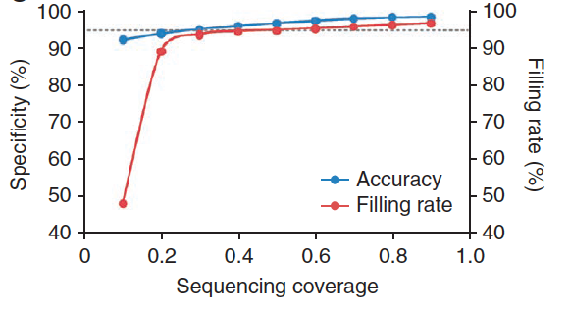
Imputation improve density
Coverage: 1X
Missing rate: 38%
Imputed by KNN
Filling rate: 97%
Accuracy: 98%
3M SNPs remain
Huang et al. 2010, Nature Genetics

Slide 5
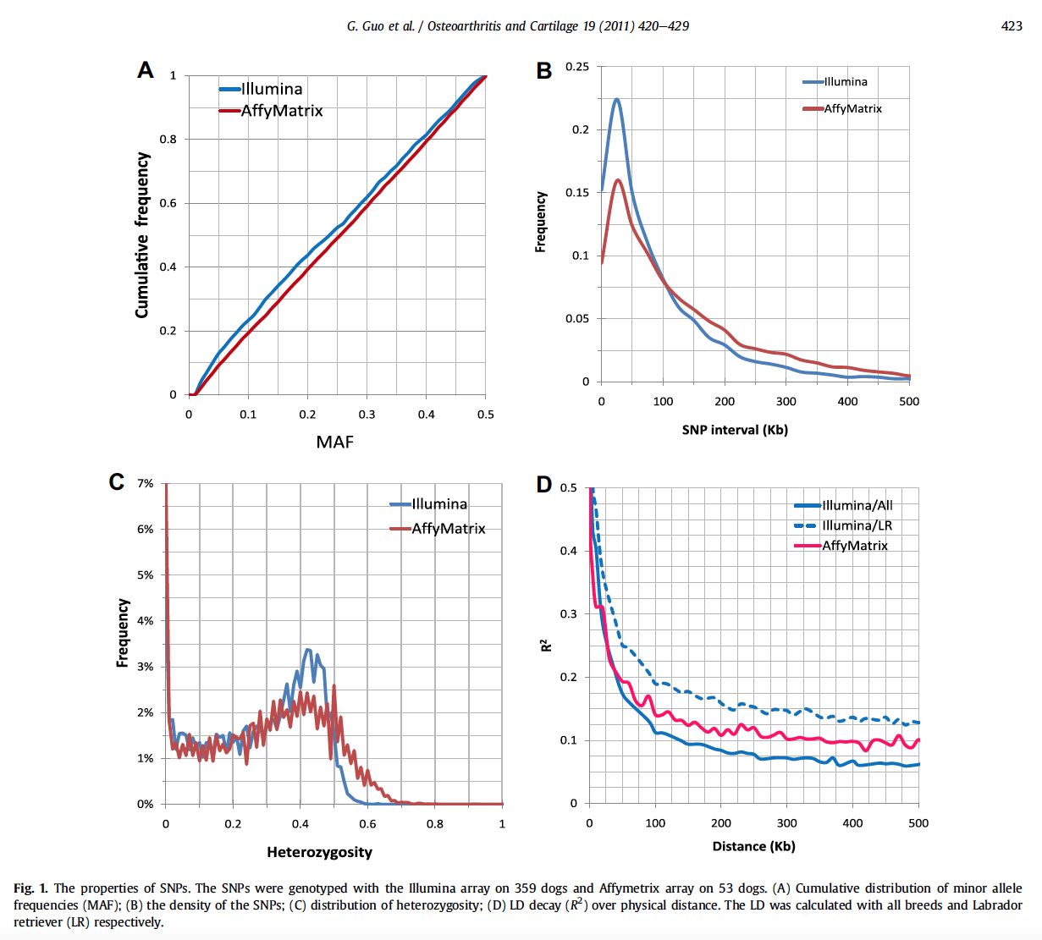

Slide 6
Example of meta analysis
Guo et. al. Osteoarthritis Cartilage. 2011, 19(4): 420–429
Fig. 5. Missing rate of SNPs. There were 21,455 SNPs on Illumina array that was used to derive the predictive formula. Aboutw40% of these SNPs were not present on the Affymetrix array that was used to genotype the dogs for independent validation (including the first and the third most influential SNPs on the Illumina array). The cumulative missing rates of SNPs are plotted against their order (descending log scale) based on their scaling factor.

Slide 7
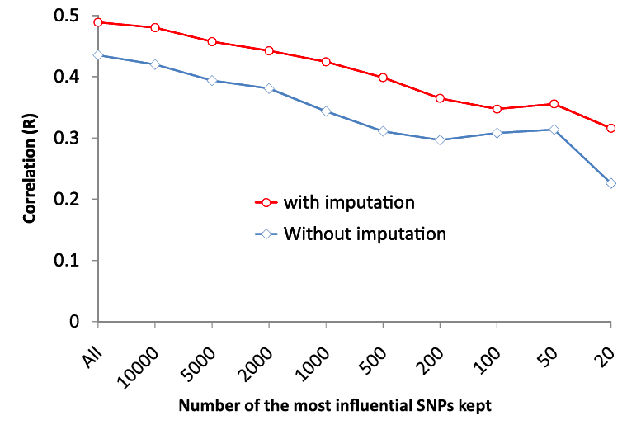
Canine hip dysplasia is predictable

Slide 8
Imputation mechanism
Fill with mean
By major allele
Haplotype
Stochastic imputation with allele frequency
KNN
Hidden Marcov Model (BEAGLE)
Much more

Slide 9
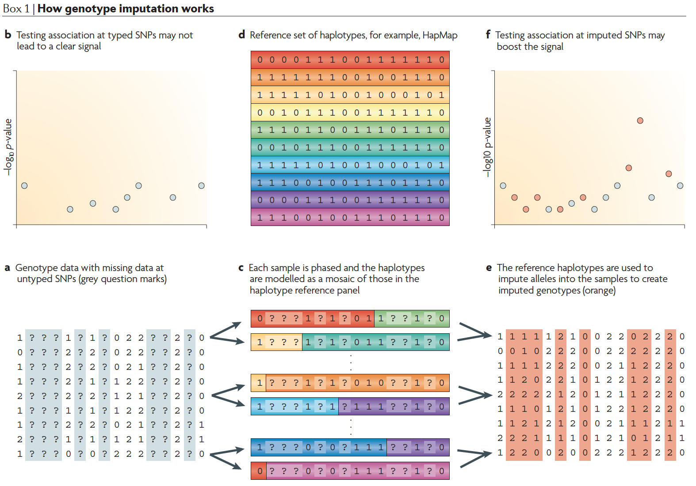
Impute by haplotype
Marchini et. al. Nat Rev Genet. 2010 Jul;11(7):499-511

Slide 10
Stochastic imputation with allele frequency
In case of inbred with alleles A or B, the frequency of A is f(A). If x has uniform distribution U(0,1), then missing allele N can be imputed as

Slide 11
Implication of stochastic imputation
#Define Stochastic Impute funciton
StochasticImpute = function(X){
n=nrow(X)
m=ncol(X)
fn=colSums(X, na.rm=T) # sum of genotypes for all individuals
fc=colSums(floor(X/3+1),na.rm=T) #count number of non missing individuals
fa=fn/(2*fc) #Frequency of allele "2"
for(i in 1:m){
index.a=runif(n)<fa[i]
index.na=is.na(X[,i])
index.m2=index.a & index.na
index.m0=!index.a & index.na
X[index.m2,i]=2
X[index.m0,i]=0
}
return(X)}

Slide 12
Evaluation of imputation accuracy
Randomly set a proportion of known data as missing
Impute the artificial missing
Compare the imputed and original

Slide 13
Import data
#Import data
myGD=read.table(file="http://zzlab.net/GAPIT/data/mdp_numeric.txt",head=T)
X.raw=myGD[,-1] #keep as original for comparison
X=X.raw # Create a new variable than may be changed later

Slide 14
Variable of uniform distribution
#Set missing values
n=nrow(X)
m=ncol(X)
dp=m*n #total data points
uv=runif(dp)
hist(uv)

Slide 15
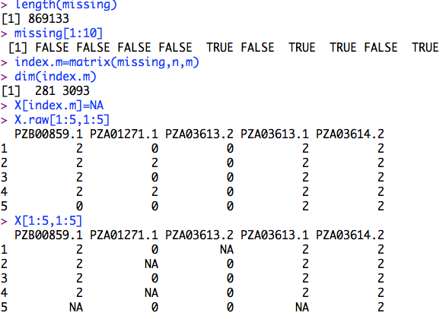
Missing value simulation
mr=.2 #missing rate
missing=uv<mr
length(missing)
missing[1:10]
#Format indicator as matrix
index.m=matrix(missing,n,m)
dim(index.m)
#Set missing values as NA
X[index.m]=NA
X.raw[1:5,1:5]
X[1:5,1:5]

Slide 16
Two types of imputation accuracy
Correlation coefficient
Proportion of match

Slide 17

Accuracy calculation
#Impute
XI= StochasticImpute(X)
#Correlation
accuracy.r=cor(X.raw[index.m], XI[index.m])
#Proportion of match
index.match=X.raw==XI
index.mm=index.match&index.m
accuracy.m=length(X[index.mm])/length(X[index.m])
accuracy.r
accuracy.m

Slide 18
The two type accuracy are correlated
nrep=100
myimp=replicate(nrep,{
uv=runif(dp)
#hist(uv)
missing=uv<mr
length(missing)
missing[1:10]
index.m=matrix(missing,n,m)
dim(index.m)
X[index.m]=NA
X.raw[1:5,1:5]
X[1:5,1:5]
#=======================================
#Impute with StochasticImpute
XI= StochasticImpute(X)
#Calcuate accuracy
accuracy.r=cor(X.raw[index.m], XI[index.m])
index.match=X.raw==XI
index.mm=index.match&index.m
accuracy.m=length(X[index.mm])/length(X[index.m])
accuracy.r
accuracy.m
acc=c(accuracy.r, accuracy.m)
})
plot(myimp[1,],myimp[2,])

Slide 19
Two types of accuracy can be very different with Low MAF
Major and minor alleles: For a diallelic marker, the allele with higher frequency is called major allele and the other minor allele
Minor Allele Frequency (MAF): The frequency of minor allele, range from 0 to 0.5
For markers with low MAF, it is challenge to impute the minor alleles correctly.

Slide 20
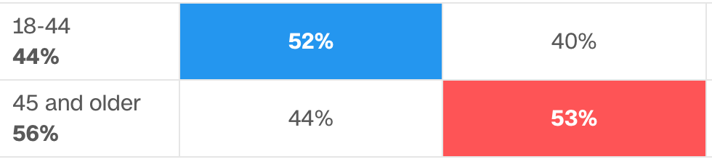
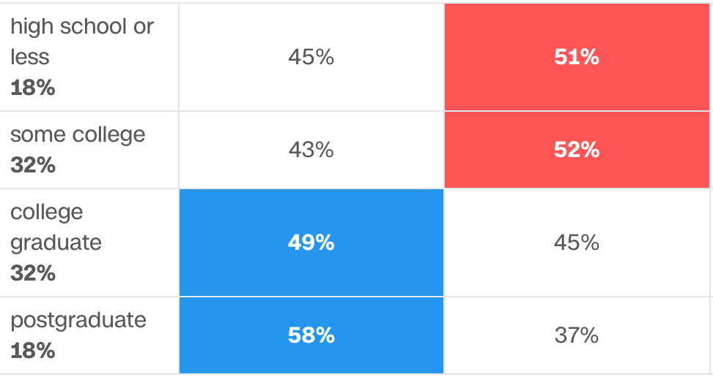
US Election 2016
Age
Education

Slide 21
K Nearest Neighbors: vote
Age
One neighbor: orange goes to blue
Five neighbors: orange goes to red
The number of neighbors can be optimized through training and testing
Education

Slide 22
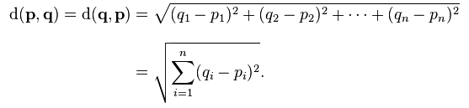
More dimension: Euclidean distance
Vote case
Predict a person’s vote by the similar people
Features to evaluate similarity among people: education and age
Number of features (n)=2

Slide 23
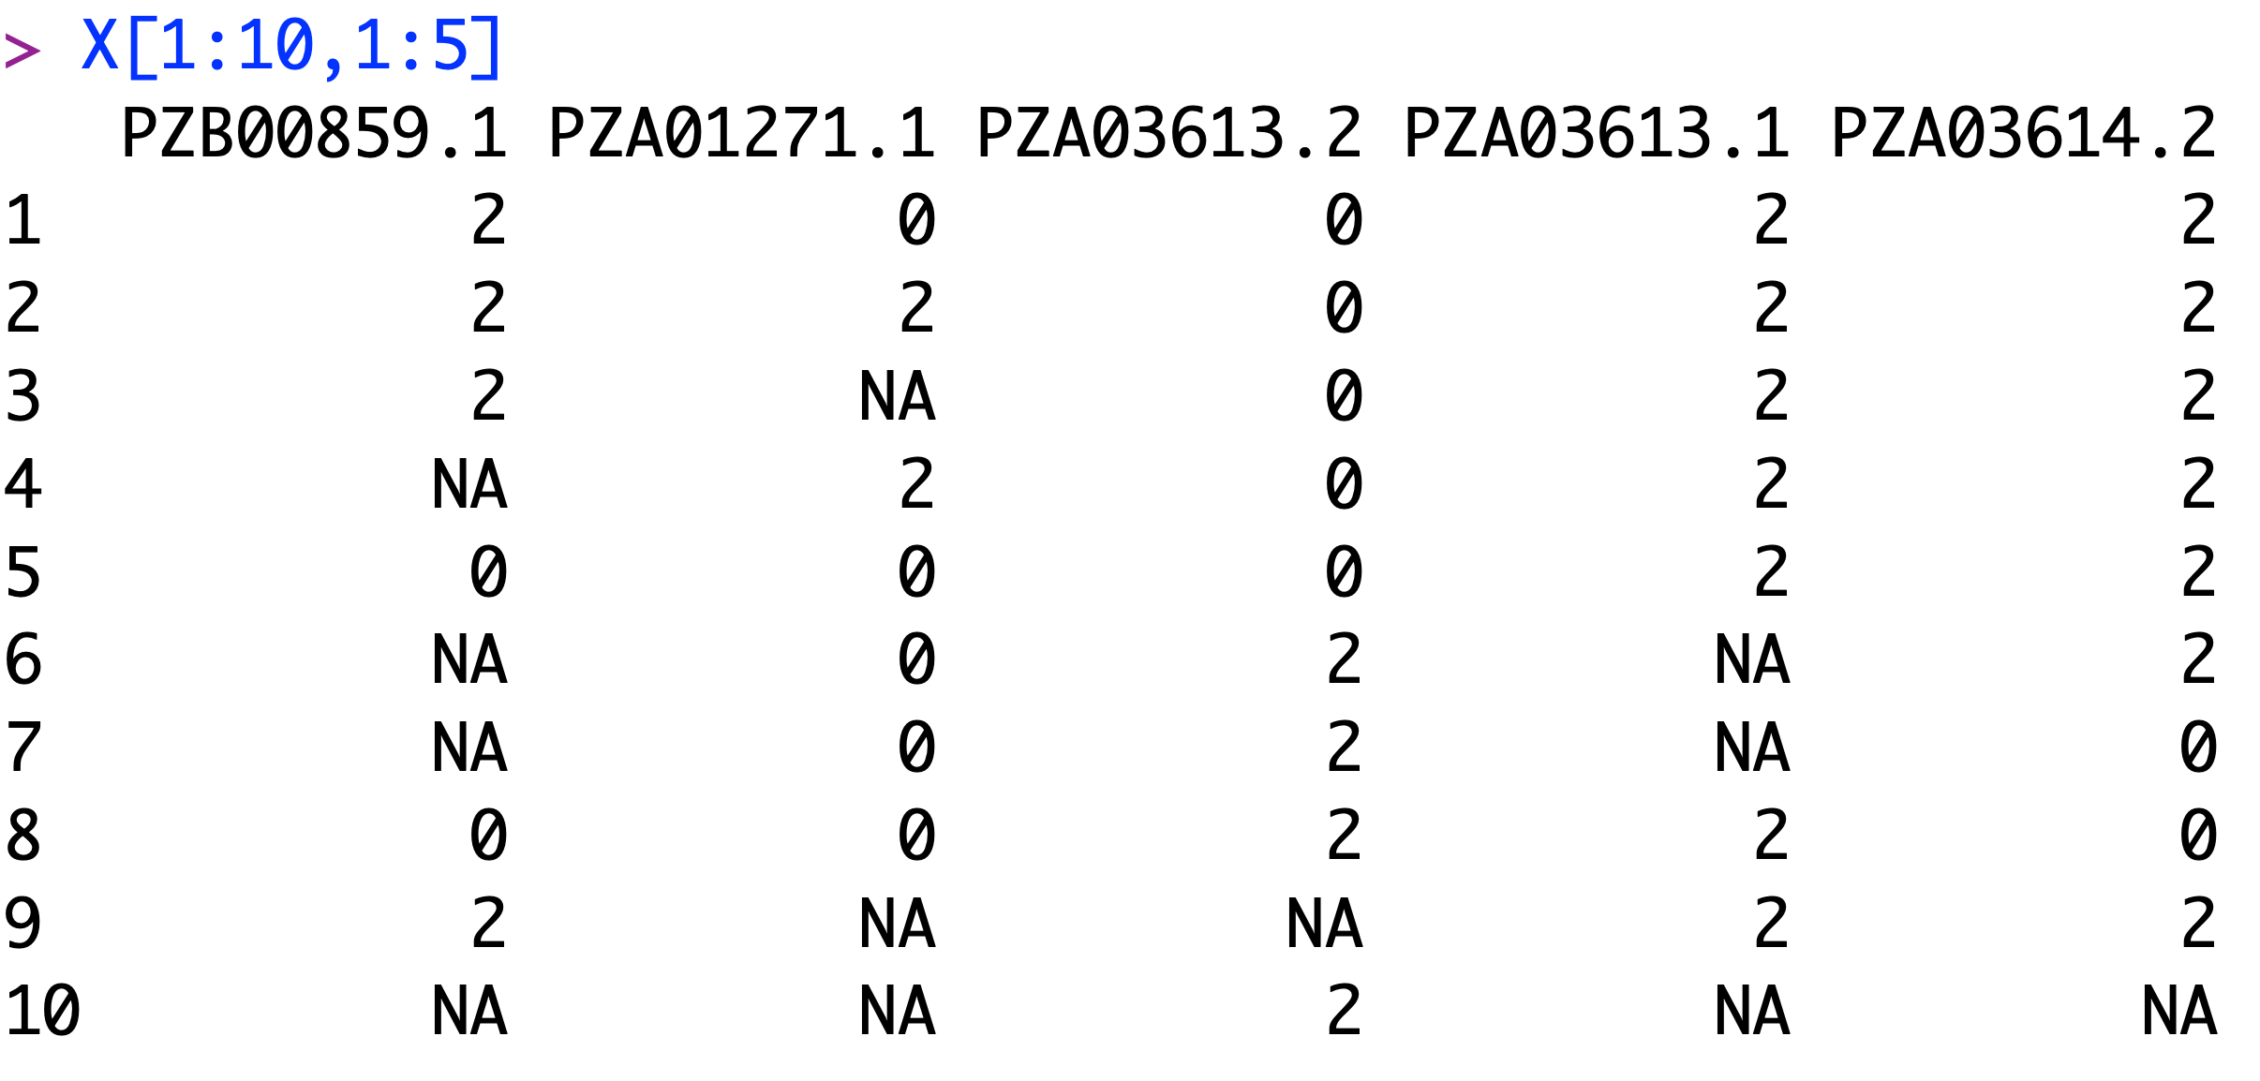
Genotype imputation
Genotype data: t individuals (rows) and m makers (columns)
Markers as features: n=m, k nearest neighbor individuals (kinship) are used to predict the missing individual
Individual as features: n=t, k nearest neighbor markers (linkage) are used to predict the missing marker

Slide 24

"impute" R package
#install.packages("impute")
## try http:// if https:// URLs are not supported
source("https://bioconductor.org/biocLite.R")
biocLite("impute")
library(impute)
if (!requireNamespace("BiocManager", quietly = TRUE)) install.packages("BiocManager") BiocManager::install("impute")
library(impute)

Slide 25
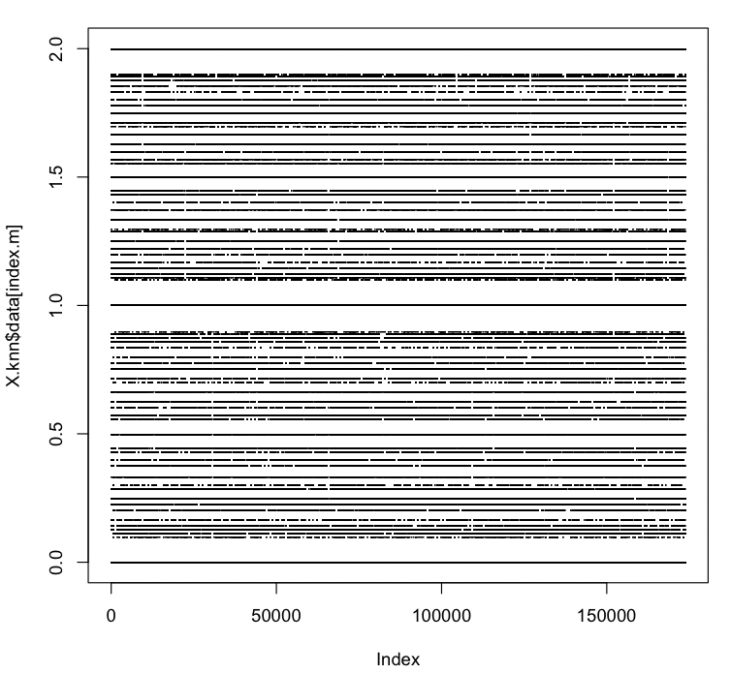
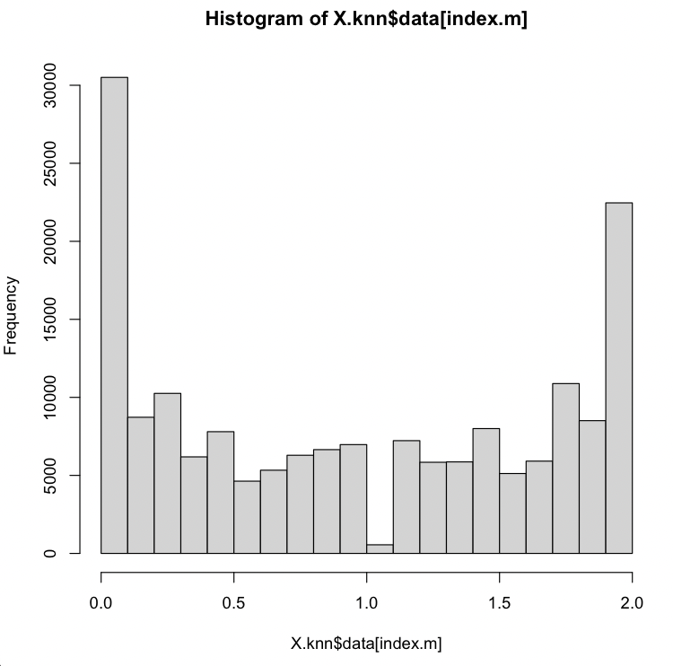
Markers as features
#Impute using marker as features
X.knn= impute.knn(as.matrix((X)), k=10)
plot(X.knn$data[index.m],pch=".")
hist(X.knn$data[index.m])

Slide 26
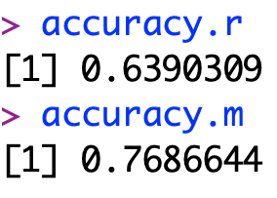
Imputation Categories
#change to integer
X.knn.I= X.knn$data
Index1= X.knn$data<1
Index2= X.knn$data>1
X.knn.I[Index1]= 0
X.knn.I[Index2]= 2
#Correlation
accuracy.r=cor(X.raw[index.m], (X.knn.I)[index.m])
#Match proportion
index.match=X.raw== X.knn.I
index.mm=index.match&index.m
accuracy.m=length(X[index.mm])/length(X[index.m])
accuracy.r
accuracy.m
2
1
0

Slide 27
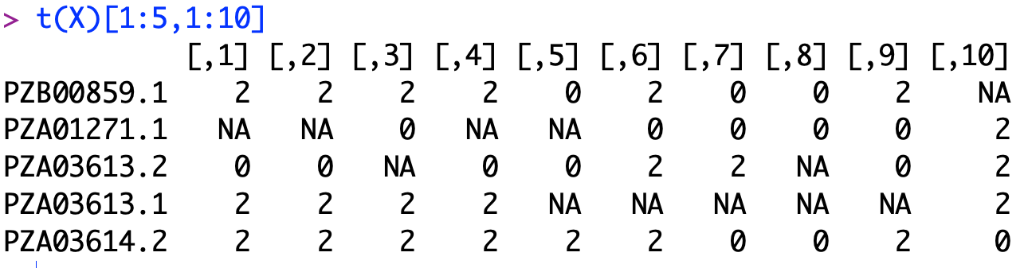
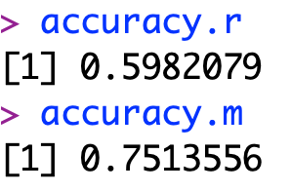
Individual as features
#Impute using individuals as features
X.knn= impute.knn(as.matrix(t(X)), k=10)
#change to integer
X.knn.I= X.knn$data
Index1= X.knn$data<1
Index2= X.knn$data>1
X.knn.I[Index1]= 0
X.knn.I[Index2]= 2
#Correlation
accuracy.r=cor(X.raw[index.m], t(X.knn.I)[index.m])
#Match proportion
index.match=X.raw== t(X.knn.I)
index.mm=index.match&index.m
accuracy.m=length(X[index.mm])/length(X[index.m])
accuracy.r
accuracy.m

Slide 28

BEAGLE
Java package
JDK required
First release: 2006
Current version: 5.1
Version used in class: 3.3.2
Multiple papers
Brian Browning
University of Washington
Department of Medicine, Division of Medical Genetics
Health Sciences Building, K-253
Box 357720
Seattle, WA 98195-7720
Phone: (206) 685-8482
Fax: (206) 543-3050
E-mail: browning@uw.edu
https://faculty.washington.edu/browning/beagle/b3.html

Slide 29
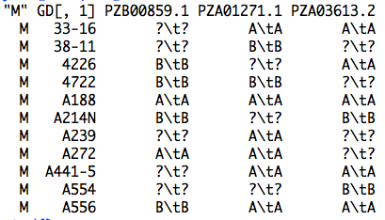
Input file

Slide 30
Output file
#Convert to BEAGLE input format
index0=X==0
index1=X==1
index2=X==2
indexna=is.na(X)
X2=X
X2[index0]="A\tA"
X2[index1]="A\tB"
X2[index2]="B\tB"
X2[indexna]="?\t?"
myGD2=cbind("M",myGD[,1],X2)
setwd("/Users/Zhiwu/Dropbox/Current/ZZLab/WSUCourse/CROPS545/Demo")
write.table(myGD2,file="test.bgl",quote=F,sep="\t",col.name=F,row.name=F)

Slide 31
Run BEAGLE
Command line
From R
#Impute with BEAGLE
system("java -Xmx12g -jar /Users/Zhiwu/Dropbox/Current/ZZLab/WSUCourse/CROPS545/Demo/Beagle/beagle.jar unphased=test.bgl missing=? out=test1" )

Slide 32
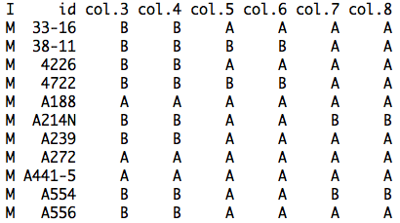
Output of BEAGLE

Slide 33
Format conversion
#Convert output format
genotype.full <- read.delim("test1.test.bgl.phased.gz",sep=" ",head=T)
genotype.c=as.matrix(genotype.full[,-(1:2)])
index.A=genotype.c=="A"
index.B=genotype.c=="B"
nr=nrow(genotype.c)
nc=ncol(genotype.c)
genotype.n=matrix(0,nr,nc)
genotype.n[index.A]=0
genotype.n[index.B]=1
n2=ncol(genotype.n)
odd=seq(1,n2-1,2)
even=seq(2,n2,2)
g0=genotype.n[,odd]
g1=genotype.n[,even]
X.bgl=g0+g1

Slide 34

Accuracy of BEAGLE
#Impute and calculate correlation
accuracy.r=cor(X.raw[index.m], X.bgl[index.m])
index.match=X.raw==X.bgl
index.mm=index.match&index.m
accuracy.m=length(X[index.mm])/length(X[index.m])
accuracy.r
accuracy.m

Slide 35
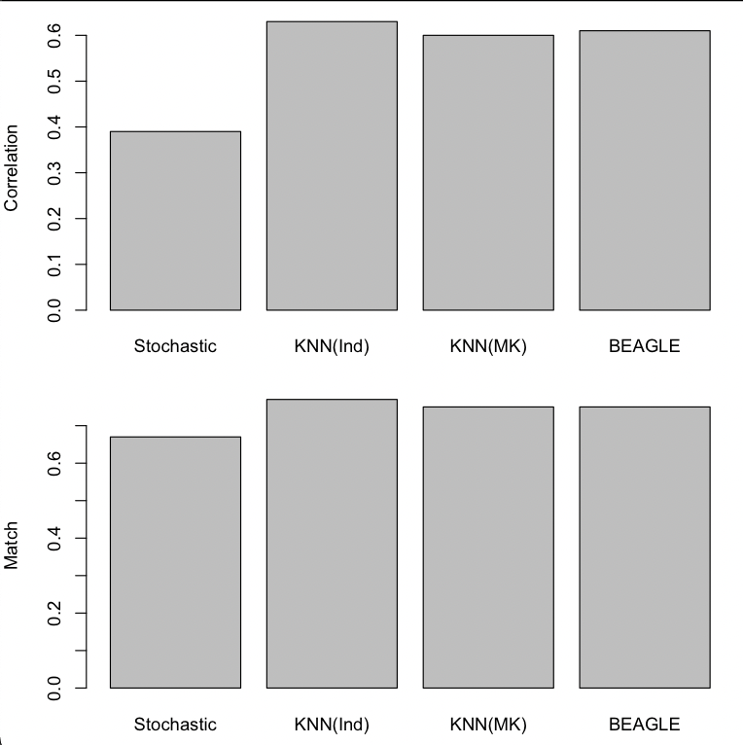
Method comparison
# Result comparison
Method=c("Stochastic", "KNN(Ind)", "KNN(MK)", "BEAGLE")
Cor=c(.39,.63,.60,.61)
Match=c(.67,.77,.75,.75)
par(mfrow=c(2,1),mar = c(3,4,1,1))
barplot(Cor, names.arg=Method, ylab="Correlation")
barplot(Match, names.arg=Method, ylab="Match")

Slide 36
Highlight
Why imputation
How to impute
Stochastic imputation
KNN
BEAGLE
Accuracy evaluation

