Slide 1


Statistical Genomics
Lecture 8: Linkage analysis
Zhiwu Zhang
Washington State University

Slide 2
Outline
Linkage
Recombination
Haldan’s map function
Linkage analysis
Software and RQTL

Slide 3
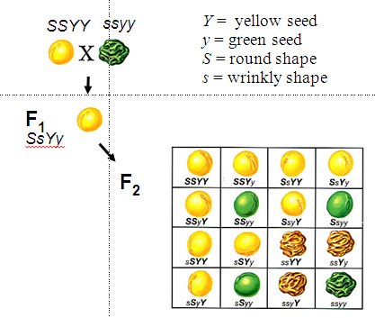
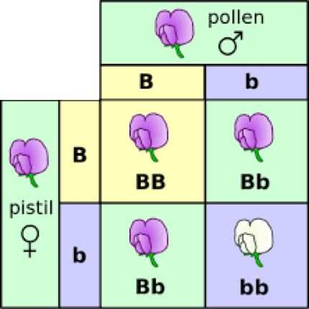
Laws of Inheritance
The Law of Segregation
The Law of Dominance
The Law of Independent Assortment
George Mendel
1865
Rediscovery in 1990
Hugo DeVries
Carl Correns
Erich von Tschermak

Slide 4
Sex chromosome & Linkage
1910
Thomas Hunt Morgan
(Nobel Prize 1933)
Fly Room at Columbia University

Slide 5
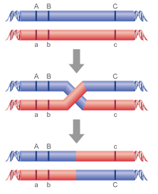
Recombination and genetic map
recombination rate (r): proportion of recombined
r=1%: centi-Morgan

Slide 6
Genetic map
Recombination rate
.5
.5
c
.5
c
.2
a
.4
b
x
b
.2
.4
Genetic distance
0
20cM
6ocM
200cM
a
.5
b
.4
a
.2
c

Slide 7
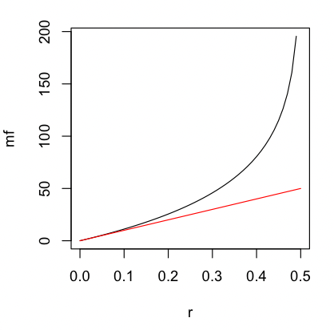
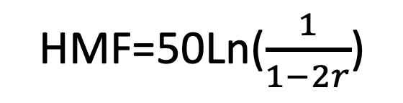
Correction of hidden (double) crossovers
Haldane’s Map Functions
r=seq(0,.5,.01)
mf=-50*(log(1-2*r))
plot(r,mf,type="l")
lines(r,r*100,col="red")
HMF=50Ln($\frac{1}{1−2r}$)
Actual
Genetic distance
(cM)
Observed
recombine
Frequency
(%)
Haldane, J.B.S. 1919, 'The combination of linkage values, and the calculation of distance between the loci of linked factors', Journal of Genetics, vol. 8, pp. 299-309.

Slide 8
Genetic map and Physical Map
Genetic maps are constructed by comparing recombination frequencies between marker pairs (Unit: centi-Morgan)
Physical maps use markers to identify overlapping sequences between larger pieces of DNA (Unit: Base pair).
-By Jamie A O'Rourke
https://doi.org/10.1002/9780470015902.a0000819.pub3
Human: 1 cM corresponds 1 MB on average
Plasmodium falciparum: 1 cM corresponds 15 KB on average
https://en.wikipedia.org/wiki/Centimorgan

Slide 9
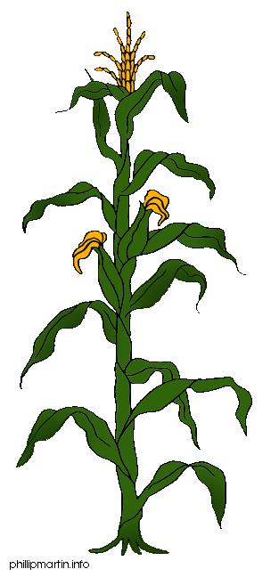
Linkage analysis
Parents
X
F1
F1 gametes
F2 Phenotype
Here lies my QTL
F2 Genotype

Slide 10
Crosses
Breed A
Breed B
M
D
m
d
M
D
m
d
F1
r
M
D
m
d
BCA
F2
M
D
M
D
M
?
M
?
m
?
M
?
m
?
M
?
m
?
m
?

Slide 11
Probability
BCA
M
D
M
D
 | D | d
MM | n1 | n2
Mm | n3 | n4
M
?
m
?
P(?=D | MM)=1-r
P(?=D | Mm)=r
P(?=d | MM)=r
P(?=d | Mm)=1-r
P= r^{(n2+n3)} (1-r)^{(n1+n4)}

Slide 12
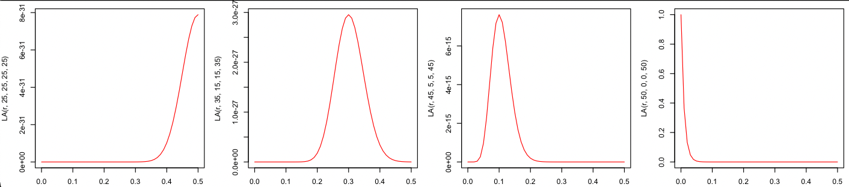
Mapping: vary r to maximize P
P= r^{(n2+n3)} (1-r)^{(n1+n4)}
 | D | d
MM | 25 | 25
Mm | 25 | 25
 | D | d
MM | 35 | 15
Mm | 15 | 35
 | D | d
MM | 45 | 5
Mm | 5 | 45
 | D | d
MM | 50 | 0
Mm | 0 | 50
r=seq(0,.5,.01)
LA=function(r,n1,n2,n3,n4){return(r^(n2+n3)*(1-r)^(n1+n4))}
par(mfrow=c(1,4),mar = c(3,4,1,1))
plot(r,LA(r,25,25,25,25),type="l",col="red")
plot(r,LA(r,35,15,15,35),type="l",col="red")
plot(r,LA(r,45,5,5,45),type="l",col="red")
plot(r,LA(r,50,0,0,50),type="l",col="red")

Slide 13
Multiple markers
M1
M2
M3
M4
Gene
M5
r1
r2
r3
r4
r5
P1
P2
P3
P4
P5
P= P1*P2*P3*P4*P5

Slide 14
Multiple markers
M1
M2
M3
M4
Gene
M5
r1
r2
r3
r4
r5
P1
P2
P3
P4
P5
P= P1*P2*P3*P4*P5

Slide 15
Multiple markers
M1
M2
M3
M4
Gene
M5
r1
r2
r3
r4
r5
P1
P2
P3
P4
P5
P= P1*P2*P3*P4*P5

Slide 16
Multiple genes
M1
M2
Gene
M3
M4
Gene
M5
Population
Single marker to multiple marker
Binary trait to quantitative trait
Single gene to multiple gene
Re-map markers
…

Slide 17
Software for Linkage Analysis
GeneNetwork
HAPPY
MapQTL
Multimapper
MapMaker/QTL
MultiQTL
QTL Café
QTLMap
QTL Cartographer
R/qtlDesign
RQTL

Slide 18
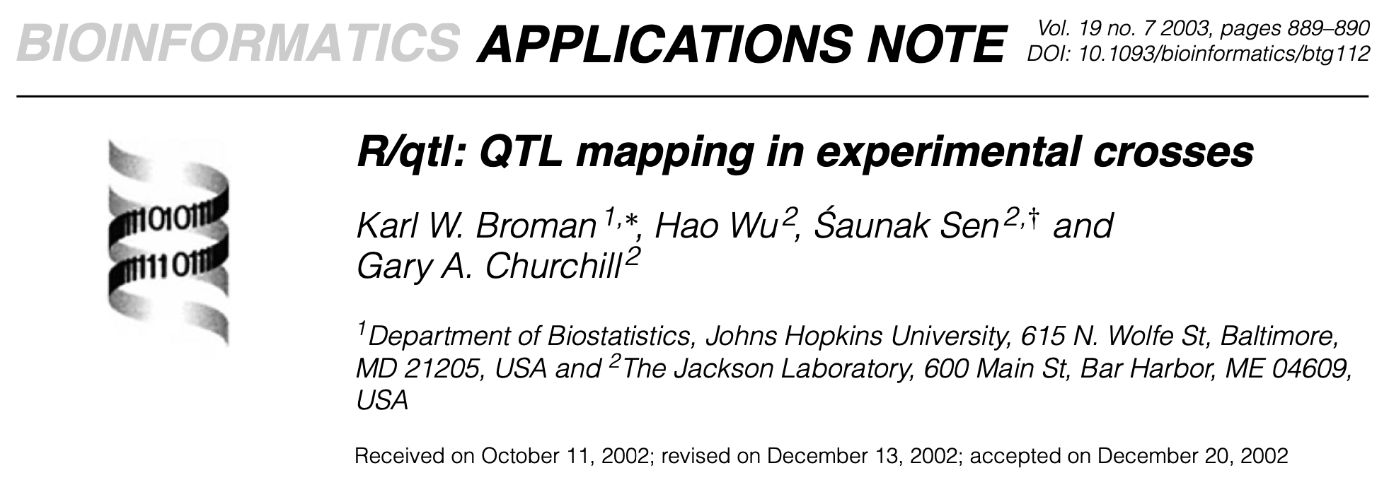
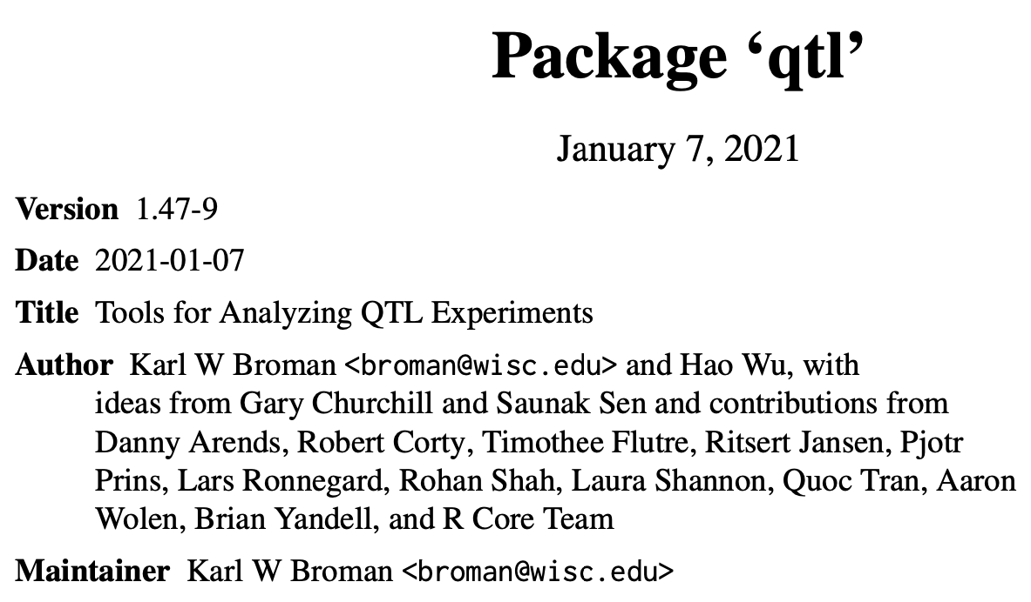
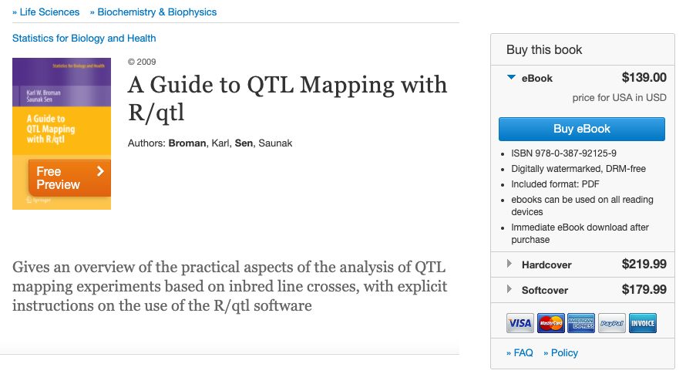
RQTL
2700 citations
https://rqtl.org

Slide 19


Parents
F1
F2 gamete
F2 individuals (10 combinations)
A
A
None crossover
Crossover
A
A
a
a
A
A
a
a
A
a
A
a
A
a
A
a
B
B
b
b
b
b
B
B
B
b
B
B
$$⊗$$
A
A
A
a
a
A
a
a
A
a
B
b
B
b
b
B
B
b
B
B
b
b
b
B
b
B
a
a
Multiple generations/DH
$$⊗$$
b
b
A
a
A
A
a
a
A
a
Recombinant Inbred Lines
(RIL)
B
B
b
b
b
b
B
B

Slide 20
Simulate phenotype
source("http://zzlab.net/GAPIT/GAPIT.library.R")
source("http://www.zzlab.net/GAPIT/gapit_functions.txt")
#Import demo data
myGD=read.table(file="http://zzlab.net/GAPIT/data/mdp_numeric.txt",head=T)
myGM=read.table(file="http://zzlab.net/GAPIT/data/mdp_SNP_information.txt",head=T)
#Simultate 10 QTN on the first half chromosomes
X=myGD[,-1]
index1to5=myGM[,2]<6
X1to5 = X[,index1to5]
taxa=myGD[,1]
set.seed(99164)
GD.candidate=cbind(taxa,X1to5)
mySim=GAPIT.Phenotype.Simulation(GD=GD.candidate,GM=myGM[index1to5,],h2=.75,NQTN=10, effectunit =.95,QTNDist="normal")

Slide 21
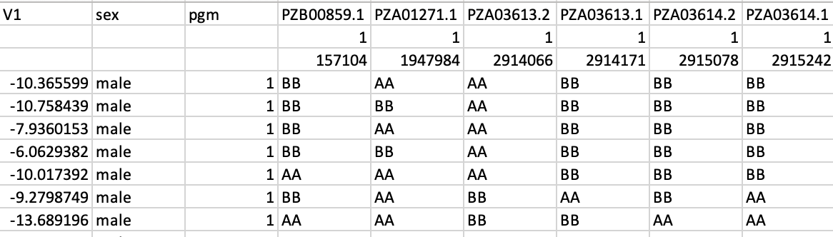
Formatting for RQTL
snp_position <- t(myGM[,2:3])
colnames(snp_position) <- myGM[,1]
rownames(snp_position) <- NULL
myGD_ <- myGD[,-1]
myGD_ <- replace(myGD_, myGD_ == 0, "AA")
myGD_ <- replace(myGD_, myGD_ == 1, "AB")
myGD_ <- replace(myGD_, myGD_ == 2, "BB")
myGD_with_posi <- rbind(snp_position,myGD_)
myY <- cbind(mySim$Y,sex="male", pgm="1")
myY <- myY[,-1]
empty_m <- matrix( ,nrow = 2,ncol = 3)
colnames(empty_m) <- colnames(myY)
myY_ <- rbind(empty_m,myY)
data_all <- cbind(myY_, myGD_with_posi)
write.csv(data_all,file = "R_qtl_data.csv", row.names=FALSE,na = "")

Slide 22
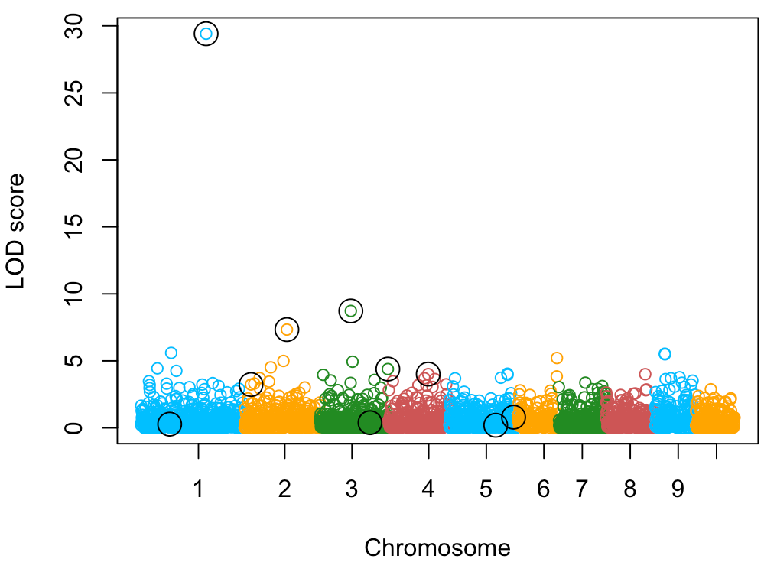
Scan with RQTL and Display
# R/qtl read the data and calculate the LOD
cross <- read.cross("csv", file = "R_qtl_data.csv", genotypes = c("AA","AB","BB"))
out.mr <- scanone(cross, method="mr")
# manhanttan plot
color.vector <- rep(c("deepskyblue","orange","forestgreen","indianred3"),10)
m=nrow(out.mr)
plot(out.mr$lod~seq(1:m),col=color.vector[myGM[,2]], xlab="Chromosome", ylab = "LOD score",xaxt="n")
axis(1, at=c(300,750,1100, 1500, 1800, 2100, 2300, 2550,2800,3000), labels=c(1:10))
symbols(x=mySim$QTN.position, out.mr$lod[mySim$QTN.position],circles=rep(1,10), add=T, inches=0.08)

Slide 23
Outline
Linkage
Recombination
Haldan’s map function
Linkage analysis
Software and RQTL

