Slide 1


Statistical Genomics
Lecture 21: BLINK
Zhiwu Zhang
Washington State University

Slide 2
Outline
Bin problem
Computing demand of FarmCPU
BLINK method and software

Slide 3
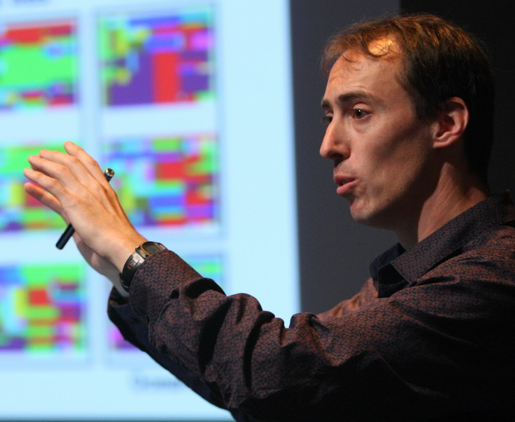

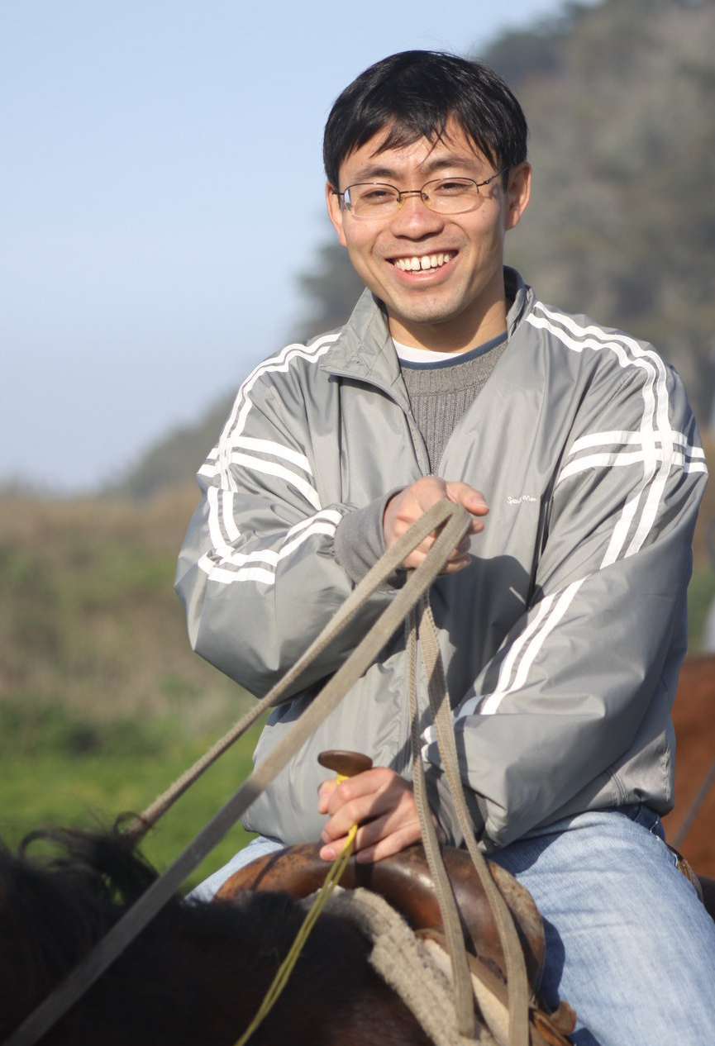

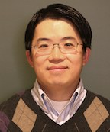

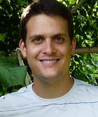

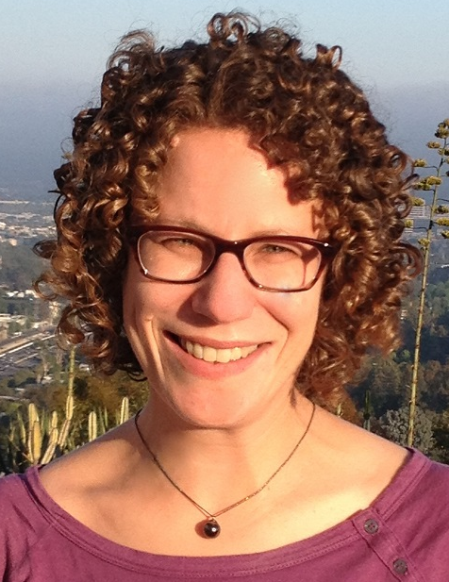
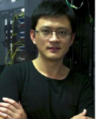
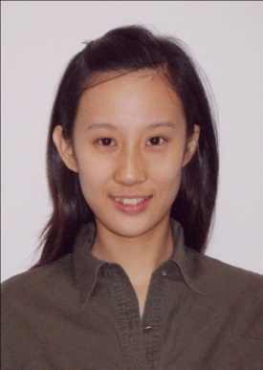

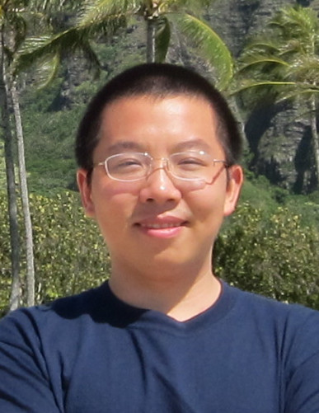



Q
EMMA
PC+K
PC
EMMAx
Q+K
GWAS Stream
MLMM
CMLM
P3D
SELECT
GCTA
ECMLM
FST-LMM
GEMMA
FarmCPU
GenAbel
BLINK

Slide 4
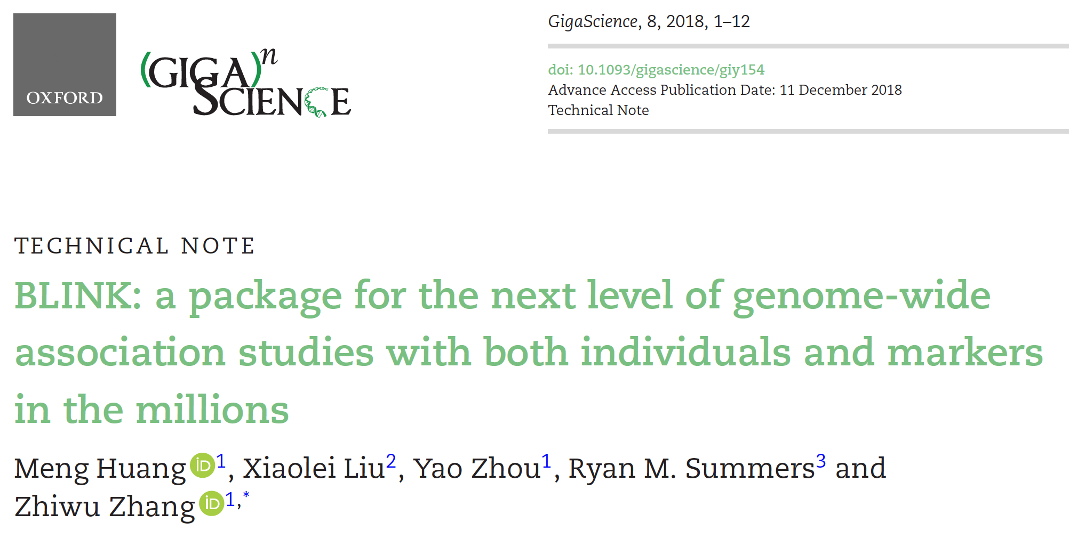

Slide 5
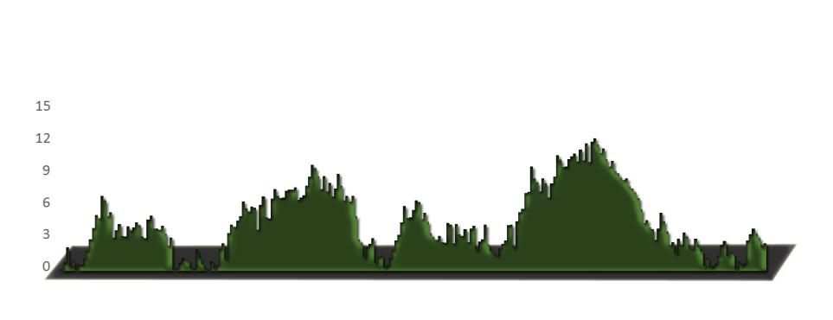
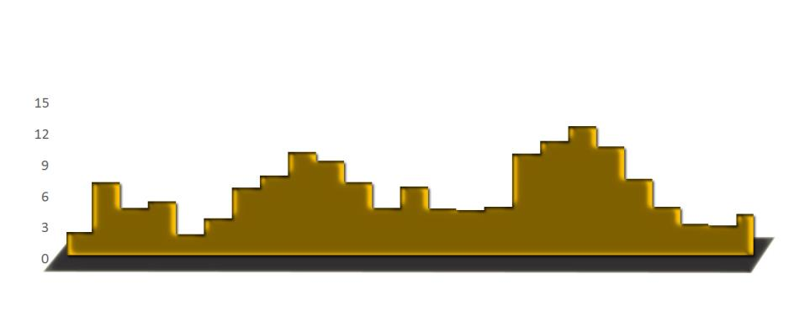
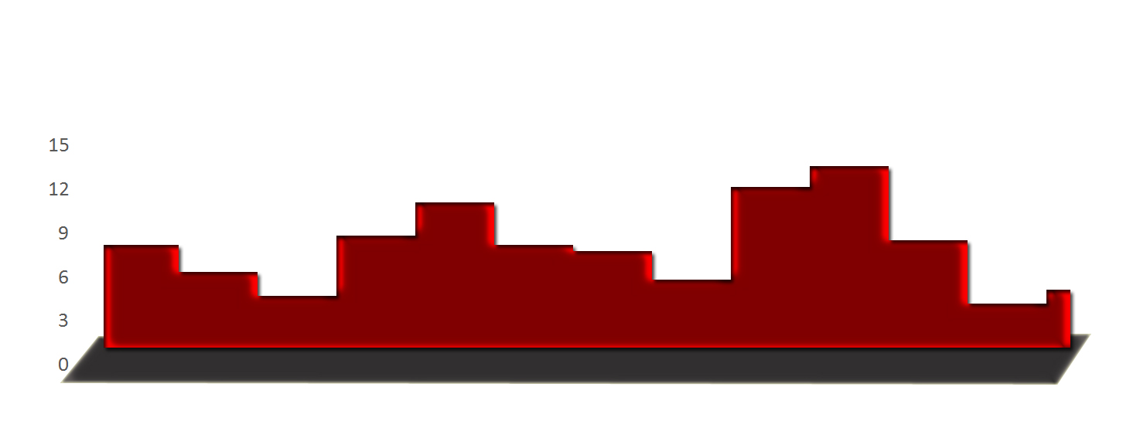
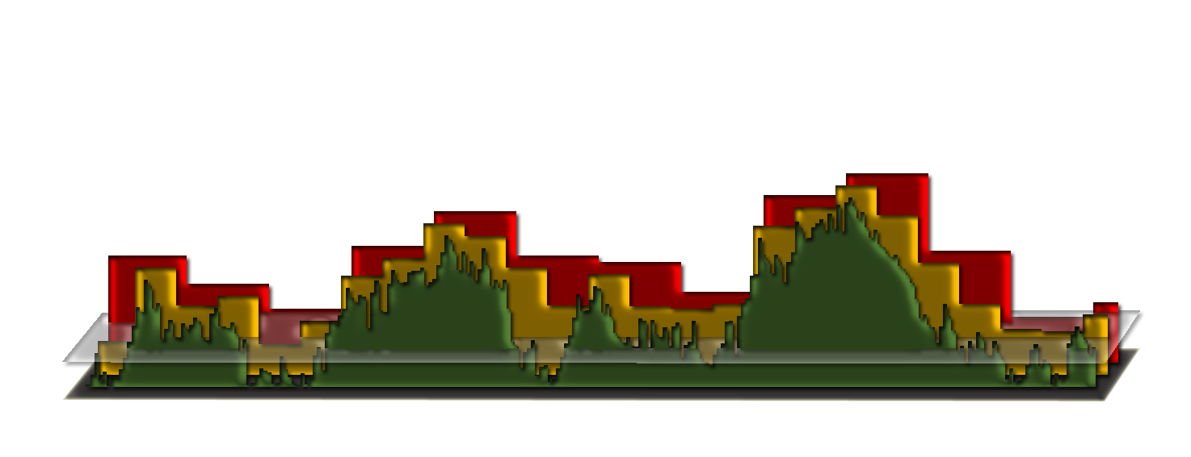
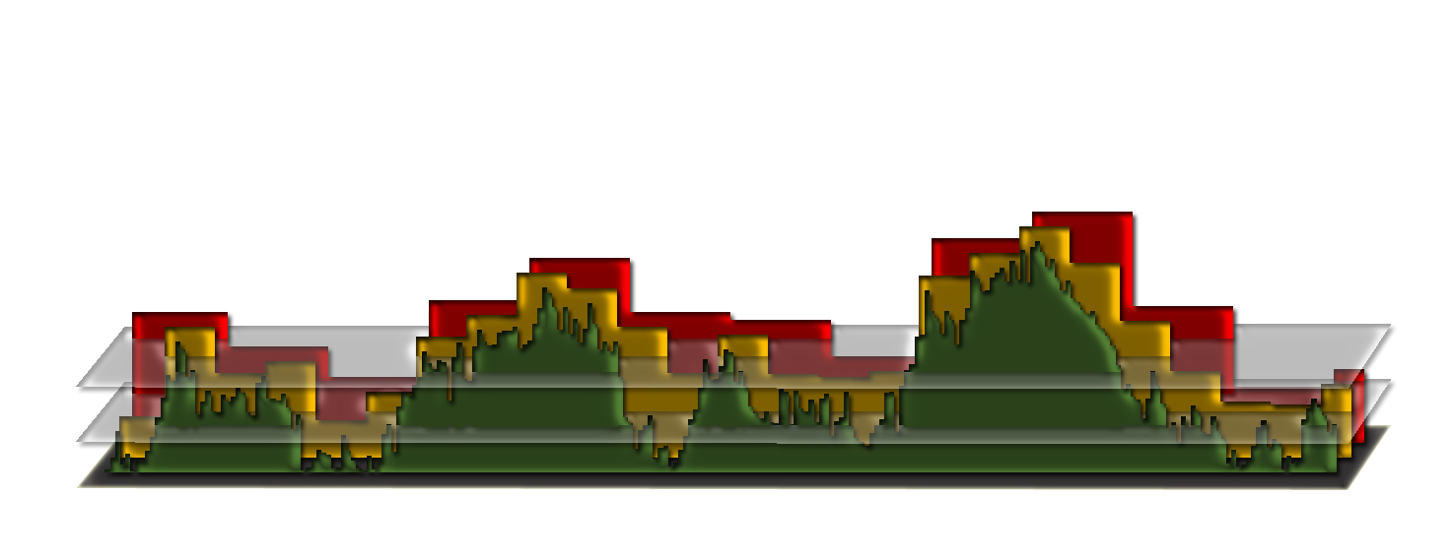
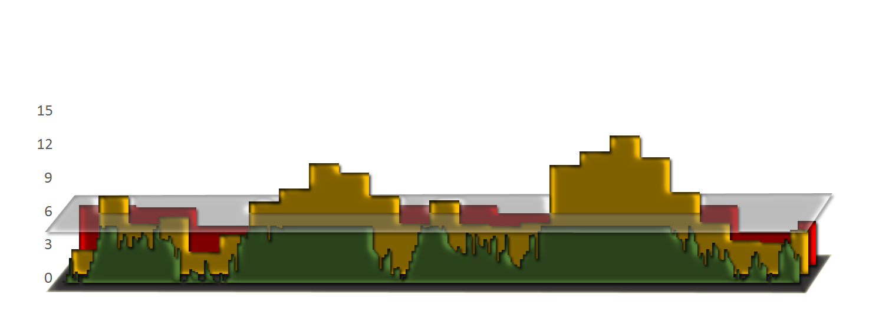
Bin approach

Slide 6
Challenges of bin method
False
(bin too small)
Missing
(bin too big)
LD
clustered

Slide 7
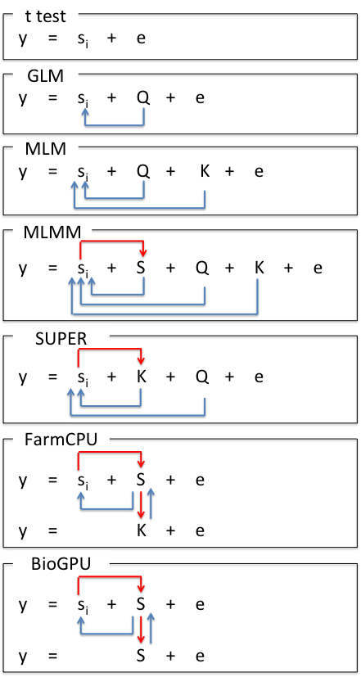
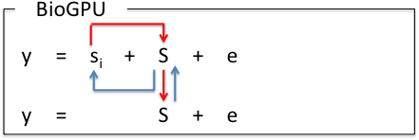
Model Development
S_{i}: Testing marker
Adjustment on marker
Q: Population structure
K: Kinship
Adjustment on covariates
S: Pseudo QTNs
BLINK

Slide 8
GWAS methods
Known M
M
K method
t test
m₁+…+m_{l}
m_{i}
Random effect
Fixed effect
K+ m_{i}
Q + m_{i}
Q method
K method
M + m_{i}
FarmCPU and BLINK
m: marker, M: Mutations, M: Estimated mutations

Slide 9
GWAS methods
FarmCPU and BLINK
M + m_{i}
Bayes
t test
m₁+…+m_{l}
m_{i}
M
Fixed effect
Random effect
K+ m_{i}
Q + m_{i}
Q method
K method
Q + K + m_{i}
Q+K
m: marker, M: Mutations, M: Estimated mutations

Slide 10
SUPER algorithm
Fixed model
y = PC + SNP + e
Complementary
-2LL
QTNs
y = PC + Kinship + SNP + e
Random model
y = PC + Kinship + e
Random model
Bins

Slide 11
FarmCPU algorithm
Fixed model
y = PC + SNP + e
-2LL
QTNs
y = PC + QTNs + SNP + e
Fixed model
y = PC + Kinship + e
Random model
Bins

Slide 12
BLINK algorithm
Fixed model
y = PC + SNP + e
BIC
LD
QTNs
y = PC + QTNs + SNP + e
Fixed model
y = PC + QTNs + e
Fixed model

Slide 13




Remove SNPs in LD
S₁*
S₂
… |  | S₂*
… |  | … |  | S₃*
… |  | … |  | … |  | S_{t}*
… |  | …
S_{m}
…
S_{M}
r(S₁*, S_{i}) <$β$
r(S₂*, S_{i}) <$β$
r(S₃*, S_{i}) <$β$
P_{m}<$α$

Slide 14
Bayesian information criterion
BIC = -2LL + k Ln(n)
k
t

Slide 15
Bayesian information criterion
BIC=-2LL+k Ln(n)
y = s_{i} + S₁* + S₂ * + S₃ * + … + S_{k} * + e, where i = 1 to M
1
k
t
y = S₁* + S₂ * + S₃ * + … + S_{k} * + e, where k maximizes BIC

Slide 16
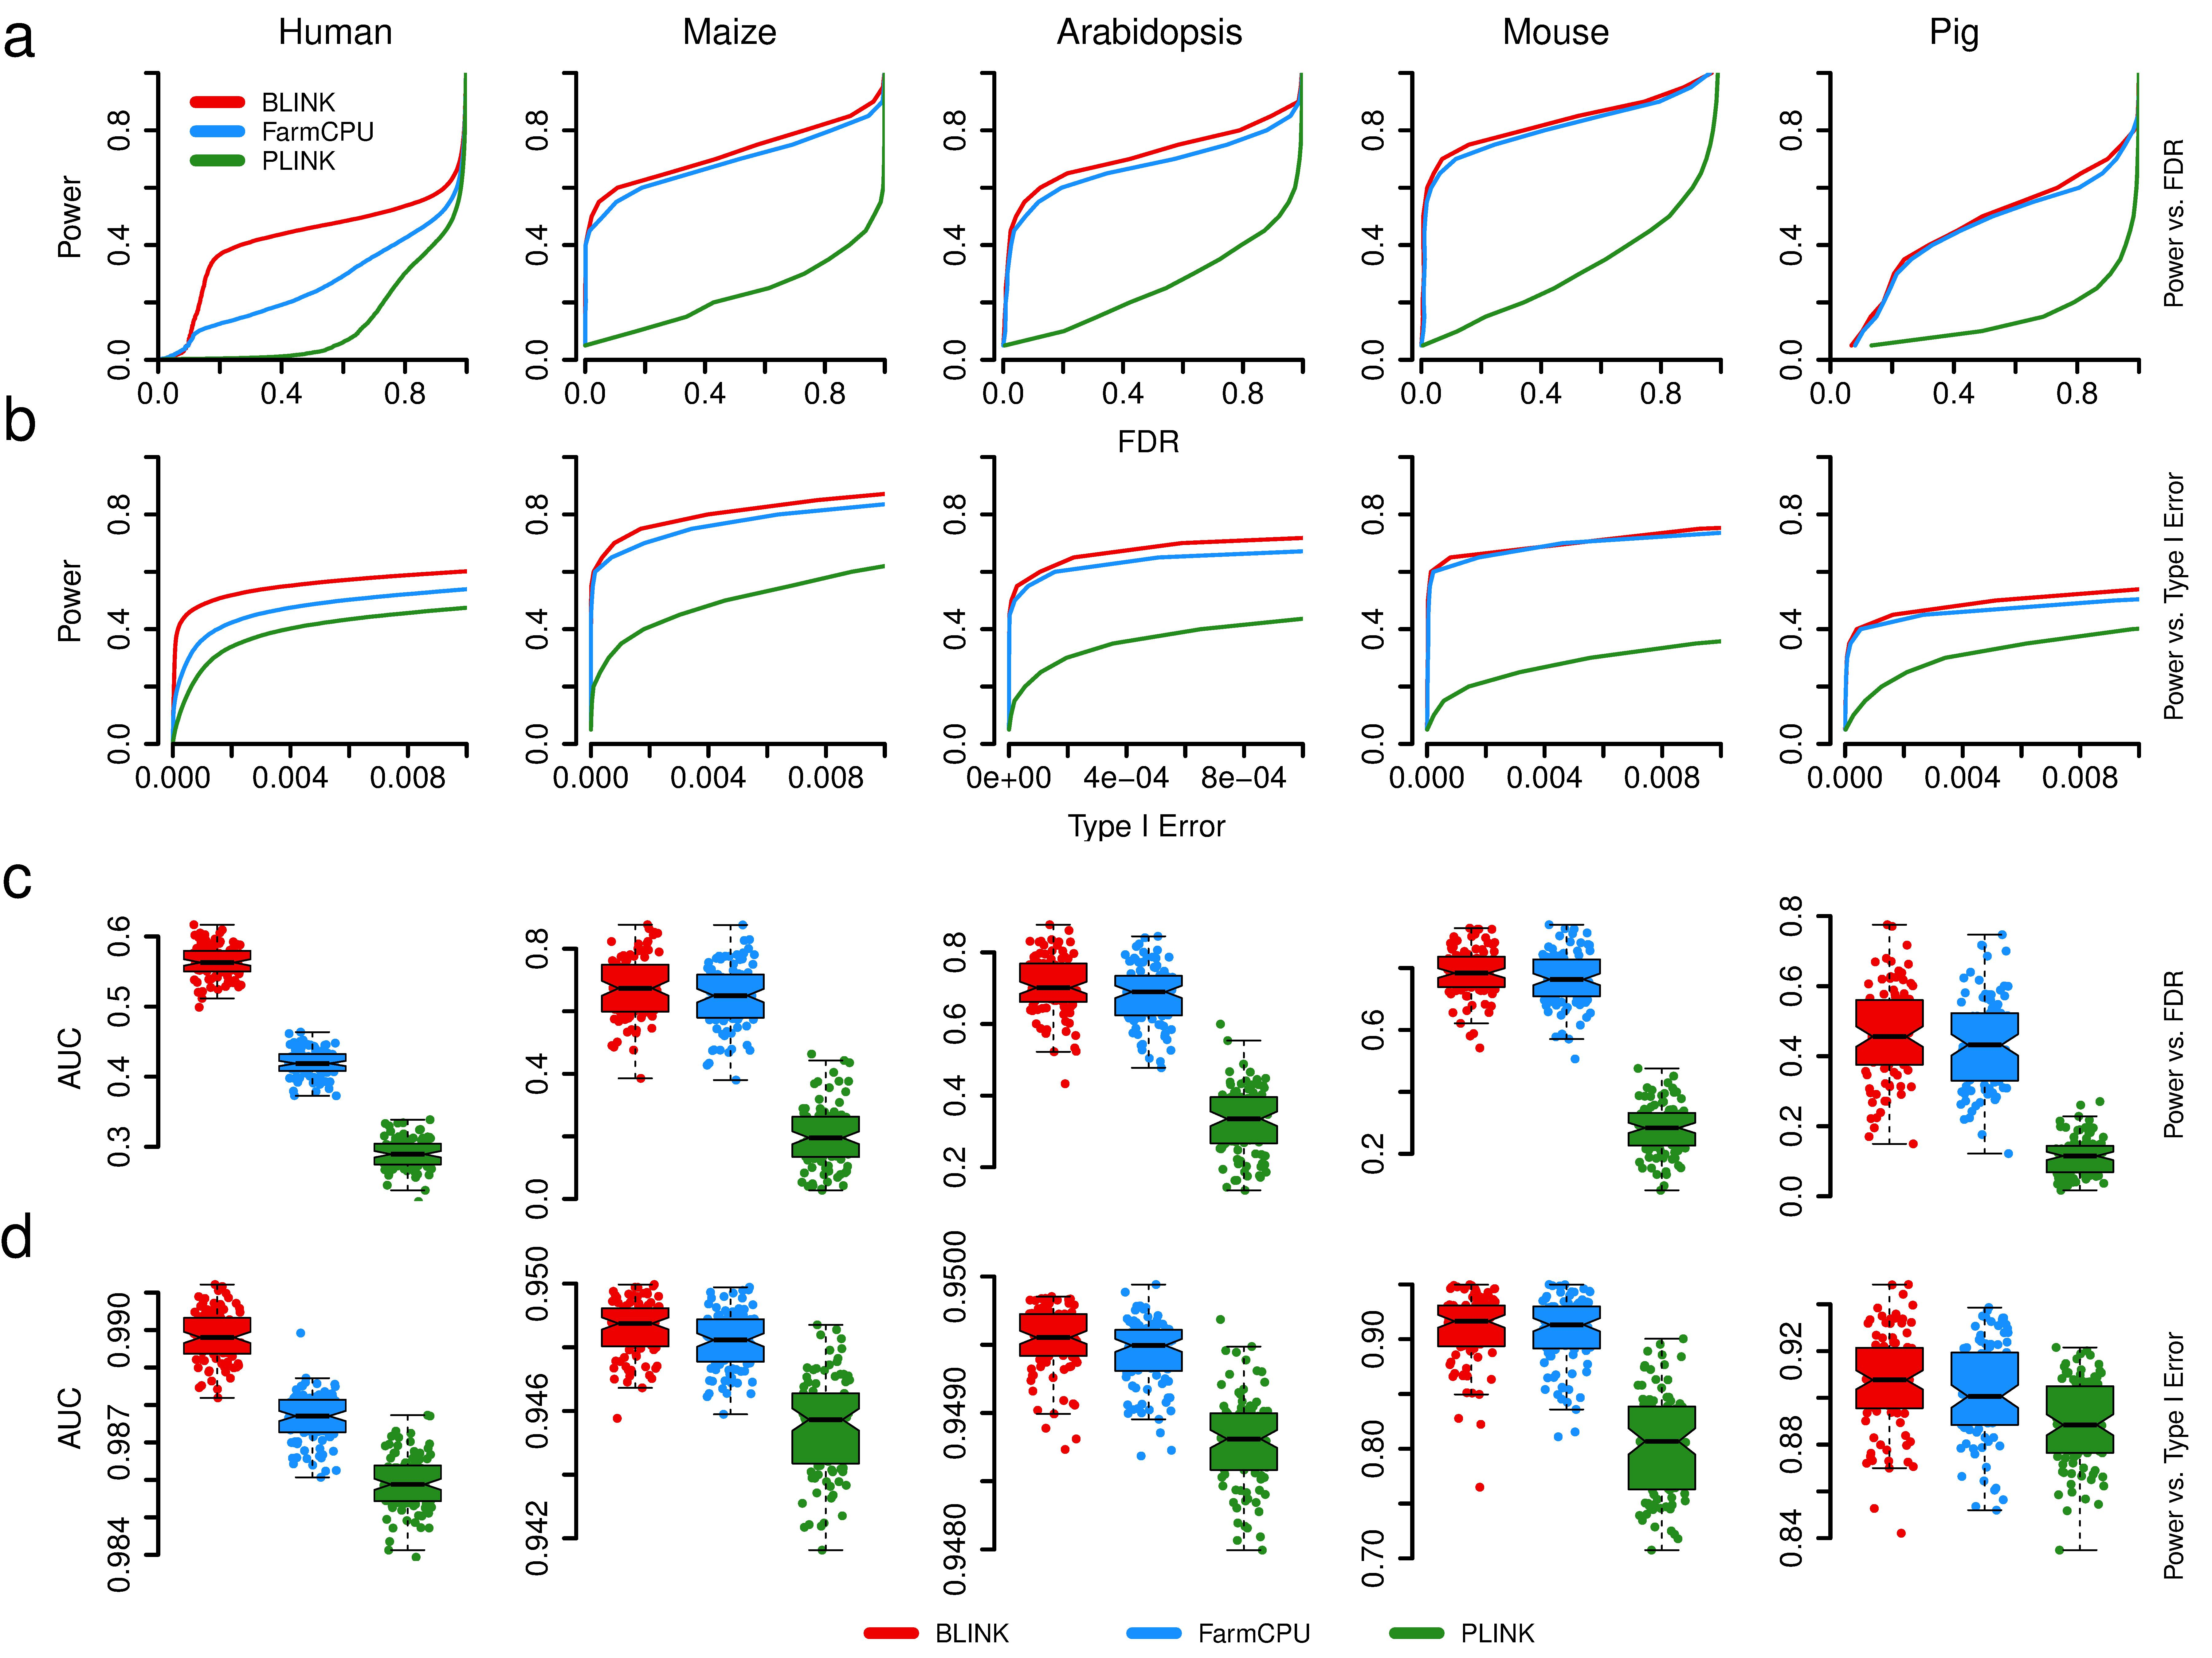
Simulation study with human data
FDR
Type I error

Slide 17
Same trend across species

Slide 18
Area under curve

Slide 19
Application in Maize

Slide 20
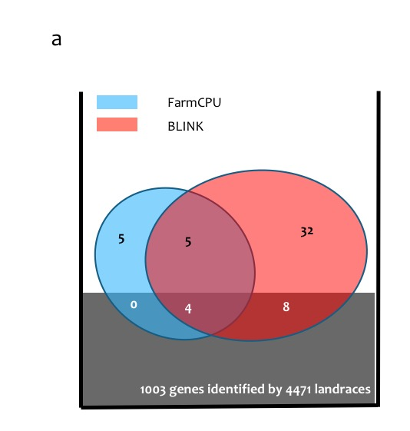
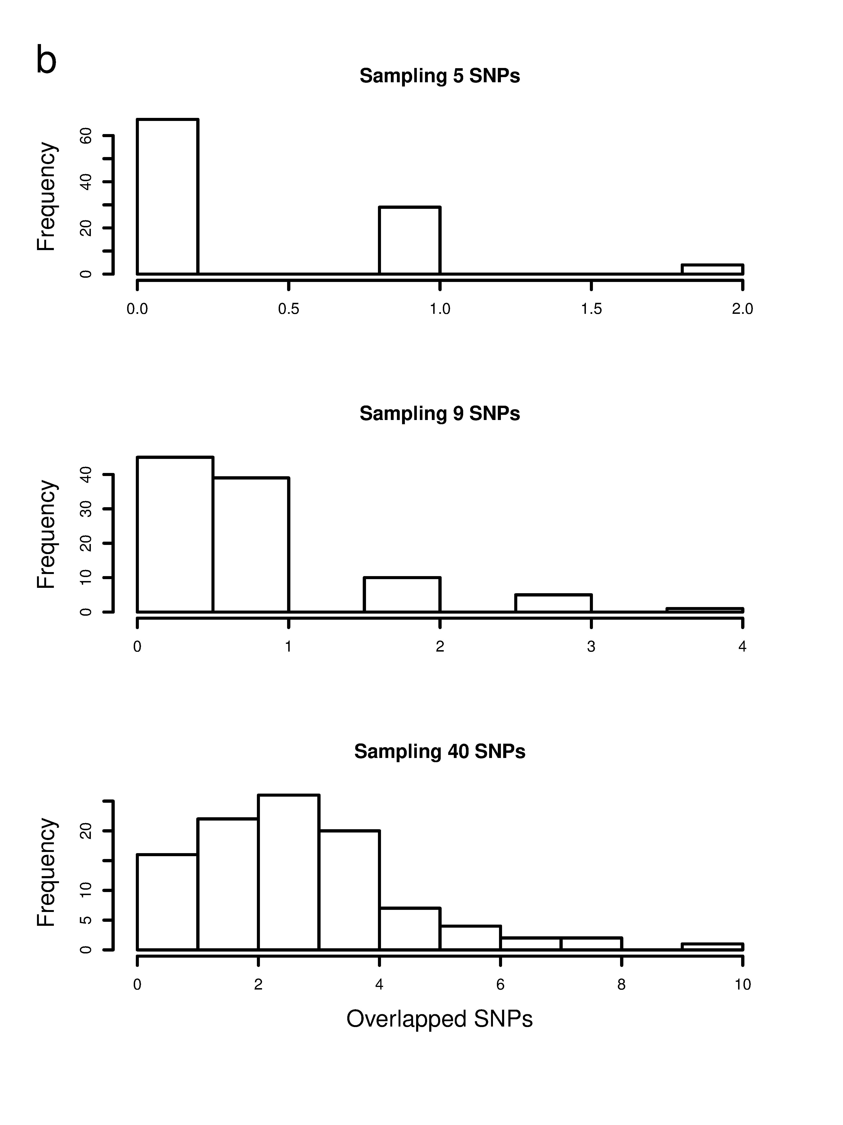
Enrichment
FarmCPU
only
<1%
Common
<3%
BLINK
only

Slide 21
http://zzlab.net/GAPIT/data/Workshop_Iowa.R
BLINK
FarmCPU
GAPIT
PLINK

Slide 22


Slide 23
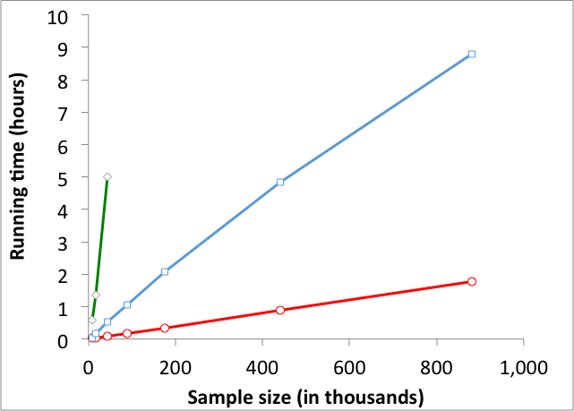
BLINK solves problems of millions of markers and individuals
Testing half million SNPs
PLINK
FarmCPU
BLINK
BLINK is 5X > PLINK, 200X > FarmCPU

Slide 24
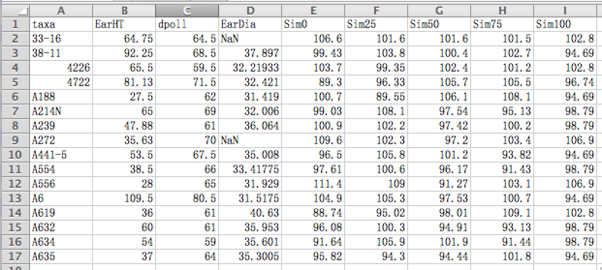
Format of phenotype data

Slide 25
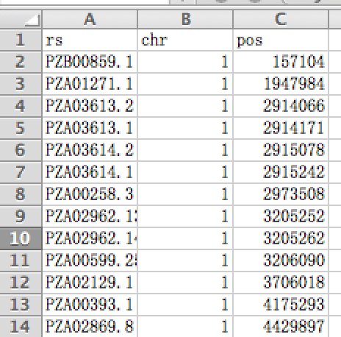
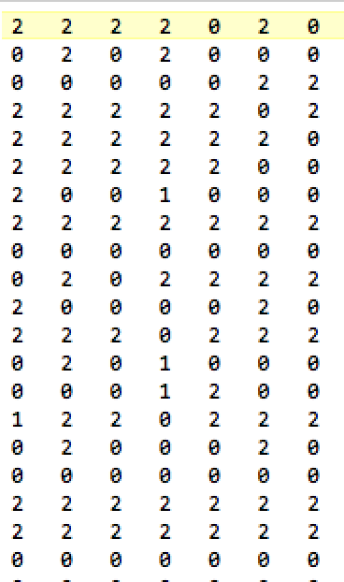
Numeric format
Individuals
SNPs
Genotype map
Genotype data

Slide 26





Accept five formats of genotype data

Slide 27
Transform of genotype data by BLINK
Numeric
VCF
BLINK
PLINK
HapMap

Slide 28
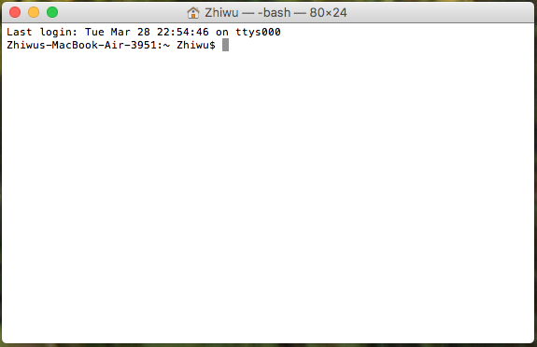
Run BLINK from command line
cd /Users/Zhiwu/Desktop/temp/demo_data/numeric
/Users/Zhiwu/Desktop/temp/blink --file myData --numeric --gwas --out myResult

Slide 29
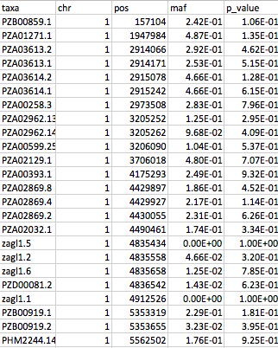
Output

Slide 30





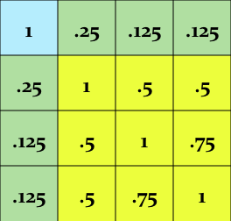
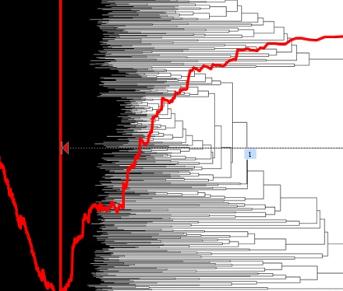


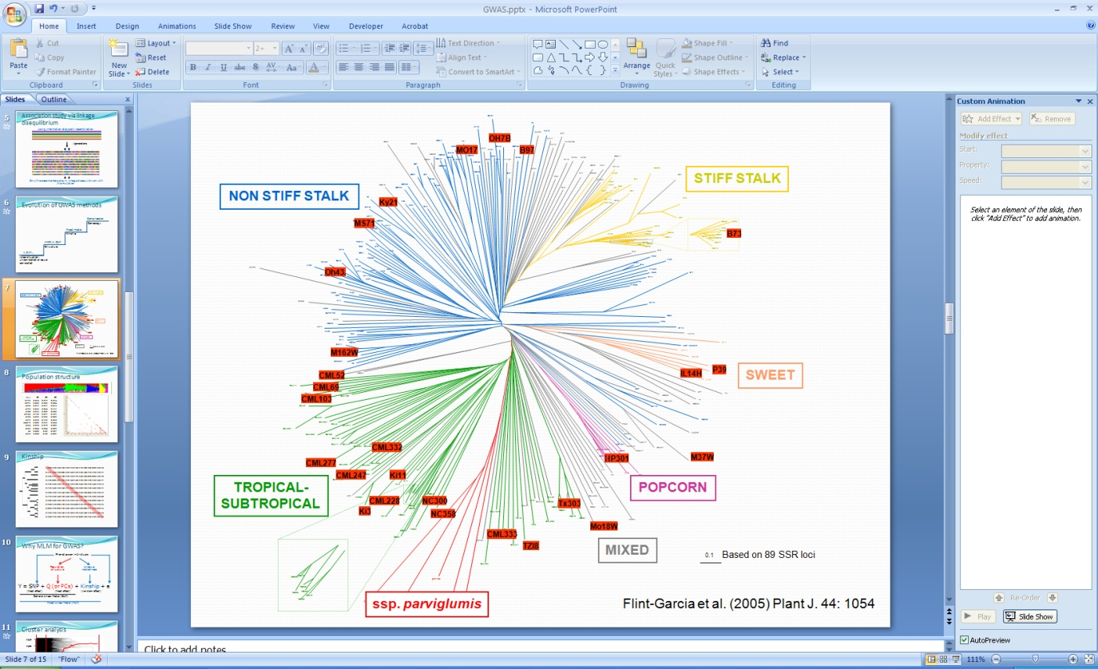
GAPIT
TASSEL
GAPIT
ECMLM
EMMA, EMMAx,
GCAT, GenABEL
CMLM
Structure, Eigenstrate
PLINK
MLM
GLM
t, F, X²…
iPat
Uncorrelated or
equally correlated

Slide 31
Import GAPIT/data and simulation
library(compiler) #required for cmpfun
source("http://www.zzlab.net/GAPIT/gapit_functions.txt")
#Import demo data
myGD=read.table(file="http://zzlab.net/GAPIT/data/mdp_numeric.txt",head=T)
myGM=read.table(file="http://zzlab.net/GAPIT/data/mdp_SNP_information.txt",head=T)
#Simultate 10 QTN on the first half chromosomes
X=myGD[,-1]
index1to5=myGM[,2]<6
X1to5 = X[,index1to5]
taxa=myGD[,1]
set.seed(99164)
GD.candidate=cbind(taxa,X1to5)
mySim=GAPIT.Phenotype.Simulation(GD=GD.candidate,GM=myGM[index1to5,],h2=.5,NQTN=10, effectunit =.95,QTNDist="normal")
setwd("~/Desktop/temp")

Slide 32
BLINK
myY=mySim$Y
colnames(myY)=c("taxa", "SimPheno")
setwd("~/Desktop/temp")
myGD1=t(myGD[,-1])
write.table(myY,file="myData.txt",quote=F,row.name=F,col.name=T,sep="\t")
write.table(myGD1,file="myData.dat",quote=F,row.name=F,col.name=F,sep="\t")
write.table(myGM,file="myData.map",quote=F,row.name=F,col.name=T,sep="\t")
#run blink
system("~/Desktop/temp/blink_mac --file myData --max_loop 10 --numeric --gwas")
#Extract p values
result<- read.table("SimPheno_GWAS_result.txt", head = TRUE)
myP=as.numeric(result[,5])
myGI.MP=cbind(myGM[,-1],myP)
GAPIT.Manhattan(GI.MP=myGI.MP,seqQTN=mySim$QTN.position)
GAPIT.QQ(myP)

Slide 33
BLINK
myGAPIT_MLM <- GAPIT(
Y=mySim$Y,
GD=myGD,#Genotype
GM=myGM,#Map information
PCA.total=3,
QTN.position=mySim$QTN.position,
model="Blink",# Can choose MLM CMLM GLM SUPER MLMM FarmCPU Blink
file.output=T
)

Slide 34
Outline
Bin problem
Computing demand of FarmCPU
BLINK method and software

