Slide 1


Statistical Genomics
Lecture 24: gBLUP
Zhiwu Zhang
Washington State University

Slide 2
Highlight
MAS by GAPIT
Method development
gBLUP
Prediction of individuals without phenotypes

Slide 3
MAS by GAPIT
Setup GAPIT
Import data
Simulate phenotype
Validation

Slide 4
mdp_env.txt
Taxa | SS | NSS | Tropical | Early | Block
33-16 | 0.014 | 0.972 | 0.014 | 0 | 0
38-11 | 0.003 | 0.993 | 0.004 | 0 | 1
4226 | 0.071 | 0.917 | 0.012 | 0 | 0
4722 | 0.035 | 0.854 | 0.111 | 0 | 1
A188 | 0.013 | 0.982 | 0.005 | 0 | 1
A214N | 0.762 | 0.017 | 0.221 | 0 | 0
A239 | 0.035 | 0.963 | 0.002 | 0 | 1
A272 | 0.019 | 0.122 | 0.859 | 1 | 0
A441-5 | 0.005 | 0.531 | 0.464 | 0 | 1
A554 | 0.019 | 0.979 | 0.002 | 0 | 0
A556 | 0.004 | 0.994 | 0.002 | 0 | 1
A6 | 0.003 | 0.03 | 0.967 | 1 | 0
A619 | 0.009 | 0.99 | 0.001 | 0 | 0
A632 | 0.993 | 0.004 | 0.003 | 0 | 0

Slide 5
Import data and simulate phenotype
library(compiler) #required for cmpfun
source("http://www.zzlab.net/GAPIT/gapit_functions.txt")
myGD=read.table(file="http://zzlab.net/GAPIT/data/mdp_numeric.txt",head=T)
myGM=read.table(file="http://zzlab.net/GAPIT/data/mdp_SNP_information.txt",head=T)
myCV=read.table(file="http://zzlab.net/GAPIT/data/mdp_env.txt",head=T)
#Simultate 10 QTN on the first half chromosomes
X=myGD[,-1]
index1to5=myGM[,2]<6
X1to5 = X[,index1to5]
taxa=myGD[,1]
GD.candidate=cbind(taxa,X1to5)
nqtn=50
set.seed(99164)
setwd("~/Desktop/temp")
mySim=GAPIT.Phenotype.Simulation(GD=GD.candidate,GM=myGM[index1to5,],h2=.5,NQTN=nqtn, effectunit =.95,QTNDist="normal",CV=myCV,cveff=c(.01,.01))

Slide 6
GWAS
myGAPIT <- GAPIT(Y=mySim$Y,GD=myGD,GM=myGM, PCA.total=3,CV=myCV,model="GLM",QTN.position=mySim$QTN.position,memo="GLM",)

Slide 7
Prediction with PC and ENV
order=match(mySim$Y[,1],myGAPIT$Pred[,1])
myPred=myGAPIT$Pred[order,]
ry2=cor(myPred[,8],mySim$Y[,2])^2
ru2=cor(myPred[,8],mySim$u)^2
par(mfrow=c(2,1), mar = c(3,4,1,1))
plot(myPred[,8],mySim$Y[,2])
mtext(paste("R square=",ry2,sep=""), side = 3)
plot(myPred[,8],mySim$u)
mtext(paste("R square=",ru2,sep=""), side = 3)

Slide 8
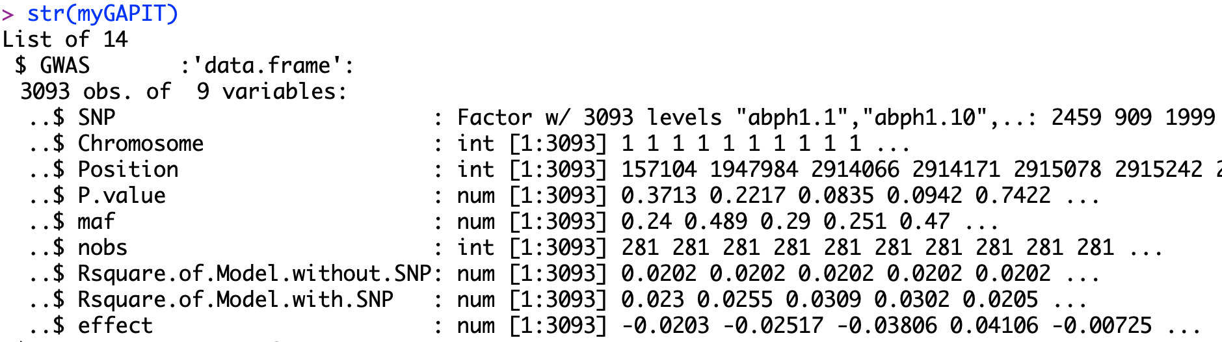
Choose top five SNPs
ntop= nqtn*2
index=order(myGAPIT$GWAS[,4])
top=index[1:ntop]
myQTN=cbind(myGAPIT$PCA[,1:4], myCV[,2:3],myGD[,c(top+1)])
#4

Slide 9
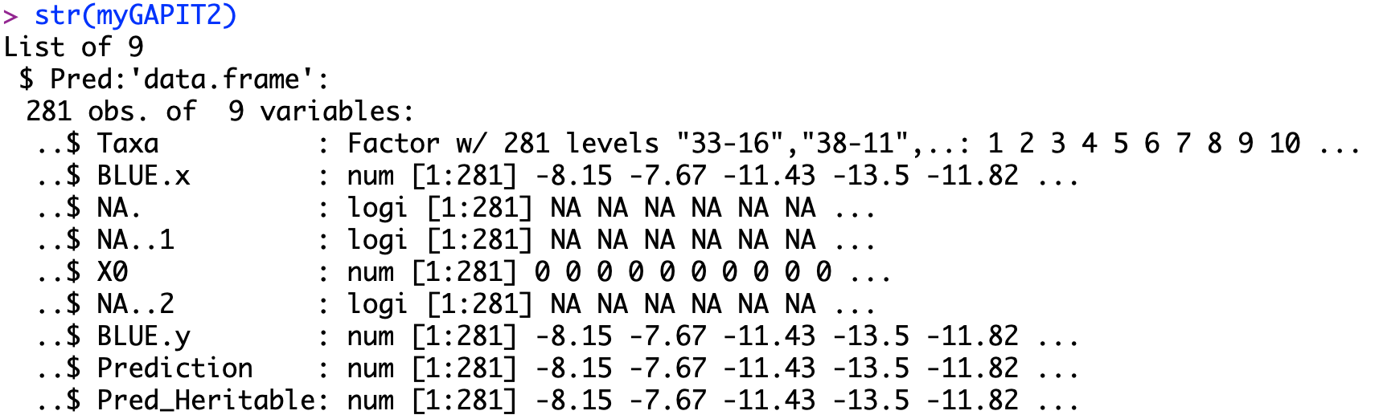
Estimate effects and prediction
myGAPIT2 <- GAPIT(
Y=mySim$Y,GD=myGD,GM=myGM,
CV=myQTN,model="GLM",
QTN.position=mySim$QTN.position,
SNP.test=FALSE,memo="GLM+QTN",)
order=match(mySim$Y[,1],myGAPIT2$Pred[,1])
myPred=myGAPIT2$Pred[order,]
ry2=cor(myPred[,8],mySim$Y[,2])^2
ru2=cor(myPred[,8],mySim$u)^2
par(mfrow=c(2,1), mar = c(3,4,1,1))
plot(myPred[,8],mySim$Y[,2])
mtext(paste("R square=",ry2,sep=""), side = 3)
plot(myPred[,8],mySim$u)
mtext(paste("R square=",ru2,sep=""), side = 3)
#8

Slide 10
Validation by Dividing into training and testing
#Cross validation
set.seed(99164)
n=nrow(mySim$Y)
testing=sample(n,round(n/5),replace=F)
training=-testing
#GWAS on training to find QTNs
myGAPIT3 <- GAPIT(
Y=mySim$Y[training,],
GD=myGD,GM=myGM,CV=myCV,
PCA.total=3,model="GLM",
memo="GWAS",)

Slide 11
Estimate QTN effects in training
ntop= nqtn*2
index=order(myGAPIT3$GWAS[,4])
top=index[1:ntop]
myQTN=cbind(myGAPIT$PCA[,1:4], myCV[,2:3],myGD[,c(top+1)])
PC
ENV
QTN
#Estimate effect and prediction
myGAPIT4 <- GAPIT(
Y=mySim$Y[training,],
GD=myGD,GM=myGM,
CV=myQTN,model="GLM",
SNP.test=FALSE,
memo="GLM+QTN",)

Slide 12
Model fit in training
order=match(mySim$Y[,1],myGAPIT4$Pred[,1])
myPred=myGAPIT4$Pred[order,]
ry2=cor(myPred[training,8],mySim$Y[training,2])^2
ru2=cor(myPred[training,8],mySim$u[training])^2
par(mfrow=c(2,1), mar = c(3,4,1,1))
plot(myPred[training,8],mySim$Y[training,2])
mtext(paste("R square=",ry2,sep=""), side = 3)
plot(myPred[training,8],mySim$u[training])
mtext(paste("R square=",ru2,sep=""), side = 3)

Slide 13
Accuracy in testing
order=match(mySim$Y[,1],myGAPIT4$Pred[,1])
myPred=myGAPIT4$Pred[order,]
ry2=cor(myPred[testing,8],mySim$Y[testing,2])^2
ru2=cor(myPred[testing,8],mySim$u[testing])^2
par(mfrow=c(2,1), mar = c(3,4,1,1))
plot(myPred[testing,8],mySim$Y[testing,2])
mtext(paste("R square=",ry2,sep=""), side = 3)
plot(myPred[testing,8],mySim$u[testing])
mtext(paste("R square=",ru2,sep=""), side = 3)
Why so good?
Only 2 QTNs

Slide 14
2 QTNs
MAS works for Mendelian traits, not polygenic traits
10 QTNs
20 QTNs
50 QTNs

Slide 15


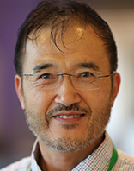
RFLP kinship in maize
Crop Science
1994
MAS
Use of Marker Based Relationships with MTDFREML
J. Animal Sci., 2007
R. Bernardo
D. Van Vleck
Efficient kinship
J. Dairy Science
2008
Prediction of total genetic value using genome wide dense marker maps
Genetics, 2001
P. VanRaden
gBLUP
Bayes A, B, Cpi, …
T. Meuwissen
B. Hayes
M. Goddard
I. Misztal
ssBLUP
Pedigree & Marker kinship
single step
GES, 2011
sBLUP
cBLUP
Super and compression
Heredity
2018
Z. Zhang
Genomic prediction

Slide 16
gBLUP
Prediction of maize single-cross performance using RFLPs and information related hybrids
Rex Bernardo
Crop Science, 1994
Y_{M} = C V⁻¹ Y_{p}
y_{M} = m × 1 vector of predicted yields of missing single crosses;
C = m × n matrix of genetic covariances between the missing and predictor hybrids;
V = n × n matrix of phenotypic variances and covariances among predictor hybrids;
y_{P} = nn × 1 vector of predictor hybrid yields corrected for trial effects.

Slide 17
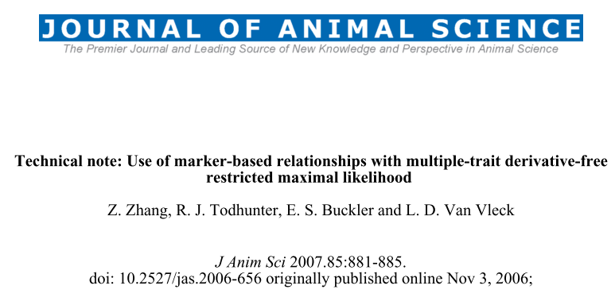

gBLUP reinvent

Slide 18
Multiple Trait Derivative Free REML (MTDFREML)
Welcome to the Multiple Trait Derivative Free REML (MTDFREML) home page. The programs were developed by Keith Boldman and Dale Van Vleck. Evolutionary development and debugging support have also been provided by by Lisa Kriese and Curt Van Tassell.
Please contact Curt Van Tassell (e-mail curtvt@aipl.arsusda.gov) or Dale Van Vleck. (e-mail lvanvleck@unlnotes.unl.edu) with any problems with the programs or discovered bugs.
Obtaining the MTDFREML programs
Get the manual
Sample analyses
Enter user information using web browser that handles forms
FTP the userinfo.txt file to enter user information (then mail completed form)
Get the Microsoft Powerstation fix for Windows 95 (compressed)
Get the Microsoft 5.1 fix for insufficient file handles (compressed)

Slide 19
Marker based kinship in MTDFREML
Pedigree
Marker
MTDF-NRM
MTDF-ARM
Arbitrary
Relationship
Matrix
kinship
MTDF-PREP
Equations
MTDF-RUN
BLUP and variance
Zhang et al., J. Anim Sci., 2007

Slide 20
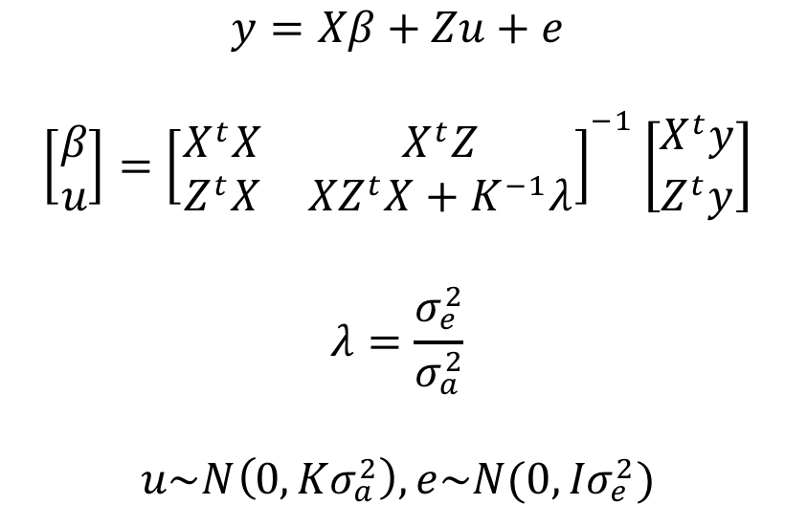
Mixed Linear Model (MLM)

Slide 21
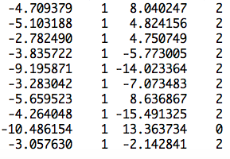
Z matrix
observation
mean
PC2
SNP
Ind1 | Ind2 | … | Ind9 | Ind10
u1 | u2 | … | u9 | u10
1 | 0 | … | 0 | 0
0 | 1 | … | 0 | 0
0 | 0 | … | 1 | 0
0 | 0 | … | 0 | 1
u=
]
[
]
[
b=
b0
b1
b2
y
1
x1
x2
=X
Z
[
]
y = Xb + Zu +e

Slide 22
Generic Z matrix
Ind1 | Ind2 | … | Ind9 | Ind10
u1 | u2 | … | u9 | u10
1 | 0 | … | 0 | 0
0 | 1 | … | 0 | 0
0 | 0 | … | 1 | 0
0 | 0 | … | 0 | 1
Ind11 | Ind12 | … | Ind19 | Ind20
u11 | u12 | … | u19 | u20
0 | 0 | … | 0 | 0
0 | 0 | … | 0 | 0
0 | 0 | … | 0 | 0
0 | 0 | … | 0 | 0
u=
]
[
]
Z_{R}
Z_{I}

Slide 23

Efficient kinship algorithm
M: n individual by m SNPs
M: -1, 0 and 1
Pi: frequency of 2nd allele for SNP i
P: Column of i is 2(pi-.5)
Z=M-P
J. Dairy Sci. 2008. 91 (11) 4414-4423. Efficient Methods to Compute Genomic Predictions P. M. VanRaden
MM^{t}, Efficient
gBLUP=Ridge Regression
Paul VanRaden: Image Number K7168-6

Slide 24
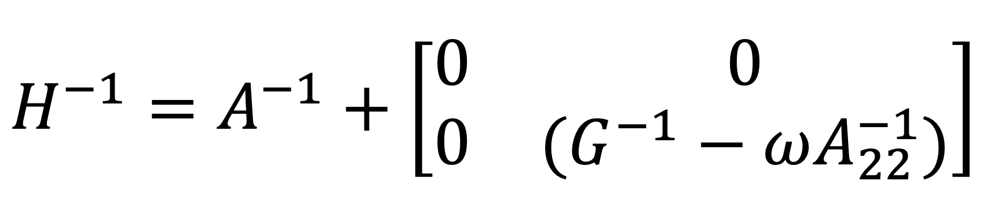
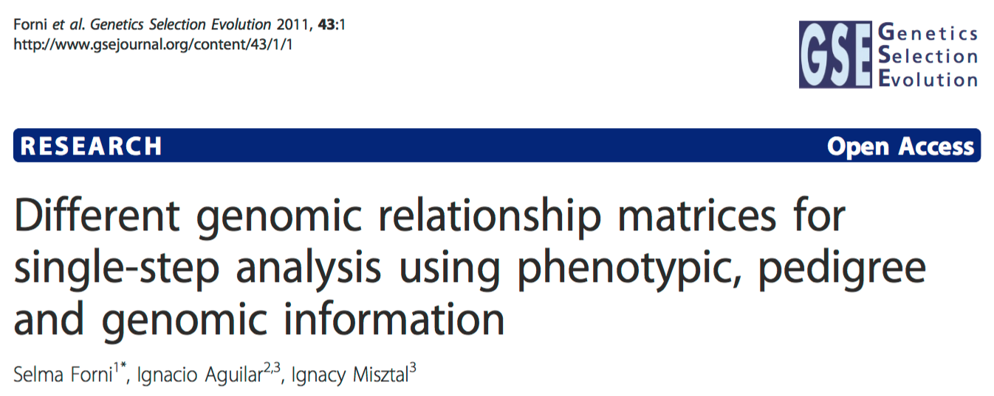
Pedigree + Marker
Non genotyped
Pedigree kinship of non genotyped
Pedigree kinship
Marker kinship
Arbitrary weight

Slide 25
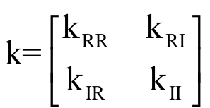
Henderson's formula

Slide 26
gBLUP by GAPIT
myGAPIT5 <- GAPIT(
Y=mySim$Y[training,],
GD=myGD,
GM=myGM,
PCA.total=3,
CV=myCV,
model="gBLUP",
SNP.test=FALSE,
memo="gBLUP",)

Slide 27
Training
order=match(mySim$Y[,1],myGAPIT5$Pred[,1])
myPred=myGAPIT5$Pred[order,]
ry2=cor(myPred[training,8],mySim$Y[training,2])^2
ru2=cor(myPred[training,8],mySim$u[training])^2
ry2.blup=cor(myPred[training,5],mySim$Y[training,2])^2
ru2.blup=cor(myPred[training,5],mySim$u[training])^2
par(mfrow=c(2,2), mar = c(3,4,1,1))
plot(myPred[training,8],mySim$Y[training,2])
mtext(paste("R square=",ry2,sep=""), side = 3)
plot(myPred[training,8],mySim$u[training])
mtext(paste("R square=",ru2,sep=""), side = 3)
plot(myPred[training,5],mySim$Y[training,2])
mtext(paste("R square=",ry2.blup,sep=""), side = 3)
plot(myPred[training,5],mySim$u[training])
mtext(paste("R square=",ru2.blup,sep=""), side = 3)
phenotype
True BV
predicted
phenotype
predicted
BV

Slide 28
Testing
order=match(mySim$Y[,1],myGAPIT5$Pred[,1])
myPred=myGAPIT5$Pred[order,]
ry2=cor(myPred[testing,8],mySim$Y[testing,2])^2
ru2=cor(myPred[testing,8],mySim$u[testing])^2
ry2.blup=cor(myPred[testing,5],mySim$Y[testing,2])^2
ru2.blup=cor(myPred[testing,5],mySim$u[testing])^2
par(mfrow=c(2,2), mar = c(3,4,1,1))
plot(myPred[testing,8],mySim$Y[testing,2])
mtext(paste("R square=",ry2,sep=""), side = 3)
plot(myPred[testing,8],mySim$u[testing])
mtext(paste("R square=",ru2,sep=""), side = 3)
plot(myPred[testing,5],mySim$Y[testing,2])
mtext(paste("R square=",ry2.blup,sep=""), side = 3)
plot(myPred[testing,5],mySim$u[testing])
mtext(paste("R square=",ru2.blup,sep=""), side = 3)
phenotype
True BV
predicted
phenotype
predicted
BV
50QTNs: gBLUP=MAS

Slide 29
Highlight
The power of molecular breeding
Method development
gBLUP
Prediction of individuals without phenotypes

