Slide 1


Statistical Genomics
Lecture 26: Bayesian theory
Zhiwu Zhang
Washington State University

Slide 2
Outline
Concept development for genomic selection
Bayesian theorem
Bayesian transformation
Bayesian likelihood
Bayesian alphabet for genomic selection

Slide 3
All SNPs have same distribution
Ridge Regression
g_{i}~N(0, I σ_{g}²)
y=x₁g₁ + x₂g₂ + … + x_{p}g_{p} + e
gBLUP
~N(0,
σ_{a}²)
U
K

Slide 4
Selection of priors
Out of control and overfitting!
Flat
Flat
Identical normal
Problems of RR?
σ_{g}²
g₁
g_{p}
LSE
solve LL solely
RR
solve REML by EMMA
Distributions of g_{i}

Slide 5
More realistic
Out of control and overfitting?
N(0, I σ_{g1}²)
N(0, I σ_{g2}²)
…
N(0, I σ_{gp}²)
y=x₁g₁ + x₂g₂ + … + x_{p}g_{p} + e

Slide 6
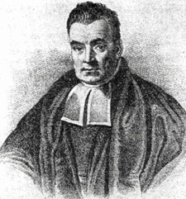
Need help from Thomas Bayes
"An Essay towards solving a Problem in the Doctrine of Chances" which was read to the Royal Society in 1763 after Bayes' death by Richard Price

Slide 7
An example from middle school
A school by 60% boys and 40% girls. All boy wear pants. Half girls wear pants and half wear skirt.
What is the probability to meet a student with pants?
P(Pants) = 60%*100% + 40%*50% = 80%

Slide 8
Probability
P(Pants) = 60%*100% + 40%*50% = 80%
P(Boy)*P(Pants | Boy) + P(Girl)*P(Pants | Girl)

Slide 9
Inverse question
A school by 60% boys and 40% girls. All boy wear pants. Half girls wear pants and half wear skirt.
Meet a student with pants. What is the probability the student is a boy?
P(Boy | Pants)
60%*100%
= 75%
60%*100% + 40%*50%

Slide 10
P(Boy|Pants)
60%*100%
= 75%
60%*100% + 40%*50%
P(Pants | Boy) P(Boy)
P(Pants | Boy) P(Boy) + P(Pants | Girl) P(Girl)
P(Pants | Boy) P(Boy)
P(Pants)

Slide 11
Bayesian theorem
θ(parameters)
X
P(Boy|Pants)P(Pants)=P(Pants|Boy)P(Boy)
Constant
y(data)

Slide 12

Bayesian transformation
Posterior distribution of θ given y
θ(parameters)
y(data)
P(θ | y)
P(Boy | Pants)
$$∝$$
P(Pants | Boy) P(Boy)
Likelihood of data given parameters
P(y|θ)
Distribution of parameters (prior)
P(θ)

Slide 13
Bayesian for hard problem
A public school containing 60% males and 40% females. What is the probability to draw four males? -- Probability (0.6^⁴=12.96%)
Four males were draw from a public school. What are the male proportion? -- Inverse probability (?)

Slide 14
Prior knowledge
Gender distribution
100% male
100% female
Safe
unlikely
Likely
Unsure
Reject
Four males were draw from a public school. What is the male proportion? -- Inverse probability (?)

Slide 15
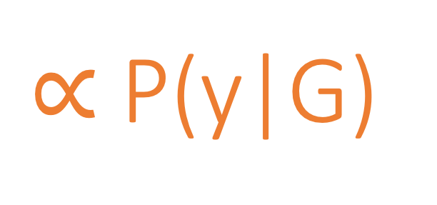
P(G|y)
Transform hard problem to easy one
$∝$P(y|G)
P(G)
Probability of unknown given data
(hard to solve)
Probability of observed given unknown
(easy to solve)
Prior knowledge of unknown
(freedom)

Slide 16
P(y|G)
Probability of having 4 males given male proportion
p=seq(0, 1, .01)
n=4
k=n
pyp=dbinom(k,n,p)
theMax=pyp==max(pyp)
pMax=p[theMax]
plot(p,pyp,type="b",main=paste("Data=", pMax,sep=""))

Slide 17
P(G)
Probability of male proportion (Prior)
ps=p*10-9
pd=dnorm(ps)
theMax=pd==max(pd)
pMax=p[theMax]
plot(p,pd,type="b",main=paste("Prior=", pMax,sep=""))

Slide 18

$\text{P}\text{(}\text{G}\text{|}\text{y}\text{)}∝$P(y|G) P(G)
Probability of male proportion given 4 males drawn
ppy=pd*pyp
theMax=ppy==max(ppy)
pMax=p[theMax]
plot(p,ppy,type="b",main=paste("Optimum=", pMax,sep=""))

Slide 19
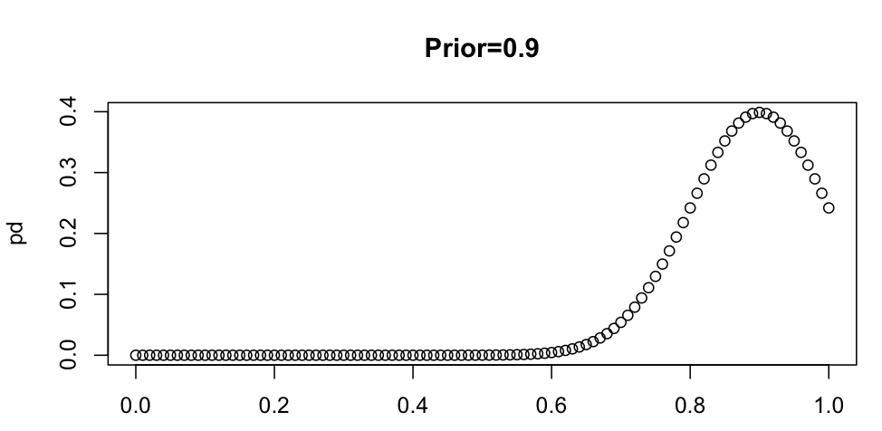
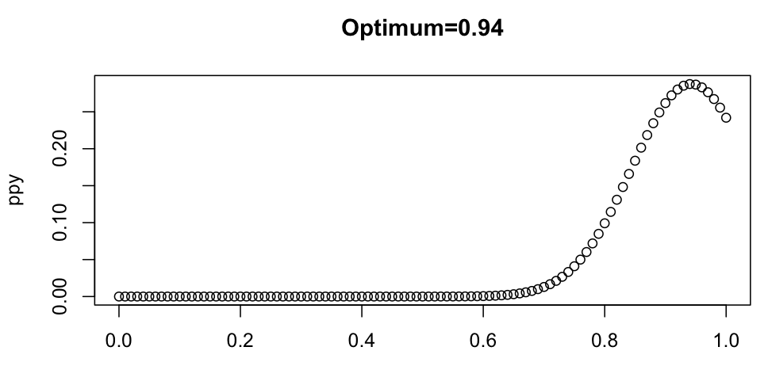
Depend what you believe
Male=Female
More Male
Much more male

Slide 20
Ten are all males
Male=Female
More Male
Much more male
vs. 57%
vs. 75%
vs. 94%

Slide 21
Bayesian transformation (likelihood)
Posterior distribution of θ given y
θ(parameters)
y(data)
P(θ | y)
P(Boy | Pants)
$$∝$$
P(Pants | Boy) P(Boy)
Likelihood of data given parameters
P(y|θ)
Distribution of parameters (prior)
P(θ)

Slide 22
More realistic
Out of control and overfitting?
Believe: Prior distributions
N(0, I σ_{g1}²)
N(0, I σ_{g2}²)
…
N(0, I σ_{gp}²)
y=x₁g₁ + x₂g₂ + … + x_{p}g_{p} + e

Slide 23
Outline
Concept development for genomic selection
Bayesian theorem
Bayesian transformation
Bayesian likelihood
Bayesian alphabet for genomic selection

