Slide 1
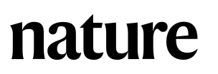
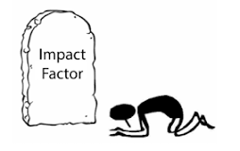
Pro
Scrutiny
Quality
Con
Time consuming
Unfair profit
Bias

Slide 2
Pro
Instant publication
Free
Open access
Open for comments
Con
Lack of scrutiny

Slide 3
Publication models
Type | Preprint | Hybrid | IF$ | IF$$ | Convention
Example | preprint.org biorxiv.org arxiv.org | reviewcommons.org peercommunityin.org | F1000Research | eLife | NSC(Nature, Science & Cell)
Cost | Free | Free | $800~1350 | $2000 | $2000~5000
Reviewed | No | Yes | Yes | Yes | Yes
Open review | NA | Yes | Yes | Yes | No
Open access | Yes | Yes | Yes | Yes | Purchased by authors
Copyright | Not taken, further is allowed | Not taken, further is allowed | Taken, nothing further | Not taken, further is allowed | Taken, nothing further
Time | Instantly | Instantly | Instantly | If review publish instantly | Month to years
Impact factor | NA | NA | 3.23 | 8.713 | Varied

Slide 4
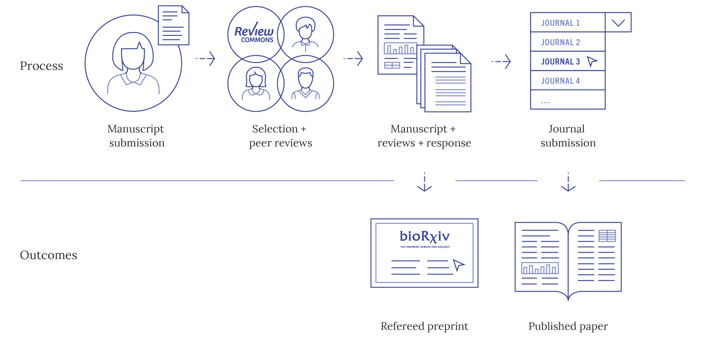
Transfers Refereed Preprints on behalf of the authors to bioRxiv and 17 affiliate journals from EMBO Press, eLife, ASCB, The Company of Biologists, Rockefeller University Press and PLOS.

Slide 5
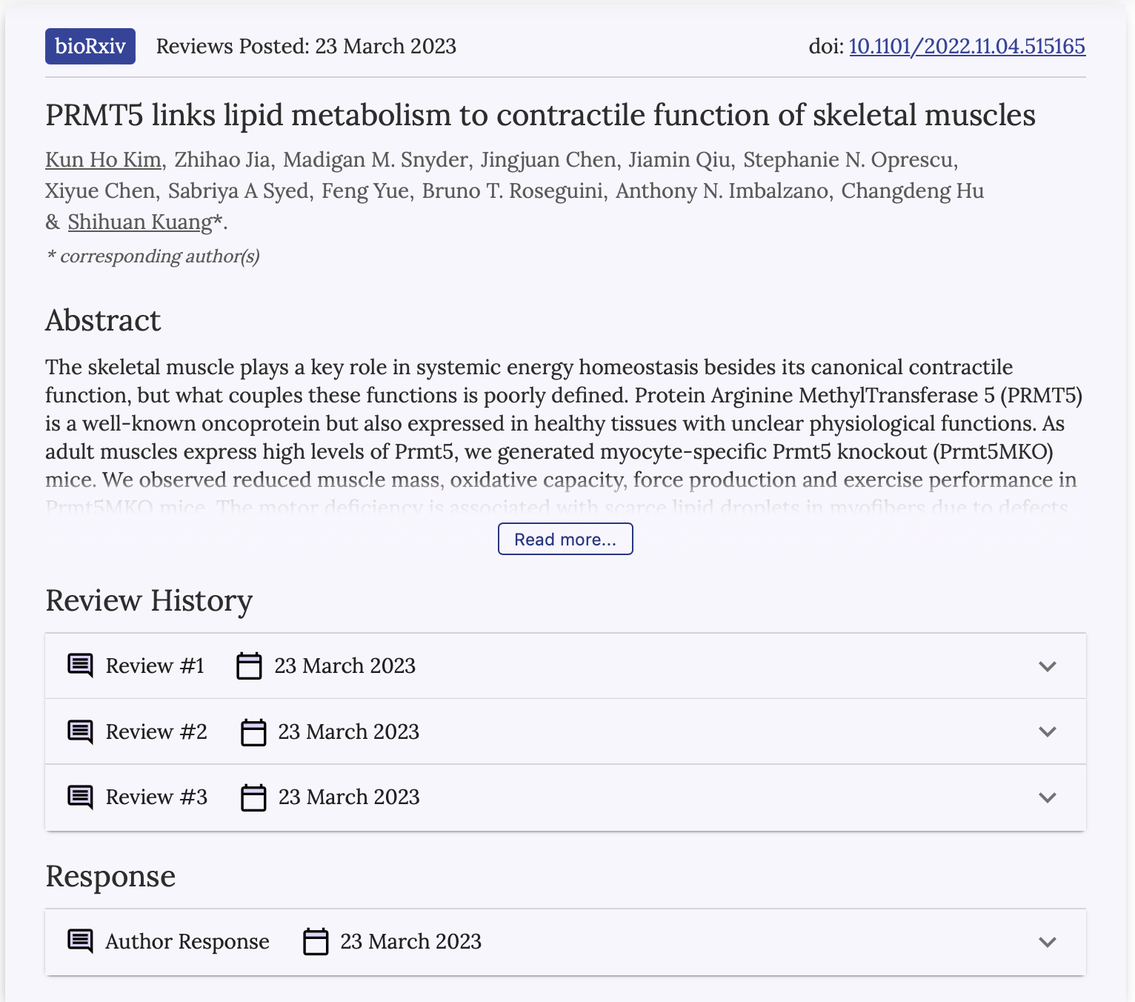
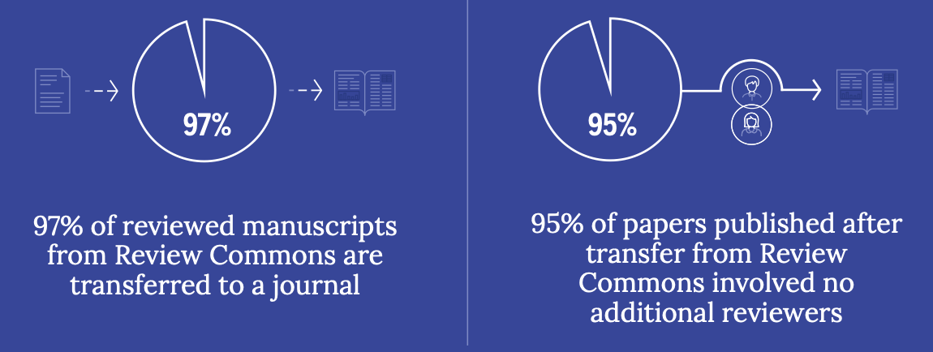

Slide 6
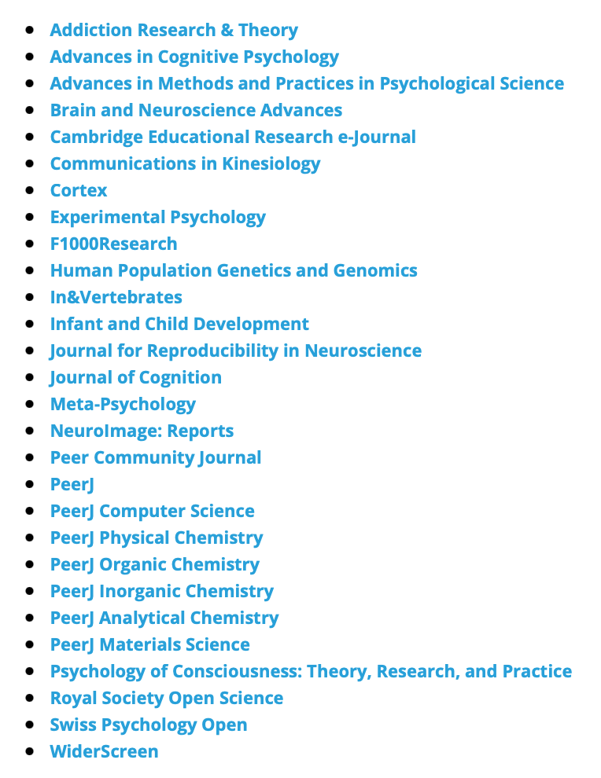
3.23
NA
3.061
3.853

Slide 7
