Slide 1


Statistical Genomics
SUPER
Zhiwu Zhang
Washington State University

Slide 2
Outline
Kinship based on QTN
Confounding between QTN and kinship
Complimentary kinship
SUPER

Slide 3
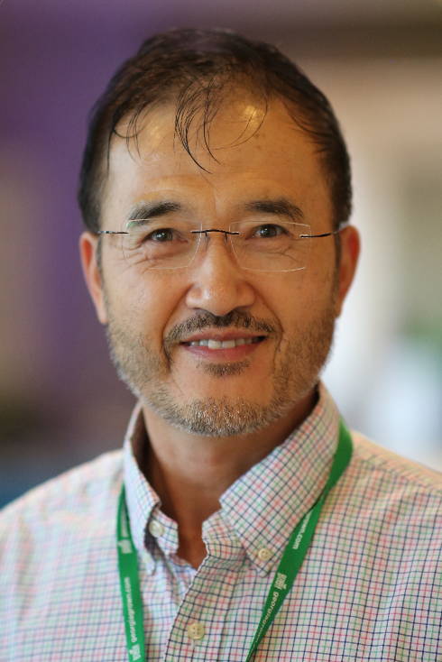
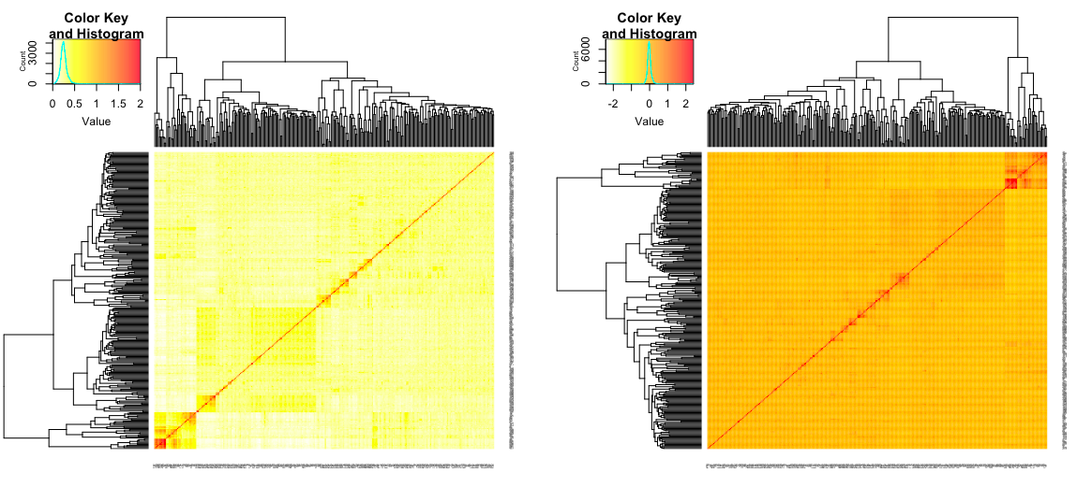
Reduction of Confound with kinship: CMLM
y = SNP + Q (or PCs) + Kinship +
e
Zhang
y = x₁b₁ + x₂b₂+x₃b₃+x₄b₄ + Zu+
e
Groups
Individuals
Zhang, Z. et al. Mixed linear model approach adapted for genome-wide association studies. Nat Genet 42, 355–360 (2010).

Slide 4
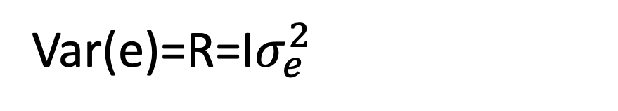
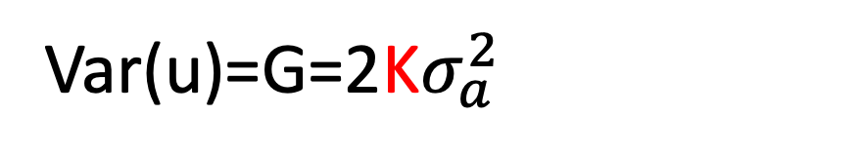
Variance in MLM
y = Xb + Zu + e
Var(y)=V=Var(u)+Var(e)
Var(u)=G=2K$σ_{a}^{2}$
Var(e)=R=I$σ_{e}^{2}$
u prediction: Best Linear Unbiased Prediction, BLUP)
b prediction: Best Linear Unbiased Estimate, BLUE)

Slide 5
Kinship defined by single marker
Sensitive
Resistance
 | S1 | S2 | S3 | S4 | R1 | R2 | R3 | R4
S1 | 1 | 1 | 1 | 1 | 0 | 0 | 0 | 0
S2 | 1 | 1 | 1 | 1 | 0 | 0 | 0 | 0
S3 | 1 | 1 | 1 | 1 | 0 | 0 | 0 | 0
S4 | 1 | 1 | 1 | 1 | 0 | 0 | 0 | 0
R1 | 0 | 0 | 0 | 0 | 1 | 1 | 1 | 1
R2 | 0 | 0 | 0 | 0 | 1 | 1 | 1 | 1
R3 | 0 | 0 | 0 | 0 | 1 | 1 | 1 | 1
R4 | 0 | 0 | 0 | 0 | 1 | 1 | 1 | 1
Adding additional markers bluer the picture

Slide 6
Derivation of kinship
QTNs
All SNPs
Kinship
Non-QTNs SNP

Slide 7
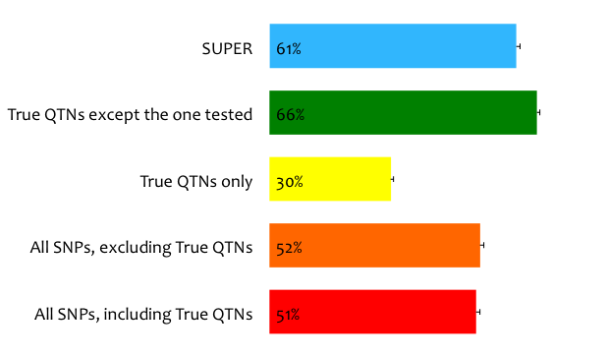
Statistical power of kinship from
Notes:
A simulation study shoed that the statistical power is 42% if all SNPs were used to derive the kinship. The power reduced to 21% if the kinship was derived from the QTNs only. The power jump over to 50% when the kinship was derived from all QTNs except the one of test.

Slide 8
Kinship evolution
All traits
QTNs
Pedigree
Markers
QTNs
QTNs
Single trait
QTNs
Remove QTN one at a time
Average
Realized
Notes:
Settlement of kinship at trait base. Pedigree is the first information used to estimate kinship which are general expectation for a pair of individuals, e.g. full sib A and B have kinship of 50%. The introduction of genetic diagnostic markers increases the certainty for a specific Mendilian trait, e.g. full sibs are identical and have kinship of 1 for color. The certainty also are also increased for complex traits with multiple markers covering entire genome and became the general realized kinship, e.g. full sibs A and B have kinship of 60% instead of 50%. With dense markers, a trait specific realized kinship exist (theoretically) by using all the QTNs underlying the trait. A kinship with all QTNs (full) is ideal for genome prediction. However, its complimentary (using all QTNs except the one of test) should be used for association study to remove the confronting between the kinship and the tested SNPs.

Slide 9
Statistical power of kinship from
Notes:
A simulation study shoed that the statistical power is 42% if all SNPs were used to derive the kinship. The power reduced to 21% if the kinship was derived from the QTNs only. The power jump over to 50% when the kinship was derived from all QTNs except the one of test.

Slide 10
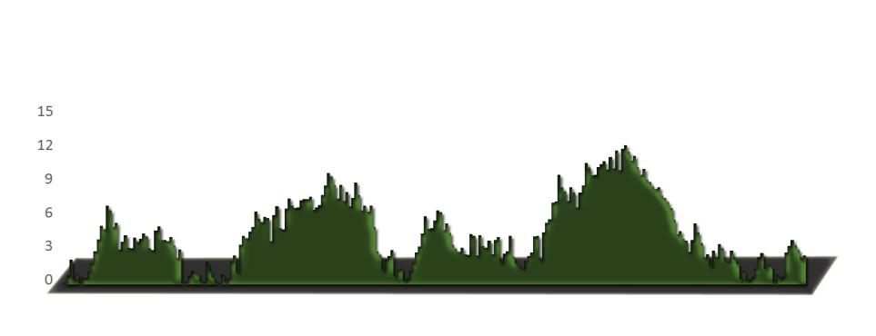
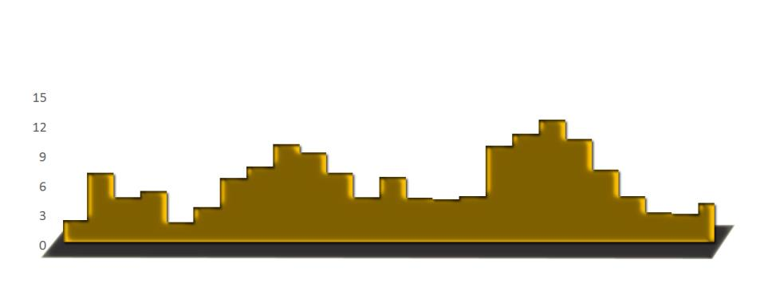
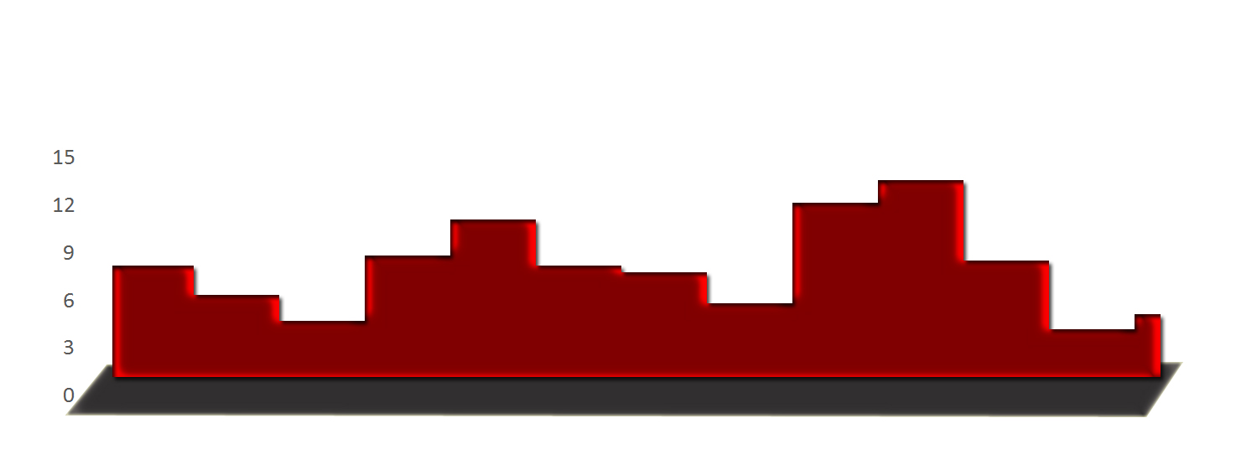
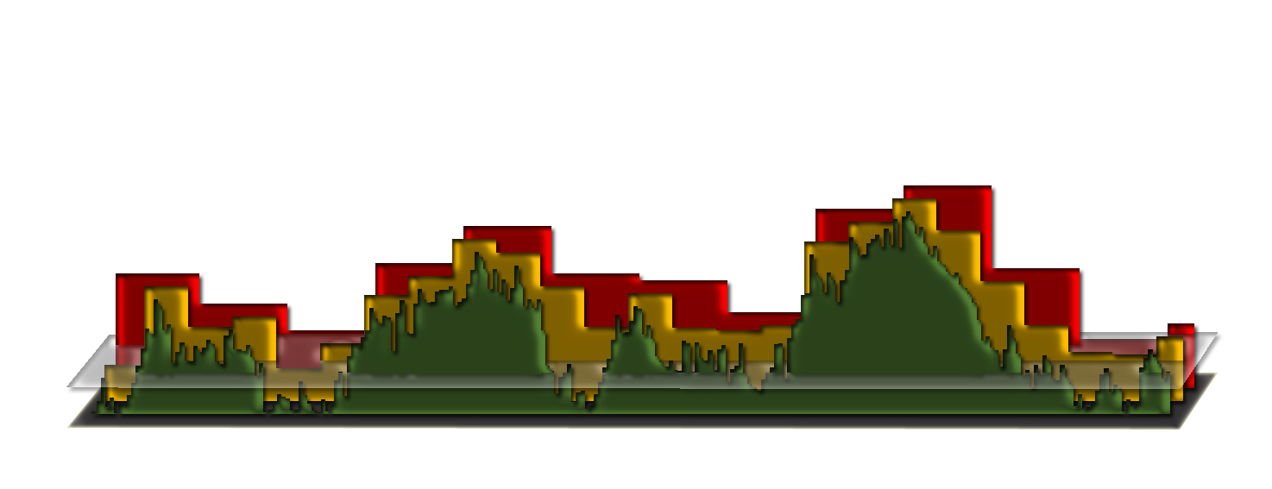
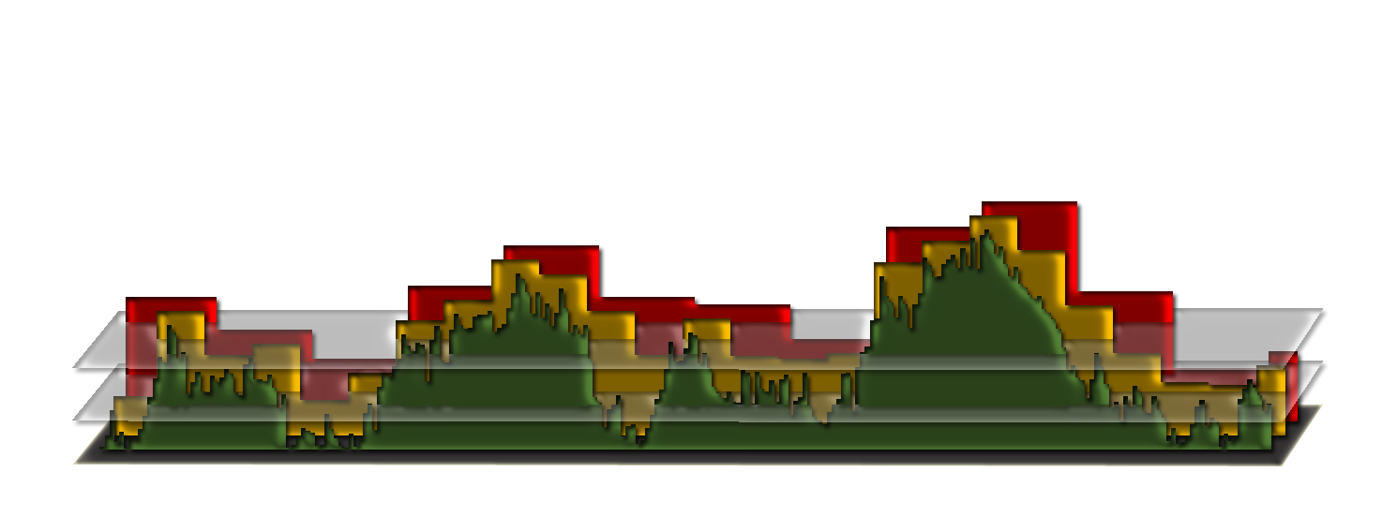
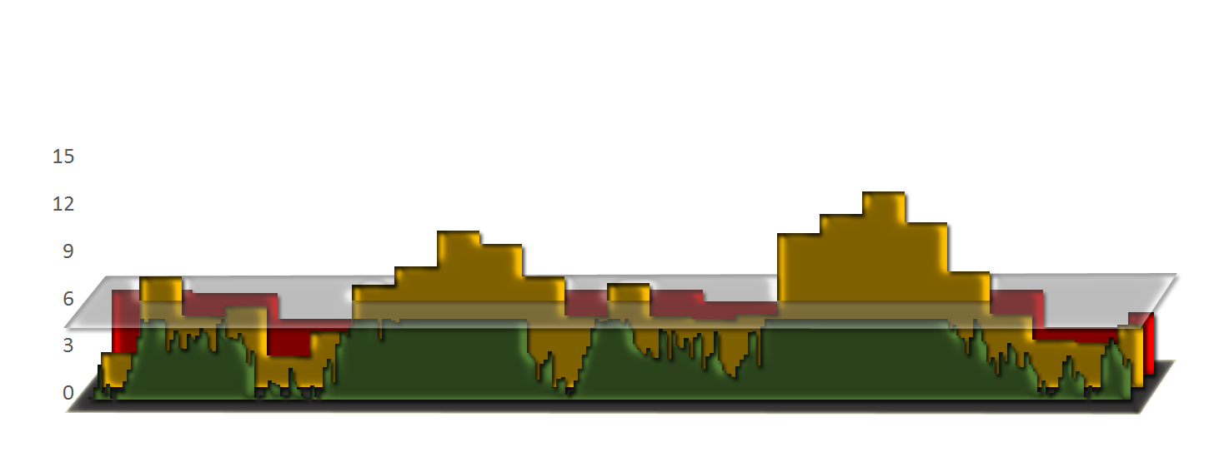
Bin approach

Slide 11
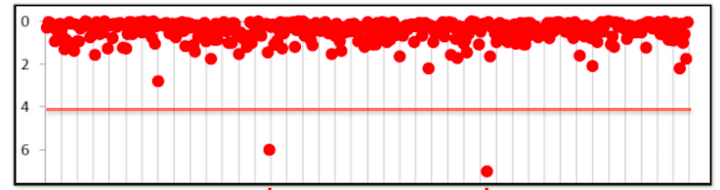
Mimic QTN-1
1. Choose t associated SNPs as QTNs each represent an interval of size s.
2. Build kinship from the t QTNs
3. Optimization on t and s
4. For a SNP, remove the QTNs in LD with the SNP, e.g. R square > 1%
5. Use the remaining QTNs to build kinship for testing the SNP

Slide 12
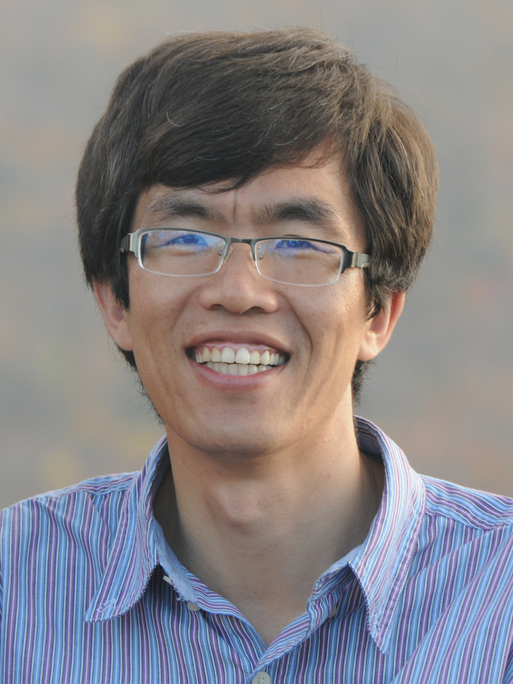
Statistical power of kinship from
Qishan Wang
PLoS One, 2014
SUPER
(Settlement of kinship Under Progressively Exclusive Relationship)
Notes:
A simulation study shoed that the statistical power is 42% if all SNPs were used to derive the kinship. The power reduced to 21% if the kinship was derived from the QTNs only. The power jump over to 50% when the kinship was derived from all QTNs except the one of test.

Slide 13
Threshold of excluding pseudo QTNs
Notes:
A simulation study shoed that the statistical power is 42% if all SNPs were used to derive the kinship. The power reduced to 21% if the kinship was derived from the QTNs only. The power jump over to 50% when the kinship was derived from all QTNs except the one of test.

Slide 14
Impact of initial P values
Notes:
A simulation study shoed that the statistical power is 42% if all SNPs were used to derive the kinship. The power reduced to 21% if the kinship was derived from the QTNs only. The power jump over to 50% when the kinship was derived from all QTNs except the one of test.

Slide 15
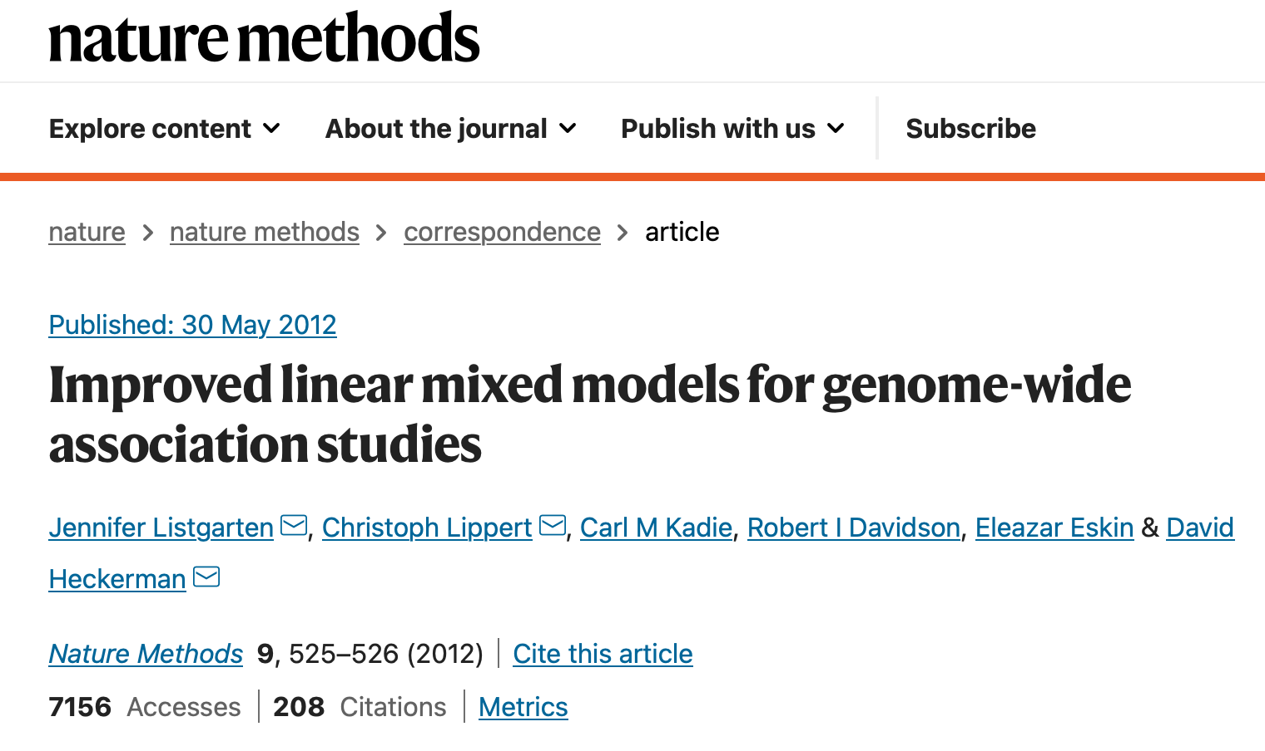

FaST-LMM-Select
351 citations

Slide 16
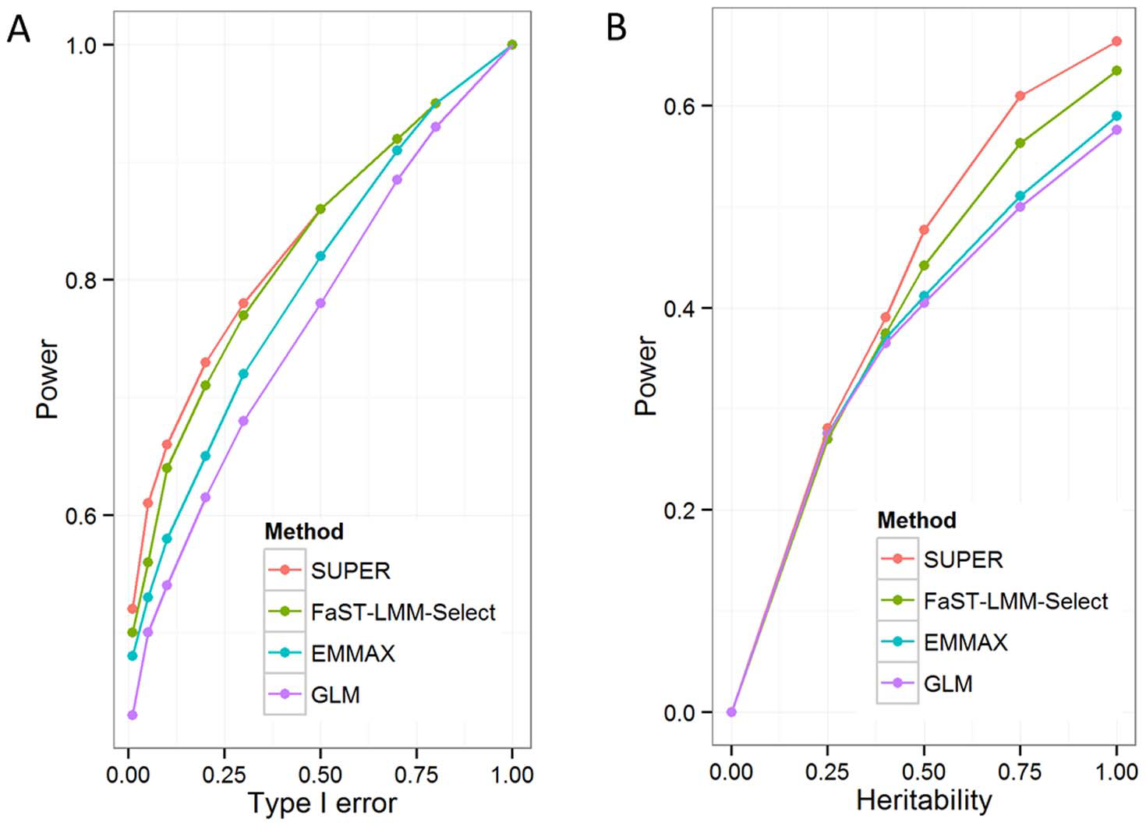
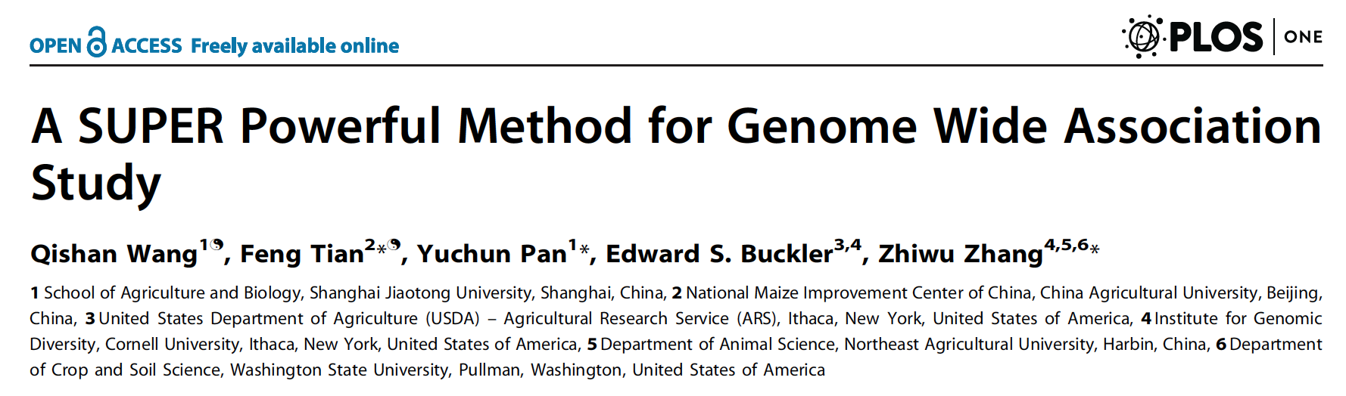
195 citations

Slide 17
Simulation with GAPIT
source("http://zzlab.net/GAPIT/gapit_functions.txt")
myGD=read.table(file="http://zzlab.net/GAPIT/data/mdp_numeric.txt",head=T)
myGM=read.table(file="http://zzlab.net/GAPIT/data/mdp_SNP_information.txt",head=T)
index1to5=myGM[,2]<6
set.seed(99164)
mySim=GAPIT.Phenotype.Simulation(GD=myGD[,c(TRUE,index1to5)],
GM=myGM[index1to5,],
h2=.7,
NQTN=40,
effectunit =.95,
QTNDist="normal")

Slide 18
SUPER in GAPIT
setwd("~/Desktop/temp")
myGAPIT=GAPIT(Y=mySim$Y, GD=myGD, GM=myGM,
PCA.total=3,
QTN.position=mySim$QTN.position,
model="SUPER")

Slide 19
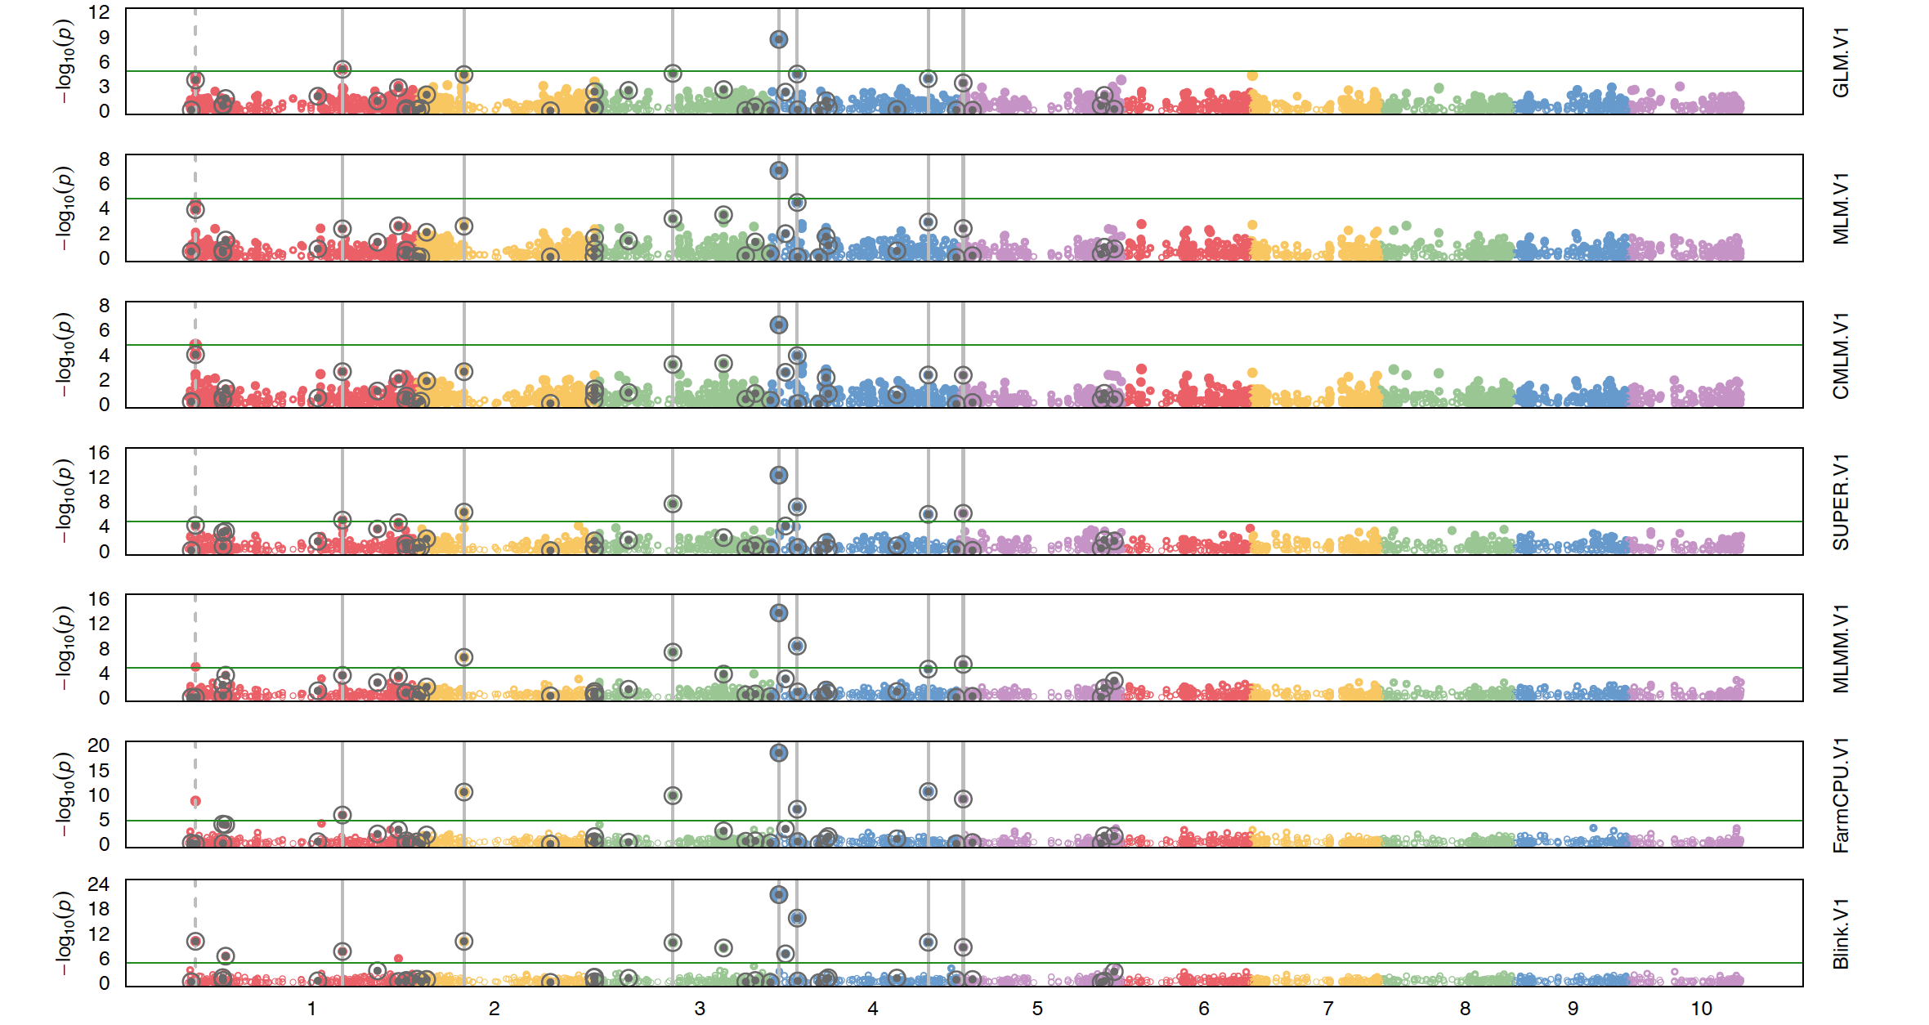
2
1
2
7
7
8
11

Slide 20
Outline
Kinship based on QTN
Confounding between QTN and kinship
Complimentary kinship
SUPER

