Slide 1


Statistical Genomics
Bayesian Tools
Zhiwu Zhang
Washington State University

Slide 2
Outline
BLR
BGLR

Slide 3
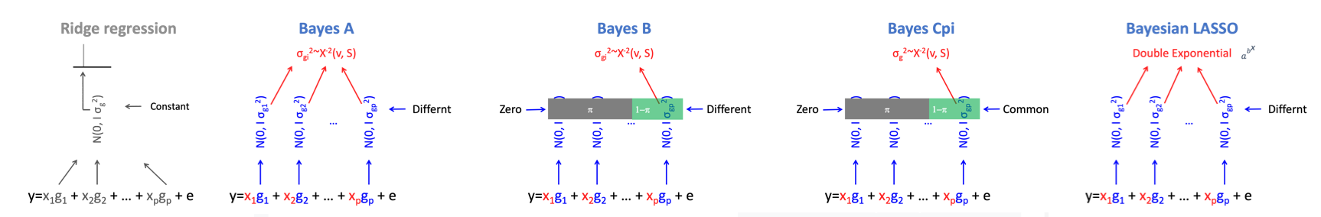
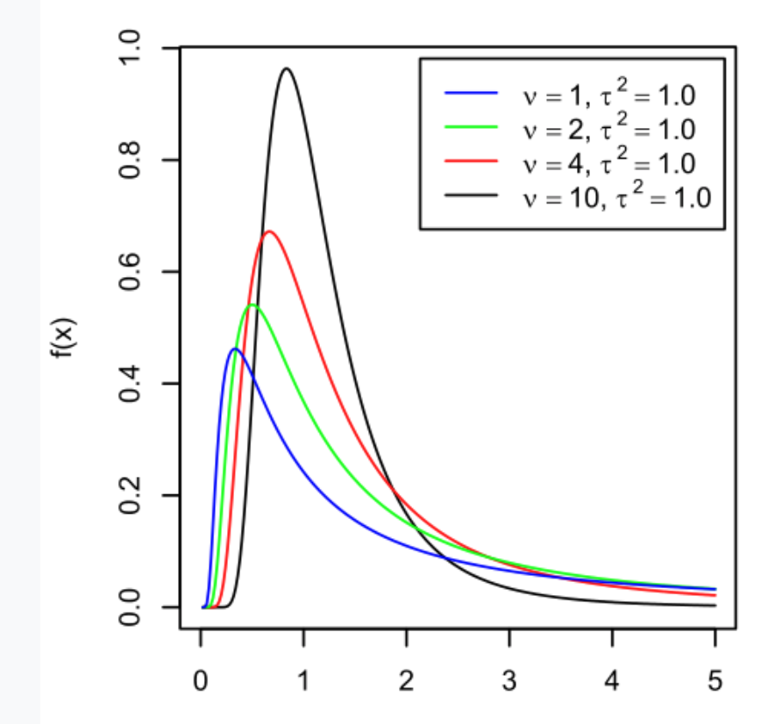
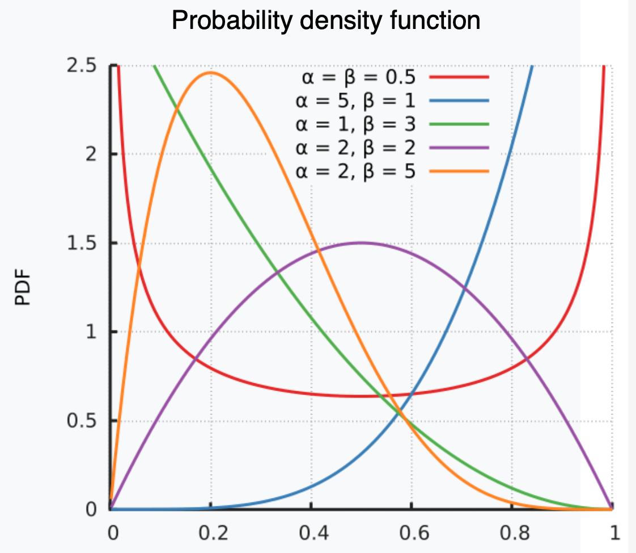
Bayesian alphabet
Variances: Scaled chi-square distribution (v, τ² )
π : Beta distribution (α,β)
DF
Shape (S)

Slide 4
Visualize Bayesian alphabet
Constant
Variance
Ridge Regression
Variance
Bayes A
Variance
Bayes B
π
1−π
Variance
Bayes CPi
π
1−π
Markers

Slide 5
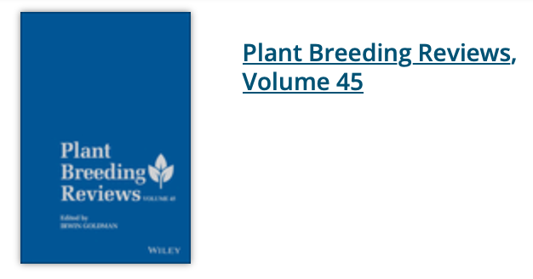

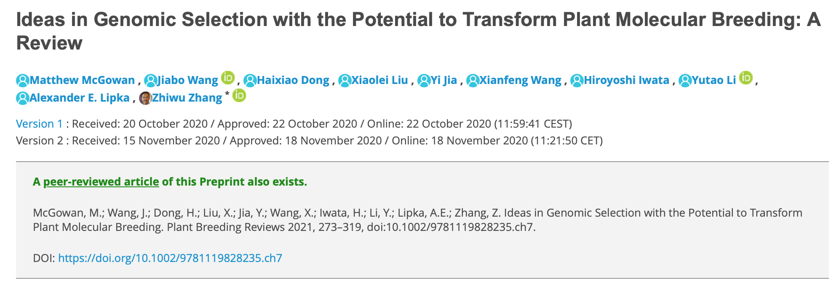

Slide 6
Bayesian likelihood
P(g_{i}, σ_{gi}², σ_{e}² v, s | y) =
P(y | g_{i}, σ_{gi}², σ_{e}² v, s) P(g_{i}, σ_{gi}², σ_{e}² v, s)
Gibbs sampling

Slide 7
Data and simulation
source("http://zzlab.net/GAPIT/gapit_functions.txt")
myGD=read.table(file="http://zzlab.net/GAPIT/data/mdp_numeric.txt",head=T)
myGM=read.table(file="http://zzlab.net/GAPIT/data/mdp_SNP_information.txt",head=T)
set.seed(99164)
n=nrow(myGD)
testing=sample(n,round(n/5),replace=F)
training=-testing
set.seed(99164)
mySim=GAPIT.Phenotype.Simulation(GD=myGD, GM=myGM,
h2=.7,
NQTN=20,
QTNDist="normal")

Slide 8
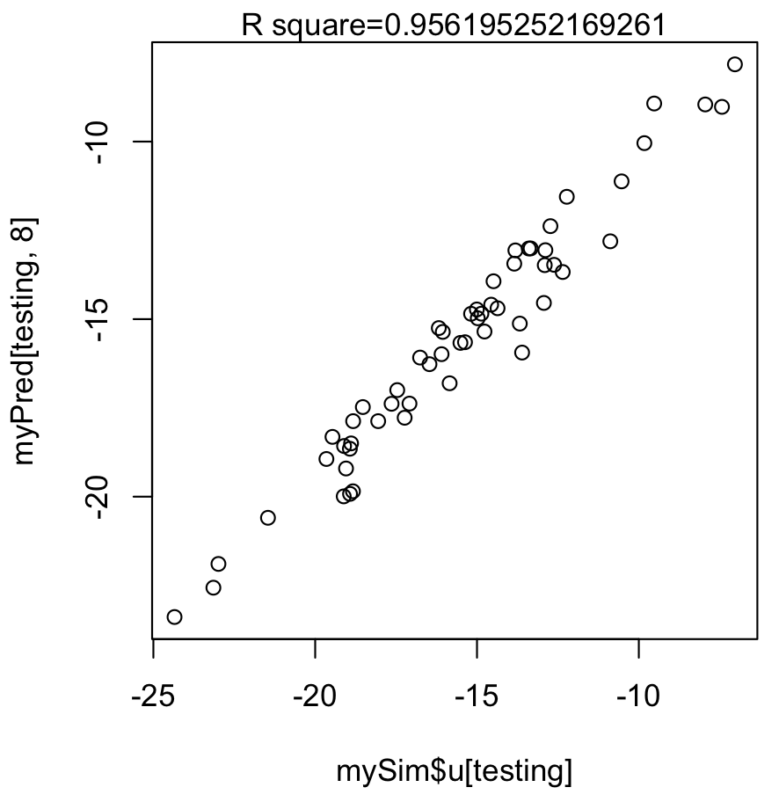
MAS
#Gene mapping (GWAS)
myGAPIT3 <- GAPIT(
Y=mySim$Y[training,],
GD=myGD,GM=myGM, PCA.total=3,
model="BLINK",
QTN.position=mySim$QTN.position,
memo="GWAS")
myCV=myGAPIT3$PCA
index=myGAPIT3$GWAS[,4]<0.05/length(myGAPIT3$GWAS[,4])
QTN.order=order(abs(mySim$effect),decreasing =T)
index= mySim$QTN.position[QTN.order]+1
myQTN=cbind(myGAPIT3$PCA,myGD[,c(FALSE,index[1:15])])
#MAS
myGAPIT4 <- GAPIT(
Y=mySim$Y[training,],
CV=myQTN,
model="GLM",
SNP.test=FALSE,
memo="MAS")
order=match(mySim$Y[,1],myGAPIT4$Pred[,1])
myPred=myGAPIT4$Pred[order,]
ru2=cor(myPred[testing,8],mySim$u[testing])^2
plot(myPred[testing,8],mySim$u[testing])
mtext(paste("R square=",ru2,sep=""), side = 3)

Slide 9
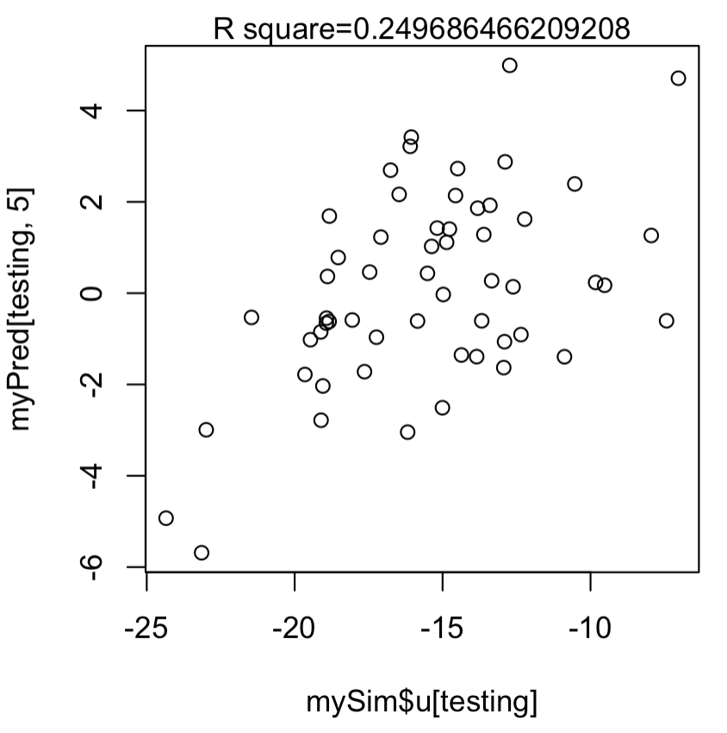
gBLUP
myGAPIT5 <- GAPIT(
Y=mySim$Y[training,],
GD=myGD,
GM=myGM,
PCA.total=3,
model="gBLUP",
SNP.test=FALSE,
memo="gBLUP")
order=match(mySim$Y[,1],myGAPIT5$Pred[,1])
myPred=myGAPIT5$Pred[order,]
ru2=cor(myPred[testing,5],mySim$u[testing])^2
plot(mySim$u[testing],myPred[testing,5])
mtext(paste("R square=",ru2,sep=""), side = 3)

Slide 10
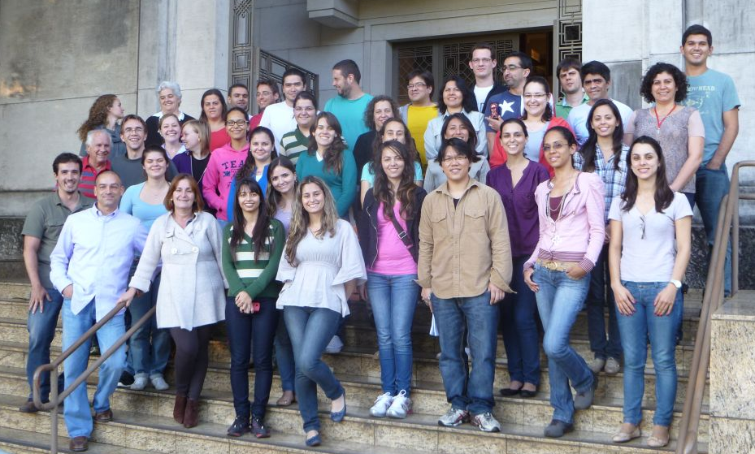
BLR and BGLR
Daniel Gianola
Gustavo
de los Campos
Jose Crossa
Guilherme Rosa
https://en.wikipedia.org/wiki/Daniel_Gianola
http://www.lce.esalq.usp.br/arquivos/aulas/2013/LCE5713/

Slide 11
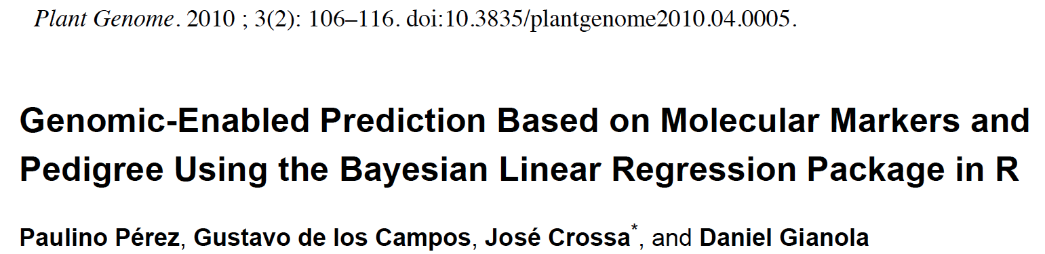
Papers of BLR and BGLR
Genome-Wide Regression & Prediction with the BGLR Statistical Package
Paulino Pérez and Gustavo de los Campos
GENETICS Early online July 9, 2014; https://doi.org/10.1534/genetics.114.164442

Slide 12
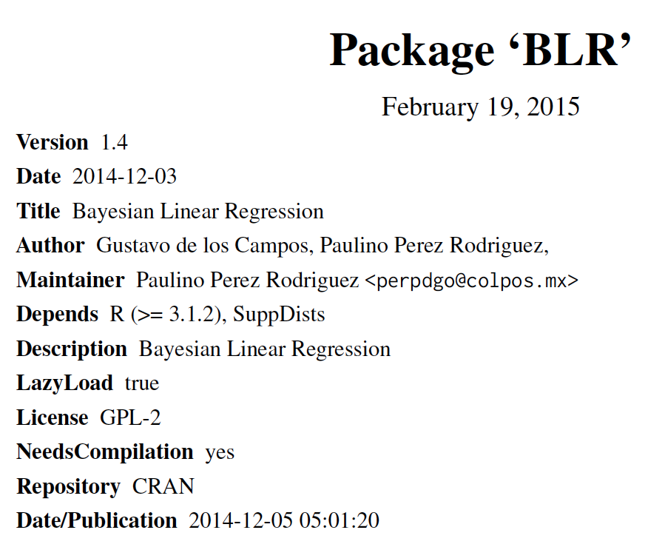
#install.packages("BLR")
library(BLR)

Slide 13
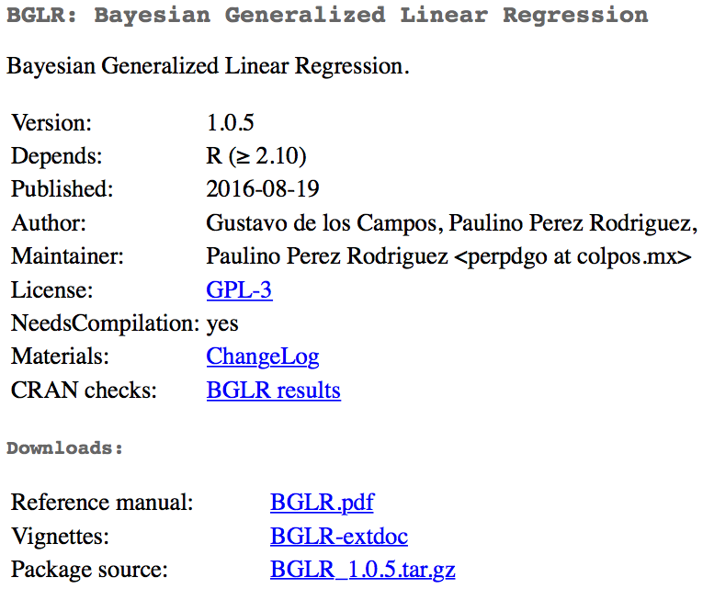
#install.packages("BGLR")
library(BGLR)

Slide 14
Model in BLR
Breeding values
(gBLUP)
Intercept
Fixed effects
(MAS)
Bayeian LASSO
(Bayes)
random regression
(Ridge regression)

Slide 15
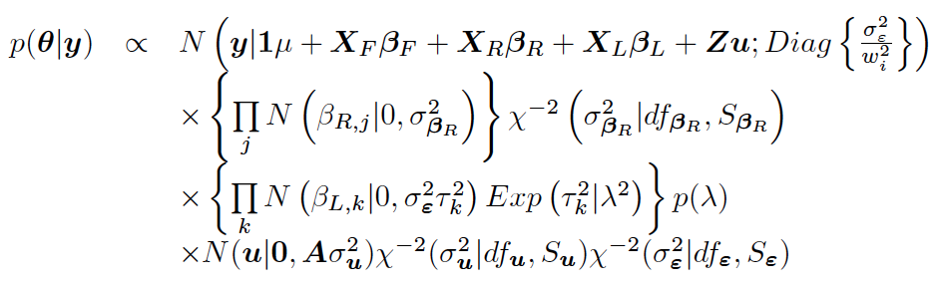
Bayesian likelihood

Slide 16
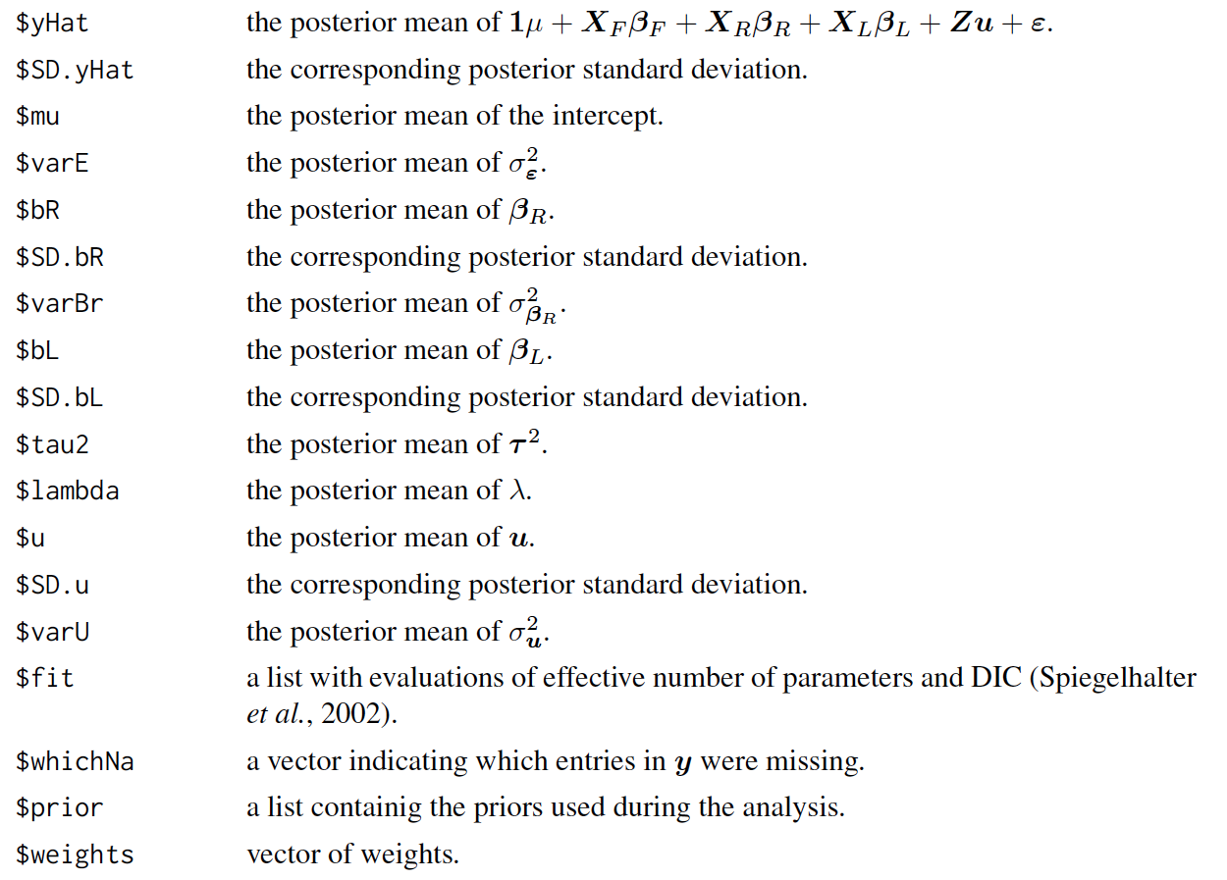
BLR output

Slide 17
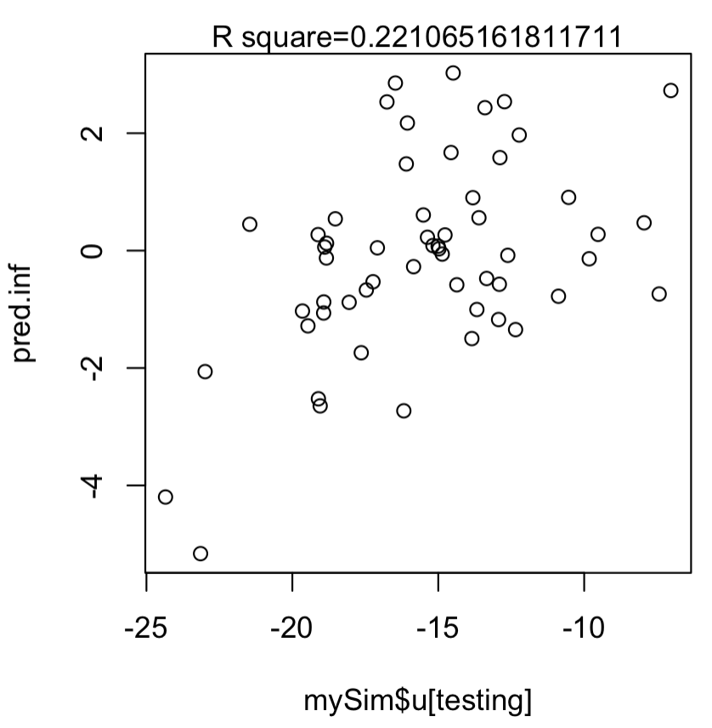
Run BLR
#install.packages("BLR")
library(BLR)
nIter=2000 #### number of iteration
burnIn=1500 #### burnin a part of iteration
set.seed(99164)
myBLR =BLR(y=as.matrix(mySim$Y[training,2]),
XF=myCV[training,-1],
XL=as.matrix(myGD[training,-1]),
nIter=nIter,
burnIn=burnIn)
pred.inf=as.matrix(myGD[testing,-1])%*%myBLR$bL
ru2 <- cor(mySim$u[testing],pred.inf)^2
plot(mySim$u[testing],pred.inf)
mtext(paste("R square=",ru2,sep=""), side = 3)

Slide 18
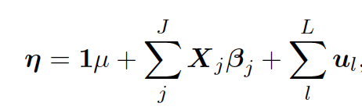
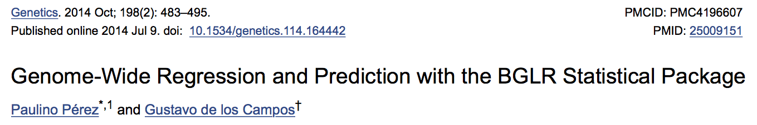
BGLR model
Markers
Individuals

Slide 19
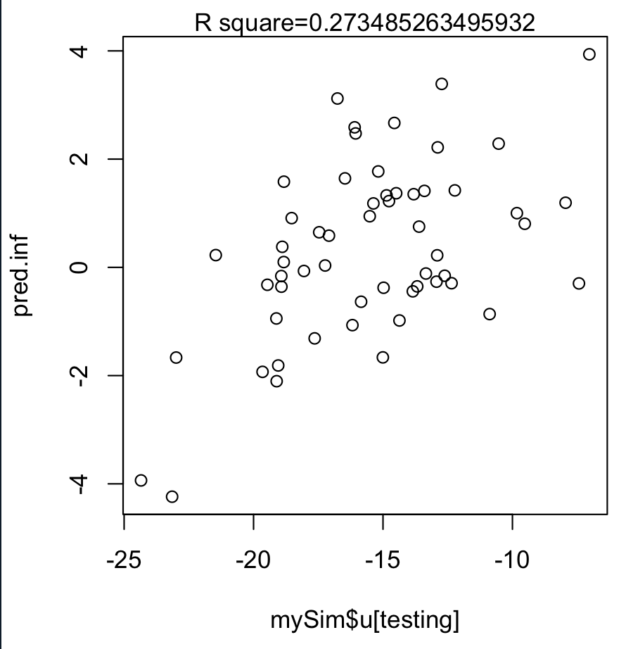
Run BGLR
#install.packages("BGLR")
library(BGLR)
nIter=2000 #### number of iteration
burnIn=1500 #### burnin a part of iteration
set.seed(99164)
myBGLR =BGLR(y=as.matrix(mySim$Y[training,2]),
ETA=list(list(X=myCV[training,-1],model='FIXED', saveEffects=TRUE),
#list(X=as.matrix(myGD[training,-1]),model='BRR', saveEffects=TRUE)
#list(X=as.matrix(myGD[training,-1]),model='BL', saveEffects=TRUE)
#list(X=as.matrix(myGD[training,-1]),model='BayesA', saveEffects=TRUE)
list(X=as.matrix(myGD[training,-1]),model='BayesB', saveEffects=TRUE)
),
nIter=nIter,
burnIn=burnIn)
pred.inf=as.matrix(myGD[testing,-1])%*%myBGLR$ETA[[2]]$b
ru2 <- cor(mySim$u[testing],pred.inf)^2
plot(mySim$u[testing],pred.inf)
mtext(paste("R square=",ru2,sep=""), side = 3)

Slide 20
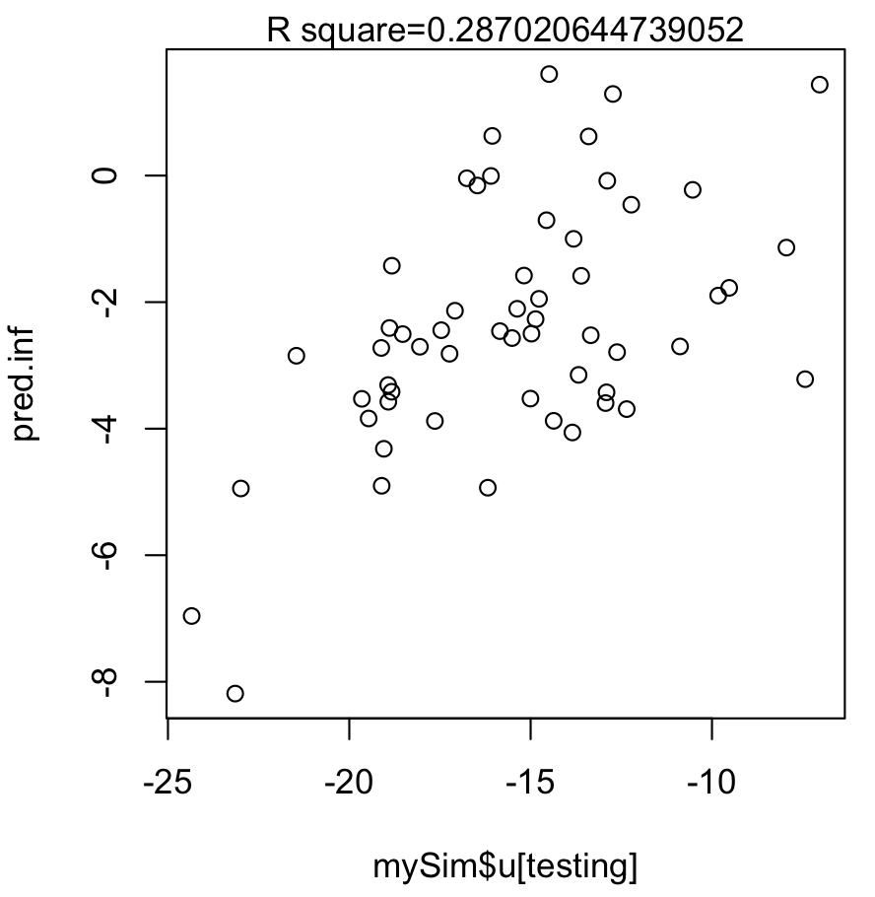
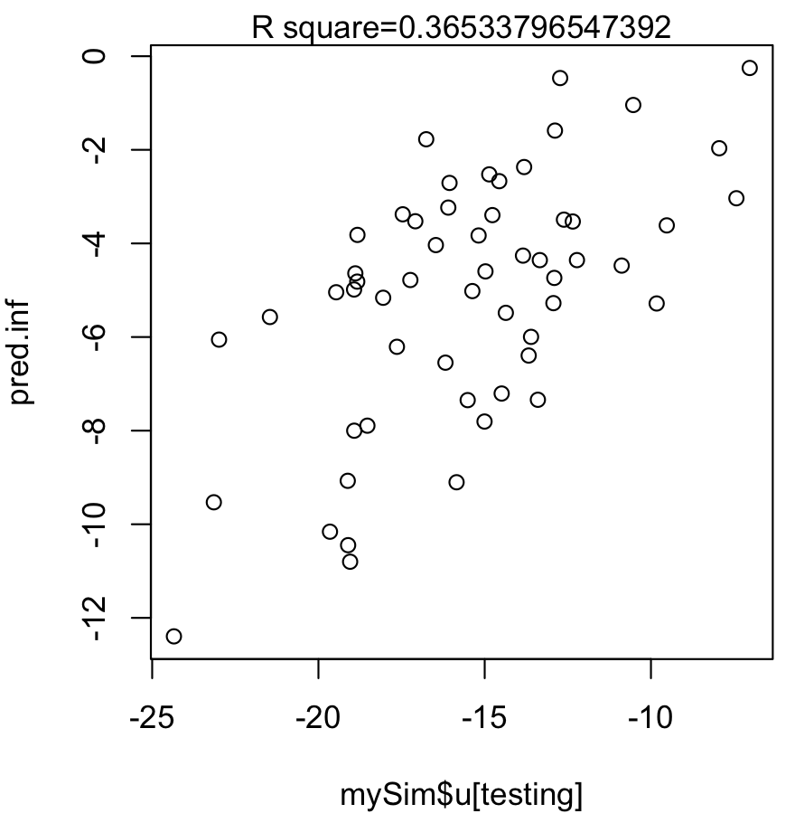
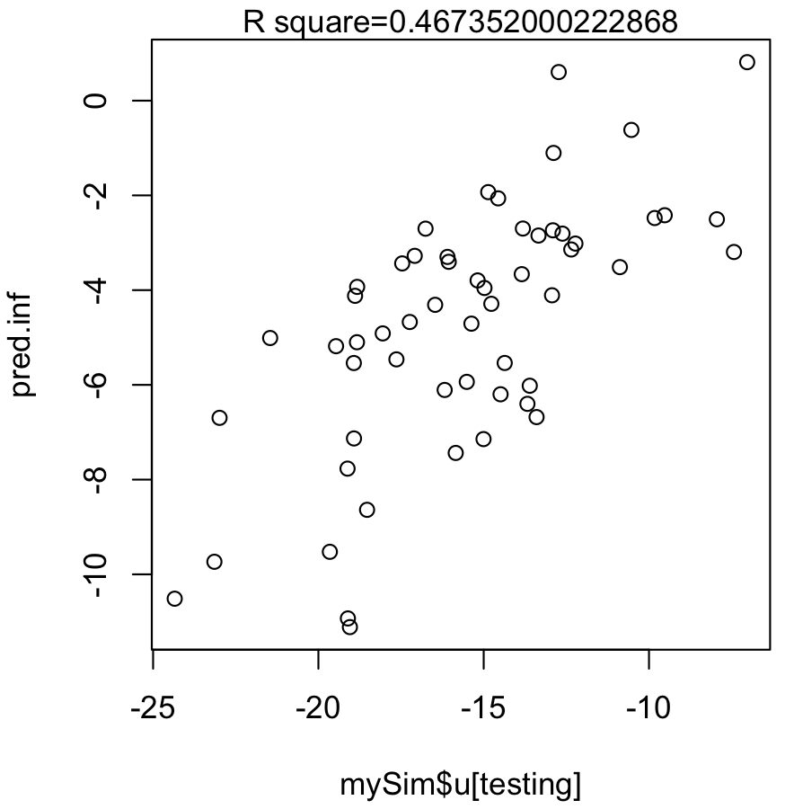
Run BGLR
RR
BL
Bayes A
Bayes B

Slide 21
Mask QTNs
#Mask QTNs
#myGD[, mySim$QTN.position+1] =0
myGD=myGD[, -(mySim$QTN.position+1)]
myGM=myGM[-mySim$QTN.position,]

Slide 22
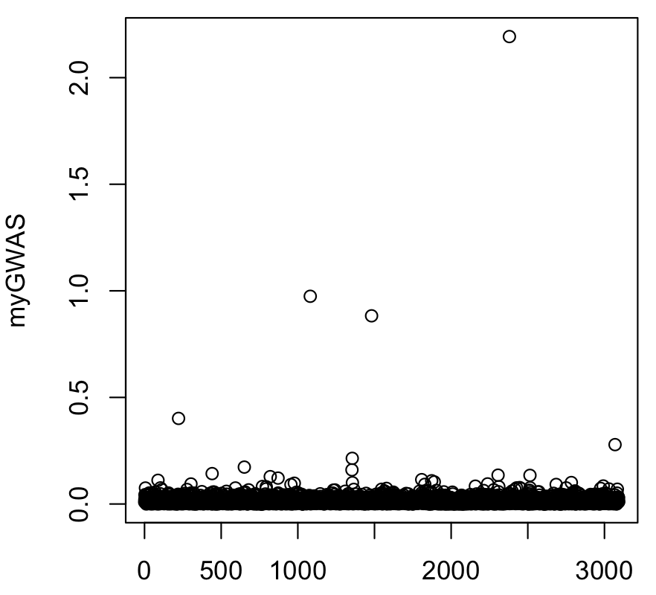
GWAS
myGWAS=abs(myBGLR$ETA[[2]]$b)
plot(myGWAS)
myP=1/(exp(20*myGWAS))
myGI.MP=cbind(myGM[,-1],myP)
GAPIT.Manhattan(GI.MP=myGI.MP,seqQTN=mySim$QTN.position)

Slide 23
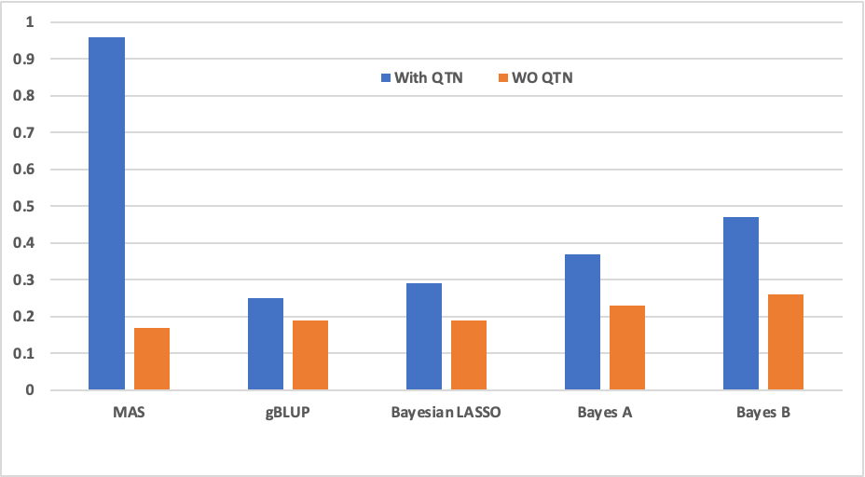
Impact of marker density

Slide 24
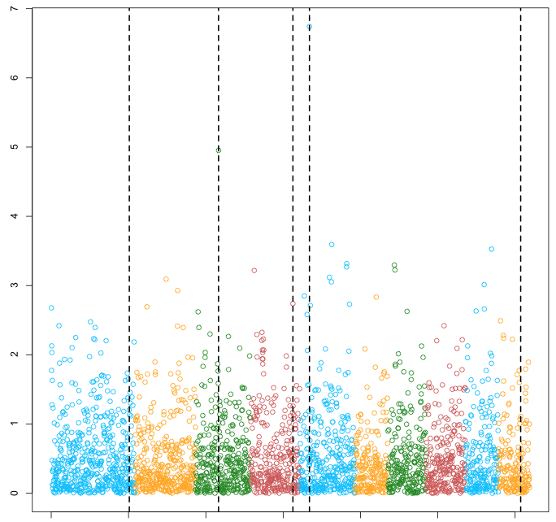
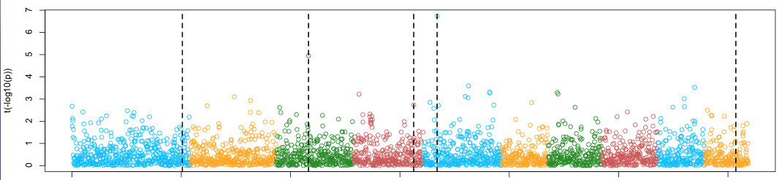


MAS
GS
Weighted
GS+Fixed
GS+Random
Fragment

Slide 25
Outline
BLR
BGLR

