Slide 1
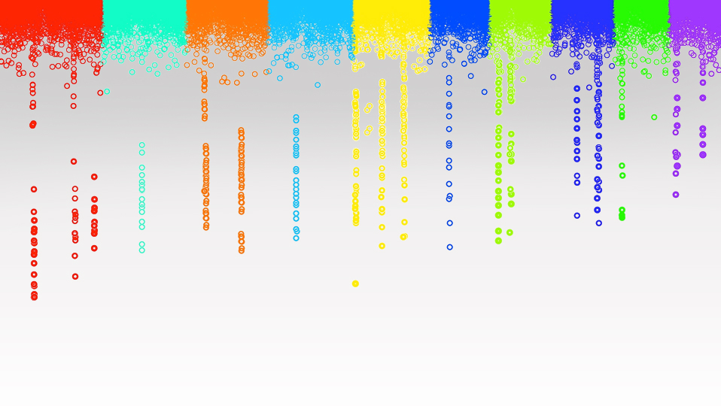
Statistical Genomics
Artificial Inteligence
Zhiwu Zhang
Washington State University

Slide 2
Outline
Statistics, statistical learning, machine learning, and artificial intelligence
Modeling genomic prediction
Machine learning
Mathematic foundation of deep learning (neural network)

Slide 3
Modeling Genomic Prediction: gBLUP
y=x₁g₁ + x₂g₂ + … + x_{p}g_{p} + e
Top Down
~N(0,
σ_{a}²)
U
K
y = Zu + e

Slide 4
RR and Bayesian Models
Believe: Prior distributions
RR, Bayes A, B, …
N(0, I σ_{g1}²)
N(0, I σ_{g2}²)
…
N(0, I σ_{gp}²)
Bottom UP
y=x₁g₁ + x₂g₂ + … + x_{p}g_{p} + e

Slide 5
Horizontal Expansion
Weight
SNPs
Weight
$$x_{i}^{(2)}=\sum_{j}{w_{j}^{(1)}x_{j}^{(1)}}$$
$$x^{(t)}=\sum{w_{i}^{(t−1)}x_{i}^{(t−1)}}$$
Activation
$x_{i}^{(2)}$=$\frac{1}{1+e^{−{(x}_{i}^{\left(2\right)}+b_{i}^{(2)})}}$
y=$\frac{1}{1+e^{−{(x}^{\left(t\right)}+b_{}^{\left(t\right)})}}$
Bias

Slide 6
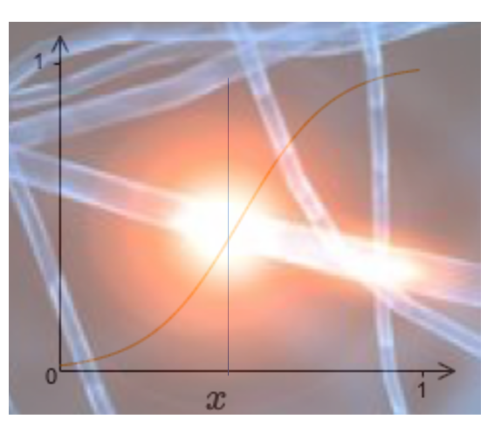
Neural Networks
SNP_{i1}
SNP_{i2}
y_{i}
SNP_{im}
$$\sum{w_{i}x_{i}}$$
$$\frac{1}{1+e^{−(x+b)}}$$
Input
Output

Slide 7
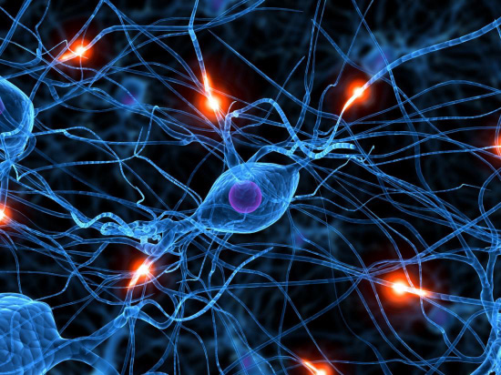
Natural and Artificial Brains

Slide 8
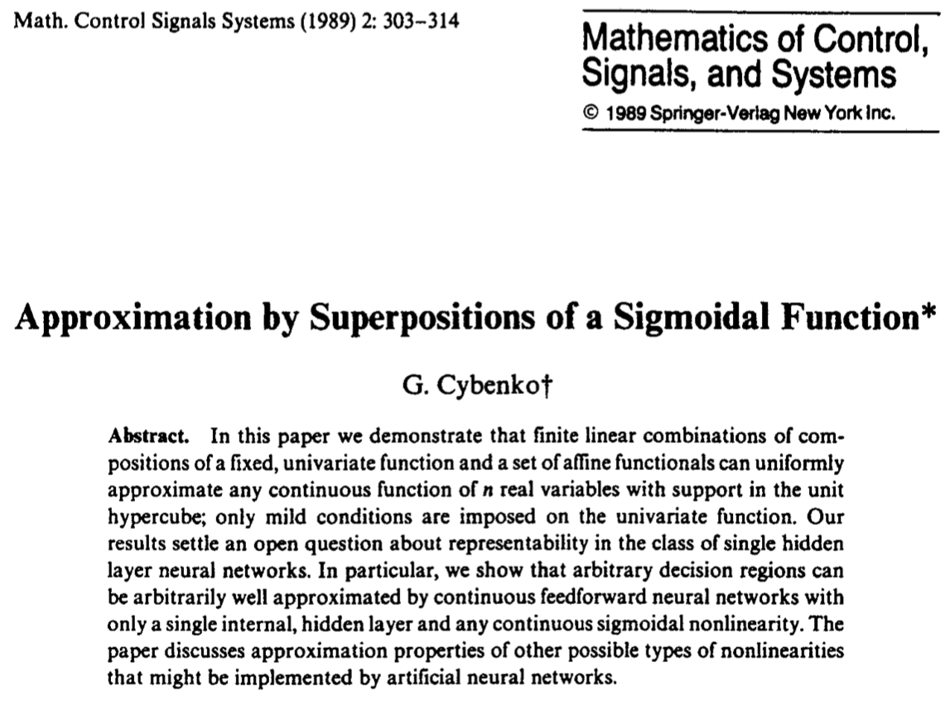
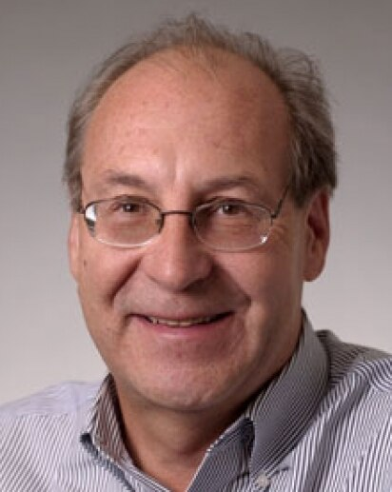
George Cybenko's Theorem
Impact factor 1.518
Cited by 17,751
Simple neural networks can represent a wide variety of interesting functions

Slide 9
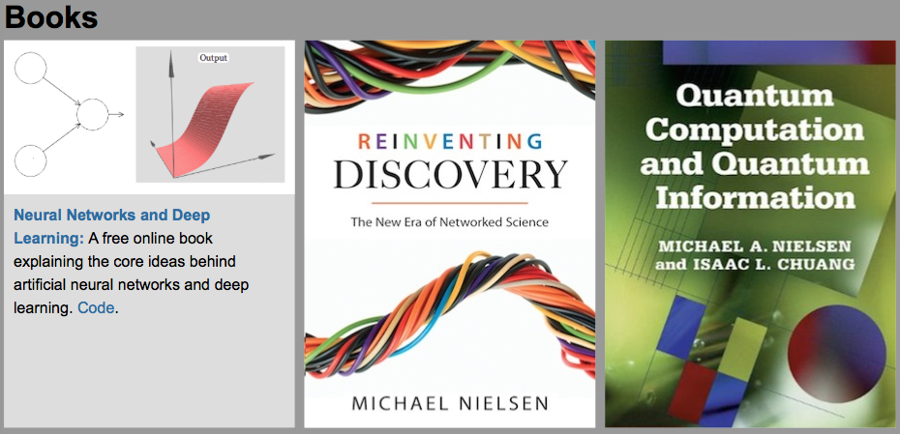
Computer demonstration
By Michael Nielsen / Dec 2019

Slide 10
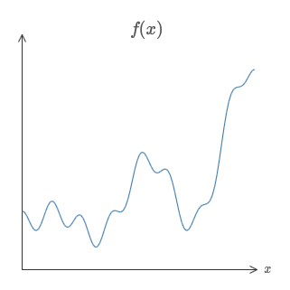
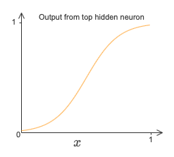
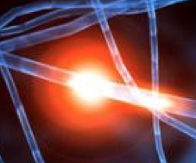
Weight and Bias
Weight5
Weight1
Weight4
Weight2
Weight3
Weight6

Slide 11
Geoffrey Hinton
Godfather of AI
B.A., Psychology, Cambridge
Ph.D., AI, Edinburgh

Slide 12
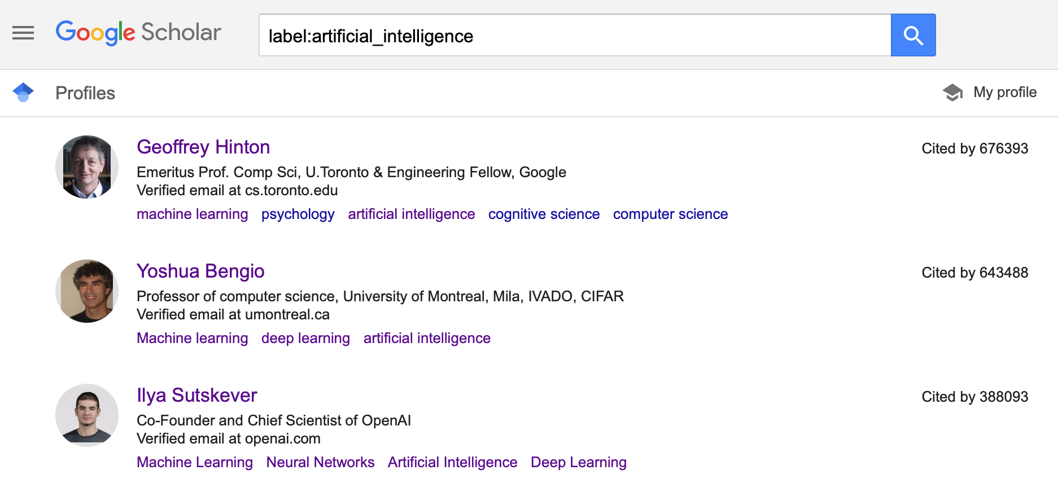

Slide 13
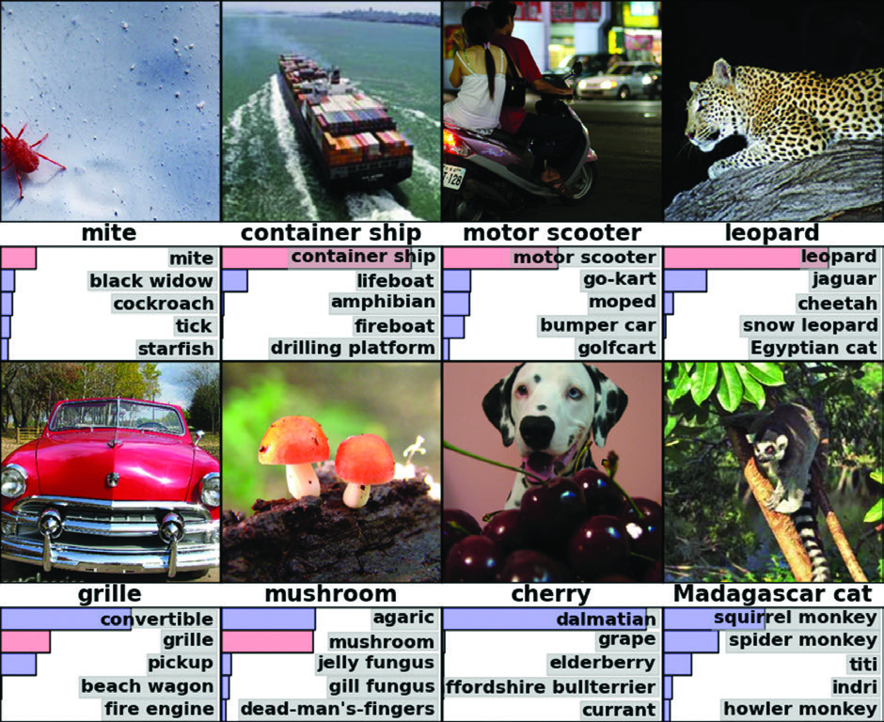
Impact factor 14.06
ImageNet LSVRC-2010
Achieved top-1 and top-5 error rates of 37.5% and 17.0% compared to 45.7% and 25.7% before

Slide 14
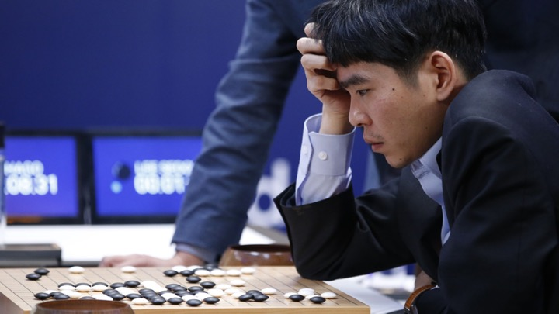
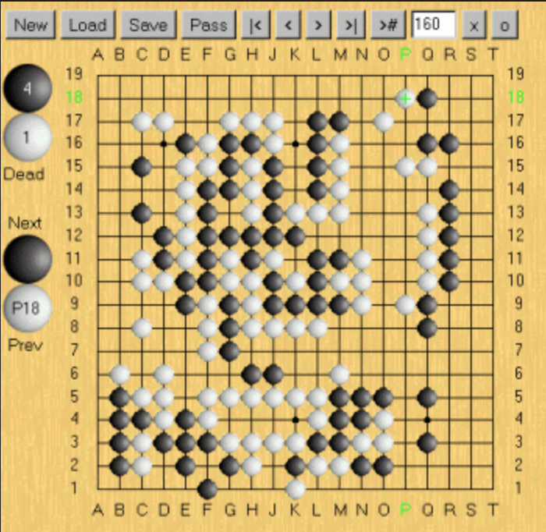
Human online game behavior
2016: AlphaGo by Google DeepMind
vs.
Lee Sedol (No2)

Slide 15
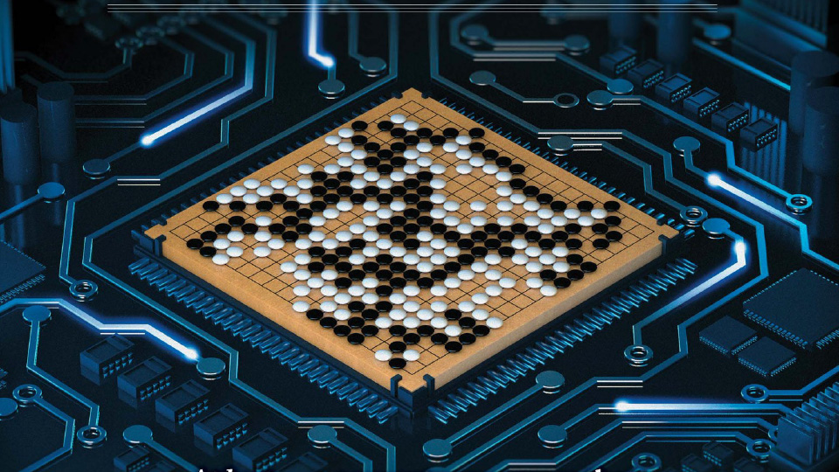

Slide 16
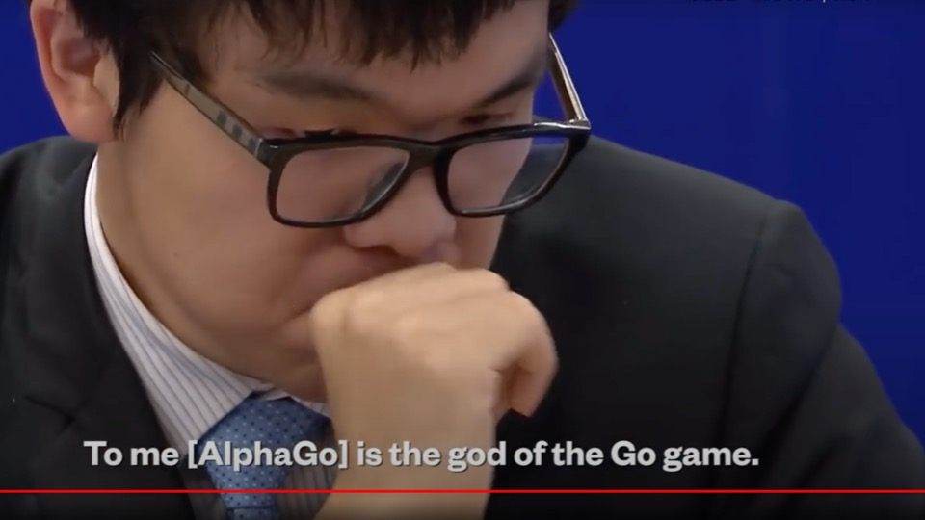
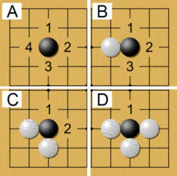
Self learning
2017: AlphaGo by Google DeepMind
vs.
Ke Jie 柯洁 (No1)

Slide 17
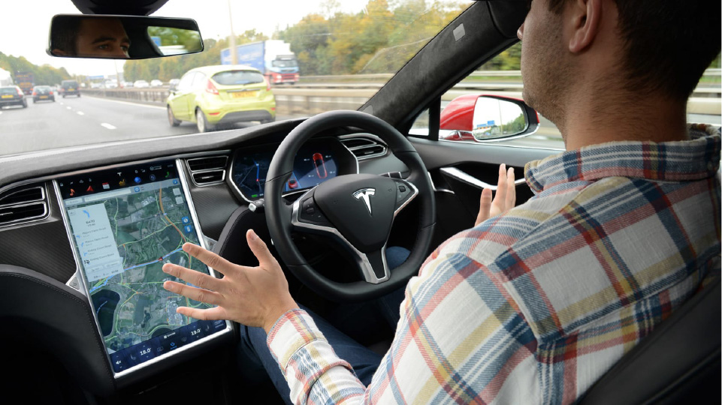
https://media.autoexpress.co.uk/image/private/s--AgytYsMD--/t_content-image-desktop@1/v1563183852/autoexpress/2016/10/dsc_2334.jpg

Slide 18
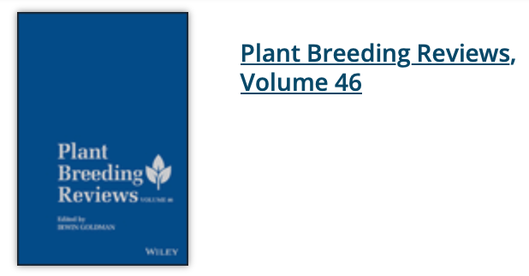
https://www.preprints.org/manuscript/202103.0519/v1

Slide 19
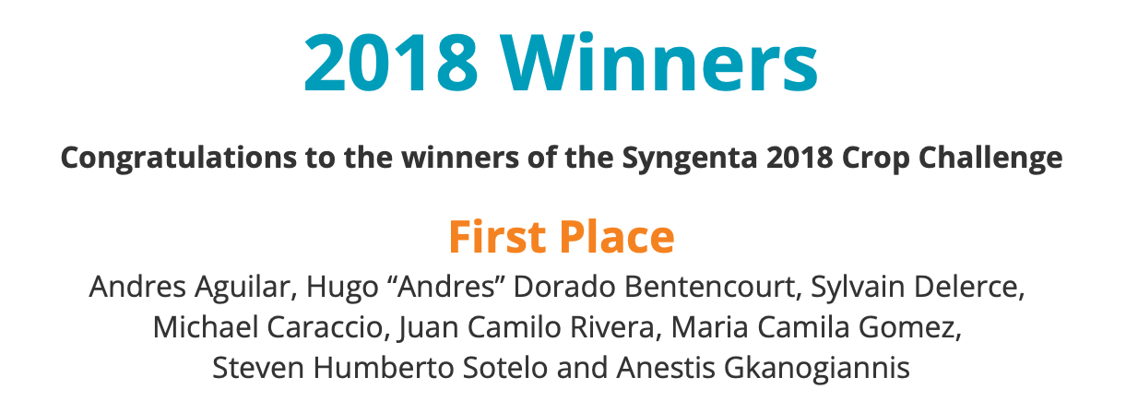
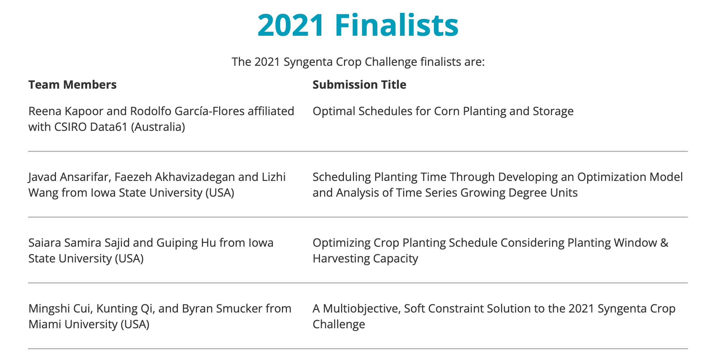
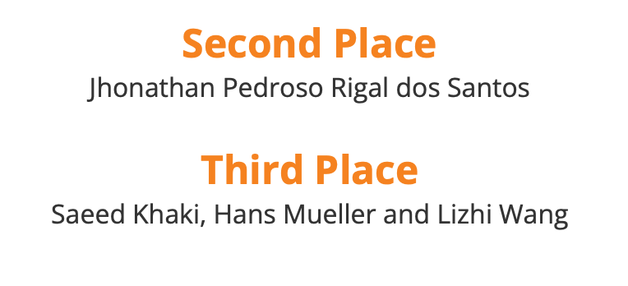

Slide 20
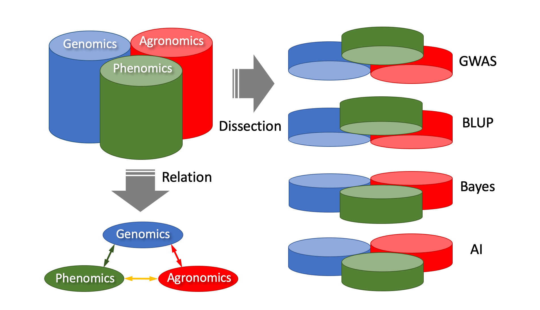
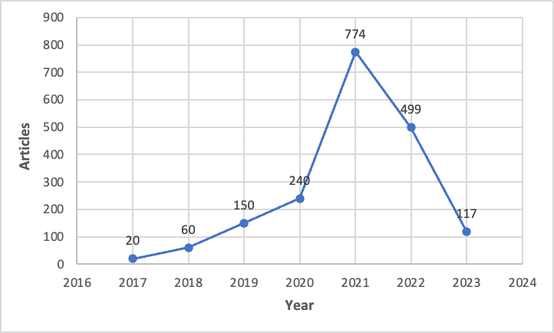
Genomics, Phenomics, and Agronomics (GPA)

Slide 21
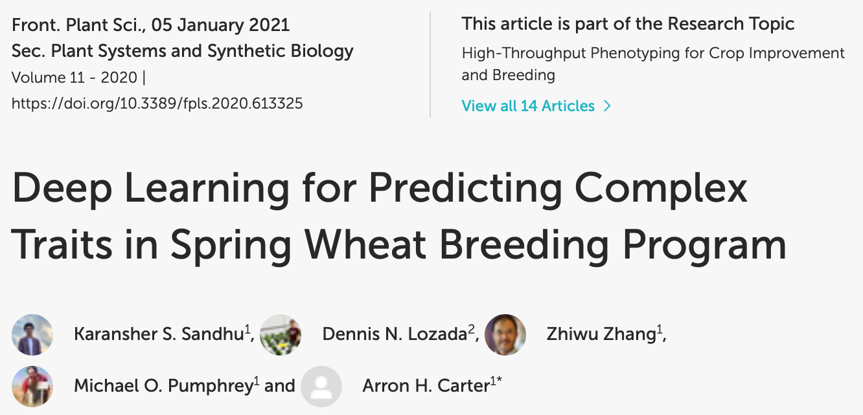
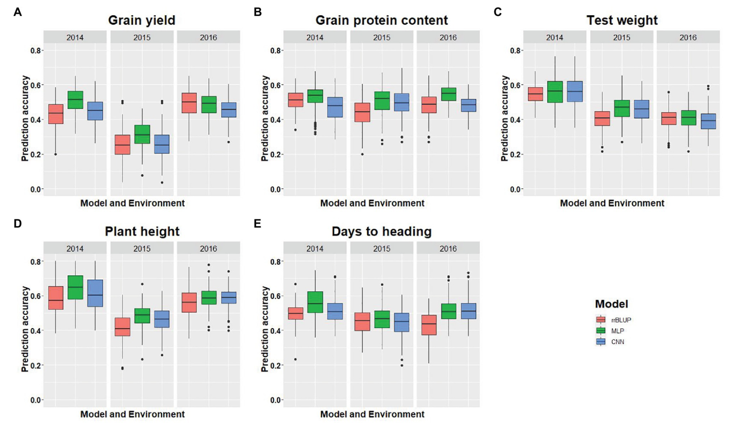

Slide 22
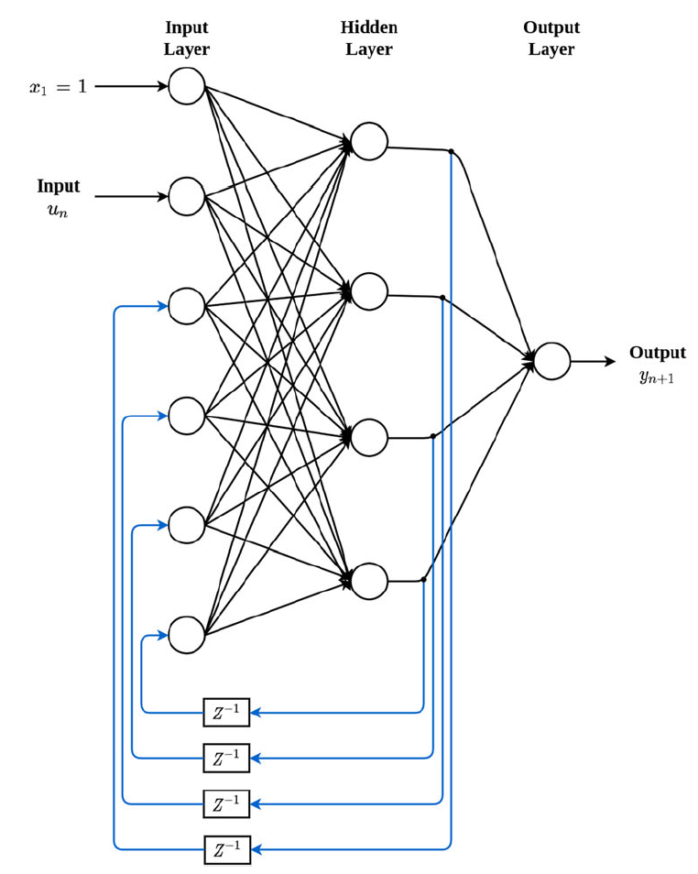
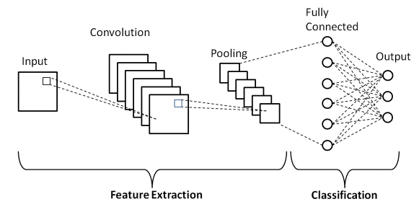
Architecture of Neural Networks
Multi-Layer Perceptron (MLP)
Feedforward networks
Fully connected layers
Convolution
Neural
Networks
(CNN)
Recurrent Neural Networks
(RNN)

Slide 23
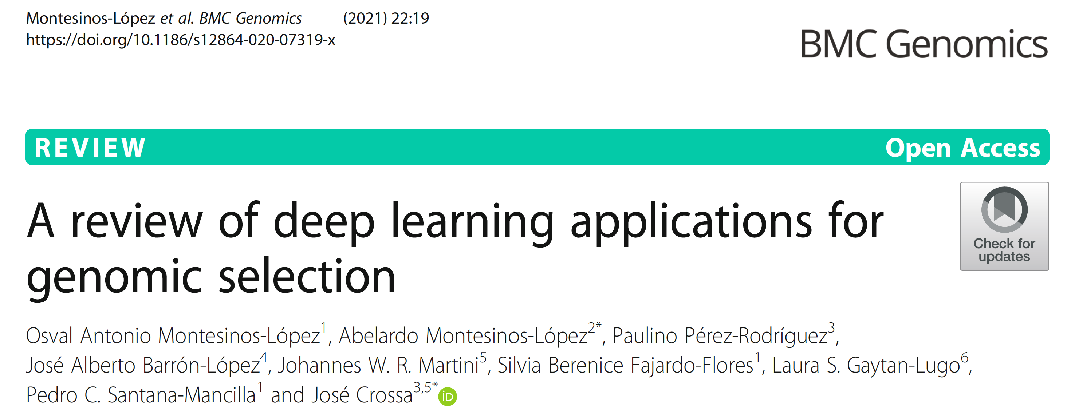
Genomic Prediction Using Neural Networks

Slide 24
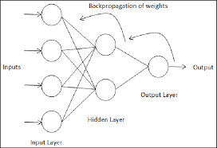
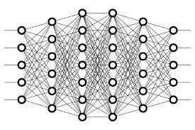
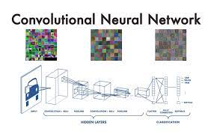
Build a path for everyone to succeed in AI
Plug&Play

Slide 25
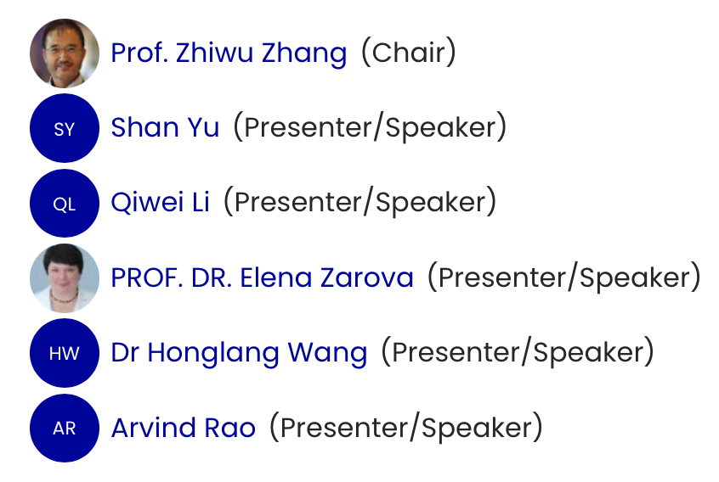

Slide 26
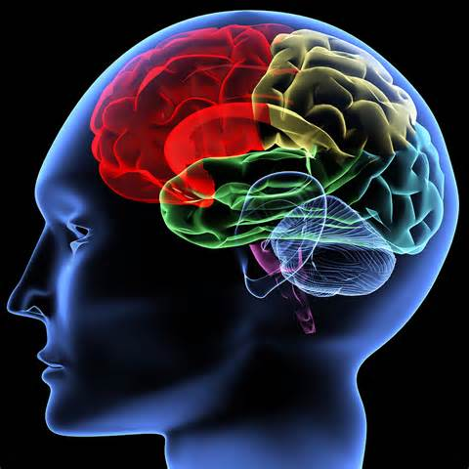
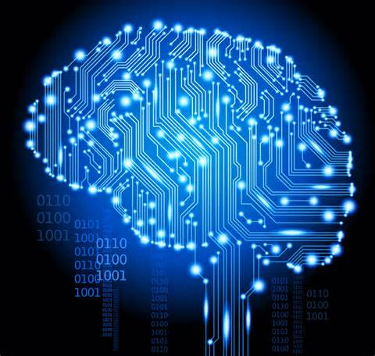
Brain vs. computer
Characteristics
Memory |  | ✔️
Calculation |  | ✔️
Information access |  | ✔️
Life span |  | ✔️
Structure | ✔️ (100B N, 4QD C, & 200MY evolution)

Slide 27
From "+&+" To "-&-"
+K
-Group K
-QTN K
+Q/PC
-QTN & -K
-QTN K & -SNP
GWAS
-QTN & -SNP
GLM
MLM
CMLM
SUPER
MLMM
FarmCPU
BLINK
t
+More
hyper parameters
+Hyper parameters
+All SNPs random
-Weight
-Bias only
+All SNP K
GS
MAS
gBLUP
RR
Bayes A
Bayes +
AI

Slide 28
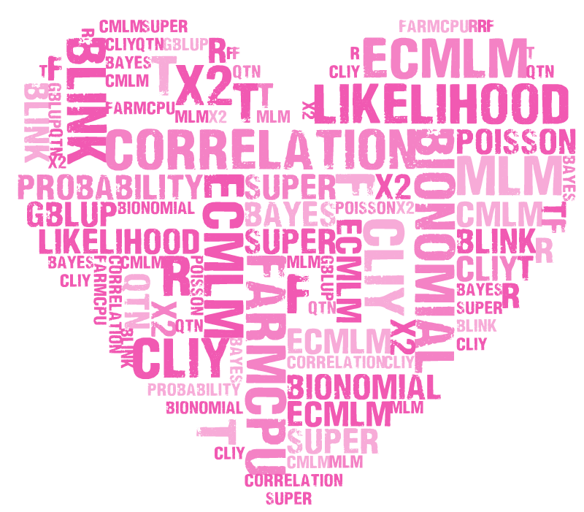
Keywords
MLM cMLM ecMLM SUPER FarmCPUPU BLINK GWASbyCor correlation QTN gBLUP Bayes likelihood probability R t f x2 Bionomial Poisson distribution statistics phenotype genotype MAF GAPIT rrBLUP BLR MLMM LASSO Gibbs PCA Structure Population Kinship EMMA Matrix inverse Transpose if loop function type1&2 error FDR threshold coverage depth simulation linkage disequilibrium power P3D MAS gBLUP ssBLUP cBLUP sBLUP Bayes A B Cpi Prior Posterior Exponential Kernel Ridge Regression
545

Slide 29
By GWAS&GS!

Slide 30
Remains in Statistical Genomics (545)
Critical thinking
Innovative
Perfection

