Slide 1
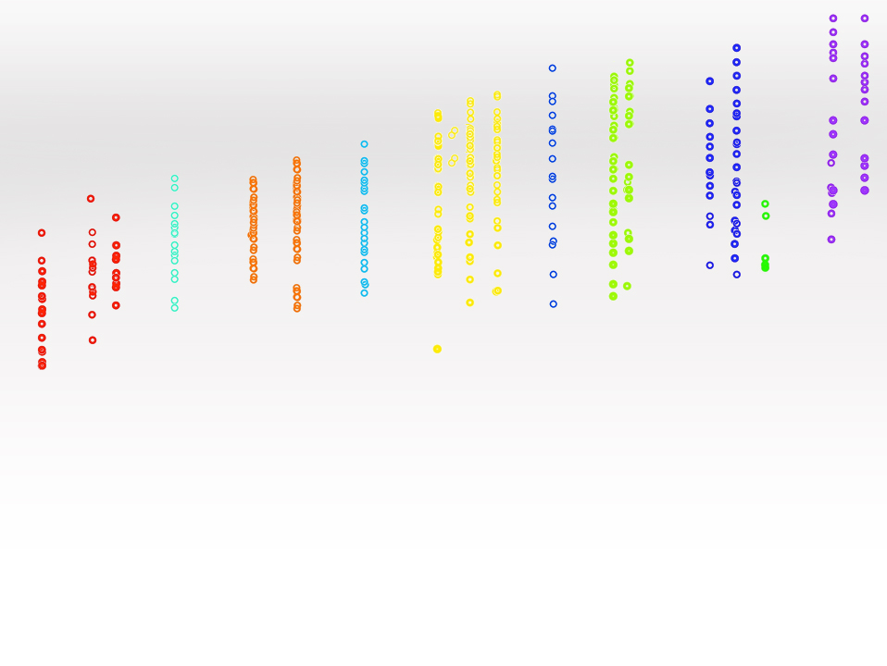
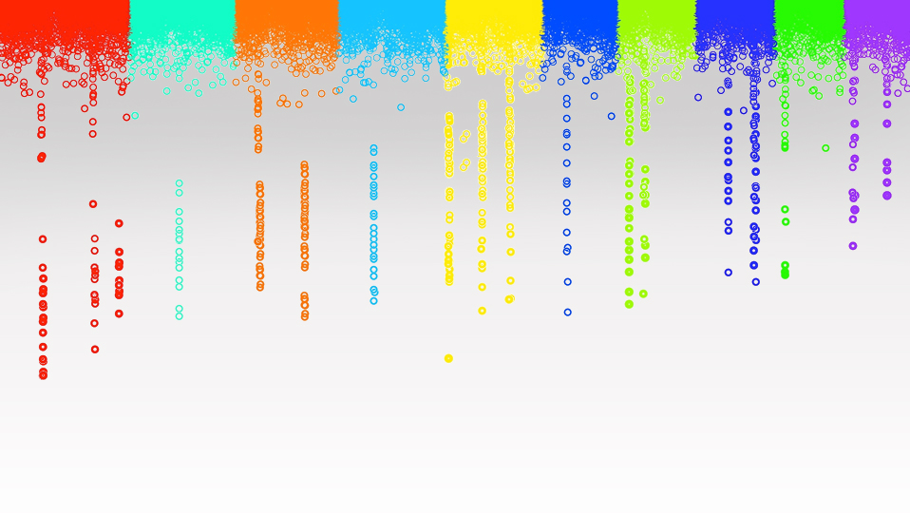
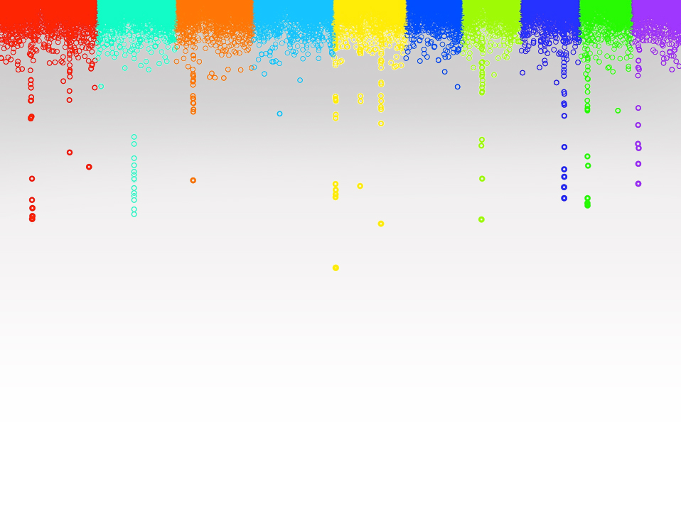

Statistical Genomics
GWAS and GS
Zhiwu Zhang
Washington State University

Slide 2
Outline
Self introduction
Syllabus
Course structure
Why this course

Slide 3
Objectives
Knowledgeable (deep understanding)
Useful: (tools, analytical, research, jobs)
Reasoning and critical thinking
Fun: motivation through re-inventing or invention

Slide 4
Prerequisites
Statistics
  Statistical inference
  General linear model
  Random effect model
  Bayesian theory
Genetics: Introduction level or beyond
Computer programming: R

Slide 5
Lectures and Labs
M&F (3:10-4:00): Lectures
W (3:10-5:40): Lab (R code in lectures and HW)

Slide 6
Grade options
  Letter
S/U
Percentage | Letter
93%-100% | A
90%-93% | A-
87%-90% | B+
83%-87% | B
80%-83% | B-
77%-80% | C+
73%-77% | C
70%-73% | C-
66%-70% | D+
60%-66% | D
0%-60% | F
Satisfied
Unsatisfied

Slide 7
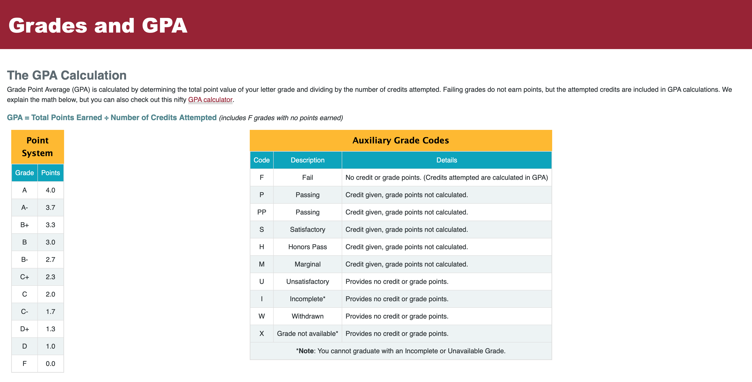
https://registrar.wsu.edu/grades-and-gpa

Slide 8
Grade components
Attendance: 10%
Participation: 30%
  10% by student,
  10% by TA, and
  10% by instructor
Homework (60%)
  HW1: 20%
  HW2: 20%
  HW3: 20%

Slide 9
Homework
Assignments: Four in total
Due 3:10 PM at specific dates
Late homework: half off per day.
Teamwork: Encouraged for debugging and discussion on solving strategies and result interpretation. Coding and writing must be individual efforts.

Slide 10


Homework
HW1: A GWAS package on Github
HW2: GWAS Power evaluation paper on preprints.org
HW3: GS accuracy evaluation paper on preprints.org

Slide 11
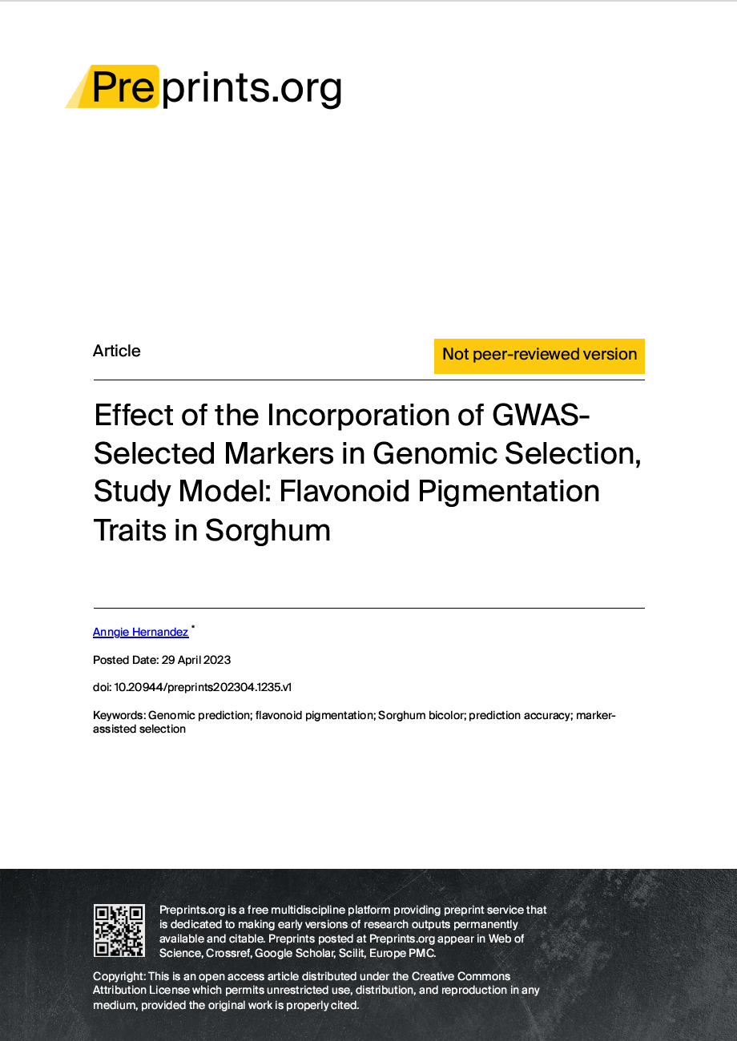
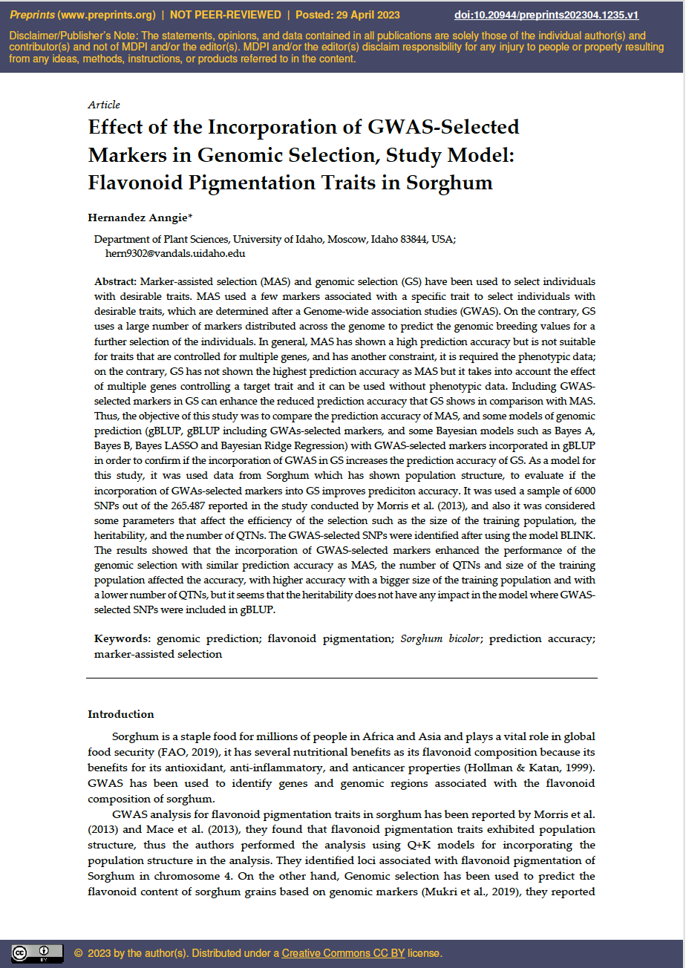

Slide 12
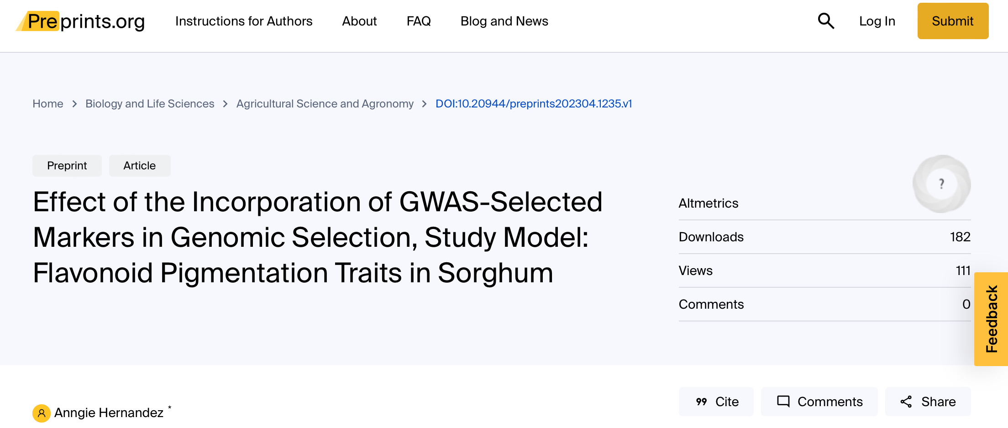
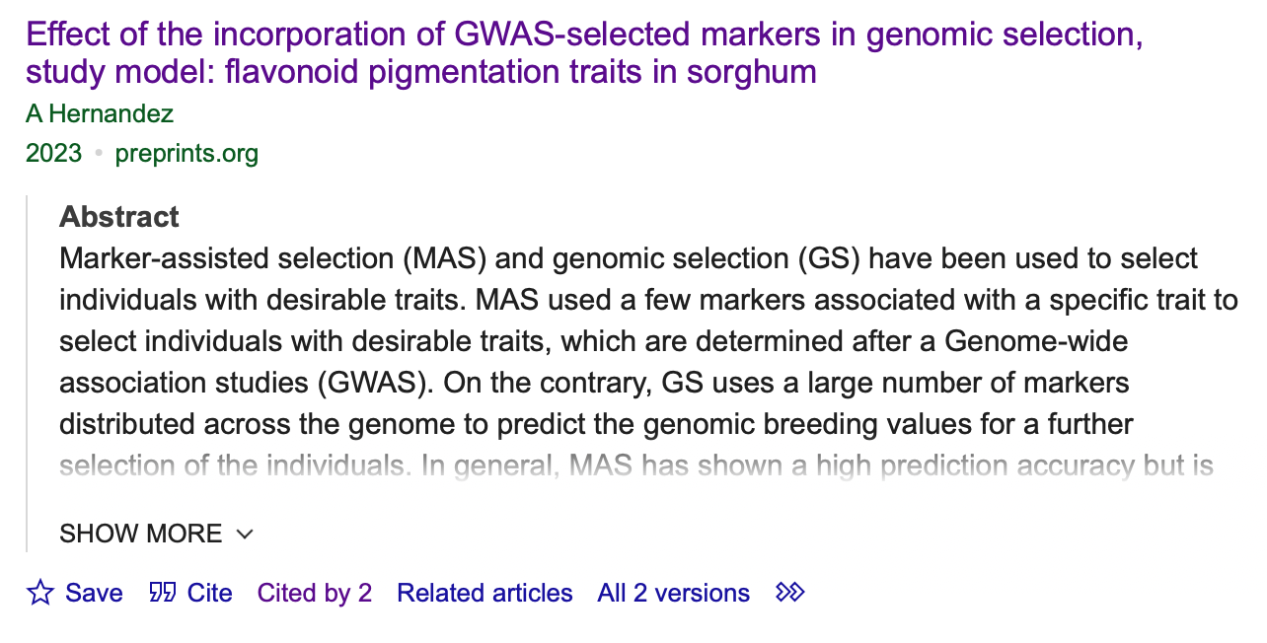

Slide 13
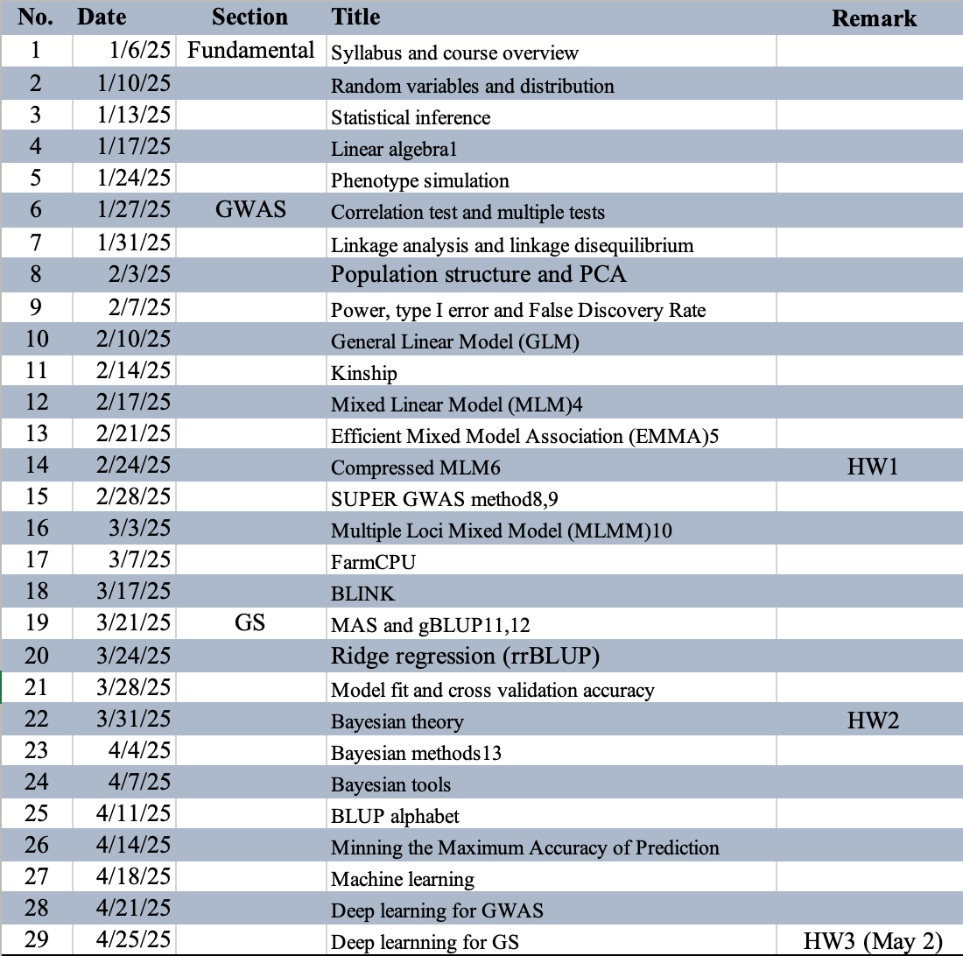

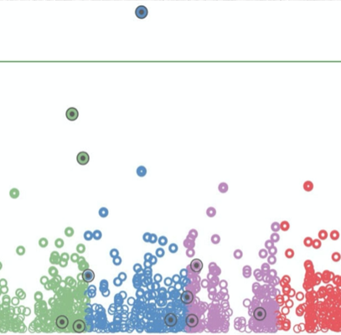
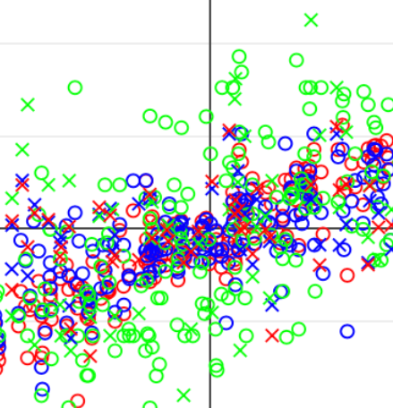
Lecture structure

Slide 14
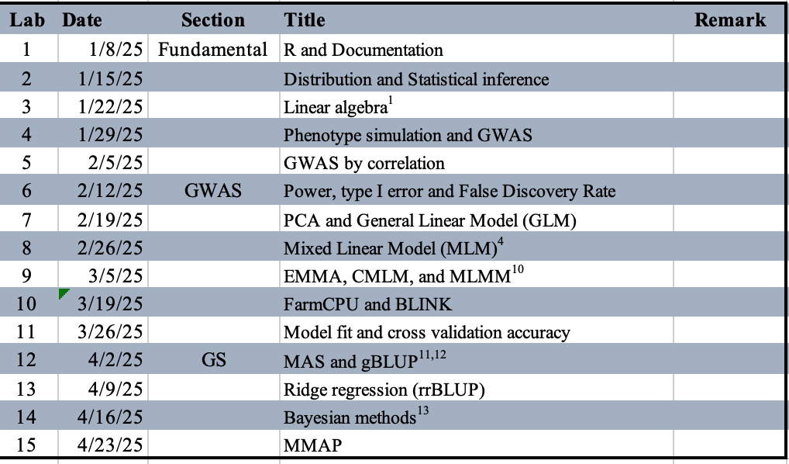
Lab structure
3:10-4:00 Assignment to interpret R code in lecture
4:10-5:00 Homework (Design, coding skills, and debug)
5:10-5:40 General questions and discussion

Slide 15

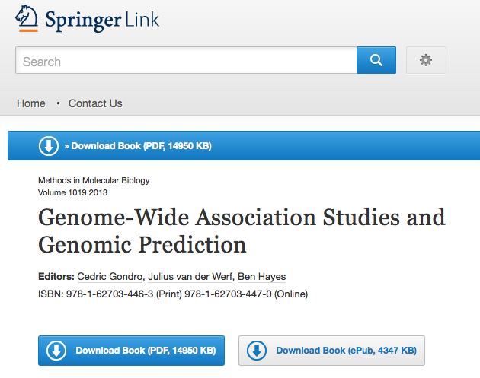
Text book
http://link.springer.com/book/10.1007%2F978-1-62703-447-0

Slide 16
Reference
1. Lynch, M. & Walsh, B. Genetics and analysis of quantitative traits. Genetics and analysis of quantitative traits. (1998).
2. Elshire, R. J. et al. A robust, simple genotyping-by-sequencing (GBS) approach for high diversity species. PLoS One 6, e19379 (2011).
3. Marchini, J. & Howie, B. Genotype imputation for genome-wide association studies. Nat Rev Genet 11, 499–511 (2010).
4. VanRaden, P. M. Efficient methods to compute genomic predictions. J Dairy Sci 91, 4414–4423 (2008).
5. Yu, J. et al. A unified mixed-model method for association mapping that accounts for multiple levels of relatedness. Nat. Genet. 38, 203–208 (2006).
6. Zhang, Z. et al. Mixed linear model approach adapted for genome-wide association studies. Nat Genet 42, 355–360 (2010).
7. Kang, H. M. et al. Efficient control of population structure in model organism association mapping. Genetics 178, 1709–1723 (2008).
8. Kang, H. M. et al. Variance component model to account for sample structure in genome-wide association studies. Nat Genet 42, 348–354 (2010).
9. Wang, Q., Tian, F., Pan, Y., Buckler, E. S. & Zhang, Z. A SUPER Powerful Method for Genome Wide Association Study. PLoS One 9, e107684 (2014).
10. Lippert, C. et al. FaST linear mixed models for genome-wide association studies. Nature Methods 8, 833–835 (2011).
11. Segura, V. et al. An efficient multi-locus mixed-model approach for genome-wide association studies in structured populations. Nature Genetics 44, 825–830 (2012).
12. Liu, X., Huang, M., Fan, B., Buckler, E. S. & Zhang, Z. Iterative Usage of Fixed and Random Effect Models for Powerful and Efficient Genome-Wide Association Studies. PLoS Genet. 12, e1005767 (2016).
13. Zhou, Y., Isabel Vales, M., Wang, A. & Zhang, Z. Systematic bias of correlation coefficient may explain negative accuracy of genomic prediction. Briefings Bioinforma. (2016).
14. Zhang, Z., Todhunter, R. J., Buckler, E. S. & Van Vleck, L. D. Technical note: Use of marker-based relationships with multiple-trait derivative-free restricted maximal likelihood. J. Anim. Sci. 85, 881–885 (2007).
15. Bernardo, R. Prediction of maize single-cross performance using RFLPs and information from related hybrids. Crop Sci. 34, 20–25 (1994).
16. Endelman, J. Ridge regression and other kernels for genomic selection in the R package rrBLUP. Plant Genome 4, 250–255 (2011).
17. Meuwissen, T. H., Hayes, B. J. & Goddard, M. E. Prediction of total genetic value using genome-wide dense marker maps. Genetics 157, 1819–1829 (2001).
18. Pérez, P., de los Campos, G., Crossa, J. & Gianola, D. Genomic-Enabled Prediction Based on Molecular Markers and Pedigree Using the Bayesian Linear Regression Package in R. Plant Genome J. 3, 106 (2010).

Slide 17
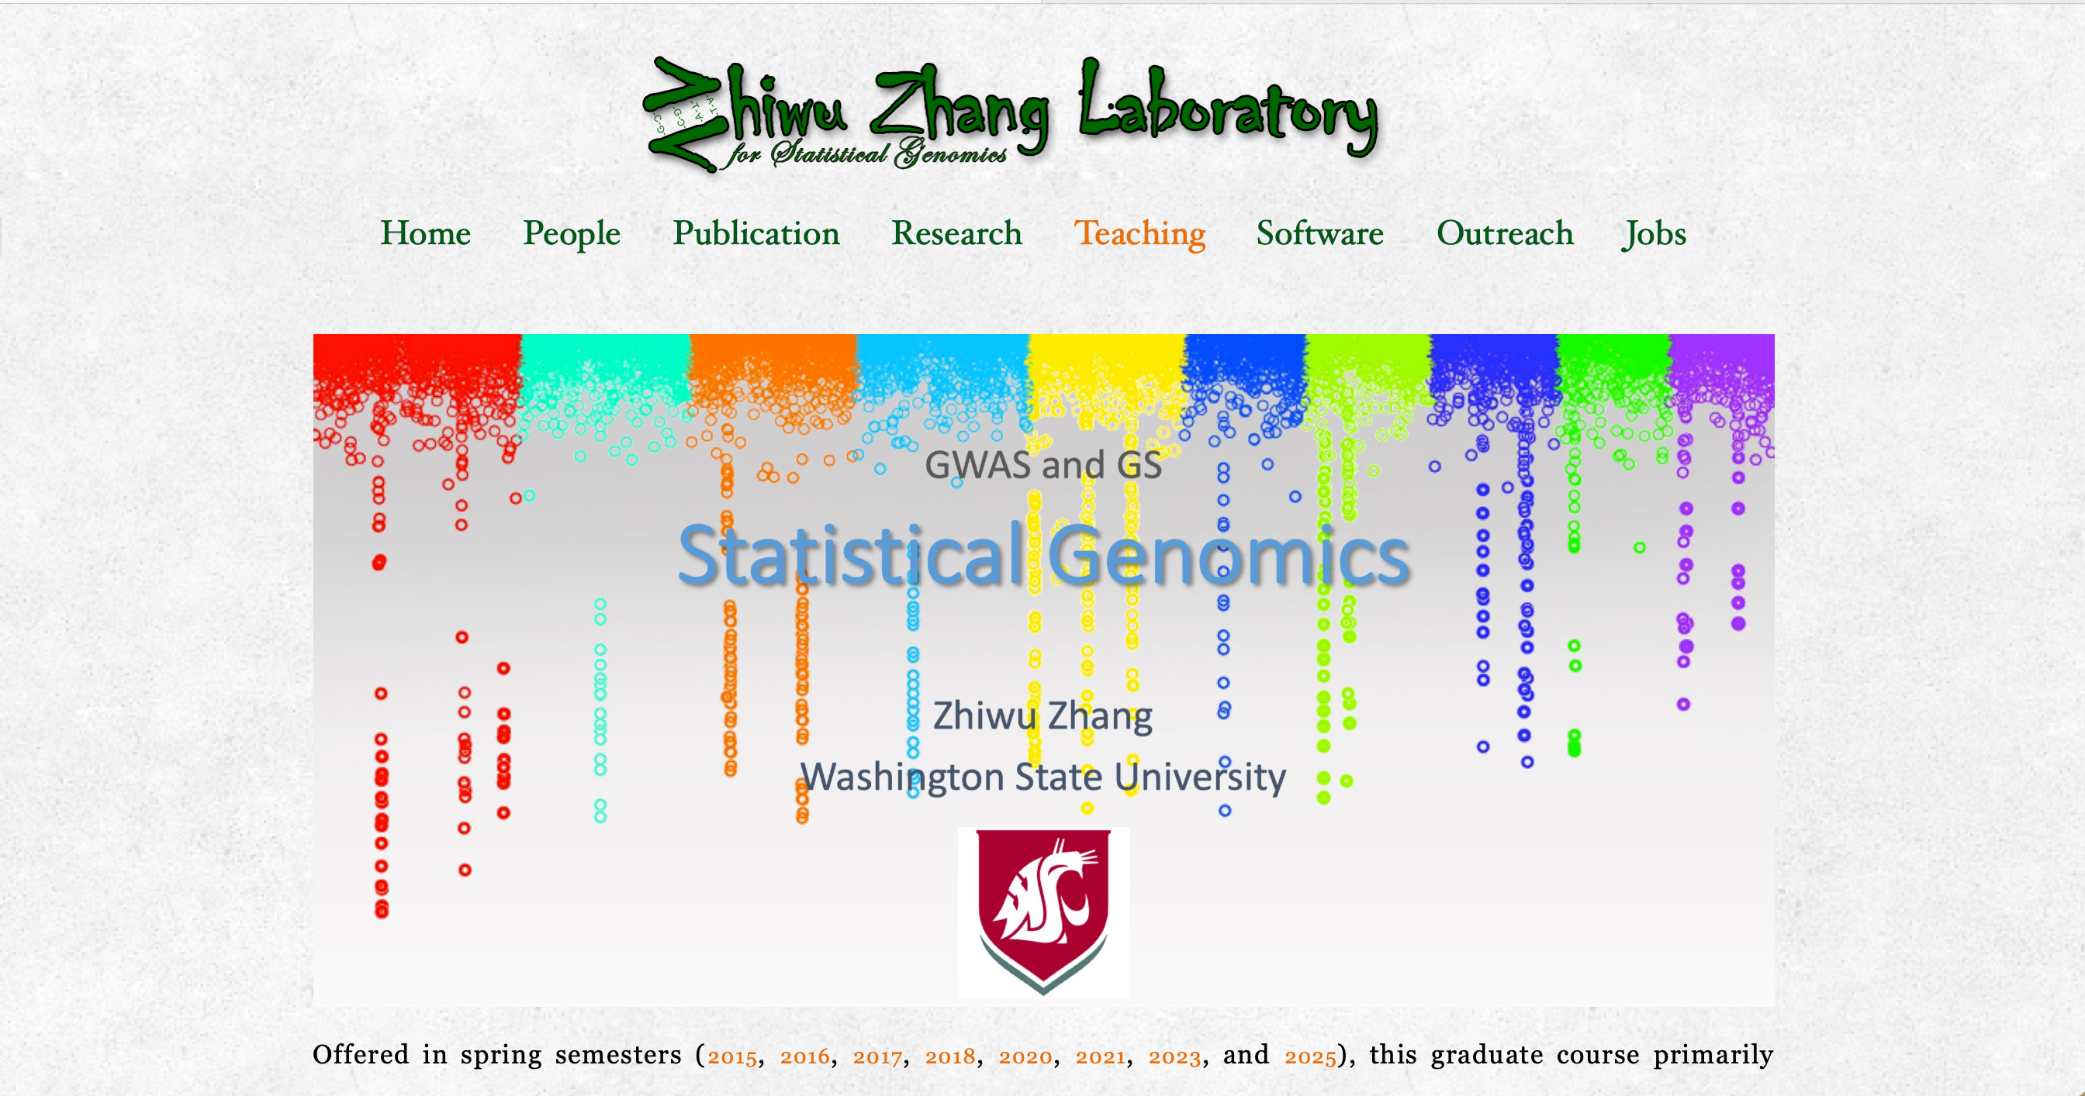
http://zzlab.net

Slide 18
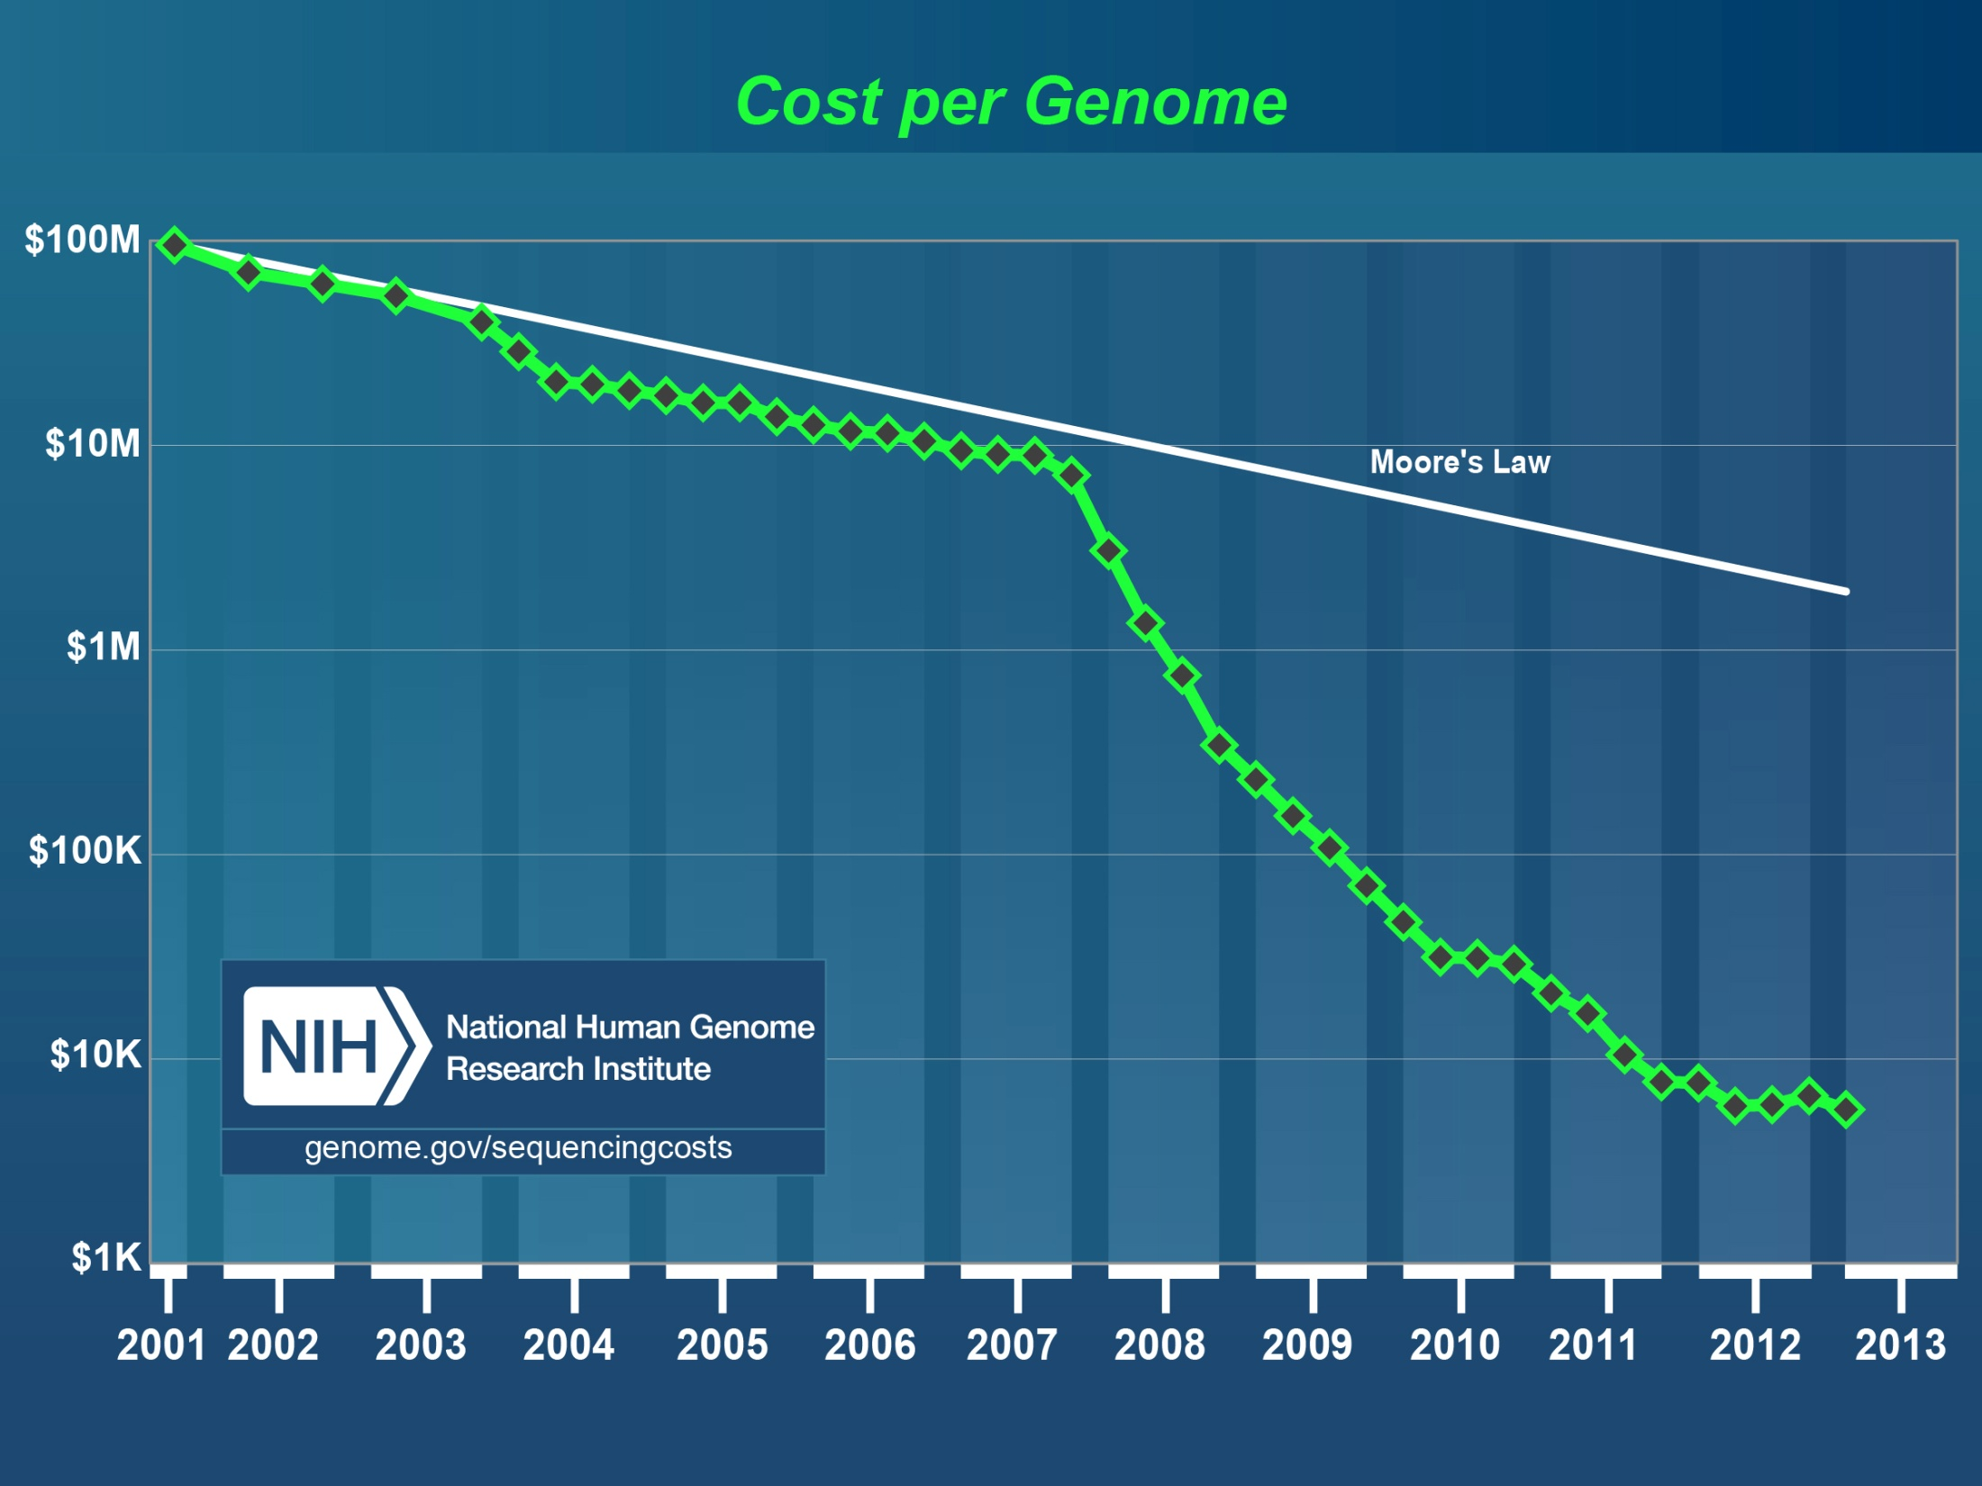
Human
genome
2nd
Generation Sequencing
http://luckyrobot.com/wp-content/uploads/2013/04/nih-cost-genome.jpg

Slide 19
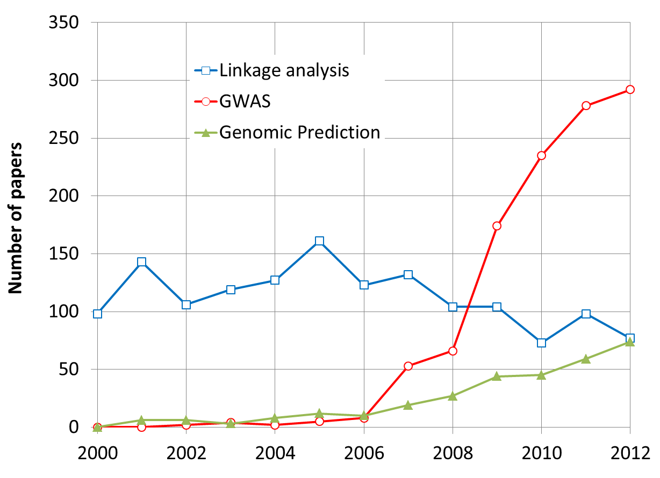
More Research on GWAS and GS
By May 31, 2013

Slide 20
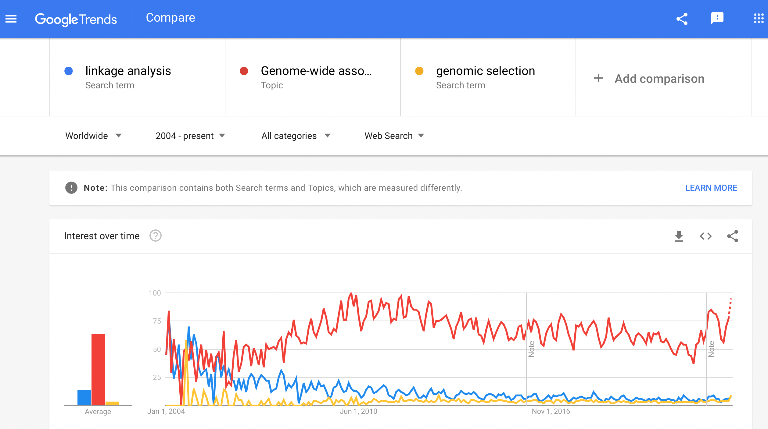

Slide 21
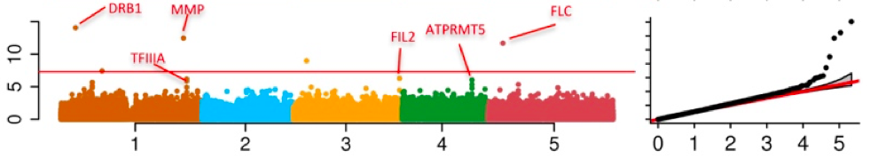
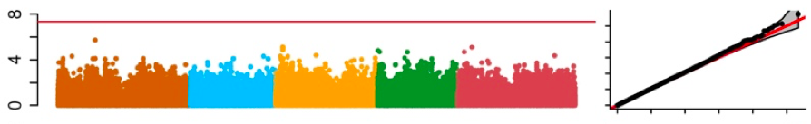
Problems in GWAS
Computing difficulties: millions of markers, individuals, and traits
False positives, ex: “Amgen scientists tried to replicate 53 high-profile cancer research findings, but could only replicate 6”, Nature, 2012, 483: 531
False negatives

Slide 22
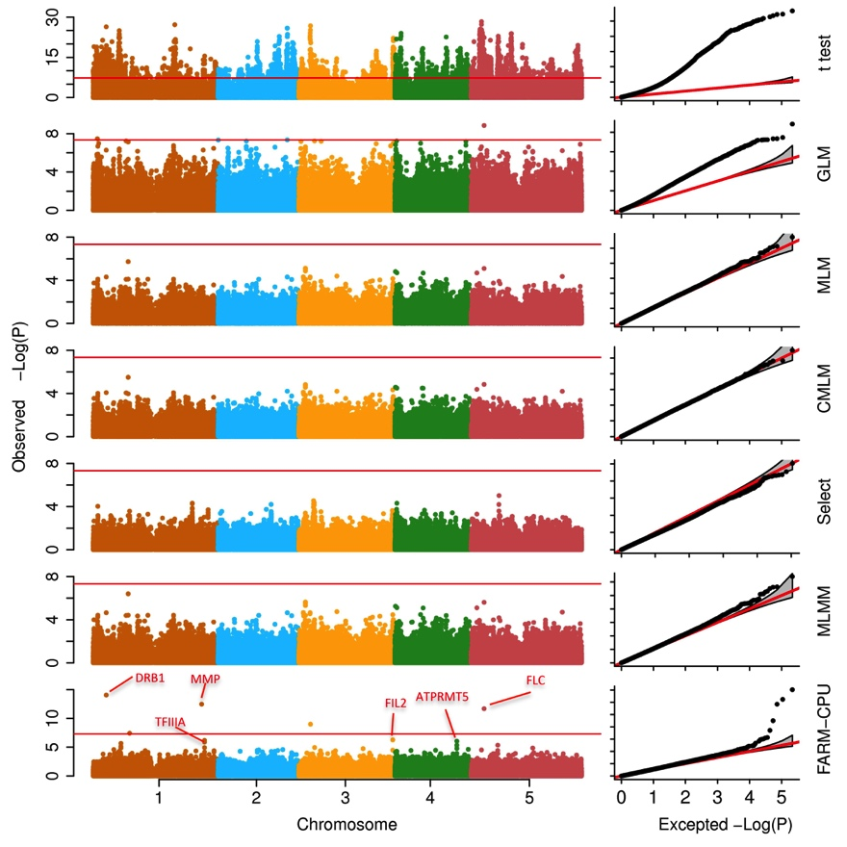
Associations on flowering time

Slide 23

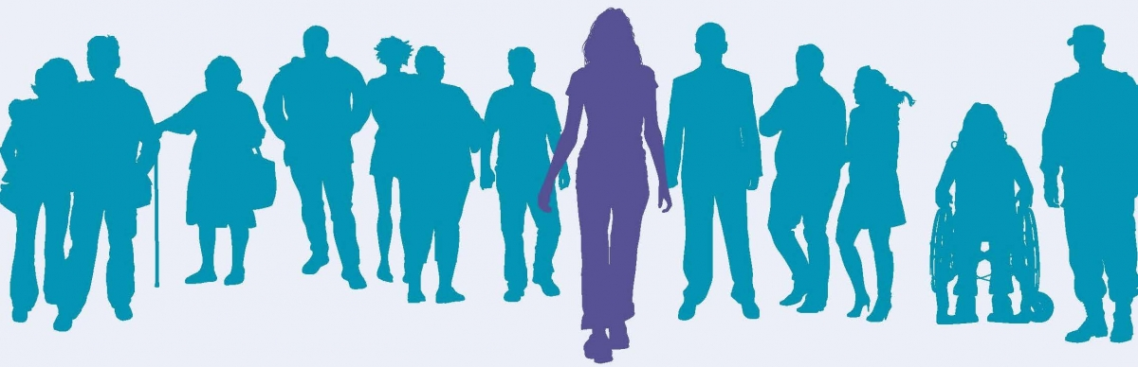
The Precision Medicine Imitative (2015)
250 Million dollars investment in 2016

Slide 24

Dosage variation among individuals

Slide 25

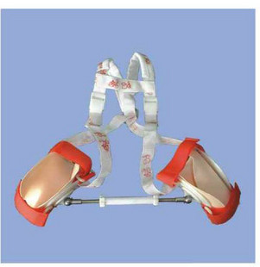
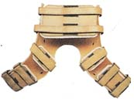
Preventive medical treatment

Slide 26
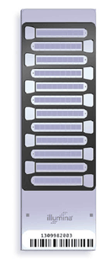
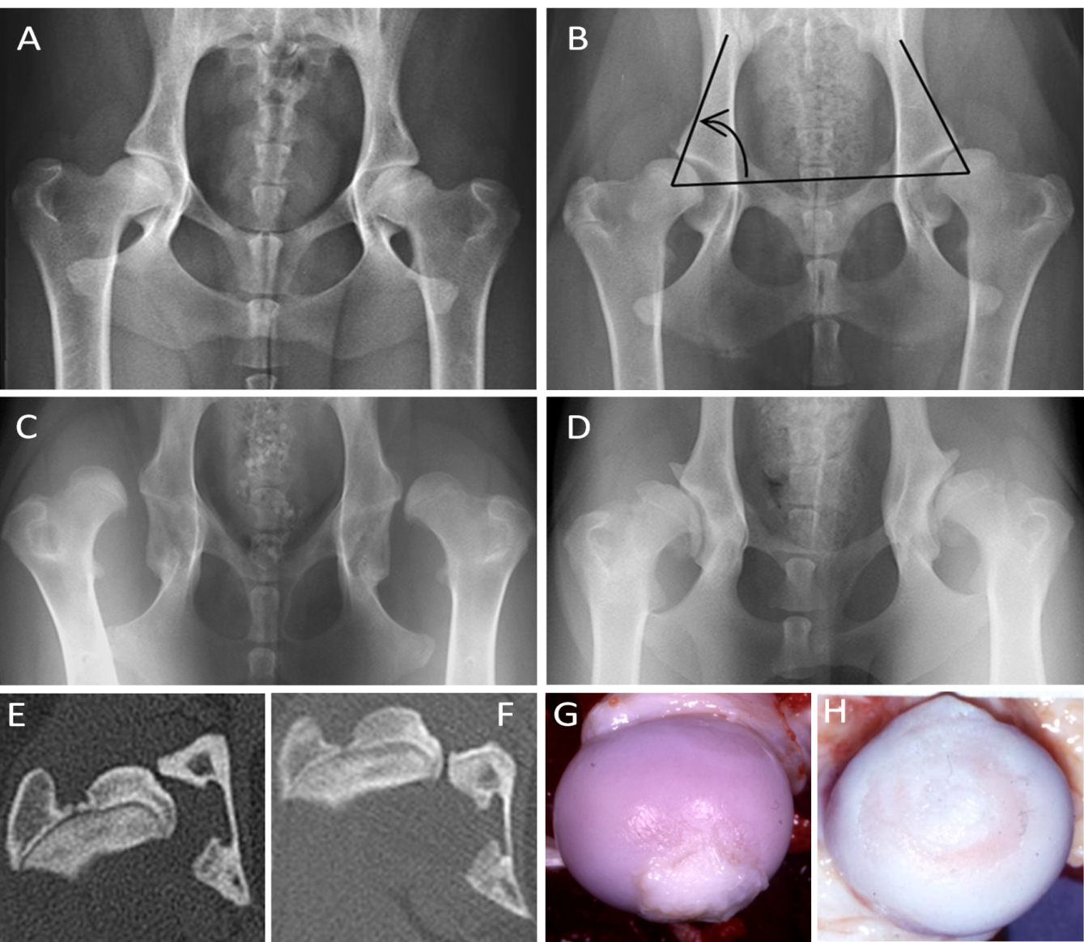
Canine Hip Dysplasia is predictive

Slide 27
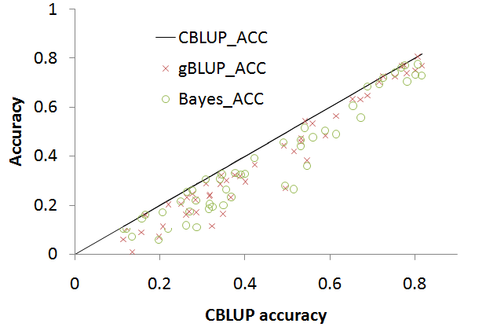
Genomic prediction

Slide 28
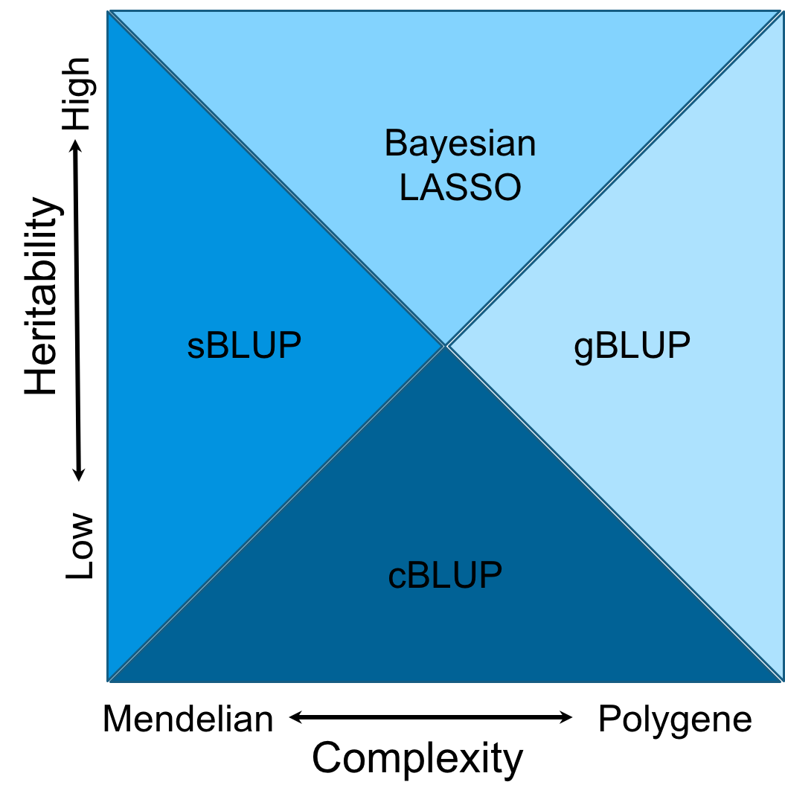
Domains
Notes:
Figure 6.The cost time of computing genomic prediction in three method.
Bayesion method (green) cost most time than other methods, and gBLUP (blue) is the least. The cost time of scBLUP (orange) computing genomic prediction depend on the number of individuals of population (compression) and the number of markers (SUPER). The computing time is calculated by CPU computing time.

Slide 29
Highlight
Syllabus
Course structure
Why this course

