Slide 1


Statistical Genomics
Linear Algebra
Zhiwu Zhang
Washington State University

Slide 2
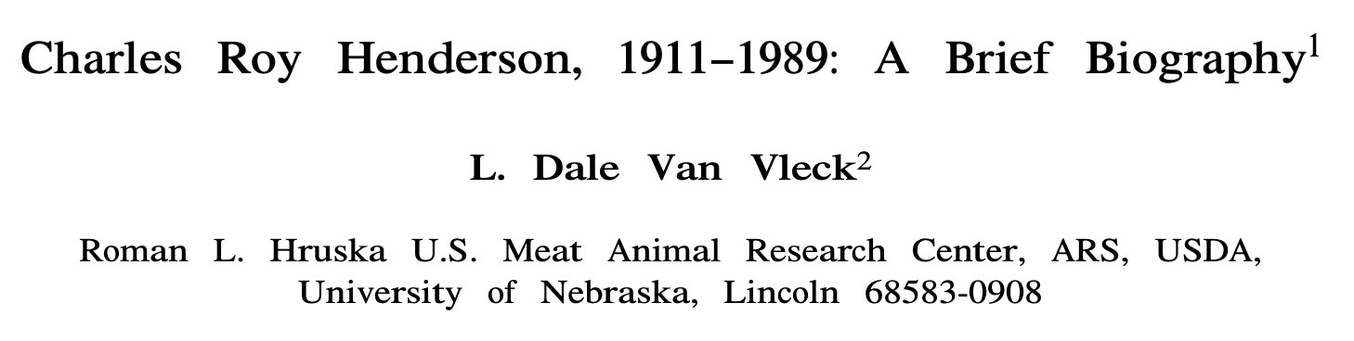
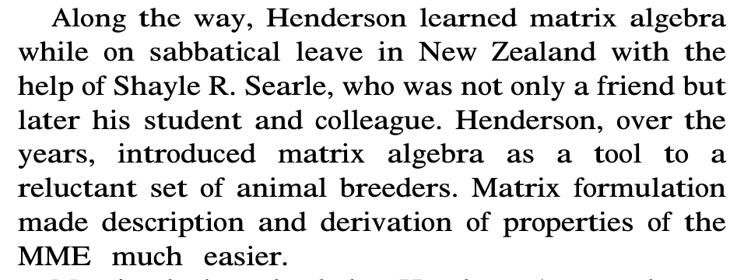

Slide 3
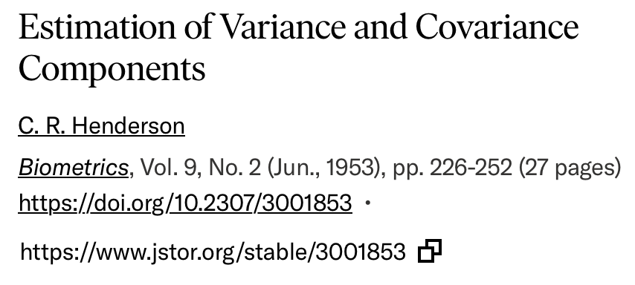
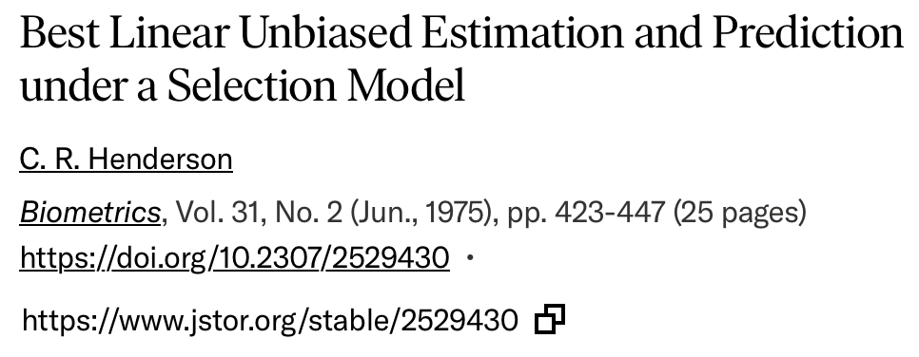
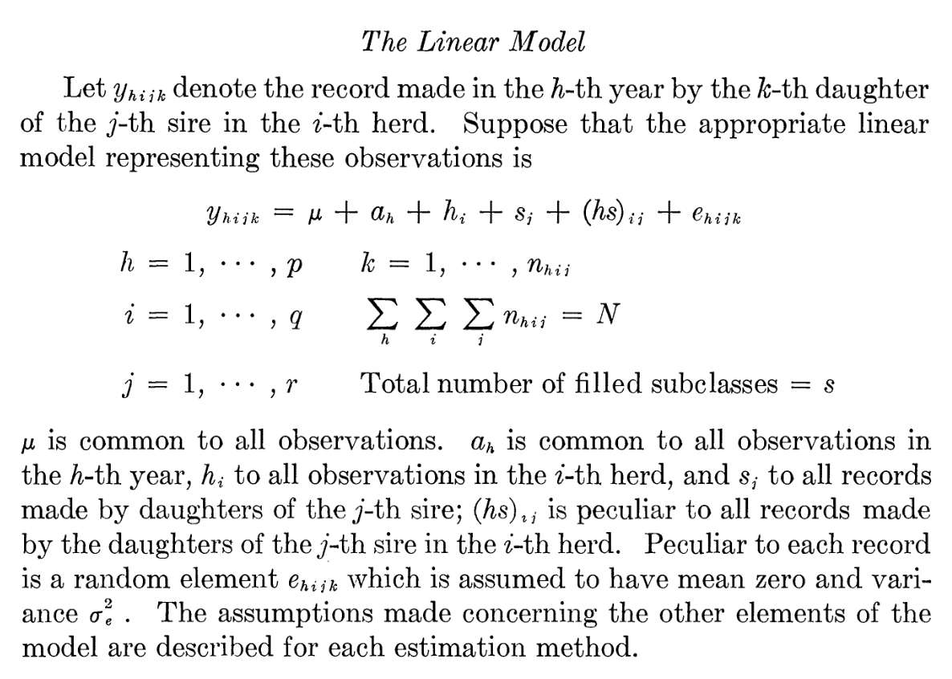
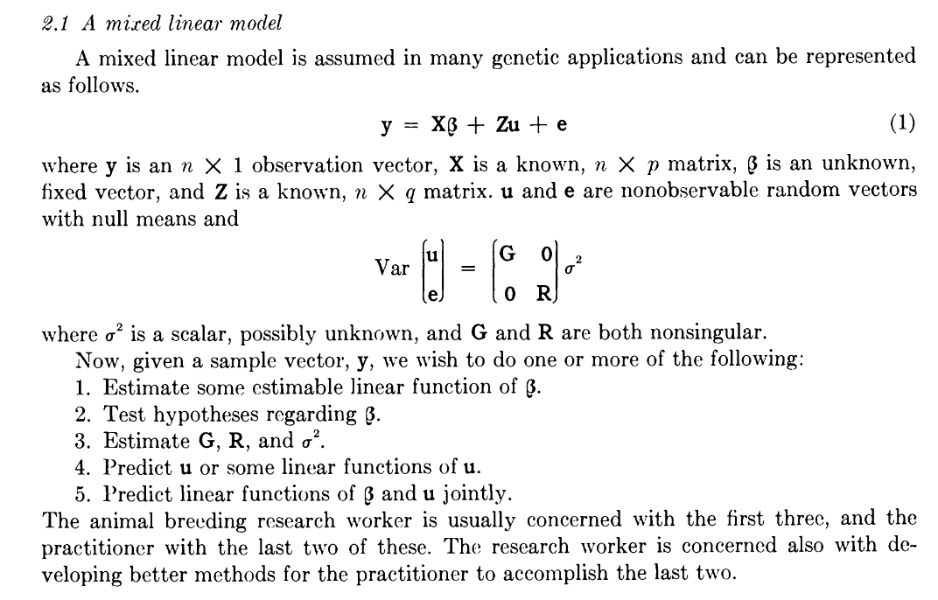

Slide 4
Outline
Expectation and Variance of random variable
Expectation and Variance of function of random variable
Covariance among variables
Matrix and manipulations (multiplication)
Special matrices: Identity, symmetric, diagonal, singular, and orthogonal
Rank

Slide 5
Expectation=Mean when sample size goes to infinity
par(mfrow=c(3,1),mar = c(3,4,1,1))
x=rchisq(n=10,df=5)
hist(x)
abline(v=mean(x), col = "red")
x=rchisq(n=100,df=5)
hist(x)
abline(v=mean(x), col = "red")
x=rchisq(n=10000,df=5)
hist(x)
abline(v=mean(x), col = "red")

Slide 6
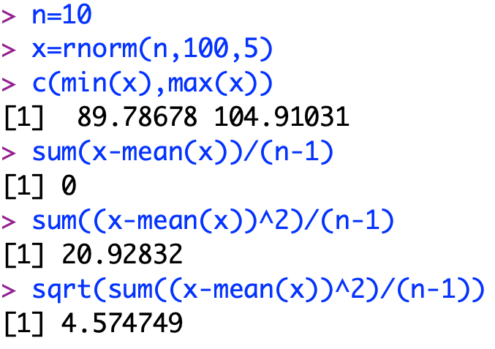
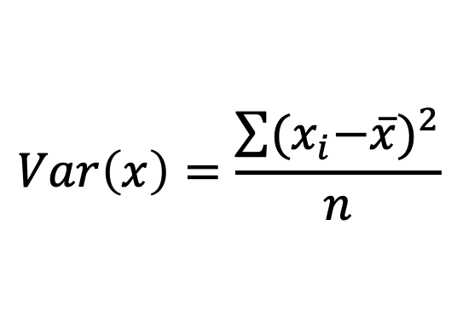
Variance
Range
Average deviation from mean, but it is always sum to zero
Average squared deviation from mean: Variance
Square root of variance = standard deviation
$$Var\left(x\right)=\frac{\sum{{{(x}_{i}−\overline{x})}^{2}}}{n}$$
n=10
x=rnorm(n,100,5)
c(min(x),max(x))
sum(x-mean(x))/(n-1)
sum((x-mean(x))^2)/(n-1)
sqrt(sum((x-mean(x))^2)/(n-1))

Slide 7
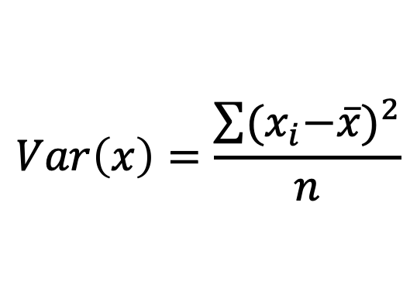
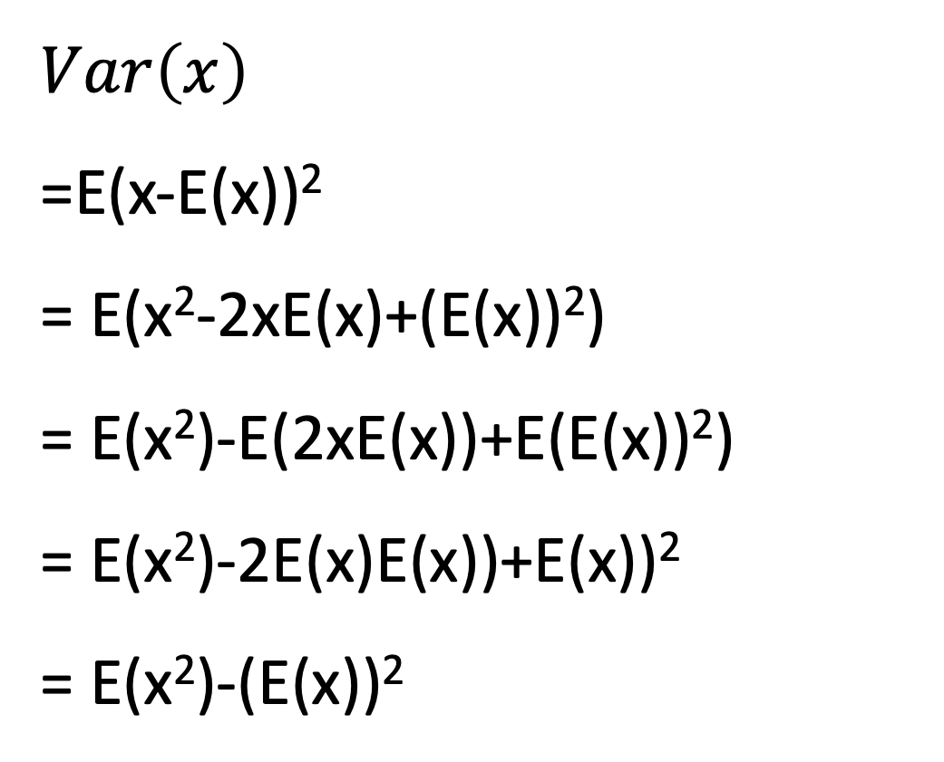
Variance from Expectation perspective
$$Var\left(x\right)$$
=E(x-E(x))²
= E(x²-2xE(x)+(E(x))²)
= E(x²)-E(2xE(x))+E(E(x))²)
= E(x²)-2E(x)E(x))+E(x))²
= E(x²)-(E(x))²
$$Var\left(x\right)=\frac{\sum{{{(x}_{i}−\overline{x})}^{2}}}{n}$$

Slide 8
Expectation and variance of linear function of random variables
n=10000
df=10
x=rchisq(n,df)
mean(x)
var(x)
y=5*x
mean(y)
var(y)
z=5+x
mean(z)
var(z)
y=ax and a is a scaler, then
E(y)=aE(x),
Var(y)=a^2*Var(x)
y=x+a, then
E(y)=E(x)+a
Var(y)=Var(x)

Slide 9
Question
x and y are two random variables
Exp(xy)=Exp(x) Exp(y)? Yes
Var(xy)=Var(x) Var(y)? Yes if x and y are independent
Otherwise No
https://stats.stackexchange.com/questions/568666/formula-for-the-variance-of-the-product-of-two-random-variables

Slide 10
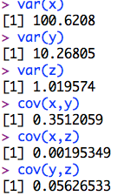
Covariance
n=10000
x=rpois(n, 100)
y=rchisq(n,5)
z=rt(n,100)
par(mfrow=c(3,1),mar = c(3,4,1,1))
plot(x,y)
plot(x,z)
plot(y,z)
var(x)
var(y)
var(z)
cov(x,y)
cov(x,z)
cov(y,z)

Slide 11
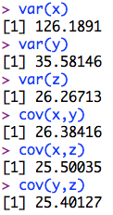
Covariance
n=10000
a=rnorm(n,100,5)
x=a+rpois(n, 100)
y=a+rchisq(n,5)
z=a+rt(n,100)
par(mfrow=c(3,1),mar = c(3,4,1,1))
plot(x,y)
plot(x,z)
plot(y,z)
var(x)
var(y)
var(z)
cov(x,y)
cov(x,z)
cov(y,z)

Slide 12
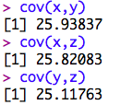
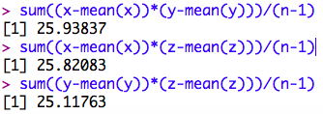
Formula of covariance
Cov(x,y)= sum( (x- mean(x)) * (y- mean(y)) )/(n-1)
sum((x-mean(x))*(y-mean(y)))/(n-1)
sum((x-mean(x))*(z-mean(z)))/(n-1)
sum((y-mean(y))*(z-mean(z)))/(n-1)

Slide 13
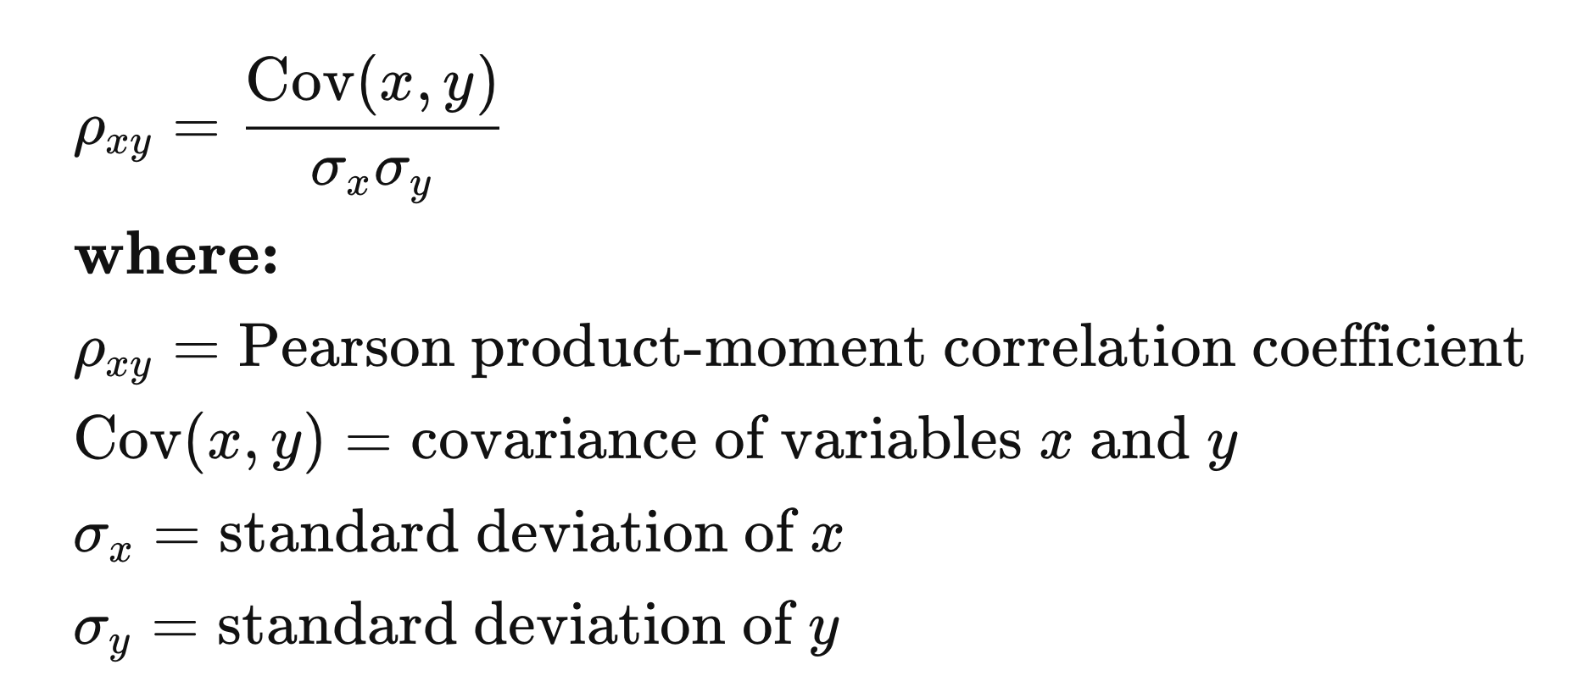
Calculation Coefficient: Standardized Covariate

Slide 14
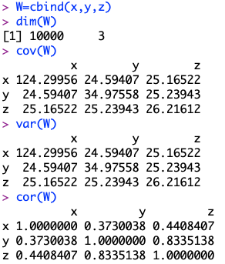
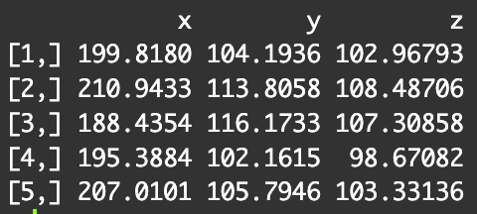
Calculation in R
W=cbind(x,y,z)
dim(W)
W[1:5,]
cov(W)
var(W)
cor(W)

Slide 15
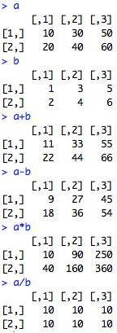
Element-wise Matrix manipulations
Add/
subtraction
(dot)product
(dot)division
a=matrix(seq(10,60,10),2,3)
b=matrix(seq(1,6),2,3)
a
b
a+b
a-b
a*b
a/b

Slide 16
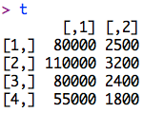
Matrix multiplication
AS | 1
BS | 2
MS | 3
PhD | 4
Base | Education | Age
1 | 3 | 30
1 | 4 | 50
1 | 2 | 40
1 | 1 | 25
John
Mary
 | Salary | SQF
Base | 20000 | 1000
Edu | 10000 | 300
Age | 1000 | 20
Sam
Sarah
1 | X | 20000
3 | X | 10000
30 | X | 1000
Salary | SQF
80000 | 2500
110000 | 3200
80000 | 2400
55000 | 1800
Sum
John
Mary
Sam
c=matrix(c(1,1,1,1,3,4,2,1,30,50,40,25),4,3)
b=matrix(c(20000,10000,1000,1000,300,20),3,2)
t=c%*%b
Sarah

Slide 17
Multiplication conformable
Base | Education | Age
1 | 3 | 30
1 | 4 | 50
1 | 2 | 40
1 | 1 | 25
John
Mary
 | Salary | SQF
Mean | 20000 | 1000
Edu | 10000 | 300
Age | 1000 | 20
Sam
Sarah
4 x 3
3 x 2
Salary | SQF
80000 | 2500
110000 | 3200
80000 | 2400
55000 | 1800
John
Mary
Sam
Sarah
4x2

Slide 18
Inverse
IF:
1
 | 1
 |  | …
 |  |  | 1
A
B
=
B is inverse of A
vice versa
Inverse is for square matrix only

Slide 19
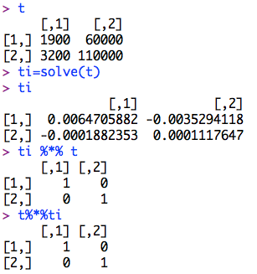
Inverse in R: solve()
t
ti=solve(t)
ti
ti %*% t
t%*%ti

Slide 20
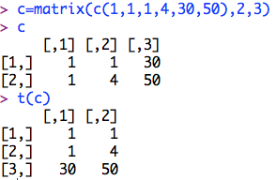
Transpose
Transpose
c=matrix(c(1,1,1,4,30,50),2,3)
c
t(c)

Slide 21
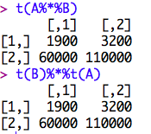
Properties of transpose
(A^{T})^{T}=A
(A+B)^{T}=A^{T}+B^{T}
(AB)^{T}=B^{T}A^{T}
(cB)^{T}=cB^{T} , where c is scalar
A=matrix(c(1,1,1,4,30,50),2,3)
B=matrix(c(1000,300,20,20000,10000,1000),3,2)
t(A%*%B)
t(B)%*%t(A)

Slide 22
Special matrix
Symmetric: A=Transpose(A)
Diagonal matrix: all elements are 0 except diagonals
Identity: Diagonals=1 and res=0
Orthogonal: A multiply by transpose (A) = Identity
Singular: A square matrix does not have a inverse

Slide 23
Rank
The size of the largest non-singular sub matrix
Full rank matrix: rank=dimension

Slide 24
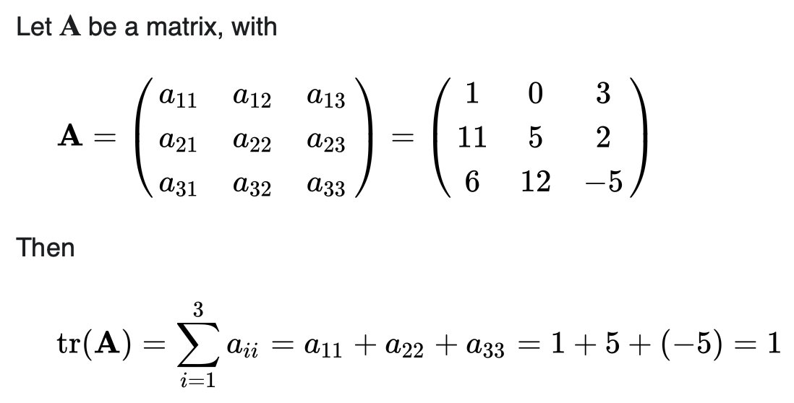
Trace
Trace: Sum of diagonals of a square matrix
https://en.wikipedia.org/wiki/Trace_(linear_algebra)

Slide 25
Highlight
Example of first question on homework1
Expectation and Variance of random variable
Expectation and Variance of function of random variable
Covariance
Matrix and manipulations
Special matrices: Identity, symmetric, diagonal, singular, and orthogonal
Rank

