Slide 1
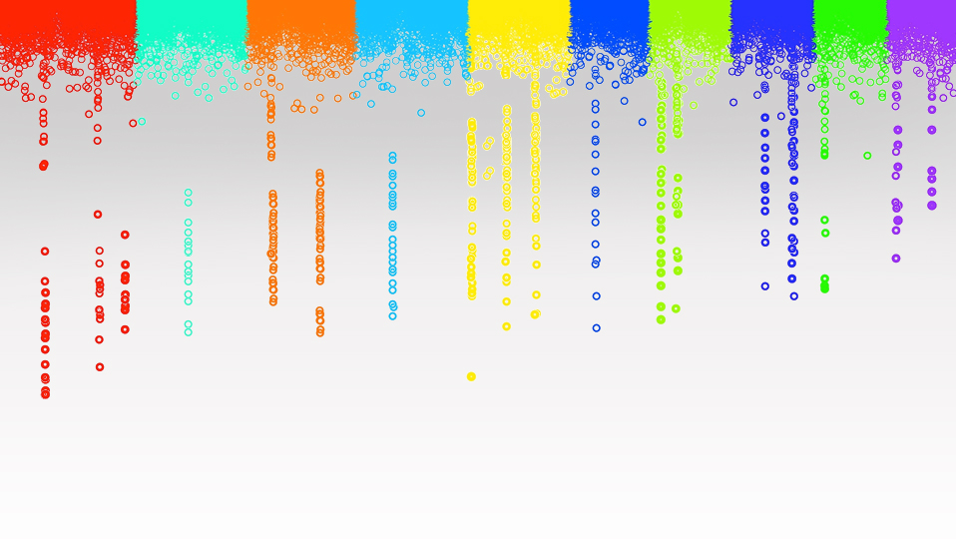

Statistical Genomics
Multiple test correction
Zhiwu Zhang
Washington State University

Slide 2
Outline
Null distribution of P values
QQ plot
Inflation of P values
Bonferroni multiple test correction
Empirical multiple test threshold

Slide 3
GWAS by correlation
GWASbyCor=function(X,y){
n=nrow(X)
r=cor(y,X)
n=nrow(X)
t=r/sqrt((1-r^2)/(n-2))
p=2*(1-pt(abs(t),n-2))
zeros=p==0
p[zeros]=1e-10
return(p)}
source("http://zzlab.net/StaGen/2020/R/GWASbyCor.R")

Slide 4
QTNs 0n CHR 1-5, leave 6-10 empty
myGD=read.table(file="http://zzlab.net/GAPIT/data/mdp_numeric.txt",head=T)
myGM=read.table(file="http://zzlab.net/GAPIT/data/mdp_SNP_information.txt",head=T)
source("http://zzlab.net/StaGen/2020/R/G2P.R")
source("http://zzlab.net/StaGen/2020/R/GWASbyCor.R")
X=myGD[,-1]
index1to5=myGM[,2]<6
X1to5 = X[,index1to5]
set.seed(99164)
mySim=G2P(X= X1to5,h2=.75,alpha=1,NQTN=10,distribution="norm")
p= GWASbyCor(X=X,y=mySim$y)

Slide 5
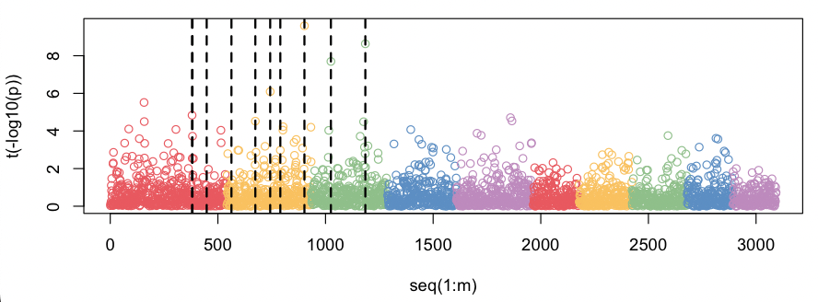
Manhattan Plot
color.vector <- rep(c('#EC5f67', '#FAC863', '#99C794', '#6699CC', '#C594C5'),10)
m=nrow(myGM)
plot(t(-log10(p))~seq(1:m),col=color.vector[myGM[,2]])
abline(v=mySim$QTN.position, lty = 2, lwd=2, col = "black")

Slide 6
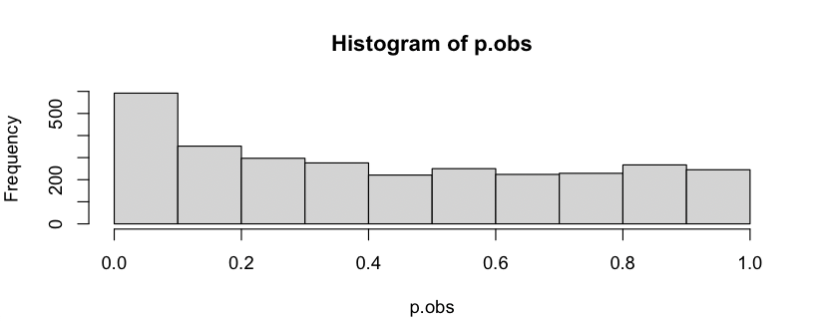
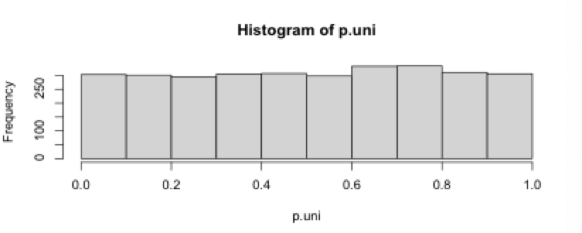
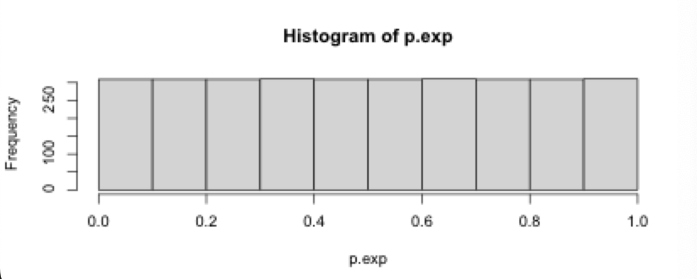
P value observed and expected (null)
p.obs=p
m=length(p.obs)
hist(p.obs)
p.uni=runif(length(p.obs),0,1)
hist(p.uni)
p.exp=seq(m)/m
hist(p.exp)

Slide 7
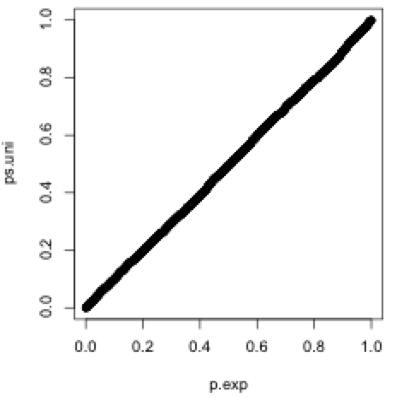
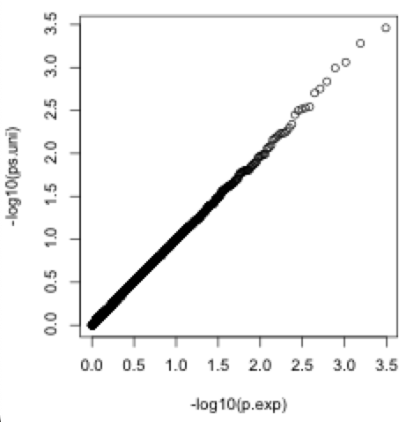
Uniform P values and expected (null)
order.uni=order(p.uni)
ps.uni=p.uni[order.uni]
plot(p.exp,ps.uni)
plot(-log10(p.exp),-log10(ps.uni))

Slide 8
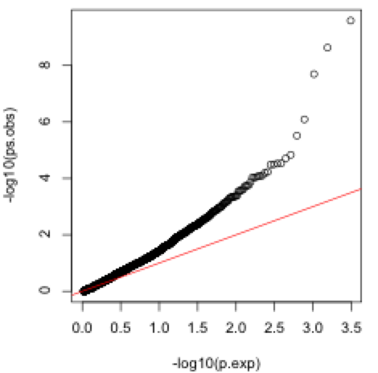
Observed against expected: QQ plot
order.obs=order(p.obs)
ps.obs=p.obs[order.obs]
plot(-log10(p.exp),-log10(ps.obs))
abline(a = 0, b = 1, col = "red")

Slide 9
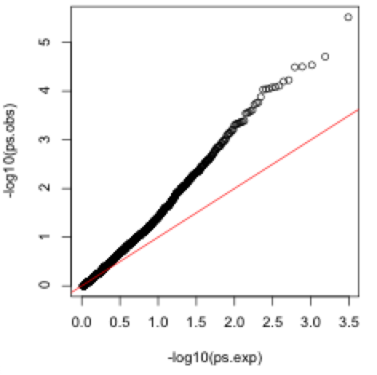
QQ plot on Non-QTN SNPs
p.obs=p[-mySim$QTN.positio]
m=length(p.obs)
p.exp=seq(m)/m
order.obs=order(p.obs)
ps.obs=p.obs[order.obs]
plot(-log10(p.exp),-log10(ps.obs))
abline(a = 0, b = 1, col = "red")

Slide 10
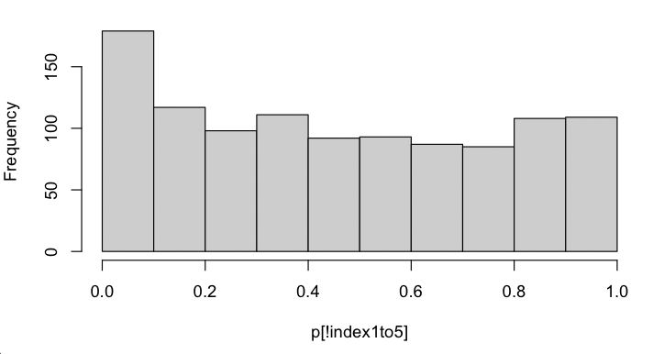
P values of null SNPs
Null SNPs: SNPs on CHR 6-10 without QTNs
p.obs=p[!index1to5]
hist(p.obs)

Slide 11
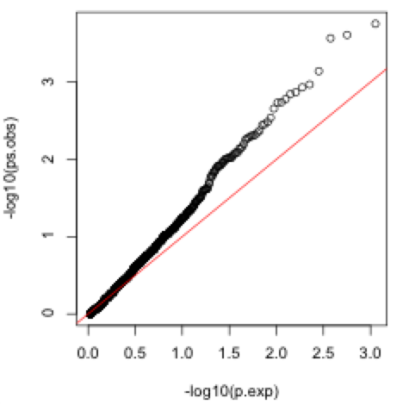
QQ plot on null SNPs
p.obs=p[!index1to5]
m=length(p.obs)
p.exp=seq(m)/m
order.obs=order(p.obs)
ps.obs=p.obs[order.obs]
plot(-log10(p.exp),-log10(ps.obs))
abline(a = 0, b = 1, col = "red")
Inflation of P values

Slide 12

Cutoff (Exact))
type1=c(0.01, 0.05, 0.1, 0.2)
cutoff=quantile(p.obs,type1,na.rm=T)
cutoff
plot(type1, cutoff,type="b")
P value of 0.00212527 is equivalent to type 1 error of 1%
-log10(0.00212527) = 2.672586

Slide 13
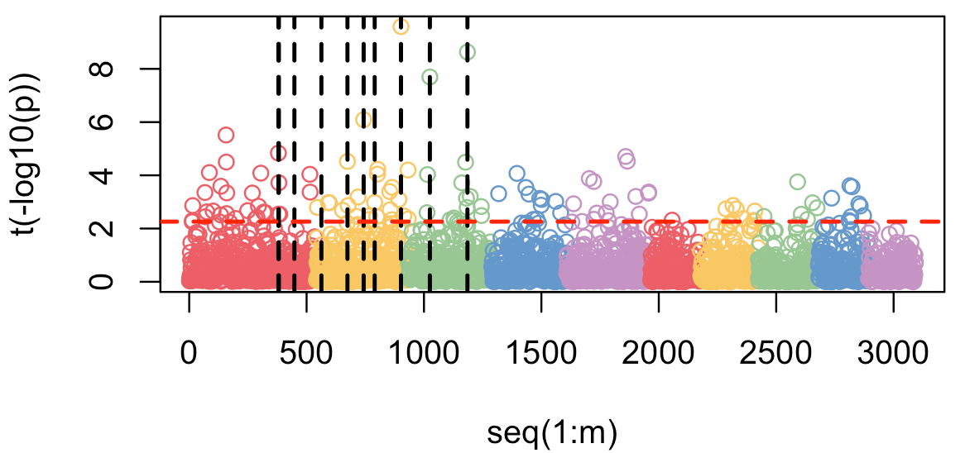
Manhattan Plot
color.vector <- rep(c('#EC5f67', '#FAC863', '#99C794', '#6699CC', '#C594C5'),10)
m=nrow(myGM)
plot(t(-log10(p))~seq(1:m),col=color.vector[myGM[,2]])
abline(v=mySim$QTN.position, lty = 2, lwd=2, col = "black")
abline(h=2.26, lty = 2, lwd=2, col = "red")
Single test threshold

Slide 14
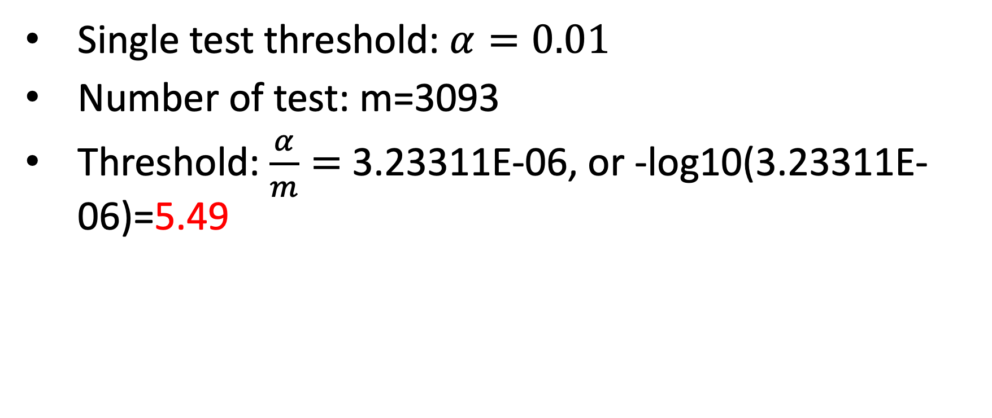
Multiple test correction: Bonferroni
Single test threshold: $α=0.01$
Number of test: m=3093
Threshold: $\frac{α}{m}=$3.23311E-06, or -log10(3.23311E-06)=5.49

Slide 15
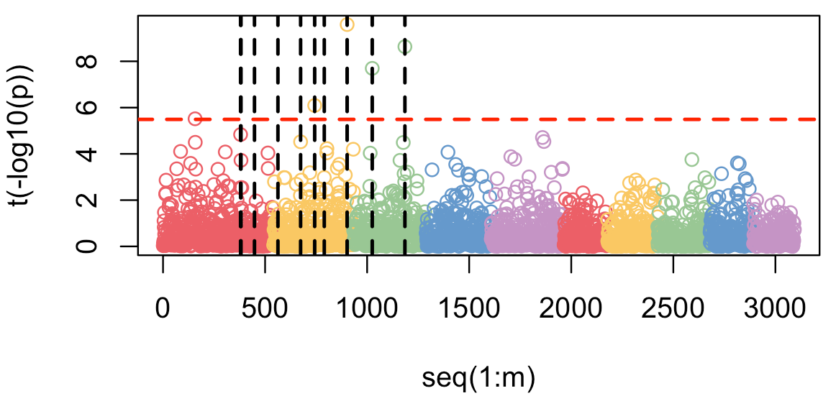
Manhattan Plot
color.vector <- rep(c('#EC5f67', '#FAC863', '#99C794', '#6699CC', '#C594C5'),10)
m=nrow(myGM)
plot(t(-log10(p))~seq(1:m),col=color.vector[myGM[,2]])
abline(v=mySim$QTN.position, lty = 2, lwd=2, col = "black")
abline(h=5.49, lty = 2, lwd=2, col = "red")
1 error
Bonferroni Multiple test threshold

Slide 16
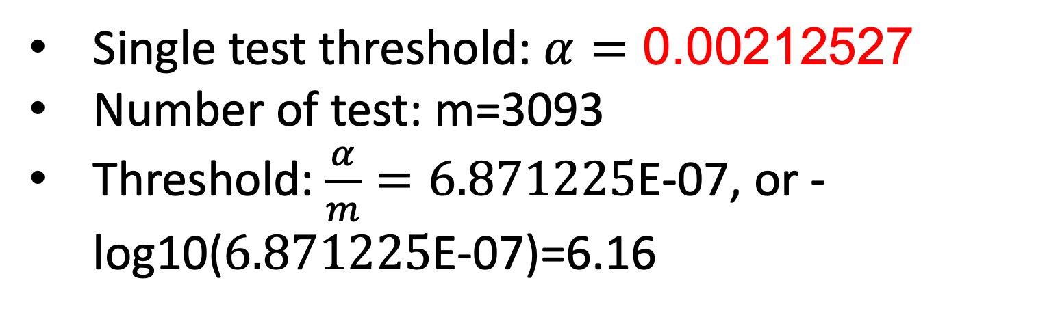
Bonferroni threshold with inflation correction
Single test threshold: $α=\text{0.00212527}$
Number of test: m=3093
Threshold: $\frac{α}{m}=6.871225$E-07, or -log10($6.871225$E-07)=6.16

Slide 17
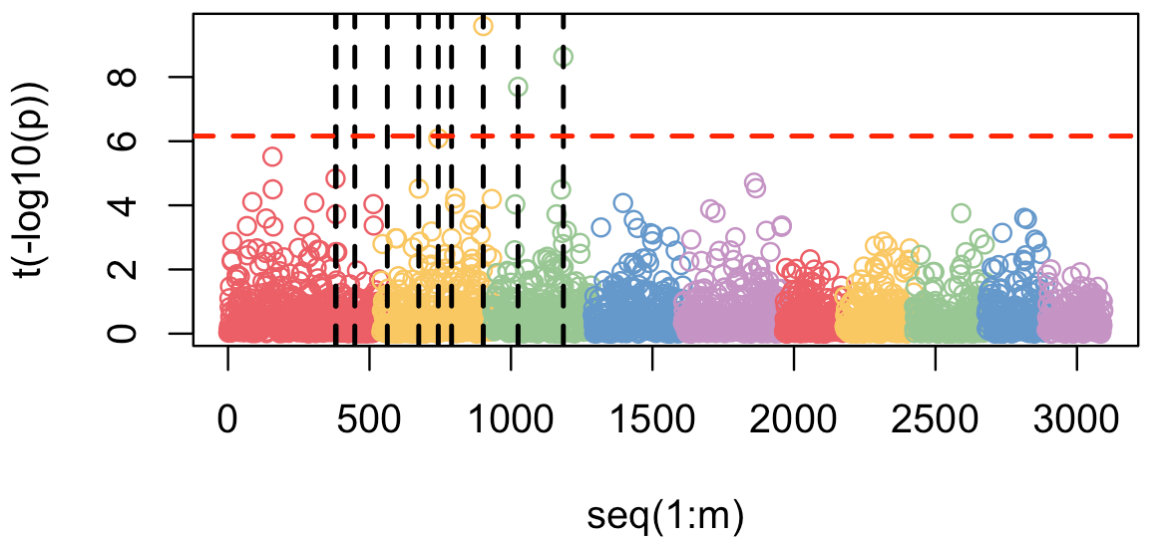
Manhattan Plot
color.vector <- rep(c('#EC5f67', '#FAC863', '#99C794', '#6699CC', '#C594C5'),10)
m=nrow(myGM)
plot(t(-log10(p))~seq(1:m),col=color.vector[myGM[,2]])
abline(v=mySim$QTN.position, lty = 2, lwd=2, col = "black")
abline(h=6.16, lty = 2, lwd=2, col = "red")
1 missing
Bonferroni multiple test threshold with inflation correction

Slide 18
Problems of Bonferroni Threshold
Bonferroni threshold leads to over correction if multiple tests are not independent, e.g. dense markers or long LD extent.

Slide 19
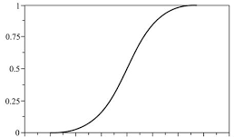
Empirical threshold
Randomly shuffle observed phenotypes to break the linkage with genotypes
Conduct GWAS on the shuffled phenotypes and record the most significant P value
Repeat 1-2 n (e.g. 1,000) times to get the distribution of the minimum P values
Use the 1% percentile as the threshold
99%
Cumulative
probability
0
1
2
3
4
5
6
7
8

Slide 20
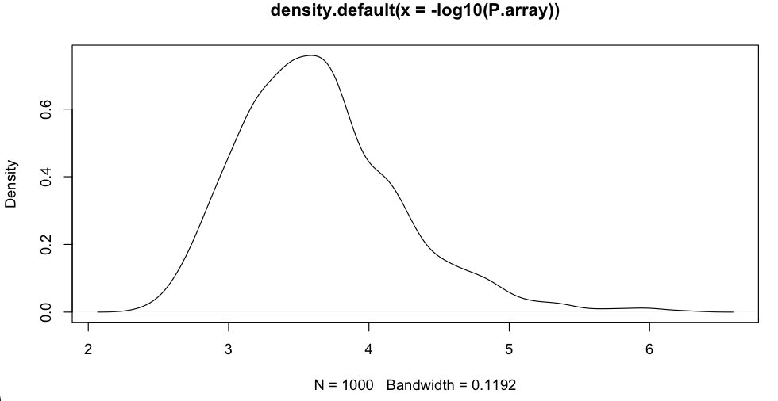
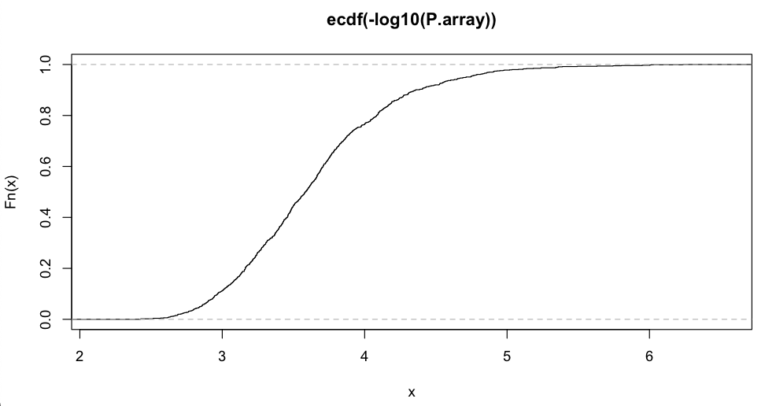
Demo of imperial threshold
set.seed(99164)
nRep=1000
P.array=matrix(NA, 1,nRep)
n=length(mySim$y)
for(i in c(1:nRep)){
theY=mySim$y[sample(n,n)]
p= GWASbyCor(X=X,y=theY)
theMinP=min(p,na.rm=T)
P.array[i]= theMinP
}
plot(density(-log10(P.array)))
plot(ecdf(-log10(P.array)))
quantile(-log10(P.array),.99)
99%
99%
5.36 v.s. Bonferroni 5.49

Slide 21

Manhattan Plot
color.vector <- rep(c('#EC5f67', '#FAC863', '#99C794', '#6699CC', '#C594C5'),10)
m=nrow(myGM)
plot(t(-log10(p))~seq(1:m),col=color.vector[myGM[,2]])
abline(v=mySim$QTN.position, lty = 2, lwd=2, col = "black")
abline(h=5.36, lty = 2, lwd=2, col = "red")
1 gain
1 error
Empirical multiple test threshold
No inflation correction

Slide 22
Consideration of P Value Inflation
quantile(-log10(P.array),1-0.00212527)
99.78747%
5.995218

Slide 23
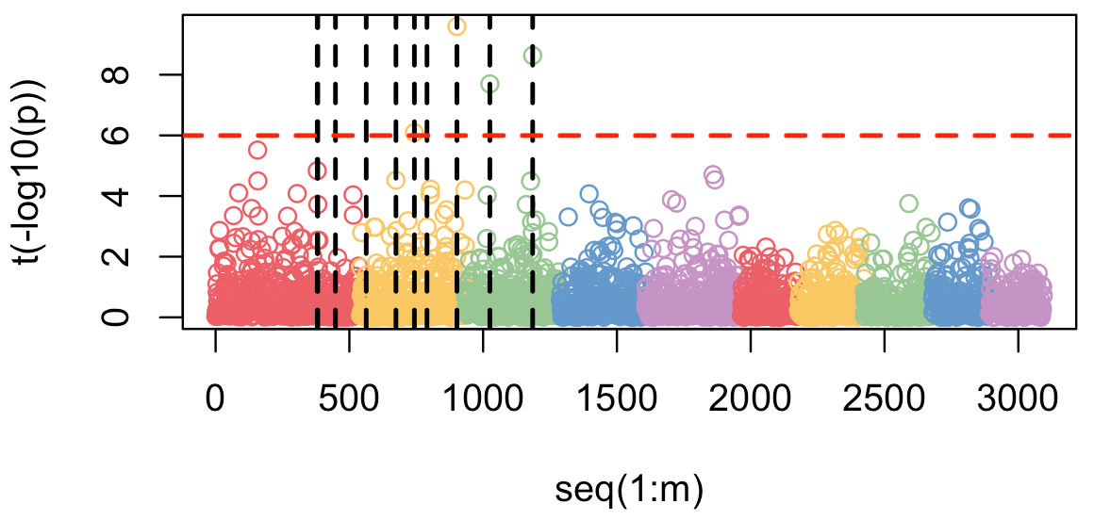
Manhattan Plot
color.vector <- rep(c('#EC5f67', '#FAC863', '#99C794', '#6699CC', '#C594C5'),10)
m=nrow(myGM)
plot(t(-log10(p))~seq(1:m),col=color.vector[myGM[,2]])
abline(v=mySim$QTN.position, lty = 2, lwd=2, col = "black")
abline(h=5.995, lty = 2, lwd=2, col = "red")
Empirical multiple test threshold with inflation correction

Slide 24
Null SNPs are not available fir correcting P value inflation in practical data analyses. What is the best way to handle the inflation problem?
Ignore the inflation of P values.
Use non-significant SNPs for approximation.
Use empirical threshold instead of Bonferroni threshold.
Choose an analytical method that does not have inflation problem on QQ plot.

Slide 25
Outline
Null distribution of P values
QQ plot
Inflation of P values
Bonferroni multiple test correction
Empirical multiple test threshold

