Slide 1
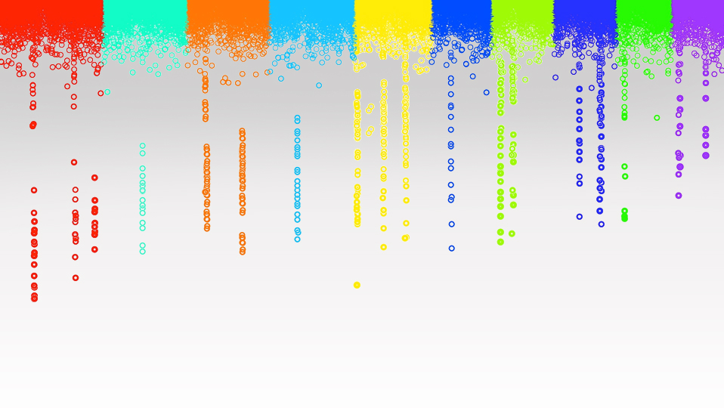

Statistical Genomics
Power, type I error and FDR
Zhiwu Zhang
Washington State University

Slide 2

Outline
Simulation of phenotype from genotype
GWAS by correlation
Power
FDR
Cutoff
Null distribution of p values
Resolution
QTN bins and non-QTN bins

Slide 3
GWAS by correlation
myGD=read.table(file="http://zzlab.net/GAPIT/data/mdp_numeric.txt",head=T)
myGM=read.table(file="http://zzlab.net/GAPIT/data/mdp_SNP_information.txt",head=T)
source("http://zzlab.net/StaGen/2020/R/G2P.R")
source("http://zzlab.net/StaGen/2020/R/GWASbyCor.R")
X=myGD[,-1]
set.seed(99164)
mySim=G2P(X= myGD[,-1],h2=.75,alpha=1,NQTN=10,distribution="normal")
p= GWASbyCor(X=X,y=mySim$y)
color.vector <- rep(c("deepskyblue","orange","forestgreen","indianred3"),10)
m=nrow(myGM)
plot(t(-log10(p))~seq(1:m),col=color.vector[myGM[,2]])
abline(v=mySim$QTN.position, lty = 2, lwd=2, col = "black")

Slide 4
Resolution and bin approach
10Kb is really good, 100Kb is OK
Bins with QTNs for power
Bins without QTNs for type I error

Slide 5
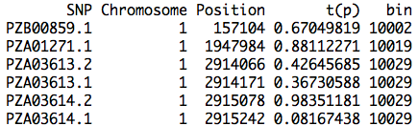
Bins (e.g. 100Kb)
bigNum=1e9
resolution=100000
bin=round((myGM[,2]*bigNum+myGM[,3])/resolution)
result=cbind(myGM,t(p),bin)
head(result)
Minimum p value within bin

Slide 6
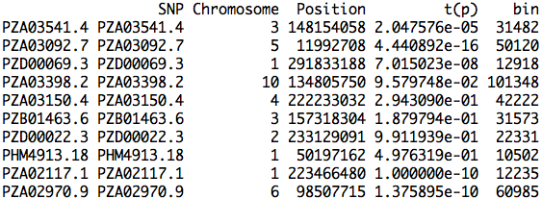
Bins of QTNs
QTN.bin=result[mySim$QTN.position,]
QTN.bin

Slide 7
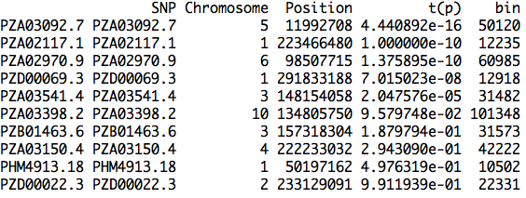
Sorted bins of QTNs
index.qtn.p=order(QTN.bin[,4])
QTN.bin[index.qtn.p,]

Slide 8
FDR and type I error
Total number of bins: 3054 (size of 100kb)
Type I error
0
0
0
0
0.00065703
0.13666229
0.19973719
0.25689882
0.32884363
0.43856767
N | bin | t(p)
1 | 50120 | 4.44E-16
2 | 12235 | 1.00E-10
3 | 60985 | 1.38E-10
4 | 12918 | 7.02E-08
5 | 31482 | 2.05E-05
6 | 101348 | 9.58E-02
7 | 31573 | 1.88E-01
8 | 42222 | 2.94E-01
9 | 10502 | 4.98E-01
10 | 22331 | 9.91E-01
Power
0.1
0.2
0.3
0.4
0.5
0.6
0.7
0.8
0.9
1
#False bins
0
0
0
0
2
416
608
782
1001
1335
FDR
0
0
0
0
0.285714286
0.985781991
0.988617886
0.989873418
0.991089109
0.992565056
0.285714286=2/(2+5)
0.00065703 = 2/(3054-10)

Slide 9
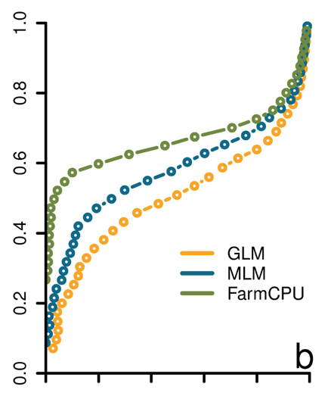
ROC curve
Receiver Operating Characteristic
"The curve is created by plotting the true positive rate against the false positive rate at various threshold settings." -Wikipedia
Power
FDR
Liu et. al. PLoS Genetics, 2016

Slide 10
GAPIT.FDR.TypeI Function
source("http://zzlab.net/GAPIT/gapit_functions.txt")
myStat=GAPIT.FDR.TypeI(
WS=c(1e0,1e3,1e4,1e5), GM=myGM,
seqQTN=mySim$QTN.position,
GWAS=result)
str(myStat)

Slide 11
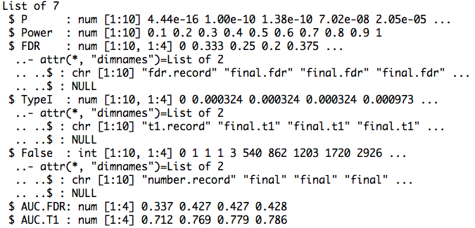
Return

Slide 12
Area Under Curve (AUC)
par(mfrow=c(1,2),mar = c(5,2,5,2))
plot(myStat$FDR[,1],myStat$Power,type="b")
plot(myStat$TypeI[,1],myStat$Power,type="b")

Slide 13
Replicates
nrep=100
set.seed(99164)
statRep=replicate(nrep, {
mySim=G2P(X=myGD[,-1],h2=.5,alpha=1,NQTN=10,distribution="norm")
p=p= GWASbyCor(X=myGD[,-1],y=mySim$y)
seqQTN=mySim$QTN.position
myGWAS=cbind(myGM,t(p),NA)
myStat=GAPIT.FDR.TypeI(WS=c(1e0,1e3,1e4,1e5), GM=myGM,seqQTN=mySim$QTN.position,GWAS=myGWAS,maxOut=100,MaxBP=1e10)
})

Slide 14
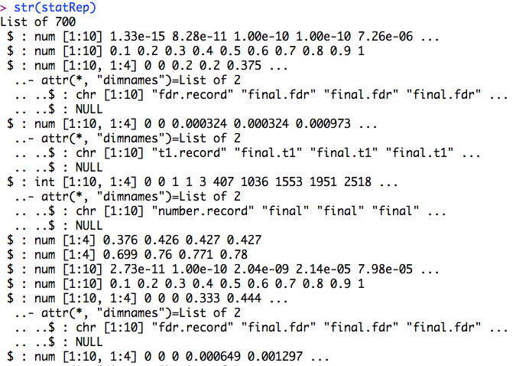
str(statRep)

Slide 15
Means over replicates
power=statRep[[2]]
#FDR
s.fdr=seq(3,length(statRep),7)
fdr=statRep[s.fdr]
fdr.mean=Reduce ("+", fdr) / length(fdr)
#AUC: power vs. FDR
s.auc.fdr=seq(6,length(statRep),7)
auc.fdr=statRep[s.auc.fdr]
auc.fdr.mean=Reduce ("+", auc.fdr) / length(auc.fdr)

Slide 16
Plots of power vs. FDR
theColor=rainbow(4)
plot(fdr.mean[,1],power , type="b", col=theColor [1],xlim=c(0,1))
for(i in 2:ncol(fdr.mean)){
lines(fdr.mean[,i], power , type="b", col= theColor [i])
}

Slide 17
Plots of AUC
barplot(auc.fdr.mean,
names.arg=c("1bp", "1K", "10K","100K"),
xlab="Resolution",
ylab="AUC")

Slide 18
ROC with different heritability
h²= 25% vs. 75%
10 QTNs
Normal distributed QTN effect
100kb resolution
Power against Type I error

Slide 19
Simulation and GWAS
nrep=100
set.seed(99164)
#h2=25%
statRep25=replicate(nrep, {
mySim=G2P(X=myGD[,-1],h2=.25,alpha=1,NQTN=10,distribution="norm")
p=p= GWASbyCor(X=myGD[,-1],y=mySim$y)
seqQTN=mySim$QTN.position
myGWAS=cbind(myGM,t(p),NA)
myStat=GAPIT.FDR.TypeI(WS=c(1e0,1e3,1e4,1e5), GM=myGM,seqQTN=mySim$QTN.position,GWAS=myGWAS,maxOut=100,MaxBP=1e10)})
#h2=75%
statRep75=replicate(nrep, {
mySim=G2P(X=myGD[,-1],h2=.75,alpha=1,NQTN=10,distribution="norm")
p= GWASbyCor(X=myGD[,-1],y=mySim$y)
seqQTN=mySim$QTN.position
myGWAS=cbind(myGM,t(p),NA)
myStat=GAPIT.FDR.TypeI(WS=c(1e0,1e3,1e4,1e5), GM=myGM,seqQTN=mySim$QTN.position,GWAS=myGWAS,maxOut=100,MaxBP=1e10)})

Slide 20
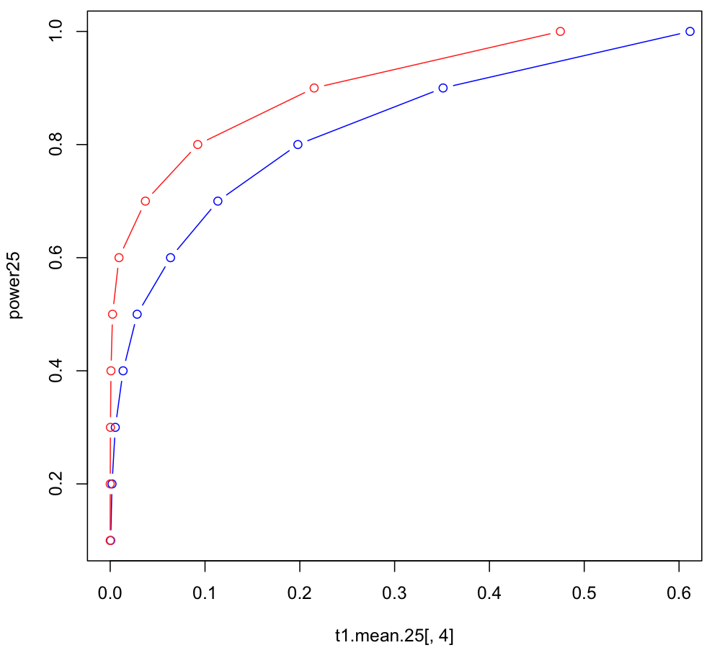
Means and plot
power25=statRep25[[2]]
s.t1=seq(4,length(statRep25),7)
t1=statRep25[s.t1]
t1.mean.25=Reduce ("+", t1) / length(t1)
power75=statRep75[[2]]
s.t1=seq(4,length(statRep75),7)
t1=statRep75[s.t1]
t1.mean.75=Reduce ("+", t1) / length(t1)
plot(t1.mean.25[,4],power25, type="b", col="blue",xlim=c(0,0.6))
lines(t1.mean.75[,4], power75, type="b", col= "red")

Slide 21
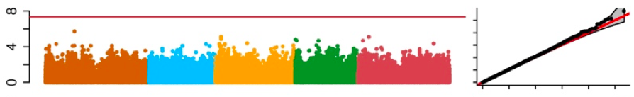
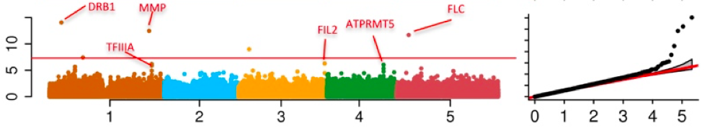
Factors Affecting Statistical Power
Number of genes
Statistical methods
Gene effect size
LD decay
Heritability
Resolution
Population size
Marker density
Population structure
Multiple test correction

Slide 22
Outline
Simulation of phenotype from genotype
GWAS by correlation
Power
FDR
Cutoff
Null distribution of p values
Resolution
QTN bins and non-QTN bins

