Slide 1
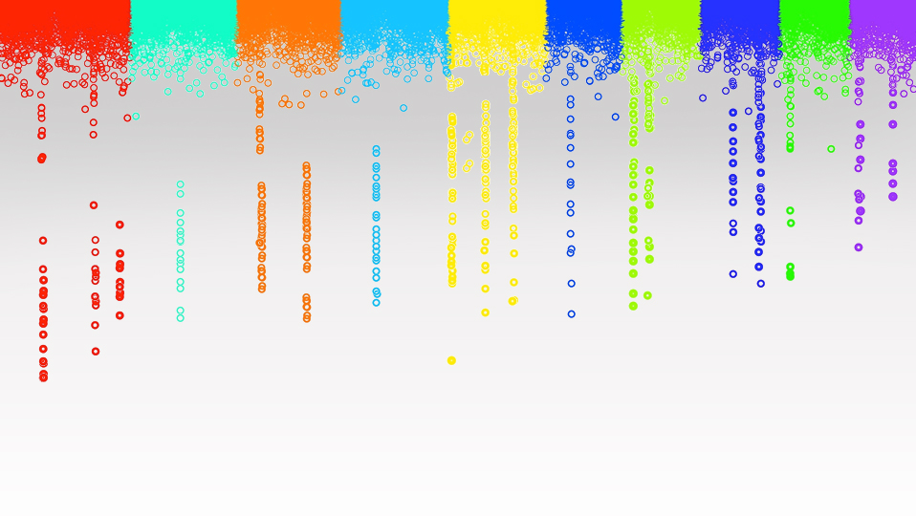

Statistical Genomics
General Linear Model
Zhiwu Zhang
Washington State University

Slide 2
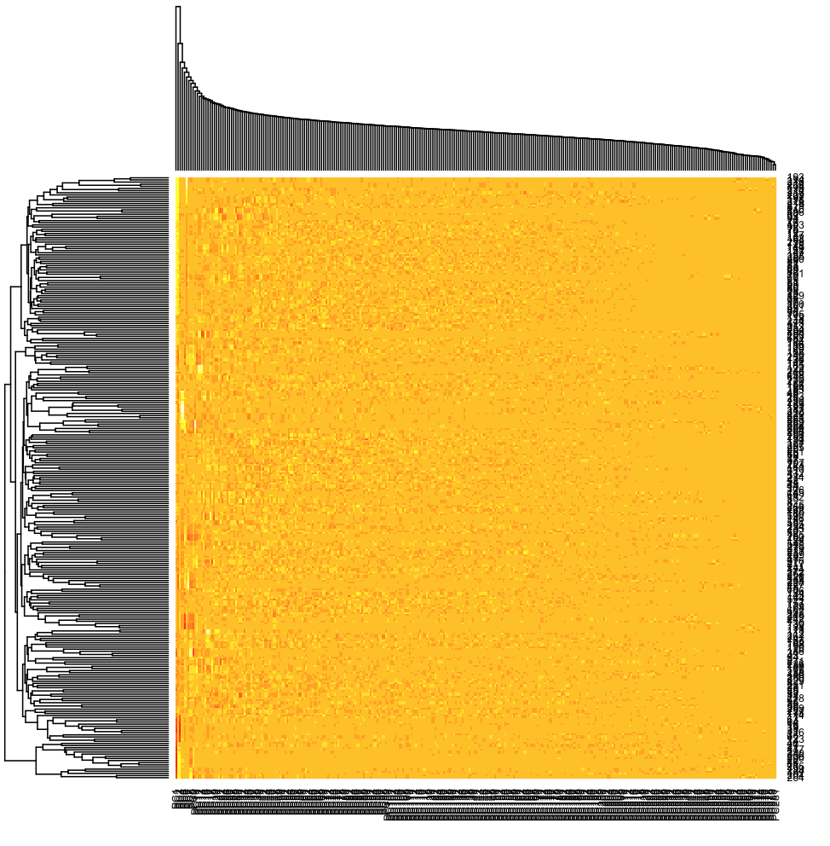
Heatmap
heatmap(PCA$x, Colv = TRUE)

Slide 3
Outline
Spurious association
Covariates
LS concept
Linear model

Slide 4
QTNs 0n CHR 1-5, leave 6-10 empty
myGD=read.table(file="http://zzlab.net/GAPIT/data/mdp_numeric.txt",head=T)
myGM=read.table(file="http://zzlab.net/GAPIT/data/mdp_SNP_information.txt",head=T)
source("http://zzlab.net/StaGen/2020/R/G2P.R")
source("http://zzlab.net/StaGen/2020/R/GWASbyCor.R")
X=myGD[,-1]
index1to5=myGM[,2]<6
X1to5 = X[,index1to5]
set.seed(99164)
mySim=G2P(X= X1to5,h2=.75,alpha=1,NQTN=10,distribution="norm")
p= GWASbyCor(X=X,y=mySim$y)

Slide 5
False positives
color.vector <- rep(c("deepskyblue","orange","forestgreen","indianred3"),10)
m=nrow(myGM)
plot(t(-log10(p))~seq(1:m),col=color.vector[myGM[,2]])
abline(v=mySim$QTN.position, lty = 2, lwd=2, col = "black")
P<10E-6

Slide 6
QQ plot
p.obs=p[!index1to5]
m2=length(p.obs)
p.uni=runif(m2,0,1)
order.obs=order(p.obs)
order.uni=order(p.uni)
plot(-log10(p.uni[order.uni]),-log10(p.obs[order.obs]))
abline(a = 0, b = 1, col = "red")

Slide 7
Phenotypes by genotypes
order.obs=order(p.obs)
X6to10=X[,!index1to5]
Xtop=X6to10[,order.obs[1]]
boxplot(mySim$y~Xtop)

Slide 8
Correlation
PCA=prcomp(X)
plot(mySim$y,PCA$x[,2])
cor(mySim$y,PCA$x[,2])
r=-0.32

Slide 9
Least Square Error
Linear regression
set.seed(99164)
s=sample(length(mySim$y),10)
plot(mySim$y[s],PCA$x[s,2])
cor(mySim$y[s],PCA$x[s,2])
r=-0.18
y
y = a + bx + e
x

Slide 10
GLM for GWAS
Phenotype on individuals
Population
structure
Y = SNP + Q (or PCs) +
e
(fixed effect)
(fixed effect)
General Linear Model (GLM)

Slide 11
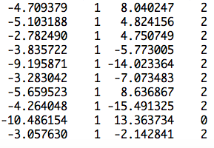
Example from the ten individuals
cbind(mySim$y[s],1, PCA$x[s,2],Xtop[s])
observation
mean
PC2
SNP
[
]
=b
Unknown defect
b0
b1
b2
known coefficient
y
1
x1
x2
=X
[
]
y = Xb +e

Slide 12
Linear model
y=b₀ + x₁b₁ + x₂b₂ + … + x_{p}b_{p} + e
y: observation, dependent variable
x: Explainary/independent variables
e: Residuals/errors
Δ =e₁² + e₂² + … + e_{n}²
=e'e
=(y-Xb)'(y-Xb)

Slide 13
Optimization
Δ =e'e
=e²=(y-Xb)²
∂Δ/∂b
=2X'(y-Xb)
=2X'y-2X'Xb=0
X'Xb=X'y
b=[X’X]⁻¹[X’Y]

Slide 14
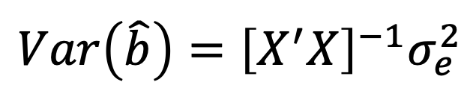
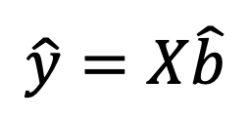
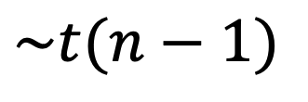
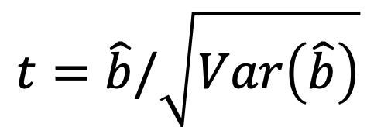
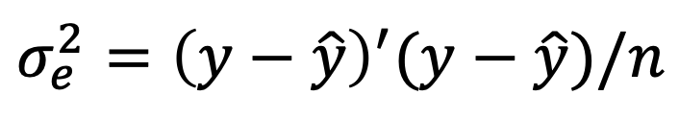
Statistical test
$$\hat{y}=X\hat{b}$$
$$σ_{e}^{2}={\left(y−\hat{y}\right)}^{′}(y−\hat{y})/n$$
$$Var\left(\hat{b}\right)={\left[X^{′}X\right]}^{−1}σ_{e}^{2}$$
$$t=\hat{b}/\sqrt{Var\left(\hat{b}\right)}$$
$$\sim t(n−1)$$

Slide 15
Action in R
y=mySim$y
X=cbind(1, PCA$x[,2],Xtop)
LHS=t(X)%*%X
C=solve(LHS)
RHS=t(X)%*%y
b=C%*%RHS
yb=X%*%b
e=y-yb
n=length(y)
ve=sum(e^2)/(n-1)
vt=C*ve
t=b/sqrt(diag(vt))
p=2*(1-pt(abs(t),n-2))

Slide 16

Phenotypes by genotypes
LM=cbind(b, t, sqrt(diag(vt)), p)
rownames(LM)=cbind("Mean", "PC2","Xtop")
colnames(LM)=cbind("b", "t", "SD","p")
LM
Comparing P<10E-6 with GWASbyCor

Slide 17
Loop through genome
G=myGD[,-1]
n=nrow(G)
m=ncol(G)
P=matrix(NA,1,m)
for (i in 1:m){
x=G[,i]
if(max(x)==min(x)){
p=1}else{
X=cbind(1, PCA$x[,2],x)
LHS=t(X)%*%X
C=solve(LHS)
RHS=t(X)%*%y
b=C%*%RHS
yb=X%*%b
e=y-yb
n=length(y)
ve=sum(e^2)/(n-1)
vt=C*ve
t=b/sqrt(diag(vt))
p=2*(1-pt(abs(t),n-2))
} #end of testing variation
P[i]=p[length(p)]
} #end of looping for markers

Slide 18
QQ plot
p.obs=P[!index1to5]
m2=length(p.obs)
p.uni=runif(m2,0,1)
order.obs=order(p.obs)
order.uni=order(p.uni)
plot(-log10(p.uni[order.uni]),
-log10(p.obs[order.obs]), ylim=c(0,7))
abline(a = 0, b = 1, col = "red")
GWASbyCor
GLM with PC2

Slide 19
Using three PCs
G=myGD[,-1]
n=nrow(G)
m=ncol(G)
P=matrix(NA,1,m)
for (i in 1:m){
x=G[,i]
if(max(x)==min(x)){
p=1}else{
X=cbind(1, PCA$x[,1:3],x)
LHS=t(X)%*%X
C=solve(LHS)
RHS=t(X)%*%y
b=C%*%RHS
yb=X%*%b
e=y-yb
n=length(y)
ve=sum(e^2)/(n-1)
vt=C*ve
t=b/sqrt(diag(vt))
p=2*(1-pt(abs(t),n-2))
} #end of testing variation
P[i]=p[length(p)]
} #end of looping for markers

Slide 20
QQ plot
GLM with PC2
p.obs=P[!index1to5]
m2=length(p.obs)
p.uni=runif(m2,0,1)
order.obs=order(p.obs)
order.uni=order(p.uni)
plot(-log10(p.uni[order.uni]),
-log10(p.obs[order.obs]), ylim=c(0,7))
abline(a = 0, b = 1, col = "red")
GLM with PC1:3

Slide 21
QQ plot
p.obs=P
m2=length(p.obs)
p.uni=runif(m2,0,1)
order.obs=order(p.obs)
order.uni=order(p.uni)
plot(-log10(p.uni[order.uni]),
-log10(p.obs[order.obs]), )
abline(a = 0, b = 1, col = "red")

Slide 22
color.vector <- rep(c("deepskyblue","orange","forestgreen","indianred3"),10)
m=nrow(myGM)
plot(t(-log10(P))~seq(1:m),col=color.vector[myGM[,2]])
abline(v=mySim$QTN.position, lty = 2, lwd=2, col = "black")
4 without mistake
2 without mistake

Slide 23
Outline
Spurious association
Covariates
LS concept
Linear model

