Slide 1
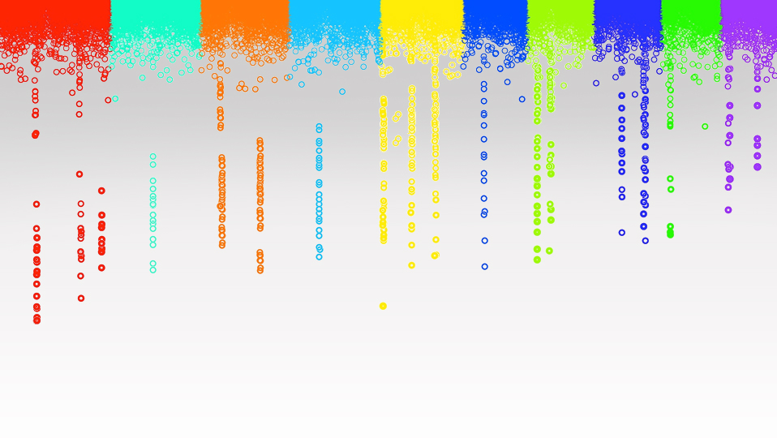

Statistical Genomics
Kinship
Zhiwu Zhang
Washington State University

Slide 2
Outline
Population structure is not enough
Dwarf8 story
Kinship
Additive Numerator Relationship
Pedigree based
Marker based

Slide 3
Association study via linkage disequilibrium
M
t generations
M
M
M
M
M
M
Jianming Yu, 2011

Slide 4
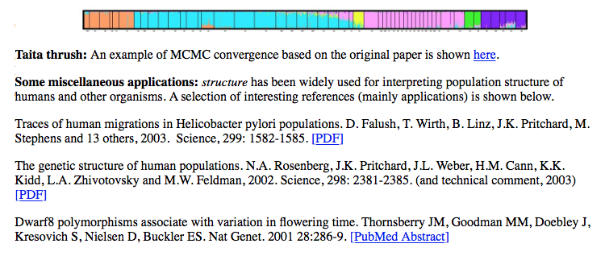
Dwarf8 story

Slide 5
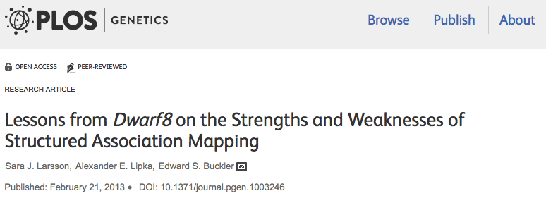
Abstract
The strengths of association mapping lie in its resolution and allelic richness, but spurious associations arising from historical relationships and selection patterns need to be accounted for in statistical analyses. Here we reanalyze one of the first generation structured association mapping studies of the Dwarf8 (d8) locus with flowering time in maize using the full range of new mapping populations, statistical approaches, and haplotype maps. Because this trait was highly correlated with population structure, we found that basic structured association methods overestimate phenotypic effects in the region, while mixed model approaches perform substantially better. Combined with analysis of the maize nested association mapping population (a multi-family crossing design), it is concluded that most, if not all, of the QTL effects at the general location of the d8 locus are from rare extended haplotypes that include other linked QTLs and that d8 is unlikely to be involved in controlling flowering time in maize. Previous independent studies have shown evidence for selection at the d8 locus. Based on the evidence of population bottleneck, selection patterns, and haplotype structure observed in the region, we suggest that multiple traits may be strongly correlated with population structure and that selection on these traits has influenced segregation patterns in the region. Overall, this study provides insight into how modern association and linkage mapping, combined with haplotype analysis, can produce results that are more robust.

Slide 6
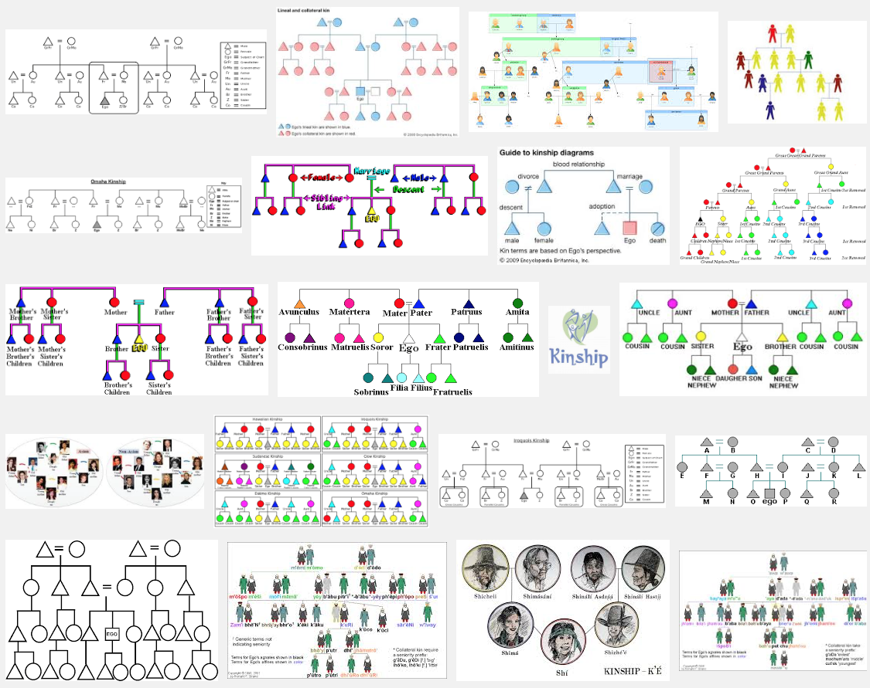
Kinship in visual

Slide 7
Kinship in concept
Blood relationship
Family ties,
Blood ties,
Common Ancestry
Sharing of characteristics or origins.

Slide 8
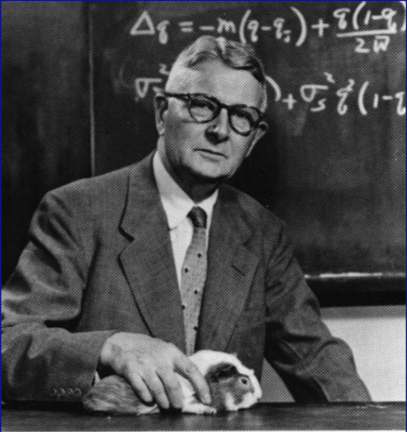
Sewell Green Wright
Founder of population genetics, alongside Ronald A. Fisher and J.B.S. Haldane
Inbreeding and relationship coefficient, 1922
12/16/1889-3/3/1988
Born in Melrose, Massachusetts
College in Illinois and Ph.D from Harvard
Worked for USDA, U Chicago and U Wisconsin

Slide 9
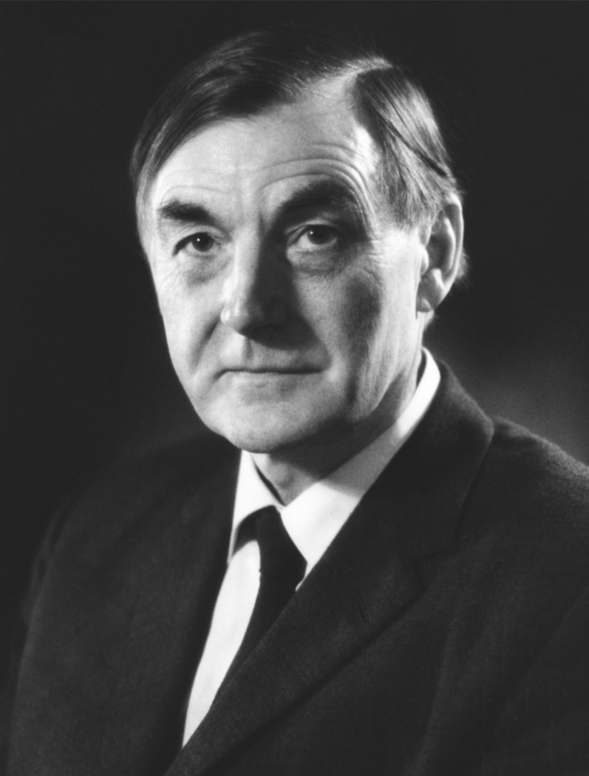
Quantification
Coefficient of Kinship
Co-ancestry
Probability of sampling two alleles, each from an individual, are Identical By Decent (IBD).
Introduction to Quantitative Genetics
Falconer & Mackay
Douglas Scott
Falconer
Trudy Mackay

Slide 10
IBS(Status) vs IBD(decent)
X
Y
IBS(X,O): ½
IBS(Y,O): 1
Parents
A / B
A / A
A:½
A:1
IBD(X,O): ½ * ½ = ¼
A
Offspring (O)
/ A
IBD(Y,O): 1 * ½ = ½

Slide 11
Twice Co-Ancestry
Additive genetic relationship matrix (A)
Numerator genetic relationship matrix
Diagonal = 1 + inbreeding coefficient
Off diagonal: twice the probability that two alleles, each sampled from an individual (identical by decent).

Slide 12
Wright's formula
Parents
X_{s}
X_{d}
Y_{s}
Y_{d}
Individuals
X
Y
a_{XY} = ¼ (a_{XsYs} + a_{XsYd} + a_{XdYs} + a_{XdYd} )

Slide 13
Additive numerator relationship
A
B
 | A | B
A | 1 | 0
B | 0 | 1
C
0.5
0.5
1
D
0.75
0.25
0.75
1.25
E
0.375
0.625
0.625
0.75
1.125
C
D
E
C | 0.5 | 0.5
Individual | Father | Mother
A
B
C | A | B
D | A | C
E | D | B
D | 0.75 | 0.25 | 0.75
E | 0.375 | 0.725 | 0.625 | 0.75
Diagonals=1+F

Slide 14
Marker based kinship
Proportion of shared alleles
Average across markers
Marker | 1 | 2 | 3 | 4 | 5 | Average
Individual 1 | AA | AA | AA | BB | AB
Individual 2 | AA | AB | BB | BB | AB
Similarity | 1 | 0.5 | 0 | 1 | 0.5 | 0.6
Maximum similarity: 1

Slide 15
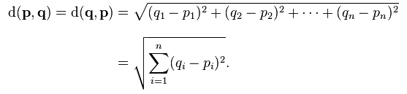
Euclidean distance
q(q2, q2)
p2-q2
p(p1, p2)
p1-q1

Slide 16
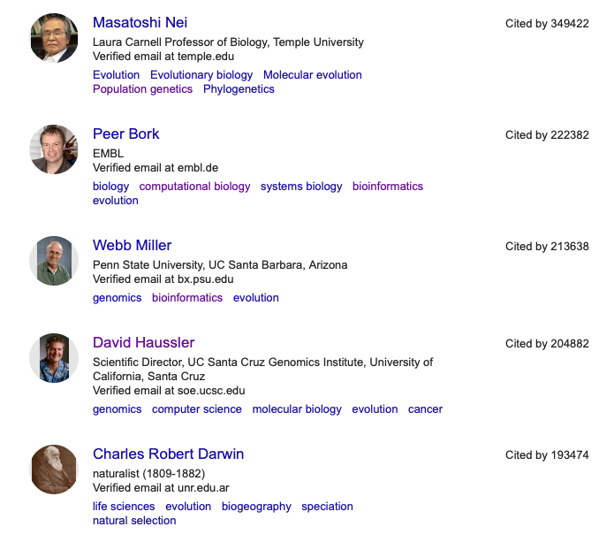
Nel's Distance
Measurement of mutation rate and genetic drift

Slide 17
SPAGeDi
Hardy OJ, Vekemans X (2002) SPAGeDi: a versatile computer program to analyse spatial
genetic structure at the individual or population levels. Molecular Ecology Notes 2: 618-620.
Kinship coefficient
  Loiselle et al. (1995)
  Ritland (1996)
Relationship coefficient
  Queller & Goodnight (1989)
  Hardy & Vekemans (1999)
  Lynch & Ritland (1999)
  Wang (2002);
Genetic distance: Rousset (2000)

Slide 18
Identical by status
 | AA | AT | TT
AA | 1 | .5 | 0
AT | .5 | .5 | .5
TT | 0 | .5 | 1
(R+1)/2
 | -1 | 0 | 1
-1 | 1 | 0 | -1
0 | 0 | 0 | 0
1 | -1 | 0 | 1

Slide 19

Efficient algorithm
M: n individual by m SNPs
M: -1, 0 and 1
Pi: frequency of 2nd allele for SNP i
P: Column of i is 2(pi-.5)
Z=M-P
J. Dairy Sci. 2008. 91 (11) 4414-4423. Efficient Methods to Compute Genomic Predictions P. M. VanRaden
Paul VanRaden: Image Number K7168-6

Slide 20
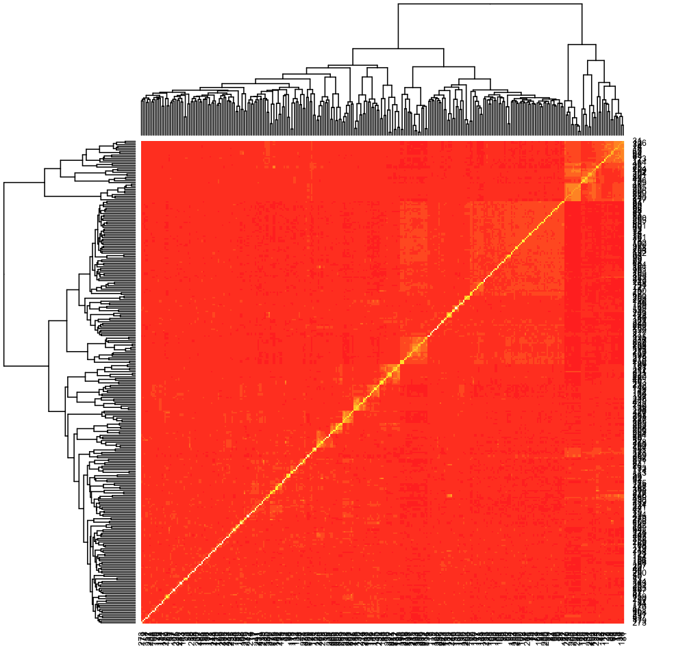
VanRaden algorithm
myGD=read.table(file="http://zzlab.net/GAPIT/data/mdp_numeric.txt",head=T)
X=myGD[,-1]
p=colMeans(X)/2
M=X-1
Z=t(M)-2*(p-.5)
K=crossprod((Z), (Z))
adj=2*sum(p*(1-p))
K=K/adj
heatmap(K)

Slide 21


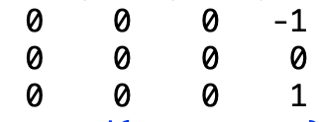


Zhang algorithm
Centralize for each SNP: X=X-mean(X)
XX'
Rescale between 0 and 2 for inbred
a=c(0,1,2,0,0,1,2,1,0,1,2,2)
snps=matrix(a,3,4,byrow=T)
snps
snpMean= apply(snps,2,mean) #mean of snp
snpMean
snps=t(snps)-snpMean #columnwise operation
t(snps)
K=crossprod(snps, snps)
K
Rescale

Slide 22
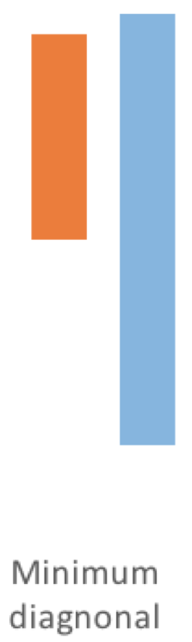
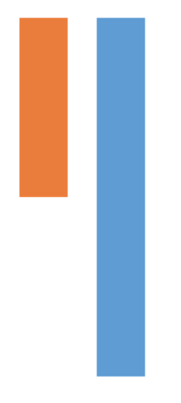
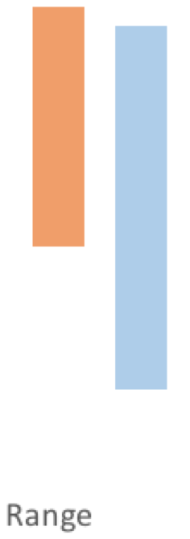
Scaling

Slide 23
source("http://zzlab.net/GAPIT/gapit_functions.txt")
myGD=read.table(file="http://zzlab.net/GAPIT/data/mdp_numeric.txt",head=T)
taxa=myGD[,1]
favorite=c("33-16", "38-11", "B73", "B73HTRHM", "CM37", "CML333", "MO17", "YU796NS")
index=taxa%in%favorite
snps=myGD[,-1]
#K=GAPIT.kinship.loiselle(t(myGD[,-1]), method="additive", use="all")
K[index,index]
K1=GAPIT.kinship.VanRaden(snps)
K1[index,index]
K2=GAPIT.kinship.Zhang(snps)
K2[index,index]

Slide 24
Zhang
 | 33-16 | 38-11 | B73 | B73HTRHM | CM37 | CML333 | MO17 | YU796NS
33-16 | 1.7676 | 0.0313 | -0.1634 | -0.1487 | 0.0684 | -0.0183 | 0.0062 | -0.0103
38-11 | 0.0313 | 1.8592 | -0.0705 | -0.0684 | -0.0489 | -0.0717 | -0.0473 | -0.0314
B73 | -0.1634 | -0.0705 | 2.4179 | 2.2726 | -0.0418 | -0.2027 | -0.2033 | -0.1310
B73HTRHM | -0.1487 | -0.0684 | 2.2726 | 2.2925 | -0.0491 | -0.2047 | -0.1907 | -0.1194
CM37 | 0.0684 | -0.0489 | -0.0418 | -0.0491 | 2.0306 | -0.0702 | 0.0975 | 0.0538
CML333 | -0.0183 | -0.0717 | -0.2027 | -0.2047 | -0.0702 | 1.9587 | 0.0056 | -0.0611
MO17 | 0.0062 | -0.0473 | -0.2033 | -0.1907 | 0.0975 | 0.0056 | 1.9114 | 0.0648
YU796NS | -0.0103 | -0.0314 | -0.1310 | -0.1194 | 0.0538 | -0.0611 | 0.0648 | 1.8492
VanRaden
 | 33-16 | 38-11 | B73 | B73HTRHM | CM37 | CML333 | MO17 | YU796NS
33-16 | 1.5307 | 0.2859 | 0.1412 | 0.1521 | 0.3134 | 0.2491 | 0.2672 | 0.2550
38-11 | 0.2859 | 1.5968 | 0.2102 | 0.2118 | 0.2263 | 0.2093 | 0.2275 | 0.2393
B73 | 0.1412 | 0.2102 | 2.0000 | 1.9511 | 0.2316 | 0.1121 | 0.1116 | 0.1653
B73HTRHM | 0.1521 | 0.2118 | 1.9511 | 1.9095 | 0.2262 | 0.1105 | 0.1209 | 0.1739
CM37 | 0.3134 | 0.2263 | 0.2316 | 0.2262 | 1.7205 | 0.2105 | 0.3351 | 0.3026
CML333 | 0.2491 | 0.2093 | 0.1121 | 0.1105 | 0.2105 | 1.6686 | 0.2668 | 0.2173
MO17 | 0.2672 | 0.2275 | 0.1116 | 0.1209 | 0.3351 | 0.2668 | 1.6345 | 0.3108
YU796NS | 0.2550 | 0.2393 | 0.1653 | 0.1739 | 0.3026 | 0.2173 | 0.3108 | 1.5896

Slide 25
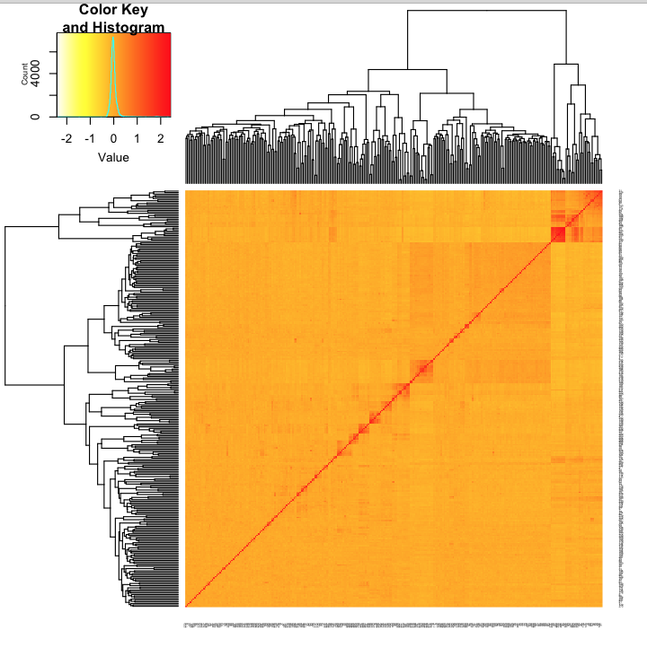
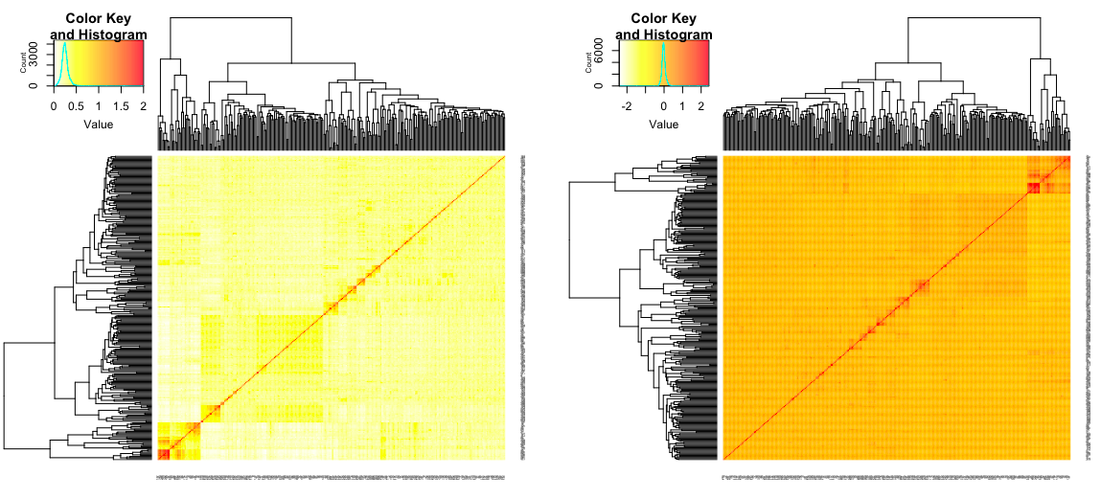
Comparison
heatmap.2(K1, cexRow =.2, cexCol = 0.2, col=rev(heat.colors(256)), scale="none", symkey=FALSE, trace="none")
quartz()
heatmap.2(K2, cexRow =.2, cexCol = 0.2, col=rev(heat.colors(256)), scale="none", symkey=FALSE, trace="none")
Zhang
VanRaden

Slide 26
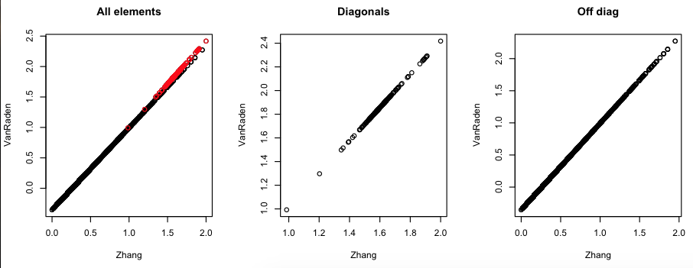
Common and differences
n=nrow(myGD)
ind.a=seq(1:(n*n))
i =1:n
j=(i-1)*n
ind.d=i+j
par(mfrow=c(1,3))
plot(K2[ind.a],K1[ind.a],main="All elements",xlab="Zhang",ylab="VanRaden")
lines(K2[ind.d],K1[ind.d],main="All elements",xlab="Zhang",ylab="VanRaden",col="red",type="p")
plot(K2[ind.d],K1[ind.d],main="Diagonals",xlab="Zhang",ylab="VanRaden")
plot(K2[-ind.d],K1[-ind.d],main="Off diag",xlab="Zhang",ylab="VanRaden")

Slide 27
Outline
Population structure is not enough
Dwarf8 story
Kinship
Additive Numerator Relationship
Pedigree based
Marker based

