Slide 1
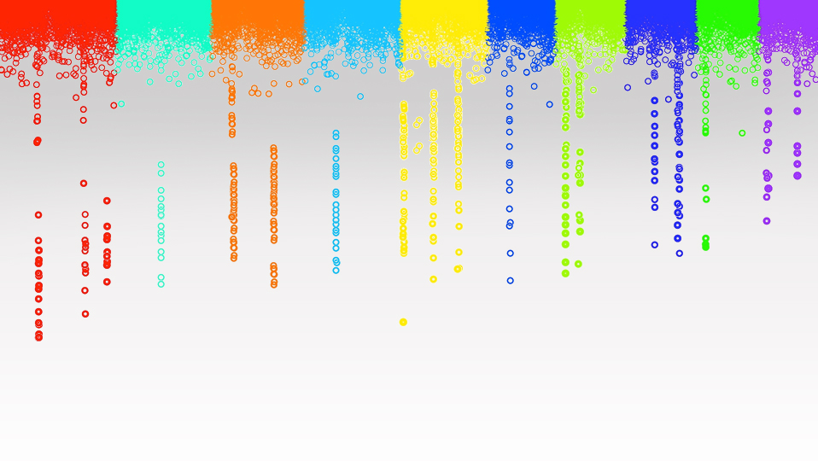

Statistical Genomics
Mixed Linear Model
Zhiwu Zhang
Washington State University

Slide 2
Outline
From GLM to MLM
Concept and working models
Incorporating kinship for GWAS
BLUE and BLUP
MLM in GAPIT
GLM in GAPIT

Slide 3
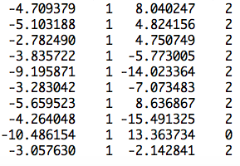
More covariates
observation
mean
PC2
SNP
Ind1 | Ind2 | … | Ind9 | Ind10
u1 | u2 | … | u9 | u10
1 | 0 | … | 0 | 0
0 | 1 | … | 0 | 0
0 | 0 | … | 1 | 0
0 | 0 | … | 0 | 1
u=
]
[
]
[
b=
b0
b1
b2
y
1
x1
x2
=X
Z
[
]
y = Xb + Zu +e

Slide 4
Recall for linear model
y=b₀ + x₁b₁ + x₂b₂ + … + x_{p}b_{p} + e
y: observation, dependent variable
x: Explanatory/independent variables
e: Residuals/errors
Δ =e₁² + e₂² + … + e_{n}²
=e'e
=(y-Xb)'(y-Xb)

Slide 5
Optimization to minimize residual
Δ =e'e
=e²=(y-Xb)²
∂Δ/∂b
=2X'(y-Xb)
=2X'y-2X'Xb=0
X'Xb=X'y
b=[X'X]⁻¹[X'Y]

Slide 6
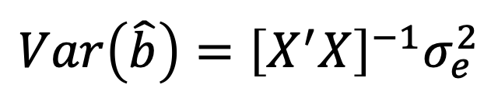
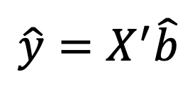
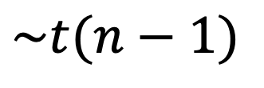
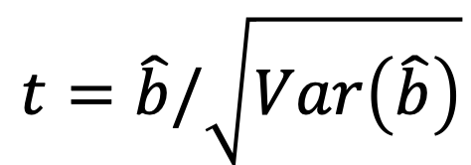
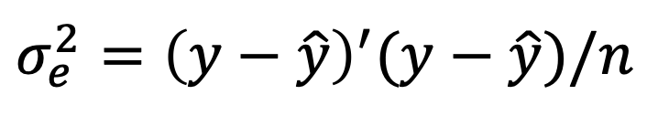
Statistical test
$$\hat{y}=X^{′}\hat{b}$$
$$σ_{e}^{2}={\left(y−\hat{y}\right)}^{′}(y−\hat{y})/n$$
$$Var\left(\hat{b}\right)={\left[X^{′}X\right]}^{−1}σ_{e}^{2}$$
$$t=\hat{b}/\sqrt{Var\left(\hat{b}\right)}$$
$$\sim t(n−1)$$

Slide 7
GLM (Conceptual)
Phenotype on individuals
Population
structure
y = SNP + Q (or PCs) +
e
(fixed effect)
(fixed effect)
General Linear Model (GLM)

Slide 8
Minimize residual does not work for adding individuals' effects
More parameters than observations
Residuals are always zero due to over model fitting
Needs new rules
X

Slide 9
New rules
Do not minimize residual only
Free individual effects
Only regulate the features for the population where they from: means (0) and variances
Optimize variances according to kinship and observation to maximize the likelihood

Slide 10
MLM for GWAS
Phenotype
Population
structure
Unequal
relatedness
Y = SNP + Q (or PCs) + Kinship + e
(fixed effect)
(fixed effect)
(random effect)
General Linear Model (GLM)
Mixed Linear Model (MLM)
(Yu et al. 2005, Nature Genetics)

Slide 11
Fixed vs. Random Effects
Fixed effect
  Limited levels
  Interest on levels
Radom effect
  Many levels
  Interest on population behind the levels (mean, variance)

Slide 12
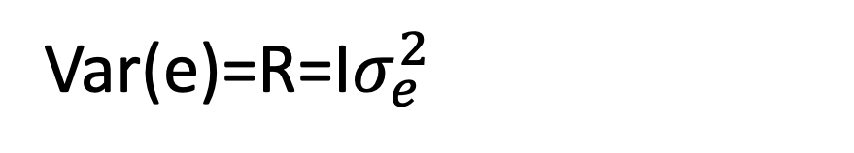
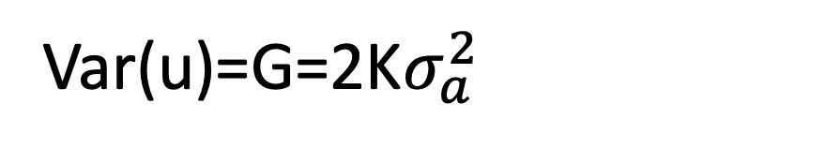
Mixed Linear Model (MLM)
y = Xb + Zu + e
Var(y)=V=Var(u)+Var(e)
Var(u)=G=2K$σ_{a}^{2}$
Var(e)=R=I$σ_{e}^{2}$
u prediction: Best Linear Unbiased Prediction, BLUP)
b prediction: Best Linear Unbiased Estimate, BLUE)

Slide 13
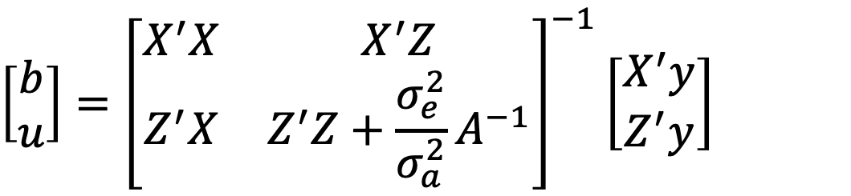
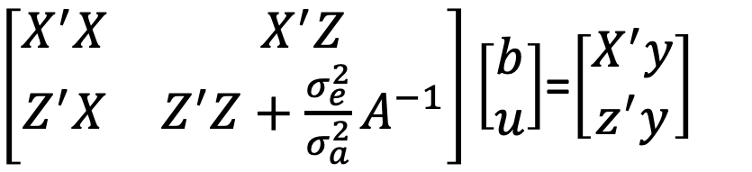
Mixed Model Equation
y = Xb + Zu + e
$\left[\begin{matrix}X^{′}X & X^{′}Z \\ Z^{′}X & Z^{′}Z+{\frac{σ_{e}^{2}}{σ_{a}^{2}}A}^{−1}\end{matrix}\right]\left[\begin{matrix}b \\ u\end{matrix}\right]$=$\left[\begin{matrix}X^{′}y \\ z^{′}y\end{matrix}\right]$
$$\left[\begin{matrix}b \\ u\end{matrix}\right]={\left[\begin{matrix}X^{′}X & X^{′}Z \\ Z^{′}X & Z^{′}Z+{\frac{σ_{e}^{2}}{σ_{a}^{2}}A}^{−1}\end{matrix}\right]}^{−1}\left[\begin{matrix}X^{′}y \\ Z^{′}y\end{matrix}\right]$$

Slide 14
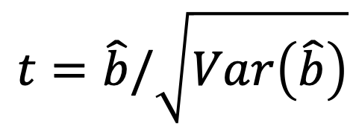
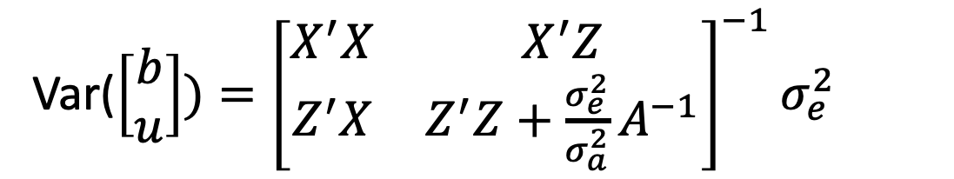
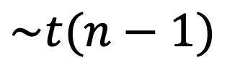
Mixed Model Equation
Estimation of $σ_{a}^{2}$ and $σ_{e}^{2}$: Maximum Likelihood (EMMA)
Var($\left[\begin{matrix}b \\ u\end{matrix}\right])={\left[\begin{matrix}X^{′}X & X^{′}Z \\ Z^{′}X & Z^{′}Z+{\frac{σ_{e}^{2}}{σ_{a}^{2}}A}^{−1}\end{matrix}\right]}^{−1}σ_{e}^{2}$
$$t=\hat{b}/\sqrt{Var\left(\hat{b}\right)}$$
$$\sim t(n−1)$$

Slide 15
Simulation with GAPIT
source("http://zzlab.net/GAPIT/gapit_functions.txt")
myGD=read.table(file="http://zzlab.net/GAPIT/data/mdp_numeric.txt",head=T)
myGM=read.table(file="http://zzlab.net/GAPIT/data/mdp_SNP_information.txt",head=T)
index1to5=myGM[,2]<6
set.seed(99164)
mySim=GAPIT.Phenotype.Simulation(GD=myGD[,c(TRUE,index1to5)],
GM=myGM[index1to5,],
h2=.7,
NQTN=40,
effectunit =.95,
QTNDist="normal")

Slide 16
MLM
setwd("~/Desktop/temp")
myGAPIT=GAPIT(Y=mySim$Y, GD=myGD, GM=myGM,
PCA.total=3,
QTN.position=mySim$QTN.position,
model="MLM")

Slide 17
GLM
setwd("~/Desktop/temp")
myGAPIT=GAPIT(Y=mySim$Y,GD=myGD,GM=myGM,
PCA.total=3,
QTN.position=mySim$QTN.position,
model="GLM")

Slide 18
t Test
setwd("~/Desktop/temp")
myGAPIT=GAPIT(Y=mySim$Y,GD=myGD,GM=myGM,
PCA.total=0,
QTN.position=mySim$QTN.position,
model="GLM",
memo="tTest")

Slide 19
Multiple models
setwd("~/Desktop/temp")
myGAPIT=GAPIT(Y=mySim$Y,GD=myGD,GM=myGM,
PCA.total=3,
QTN.position=mySim$QTN.position,
model=c("GLM","MLM"))

Slide 20
GAPIT Output

Slide 21
Phenotype

Slide 22
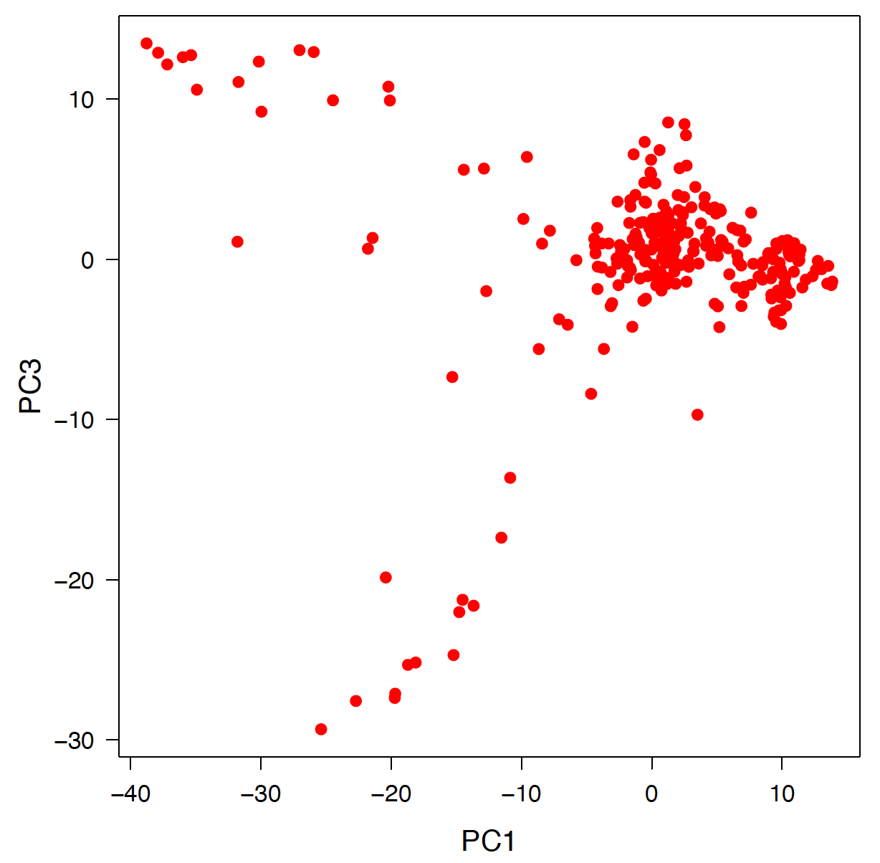
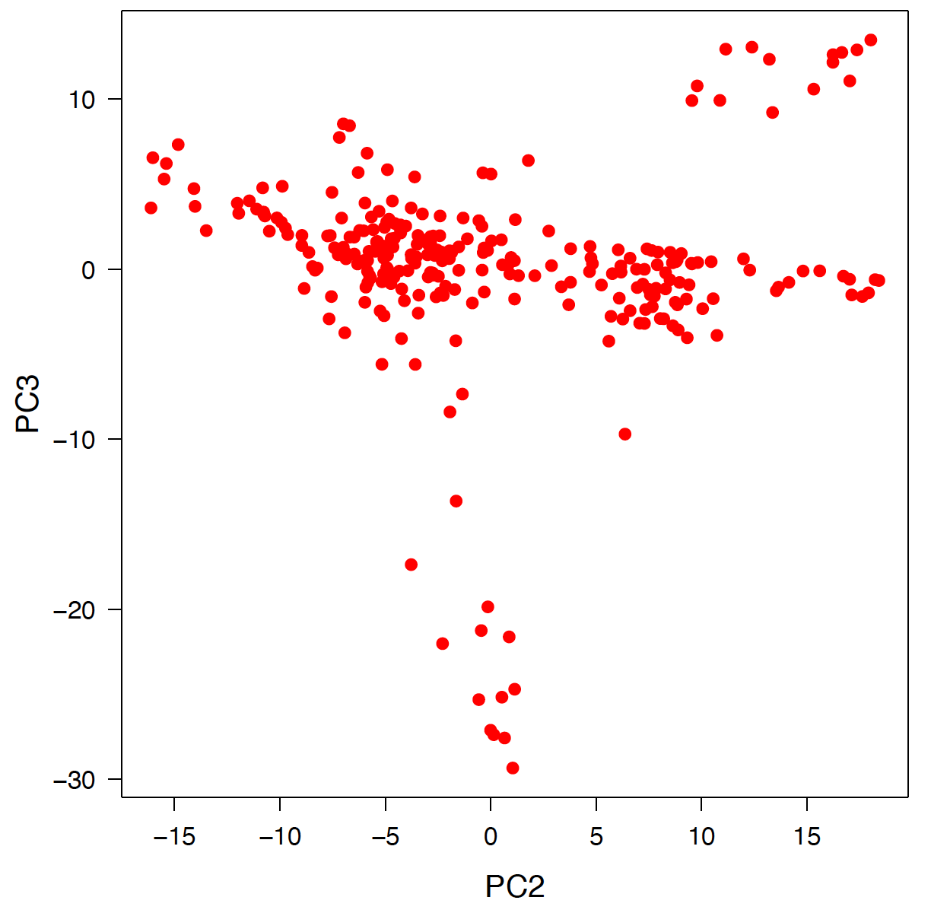
PCA

Slide 23
MAF and Heterozygosity

Slide 24
MAF and Heterozygosity

Slide 25
Marker density and LD

Slide 26
Kinship

Slide 27
Outline
From GLM to MLM
Concept and working models
Incorporating kinship for GWAS
BLUE and BLUP
MLM in GAPIT
GLM in GAPIT

