Slide 1
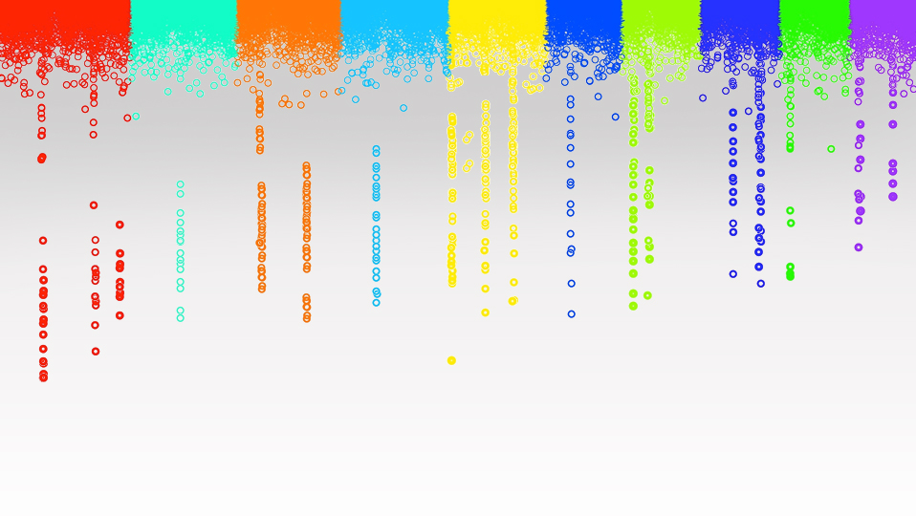

Statistical Genomics
Compressed CMLM
Zhiwu Zhang
Washington State University

Slide 2
Outline
Diving into MLM
CMLM
ECMLM
Computing time complexity
P3D/EMMAx

Slide 3
Hidden, observed, induction, and modeling
Genes
SNPs
PCs
y=SNP+e
y=SNP+PC+e
y=SNP+PC+BLUP(K)+e
BLUP=SNP+e
BLUP=SNP+PC+e
Residual=SNP+e
Residual=SNP+PC+e
Y=SNP1 + SNP2+ … + e
K
BV
BLUP
y
Residual
Hidden
Observed
Induction
Modeling
Notes:
How does unequal relatedness between individuals create false positives?
Why would you perform GWAS with residuals?
What does it mean GWAS does not work for traits associated with structure?
Q and PC represent population structure, when do we get one or the other?
CMLM: on lecture slide 11. Why is the power higher, but model fit is lower when compression level is small?

Slide 4
MLM (Q+K) for GWAS
Phenotype
Population
structure
Unequal
relatedness
Jianming Yu
Y = SNP + Q (or PCs) + Kinship + e
(fixed effect)
(fixed effect)
(random effect)
General Linear Model (GLM)
Mixed Linear Model (MLM)
(Yu et al. 2005, Nature Genetics)

Slide 5
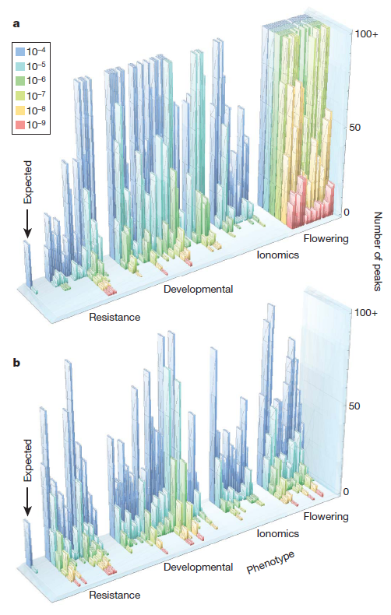

GWAS does not work for traits associated with structure
Atwell et al Nature 2010
a, No correction test
b, Correction with MLM
Magnus Norborg

Slide 6
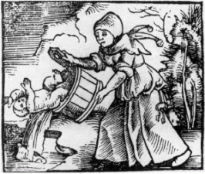
Queen + King

Slide 7
Critical thinking on MLM
Computation intensive, cubic to sample size (n³)
Converge problems (h²=0 or 1)
Q(PC) and K from same set of markers, double counted
Confounded between testing marker and Q(PC) and K
Disappointed on the opposite side of inflated p values

Slide 8

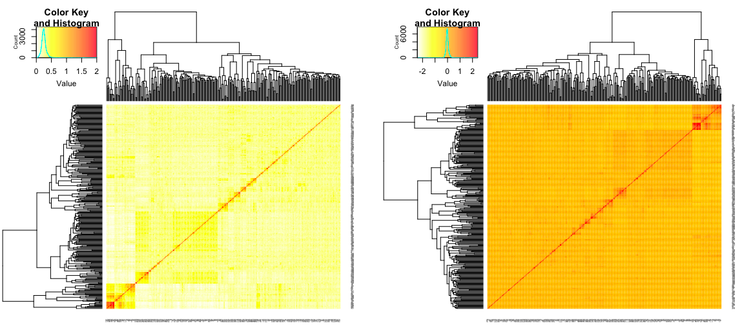
Compressed MLM
y = SNP + Q (or PCs) + Kinship +
e
Zhang
y = x₁b₁ + x₂b₂+x₃b₃+x₄b₄ + Zu+
e
Groups
Individuals
Zhang, Z. et al. Mixed linear model approach adapted for genome-wide association studies. Nat Genet 42, 355–360 (2010).

Slide 9
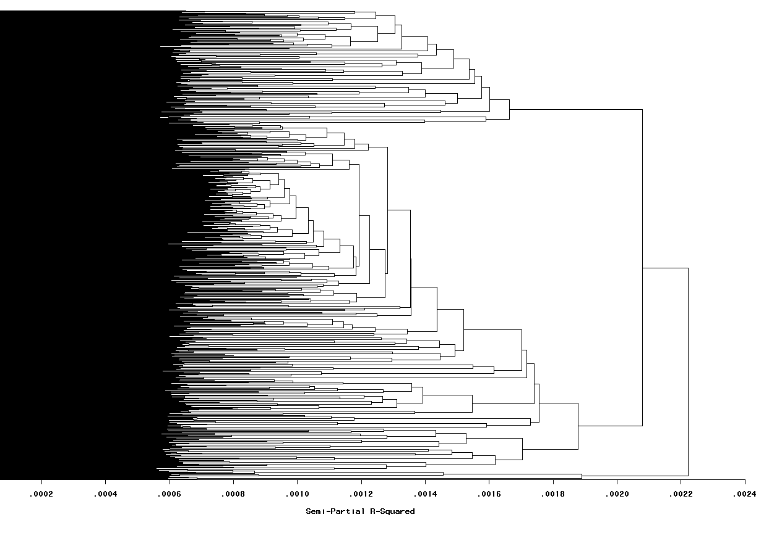
Likelihood over Grouping by kinship
-2 Log Likelihood
Compression level (AVG individuals/group)

Slide 10
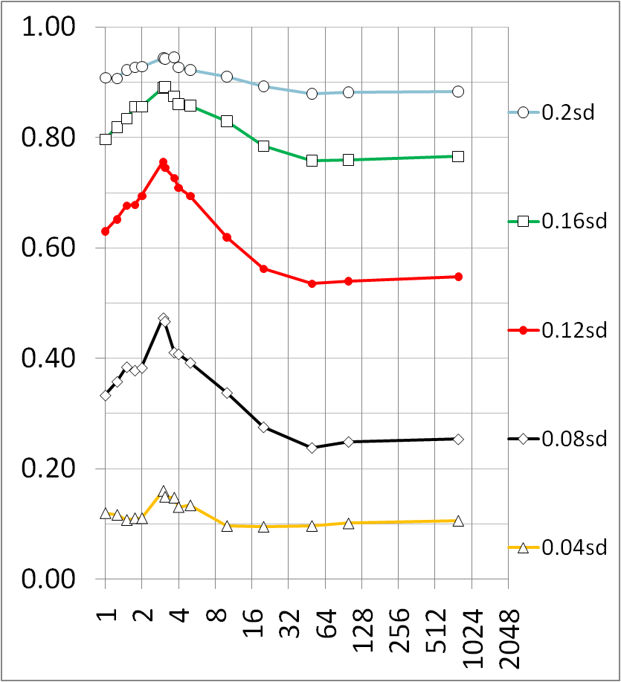
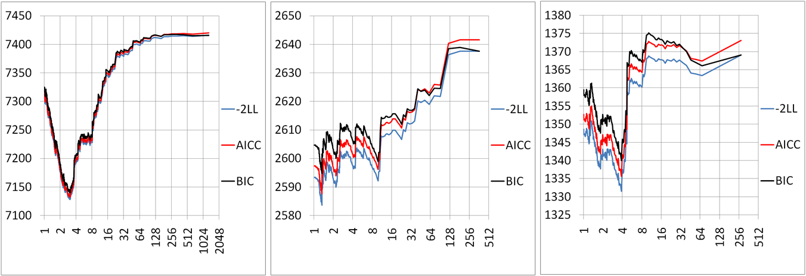
Compression improves power
The optimum point can be found by maximum likelihood
Average number of individuals per group

Slide 11
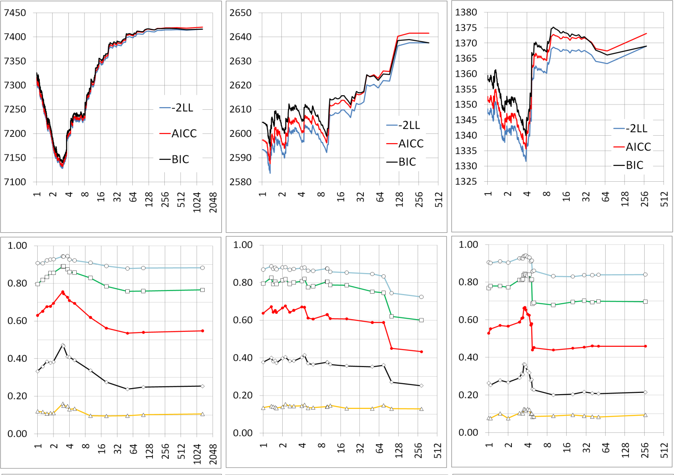
The trend is consistent across species
Human (n=1315)
Dog (n=292)
Maize (n=277)
Fit of Model
0.20sd (0.83%)
0.5sd (4.99%)
0.5sd (4.99%)
0.16sd (0.53%)
0.4sd (3.25%)
0.4sd (3.25%)
0.3sd (1.85%)
Statistical power
0.12sd (0.30%)
0.3sd (1.85%)
0.2sd (0.83%)
0.08sd (0.13%)
0.2sd (0.83%)
0.04sd 0(.03%)
0.1sd (0.21%)
0.1sd (0.21%)
Compression level

Slide 12
Compressed MLM is more general
GLM
(1 group)
SA, GC, PCA and QTDT
Compressed MLM
Compressed MLM (s groups)
Sire model
n ≥ s ≥ 1
Full MLM
(n groups)
Henderson’s MLM
Unified MLM
Pedigree
based kinship
Marker
based kinship

Slide 13
Enriched Compressed MLM
Kinship: Among individuals -> among groups
1 | .167
.167 | .72
1 | .25 | .125 | .125
.25 | 1 | .5 | .5
.125 | .5 | 1 | .75
.125 | .5 | .75 | 1
Average
Maximum
1 | .25
.25 | 1
Minimum
Median
…

Slide 14
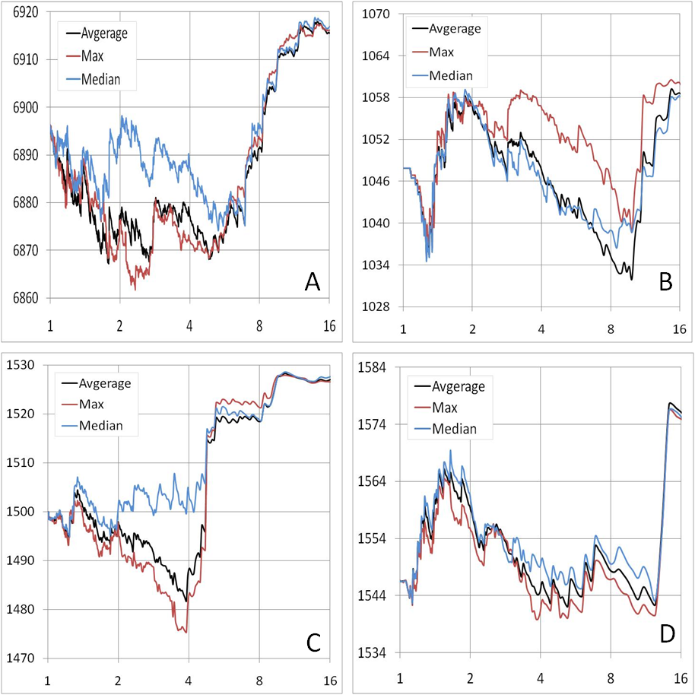
Better optimization with group kinship
A-Human
B-Dog
C-Maize
D-Arabidopsis

Slide 15
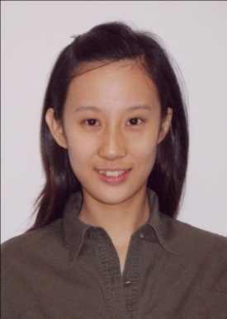
Statistical power improvement
Meng Li
Method shift | Human | Dog | Maize | Arabidopsis
GLM to MLM | 3.6% | 13.8% | 10.1% | 29.6%
MLM to compression | 4.0% | 14.2% | 7.6% | 2.5%
Compression to group kinship | 6.4% | 13.3% | 2.9% | 2.6%
BMC Biology, 2014

Slide 16

Computing time of inverse
n=500
a=matrix(sample(100,n*n,replace=T),n,n)
ptm <- proc.time()
b=solve(a)
proc.time() - ptm
proc.time() - ptm
user system elapsed
0.284 0.004 0.291
n | 500 | 1000 | 2000
Time | 0.291 | 2.235 | 16.762
Ratio (n) | 1 | 2 | 2
Ratio (Time) | 1 | 7.7 | 7.5
T $∝$ n³

Slide 17
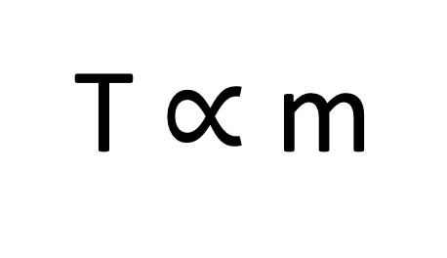
Computing time of MLM GWAS
T $∝$ m
n³
p
Number of markers
Number of individuals
Estimation of variances

Slide 18

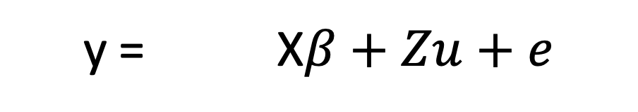
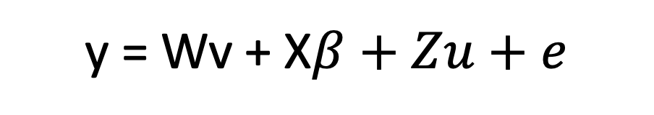
Genetic evaluation strategy for GWAS
y = X$β+Zu+e$
y = Wv + X$β+Zu+e$

Slide 19

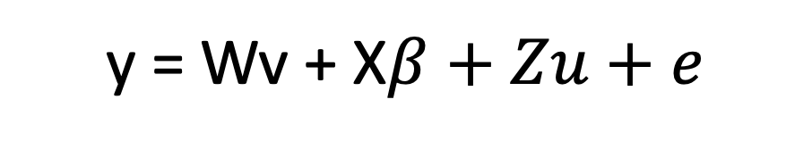
Population Parameters Previously Determined (P3D)
Population Parameters Previously Determined
y = Wv + X$β+Zu+e$
C is compression level in CMLM

Slide 20
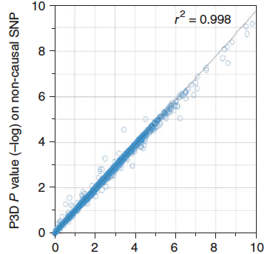
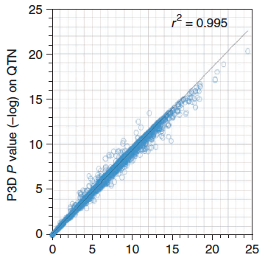
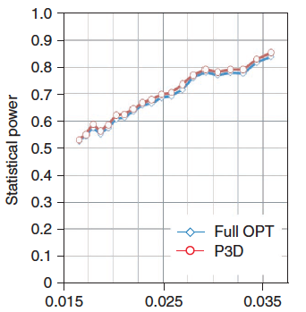
P3D and Full optimization are similar
Full optimization: estimate h² for every SNPs
P3D: Estimate h² without SNP and fix it for testing SNPs

Slide 21
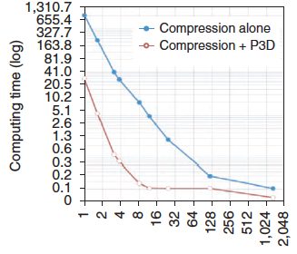
Compression + P3D
Compression levels
100~10,000X faster

Slide 22

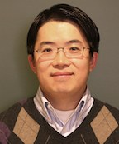
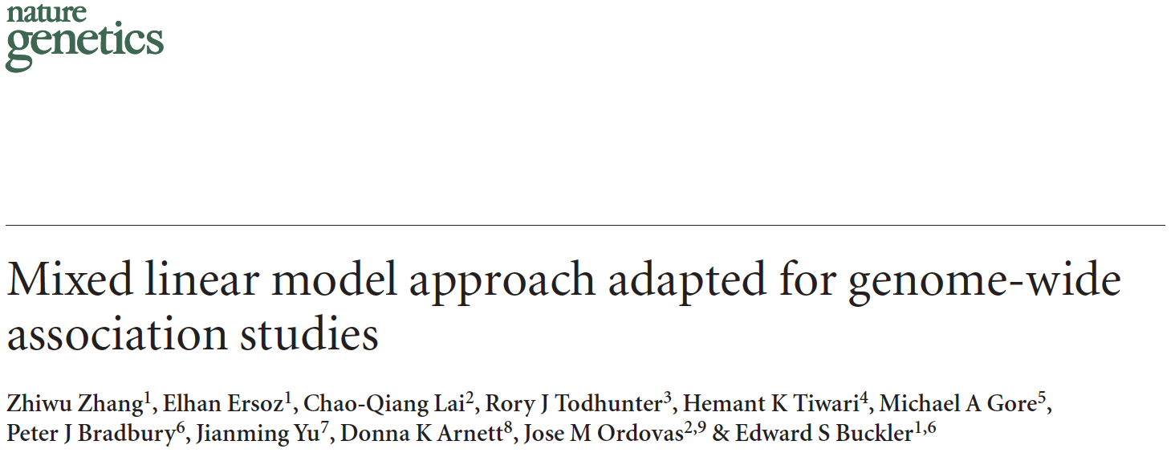
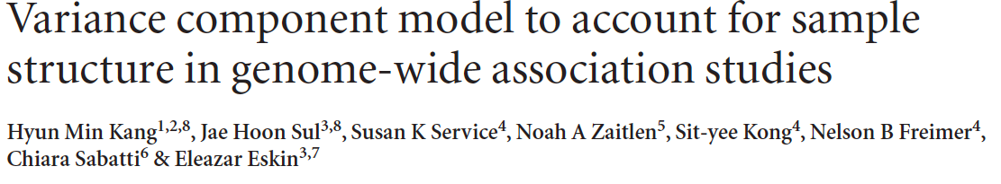
P3D/EMMAx
Zhang
Kang
Zhang, Z. et al. Mixed linear model approach adapted for genome-wide association studies. Nat Genet 42, 355–360 (2010).
Kang, H. M. et al. Variance component model to account for sample structure in genome-wide association studies. Nat Genet 42, 348–354 (2010).

Slide 23
Simulation with GAPIT
source("http://zzlab.net/GAPIT/gapit_functions.txt")
myGD=read.table(file="http://zzlab.net/GAPIT/data/mdp_numeric.txt",head=T)
myGM=read.table(file="http://zzlab.net/GAPIT/data/mdp_SNP_information.txt",head=T)
index1to5=myGM[,2]<6
set.seed(99164)
mySim=GAPIT.Phenotype.Simulation(GD=myGD[,c(TRUE,index1to5)],
GM=myGM[index1to5,],
h2=.7,
NQTN=40,
effectunit =.95,
QTNDist="normal")

Slide 24
CMLM in GAPIT
setwd("~/Desktop/temp")
myGAPIT=GAPIT(Y=mySim$Y, GD=myGD, GM=myGM,
PCA.total=3,
QTN.position=mySim$QTN.position,
model="CMLM")

Slide 25
Outline
Diving into MLM
CMLM
ECMLM
Computing time complexity
P3D/EMMAx

