Slide 1


Statistical Genomics
FarmCPU
Zhiwu Zhang
Washington State University

Slide 2
Outline
History of method and software development
SUPER inspiration
FarmCPU algorithm
FarmCPU performances
Five packages: FarmCPU, GAPIT, FarmCPUpp, MVP, and iPat

Slide 3
Models
GLM and Stepwise regression
QTNs +
y = PC + SNP + e
FarmCPU: -2LL
BLINK: -2LL
QTNs
MAS
BLUP/gBLUP
y = PC + Kinship + e
y = PC + QTNs + e
SUPER
Complementary
QTNs +
y = PC + Kinship + SNP + e
MLM and MLMM

Slide 4

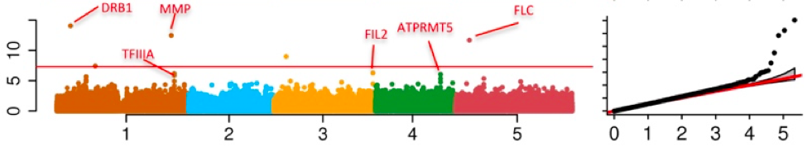
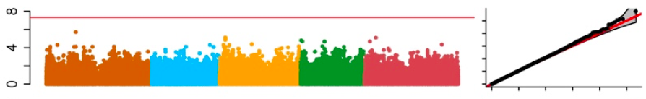
Problems in GWAS
Computing difficulties: millions of markers, individuals, and traits
False positives, ex: “Amgen scientists tried to replicate 53 high-profile cancer research findings, but could only replicate 6”, Nature, 2012, 483: 531
False negatives

Slide 5
t test
Speed improvement
Power
improvement
GLM
GenABEL
Computing speed
FaST-LMM
CMLM
ECMLM
GEMMA
Select
P3D/EMMAX
SUPER
EMMA
MLMM
MLM
Power | type I error

Slide 6
Usage of Models and Software Packages
Software | Year | Citations | GLM | MLM | CMLM | ECMLM | SUPER | MLMM | FarmCPU | BLINK
PLINK | 2007 | 28141 | ✔️
TASSEL | 2007 | 5930 | ✔️ | ✔️ | ✔️
GenABEL | 2007 | 2002 | ✔️ | ✔️
EMMA | 2008 | 1783 |  | ✔️
EMMAx | 2010 | 1991 |  | ✔️
GCTA* | 2011 | 5811 |  | ✔️
FaST-LMM | 2011 | 1123 |  | ✔️
GEMMA | 2012 | 2358 |  | ✔️
GAPIT | 2012 | 1676 | ✔️ | ✔️ | ✔️ | ✔️ | ✔️ | ✔️ | ✔️ | ✔️
MLMM | 2012 | 787 |  |  |  |  |  | ✔️
FaST-LMM-Select | 2012 | 351 |  | ✔️ |  |  | ✔️
BOLT-LMM | 2015 | 471 |  | ✔️
FarmCPU | 2016 | 786 |  |  |  |  |  |  | ✔️
BLINK | 2019 | 209 |  |  |  |  |  |  |  | ✔️
rMVP | 2021 | 252 | ✔️ | ✔️ |  |  |  | ✔️ | ✔️

Slide 7
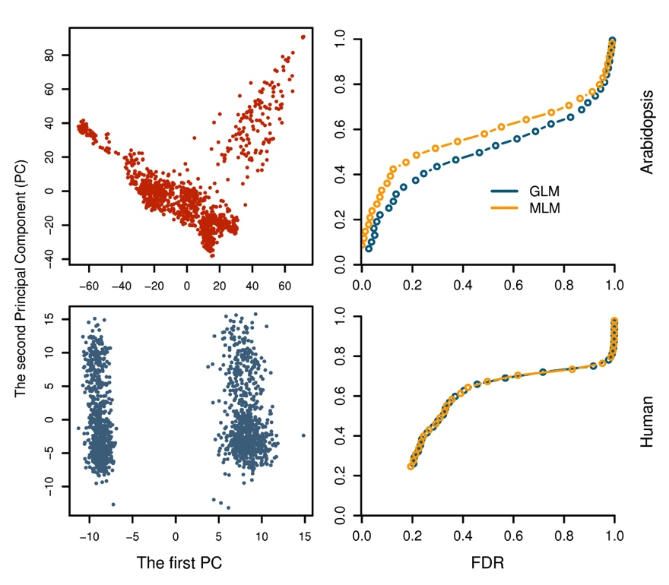
Why human geneticists do not go beyond PLINK?

Slide 8
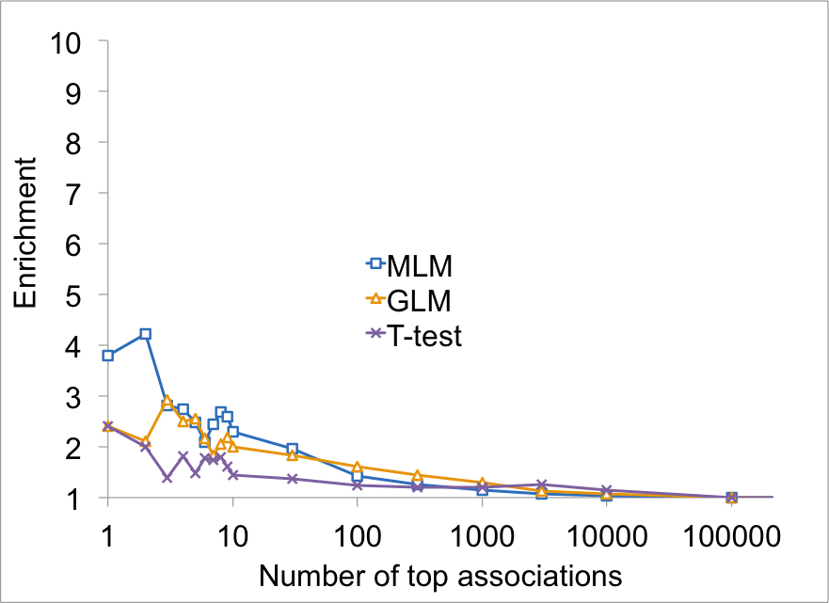
MLM was more enriched on Flowering time genes than GLM

Slide 9
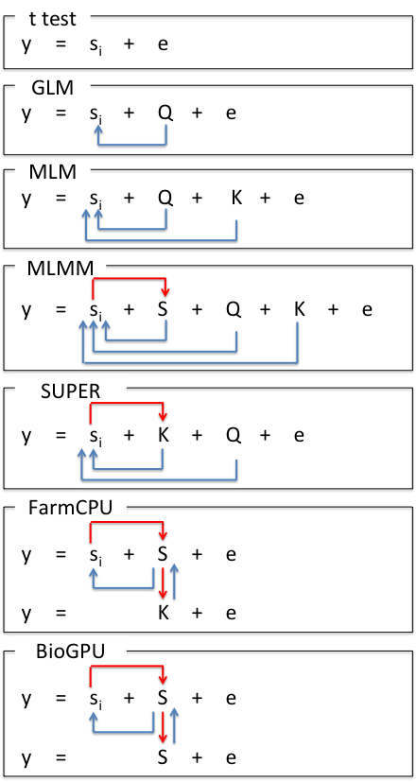
Model Development
S_{i}: Testing marker
Adjustment on marker
Q: Population structure
K: Kinship
Adjustment on covariates
S: Pseudo QTNs

Slide 10
SUPER algorithm
Fixed model
y = PC + SNP + e
Complementary
-2LL
QTNs
y = PC + Kinship + SNP + e
Random model
y = PC + Kinship + e
Random model
Bins

Slide 11
FarmCPU algorithm
Fixed model
y = PC + SNP + e
-2LL
QTNs
y = PC + QTNs + SNP + e
Fixed model
y = PC + Kinship + e
Random model
Bins

Slide 12
t test
Speed improvement
Power
improvement
GLM
GenABEL
FarmCPU
Computing speed
FaST-LMM
CMLM
ECMLM
GEMMA
Select
P3D/EMMAX
SUPER
EMMA
MLMM
MLM
Power | type I error

Slide 13
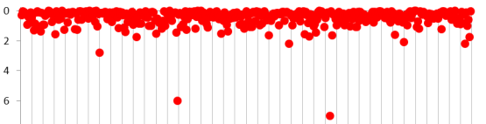
FARM-CPU
(Fixed And Random Model Circuitous Probability Unification)
Fixed model
y = M₁ + … + M_{t} + m_{i} + e
SNP | p₁ | … | NA | … | NA | … | p_{l}
M_{t} | P_{t1} | … | P_{tj} | … | P_{tk} | … | P_{tl} | P_{t}
… | … | … | … | … | … | … | … | …
M₂ | P₂₁ | … | P_{2j} | … | P_{2k} | … | P_{2l} | P₂
M₁ | P₁₁ | … | P_{1j} | … | P_{1k} | … | P_{1l} | P₁
 | m₁ | … | m_{j} | … | m_{k} | … | m_{l}
Substitution
Random model
y = u + e with
Var(u)∝SVD(M)
Optimization
Notes:
FARM-CPU (Fixed And Random Model Circulative Probability Unification)
Keywords: substitution, test, screen, storage, memory, mutation, markers, formula, optimization, processer, unit, background,
The shaded area is the storage of p values for markers (dark shaded) and mutations (shadow shaded). The Manhattan plot (with red dots) area is the processer to optimize bin size and the bin selected as pseudo mutations (M) connected by the green wires. The equation is the processer to test marker (m) one at a time with mutation (M) as covariates. The p values of M are processed xx unit (non-shaded area) to get average P values which are connect by the blue wires to substitute the Nas for the corresponding markers which do not have P values in the test as they are confounded to M.

Slide 14
Substitution of P values for QTNs
Fixed model
y = M₁ + … + M_{t} + m_{i} + e
SNP | p₁ | … | NA | … | NA | … | p_{l}
M_{t} | P_{t1} | … | P_{tj} | … | P_{tk} | … | P_{tl} | P_{t}
… | … | … | … | … | … | … | … | …
M₂ | P₂₁ | … | P_{2j} | … | P_{2k} | … | P_{2l} | P₂
M₁ | P₁₁ | … | P_{1j} | … | P_{1k} | … | P_{1l} | P₁
 | m₁ | … | m_{j} | … | m_{k} | … | m_{l}
Substitution
MLMM (Onsite): y = M₁ + … + M_{t} + e
Alternatives: Minimum, maximum, median, and mean
Notes:
FARM-CPU (Fixed And Random Model Circulative Probability Unification)
Keywords: substitution, test, screen, storage, memory, mutation, markers, formula, optimization, processer, unit, background,
The shaded area is the storage of p values for markers (dark shaded) and mutations (shadow shaded). The Manhattan plot (with red dots) area is the processer to optimize bin size and the bin selected as pseudo mutations (M) connected by the green wires. The equation is the processer to test marker (m) one at a time with mutation (M) as covariates. The p values of M are processed xx unit (non-shaded area) to get average P values which are connect by the blue wires to substitute the Nas for the corresponding markers which do not have P values in the test as they are confounded to M.

Slide 15
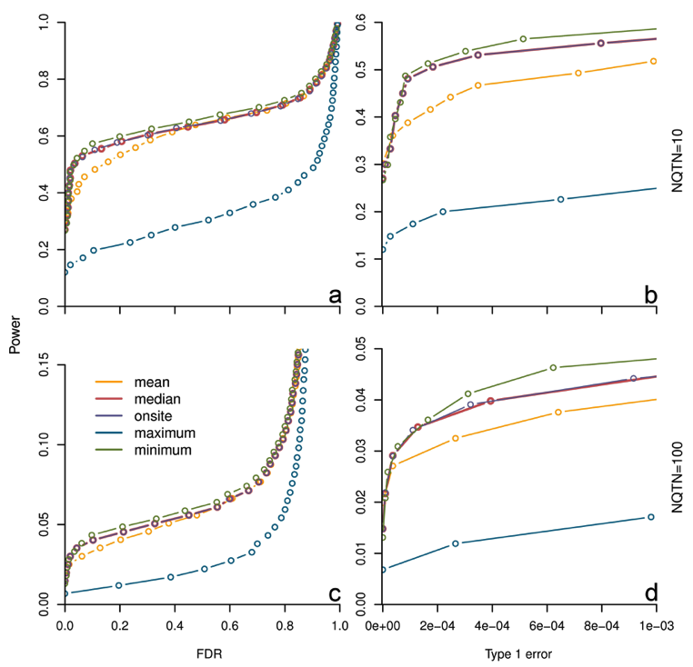
Substitution makes difference

Slide 16
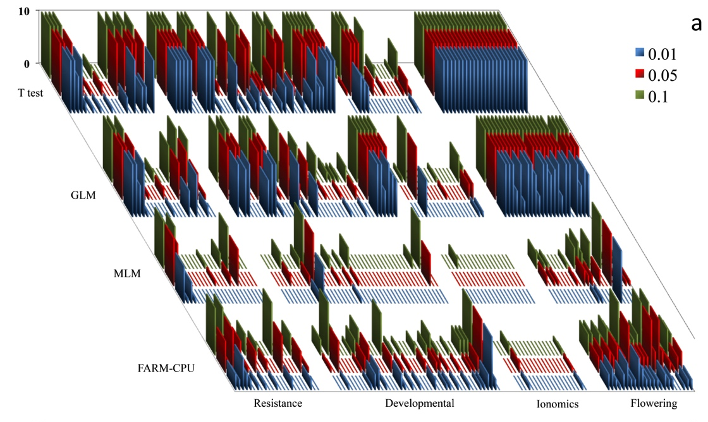

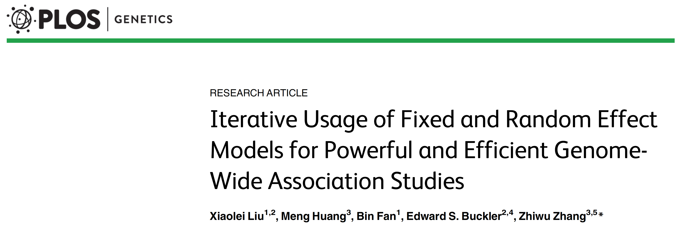
Re-analysis of Arabidopsis data
Xiaolei Liu

Slide 17
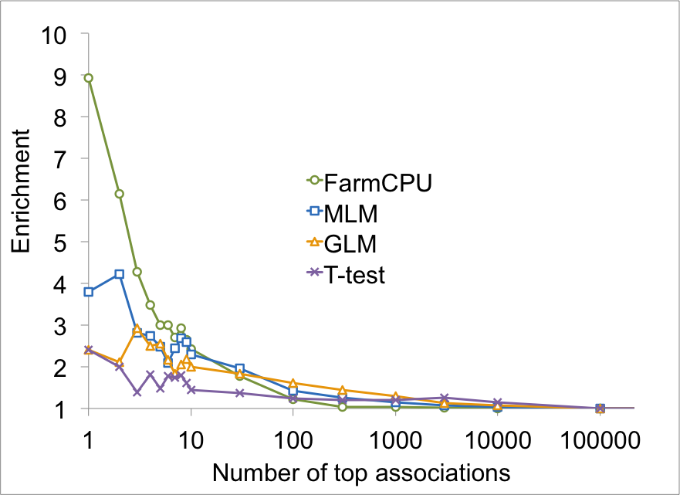
Flowering time genes enriched

Slide 18
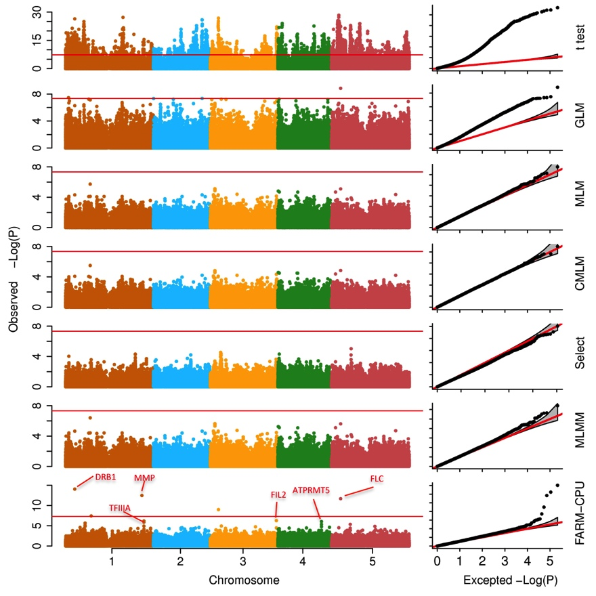
Associations on flowering time

Slide 19
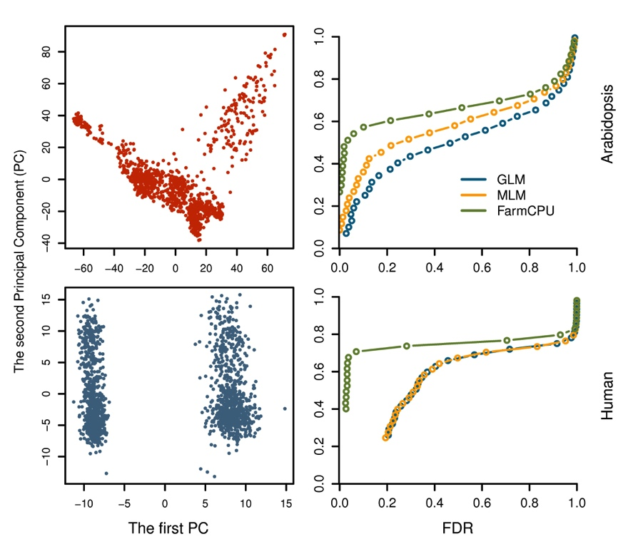
It is time for human geneticists to move forward

Slide 20
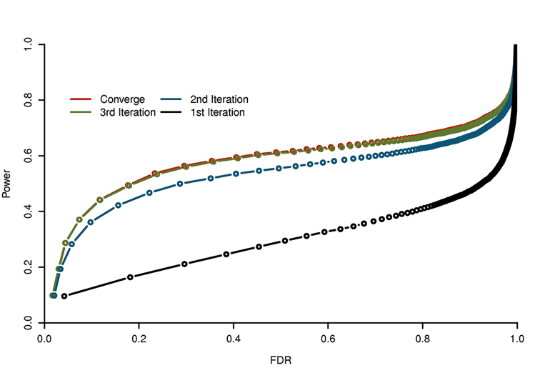
Converge fast
GLM

Slide 21
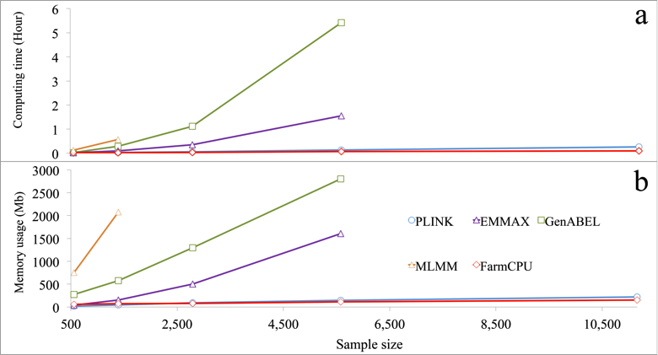
FarmCPU is computing efficient
Testing 60K SNPs

Slide 22
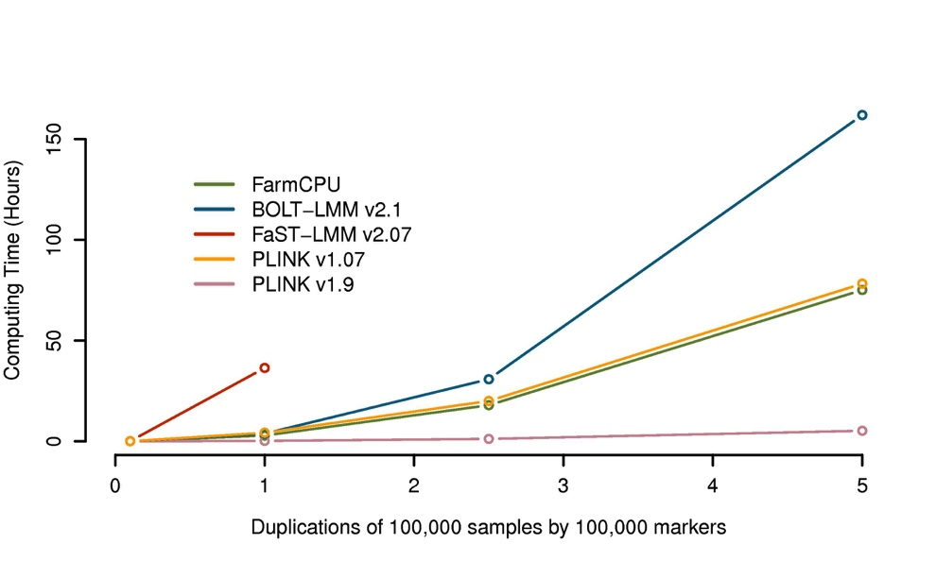
Half million individuals, half million SNPs: three days
But, PINK new version is faster

Slide 23

The most cited paper
https://exaly.com/author/5164729/zhi-wu-zhang/rankings

Slide 24


Slide 25
Simulation with GAPIT
source("http://zzlab.net/GAPIT/gapit_functions.txt")
myGD=read.table(file="http://zzlab.net/GAPIT/data/mdp_numeric.txt",head=T)
myGM=read.table(file="http://zzlab.net/GAPIT/data/mdp_SNP_information.txt",head=T)
index1to5=myGM[,2]<6
set.seed(99164)
mySim=GAPIT.Phenotype.Simulation(GD=myGD[,c(TRUE,index1to5)],
GM=myGM[index1to5,],
h2=.7,
NQTN=40,
effectunit =.95,
QTNDist="normal")

Slide 26
MLMM within GAPIT
myGAPIT_MLM <- GAPIT(
Y=mySim$Y,
GD=myGD,#Genotype
GM=myGM,#Map information
PCA.total=3,
QTN.position=mySim$QTN.position,
model="FarmCPU")

Slide 27
Outline
History of method and software development
SUPER inspiration
FarmCPU algorithm
FarmCPU performances
Five packages: FarmCPU, GAPIT, FarmCPUpp, MVP, and iPat

