Slide 1
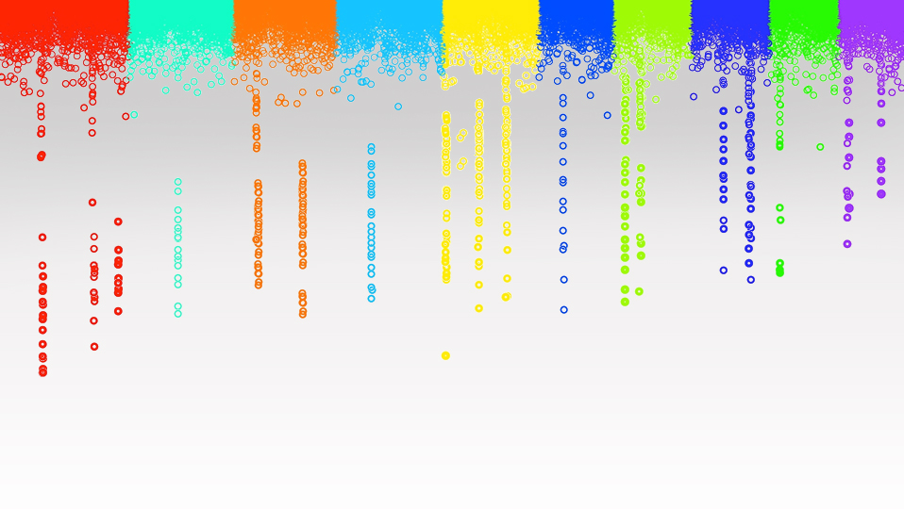

Statistical Genomics
BLINK
Zhiwu Zhang
Washington State University

Slide 2
Outline
Bin problem
Computing demand of FarmCPU
BLINK method and software

Slide 3



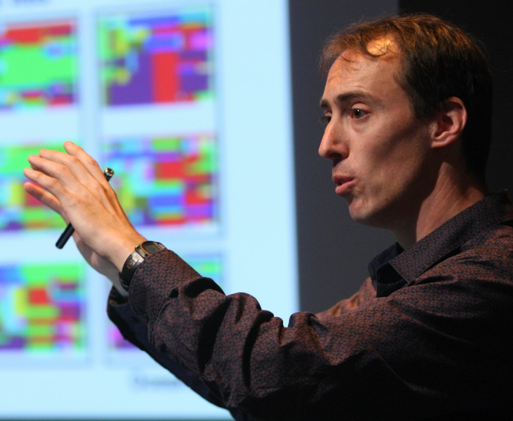


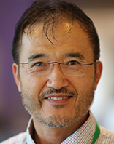


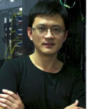
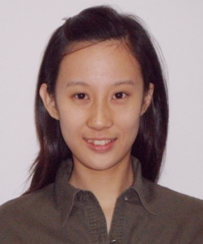






Q
EMMA
PC+K
PC
EMMAx
CMLM
Q+K
SELECT
MLMM
GWAS Stream
P3D
GCTA
ECMLM
SUPER
FAST-LMM
GEMMA
FarmCPU
GenAbel
BLINK

Slide 4
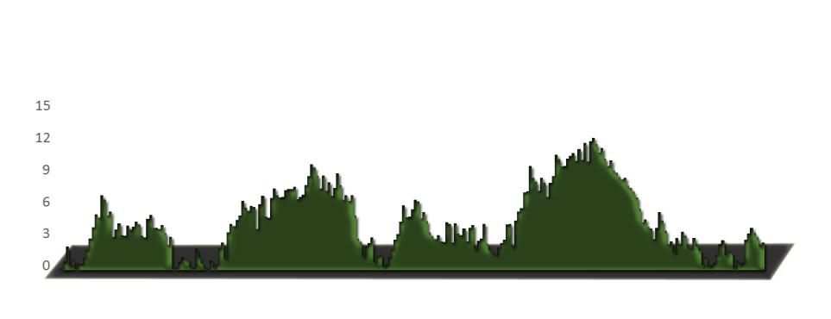
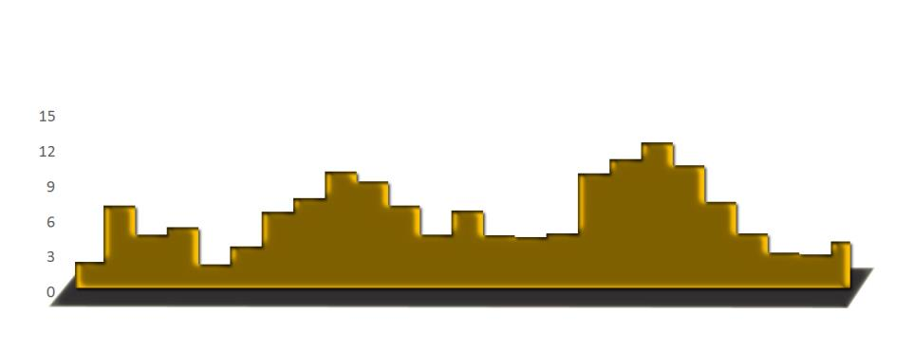
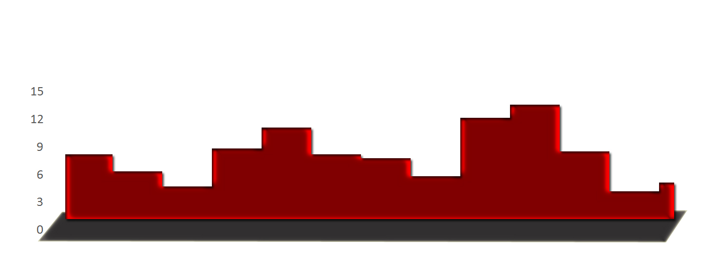
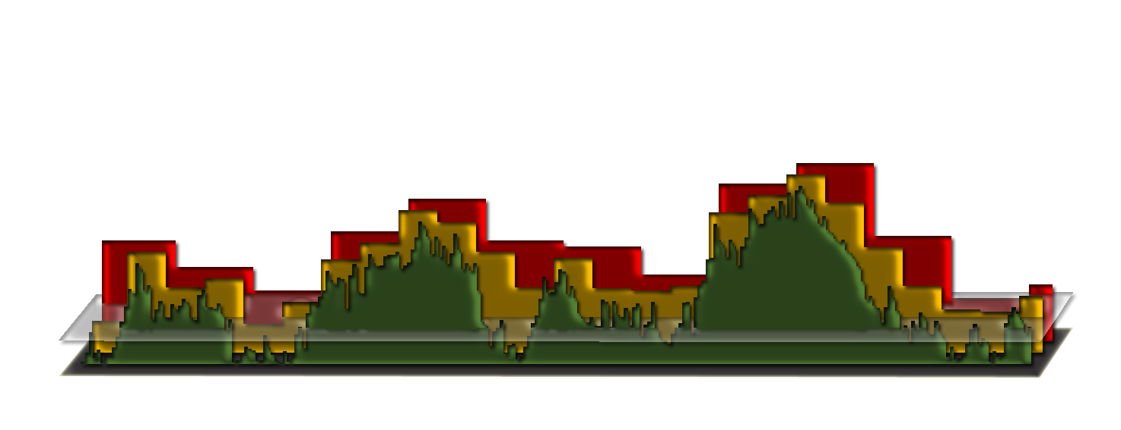
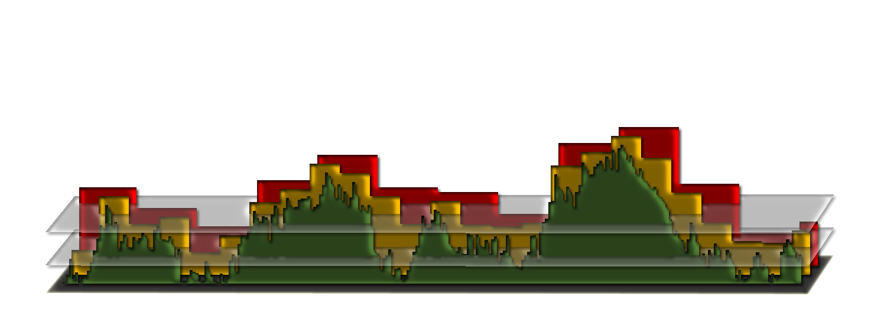
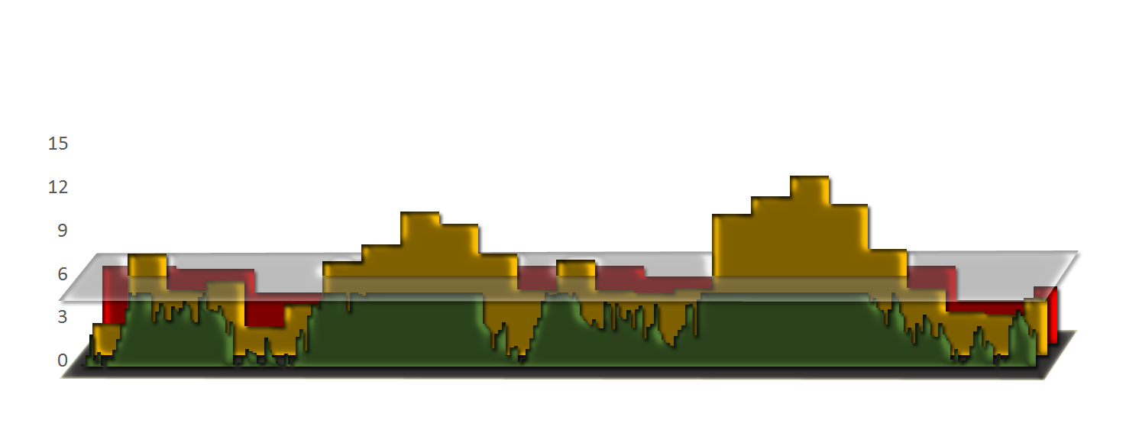
Bin approach
Optimization on bin size and numbers selected

Slide 5
Challenges of bin method
False
(bin too small)
Missing
(bin too big)
LD
clustered

Slide 6
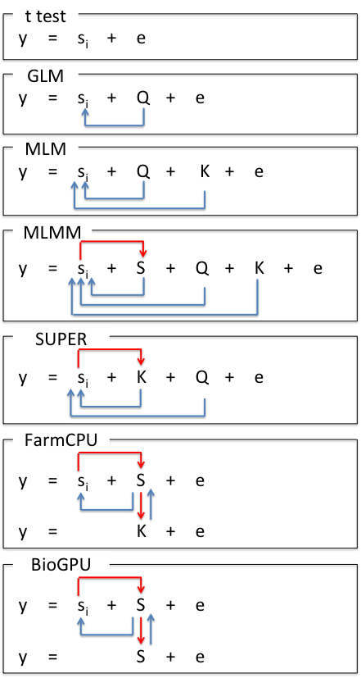
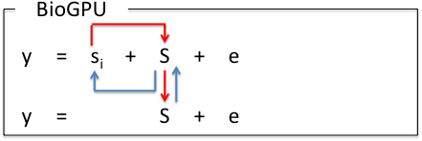
Model Development
S_{i}: Testing marker
Adjustment on marker
Q: Population structure
K: Kinship
Adjustment on covariates
S: Pseudo QTNs
BLINK

Slide 7
GWAS methods
Known M
M
K method
t test
m₁+…+m_{l}
m_{i}
Random effect
Fixed effect
K+ m_{i}
Q + m_{i}
Q method
K method
M + m_{i}
FarmCPU and BLINK
m: marker, M: Mutations, M: Estimated mutations

Slide 8
SUPER algorithm
Fixed model
y = PC + SNP + e
Complementary
-2LL
QTNs
y = PC + Kinship + SNP + e
Random model
y = PC + Kinship + e
Random model
Bins

Slide 9
FarmCPU algorithm
Fixed model
y = PC + SNP + e
-2LL
QTNs
y = PC + QTNs + SNP + e
Fixed model
y = PC + Kinship + e
Random model
Bins

Slide 10
BLINK algorithm
Fixed model
y = PC + SNP + e
LD
BIC
QTNs
y = PC + QTNs + SNP + e
Fixed model
y = PC + QTNs + e
Fixed model

Slide 11




Remove SNPs in LD
S₁*
S₂
… |  | S₂*
… |  | … |  | S₃*
… |  | … |  | … |  | S_{t}*
… |  | …
S_{m}
…
S_{M}
r(S₁*, S_{i}) <$β$
r(S₂*, S_{i}) <$β$
r(S₃*, S_{i}) <$β$
P_{m}<$α$

Slide 12
Bayesian information criterion
BIC = -2LL + k Ln(n)
k
t

Slide 13
Bayesian information criterion
BIC=-2LL+k Ln(n)
y = s_{i} + S₁* + S₂ * + S₃ * + … + S_{k} * + e, where i = 1 to M
1
k
t
y = S₁* + S₂ * + S₃ * + … + S_{k} * + e, where k maximizes BIC

Slide 14
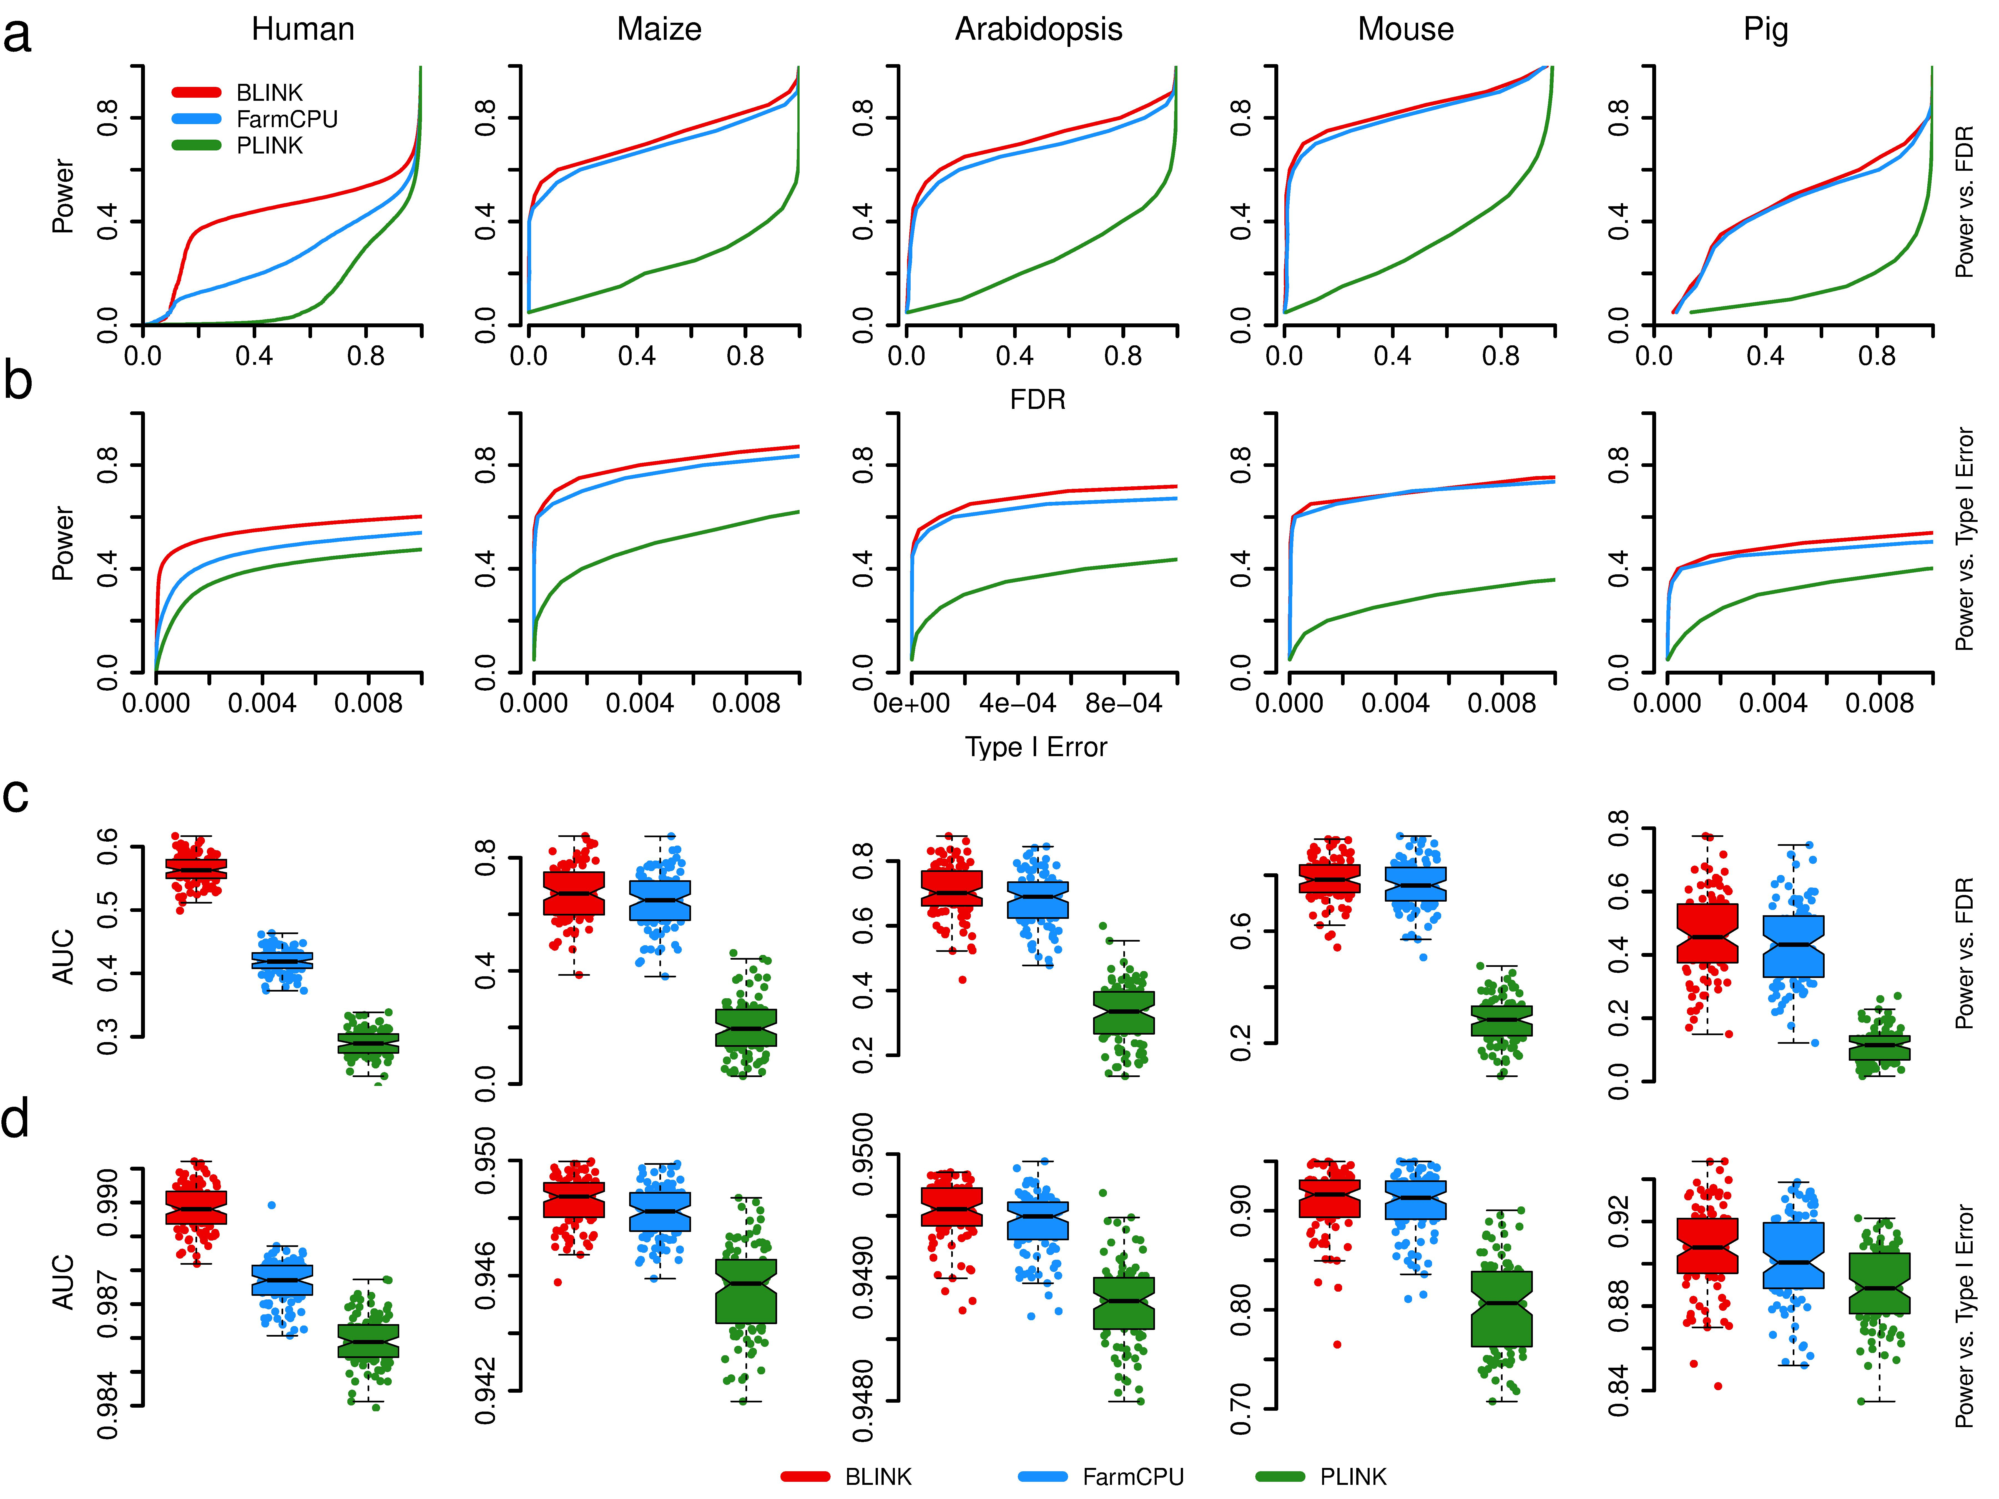
Simulation study with human data
FDR
Type I error

Slide 15
Same trend across species

Slide 16
Area under curve

Slide 17
http://zzlab.net/GAPIT/data/Workshop_Iowa.R
BLINK
FarmCPU
GAPIT
PLINK

Slide 18
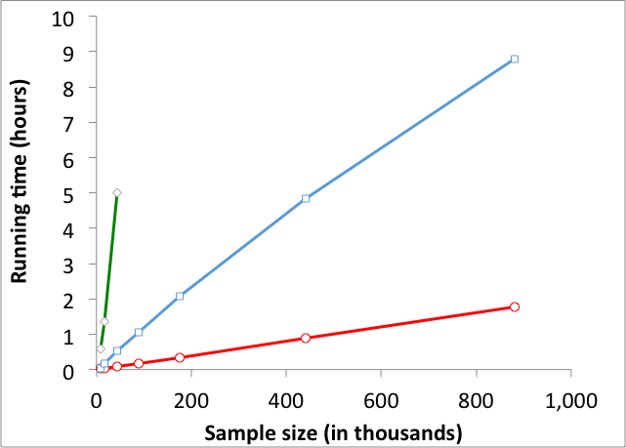
BLINK solves problems of millions of markers and individuals
Testing half million SNPs
PLINK
FarmCPU
BLINK
BLINK is 5X > PLINK, 200X > FarmCPU

Slide 19
Application in Maize

Slide 20
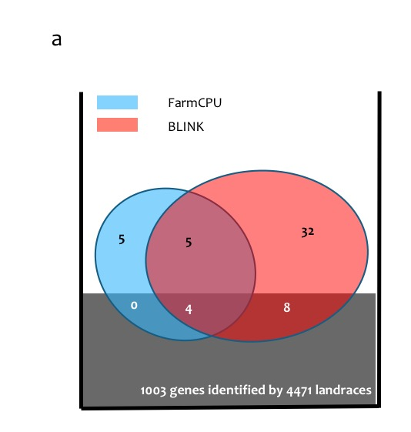
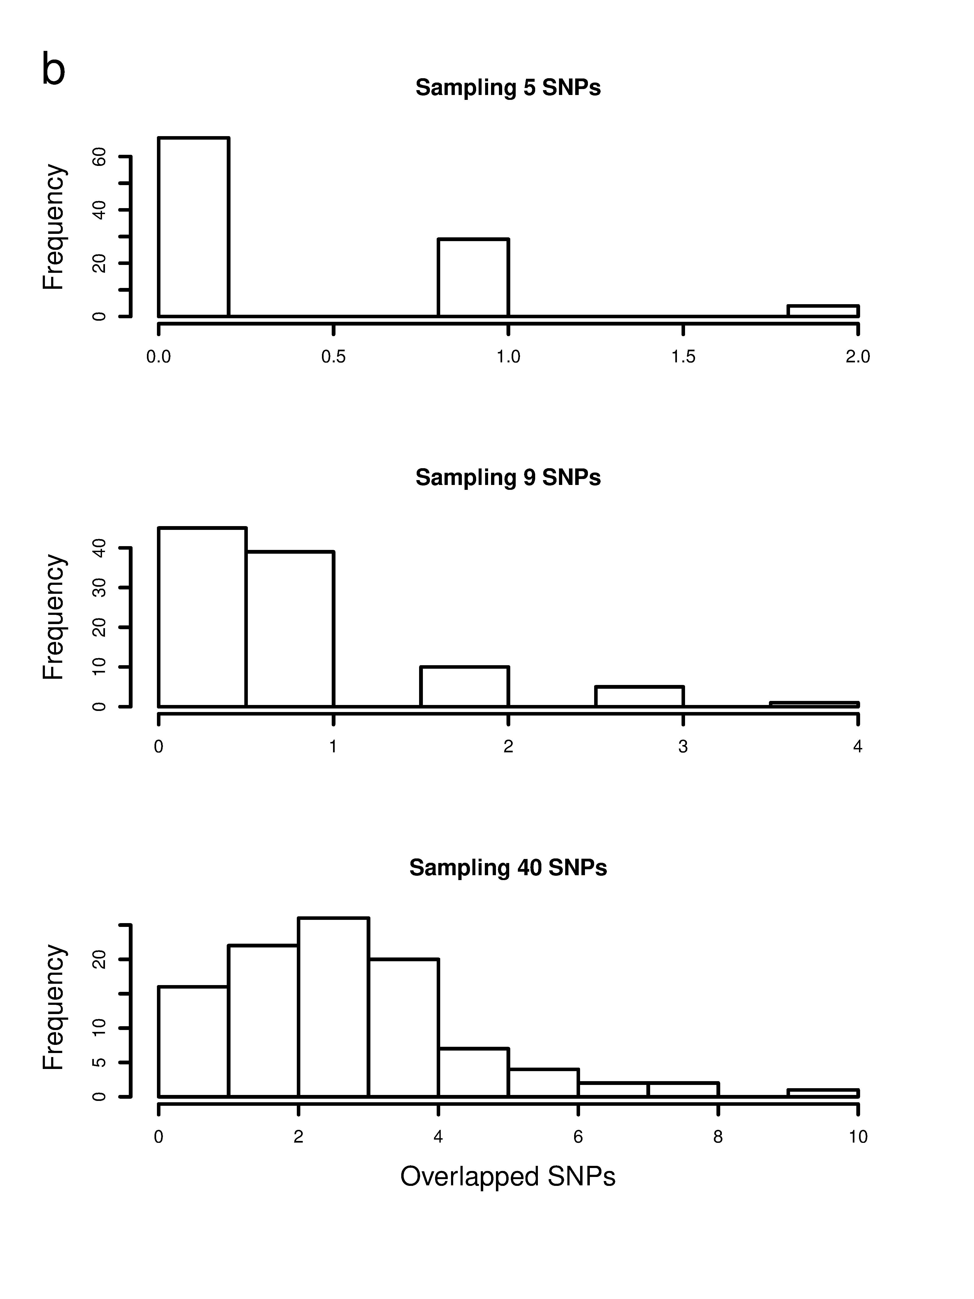
Enrichment
FarmCPU
only
<1%
Common
<3%
BLINK
only

Slide 21
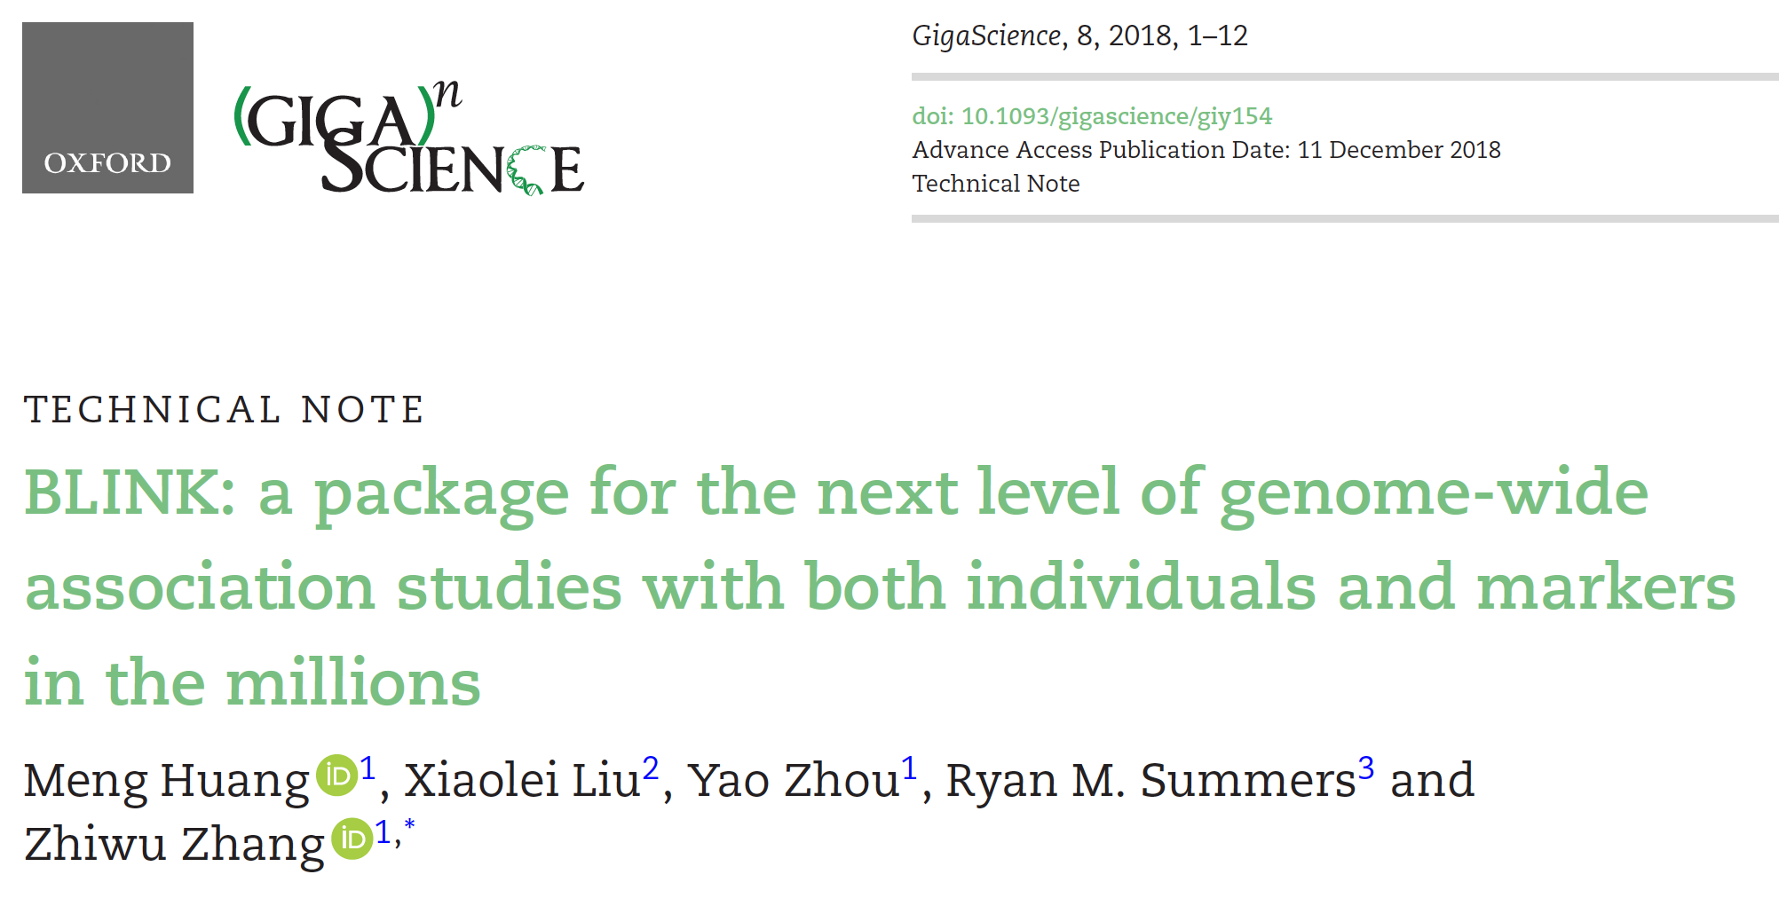
The sixth most cited paper
https://exaly.com/journal/23373/gigascience/top-articles/2019

Slide 22
Simulation with GAPIT
source("http://zzlab.net/GAPIT/gapit_functions.txt")
myGD=read.table(file="http://zzlab.net/GAPIT/data/mdp_numeric.txt",head=T)
myGM=read.table(file="http://zzlab.net/GAPIT/data/mdp_SNP_information.txt",head=T)
index1to5=myGM[,2]<6
set.seed(99164)
mySim=GAPIT.Phenotype.Simulation(GD=myGD[,c(TRUE,index1to5)],
GM=myGM[index1to5,],
h2=.7,
NQTN=40,
effectunit =.95,
QTNDist="normal")

Slide 23
BLINK within GAPIT
myGAPIT_MLM <- GAPIT(
Y=mySim$Y,
GD=myGD,#Genotype
GM=myGM,#Map information
PCA.total=3,
QTN.position=mySim$QTN.position,
model="BLINK")

Slide 24


Slide 25





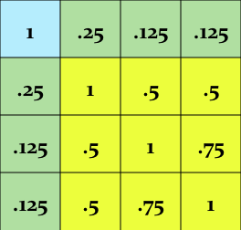
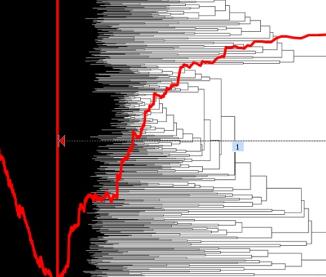


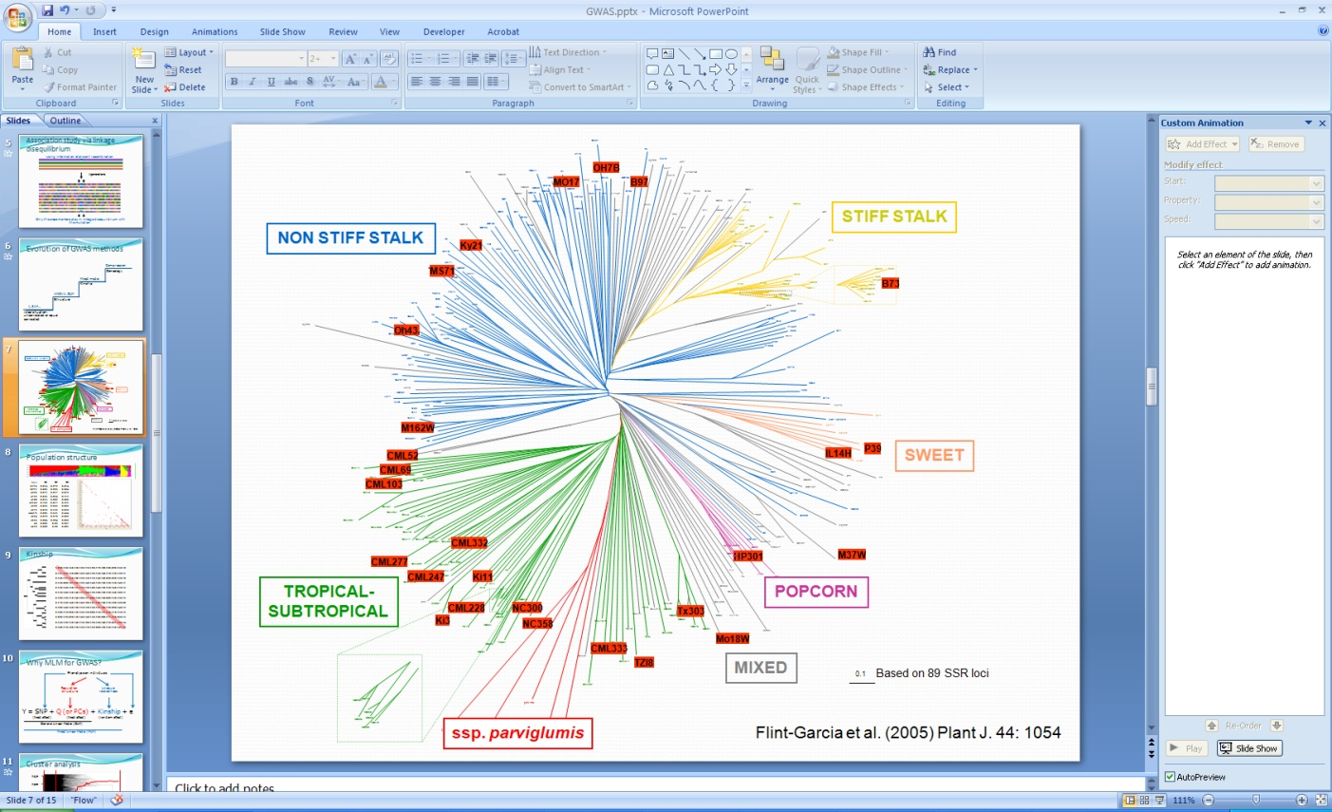
GAPIT
TASSEL
GAPIT
ECMLM
EMMA, EMMAx,
GCAT, GenABEL
CMLM
Structure, Eigenstrate
PLINK
MLM
GLM
t, F, X²…
iPat
Uncorrelated or
equally correlated

Slide 26
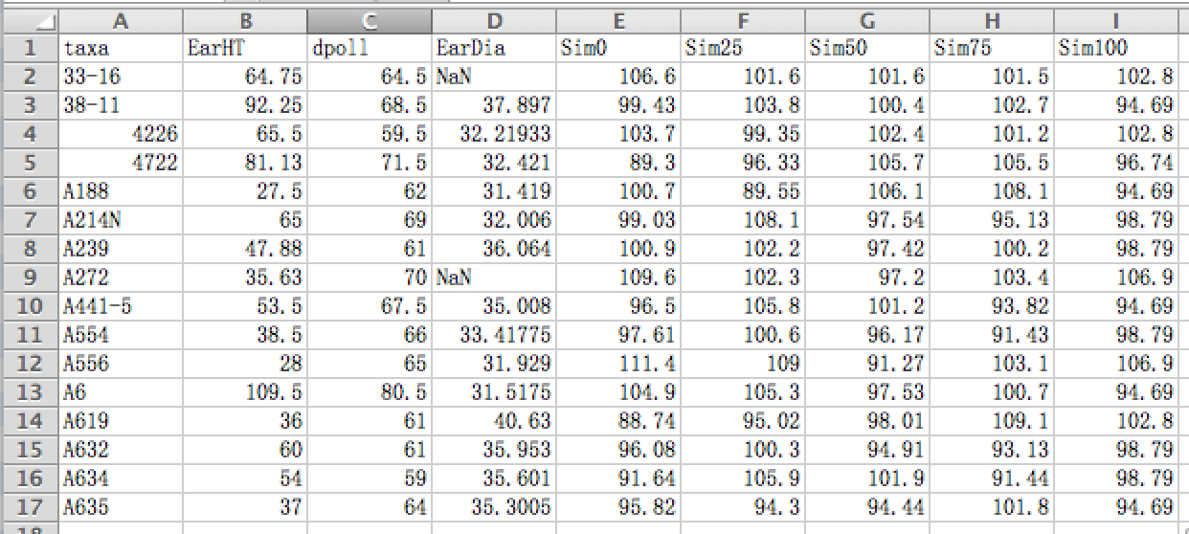
Format of phenotype data

Slide 27
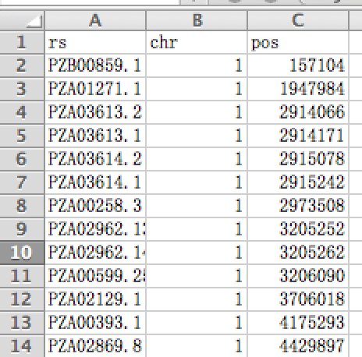
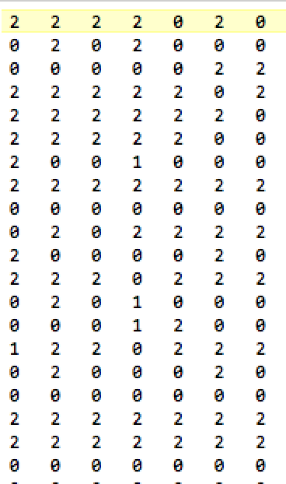
Numeric format
Individuals
SNPs
Genotype map
Genotype data

Slide 28





Accept five formats of genotype data

Slide 29
Transform of genotype data by BLINK
Numeric
VCF
BLINK
PLINK
HapMap

Slide 30
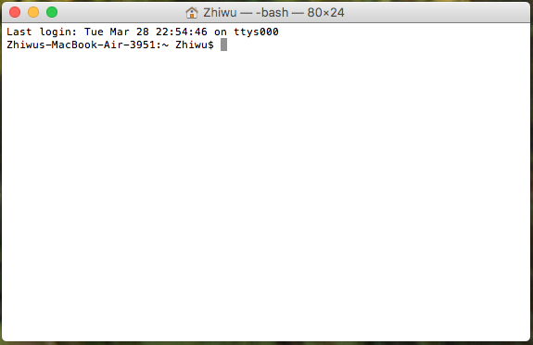
Run BLINK from command line
cd /Users/Zhiwu/Desktop/temp/demo_data/numeric
/Users/Zhiwu/Desktop/temp/blink --file myData --numeric --gwas --out myResult

Slide 31
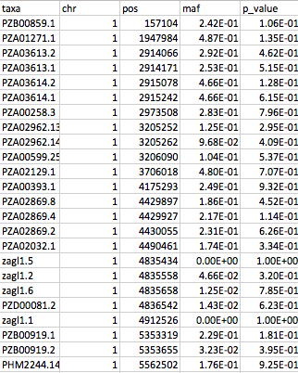
Output

Slide 32
Simulation with GAPIT
source("http://zzlab.net/GAPIT/gapit_functions.txt")
myGD=read.table(file="http://zzlab.net/GAPIT/data/mdp_numeric.txt",head=T)
myGM=read.table(file="http://zzlab.net/GAPIT/data/mdp_SNP_information.txt",head=T)
index1to5=myGM[,2]<6
set.seed(99164)
mySim=GAPIT.Phenotype.Simulation(GD=myGD[,c(TRUE,index1to5)],
GM=myGM[index1to5,],
h2=.7,
NQTN=40,
effectunit =.95,
QTNDist="normal")

Slide 33

myY=mySim$Y
colnames(myY)=c("taxa", "SimPheno")
setwd("~/Desktop/temp")
myGD1=t(myGD[,-1])
write.table(myY,file="myData.txt",quote=F,row.name=F,col.name=T,sep="\t")
write.table(myGD1,file="myData.dat",quote=F,row.name=F,col.name=F,sep="\t")
write.table(myGM,file="myData.map",quote=F,row.name=F,col.name=T,sep="\t")
#run blink
system("~/Desktop/temp/blink_mac --file myData --max_loop 10 --numeric --gwas")
#Extract p values
result<- read.table("SimPheno_GWAS_result.txt", head = TRUE)
myP=as.numeric(result[,5])
myGI.MP=cbind(myGM[,-1],myP)
GAPIT.Manhattan(GI.MP=myGI.MP,seqQTN=mySim$QTN.position)
GAPIT.QQ(myP)

Slide 34
Outline
Bin problem
Computing demand of FarmCPU
BLINK method and software

