Slide 1
How to use BLINK C version
Meng Huang
Meng.huang.cn@gmail.com

Slide 2
Input file preparation
Download demo data from https://github.com/Menggg/BLINK/blob/master/demo_data.zip
Download windows executable file from https://github.com/Menggg/BLINK/blob/master/blink.exe

Slide 3
Phenotype file

Slide 4
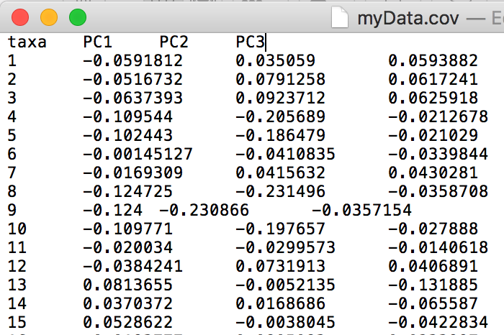
Covariates file

Slide 5
Implement GWAS
blink --file myData --plink --gwas --out test
./blink_linux --file myData --plink --gwas --out test

Slide 6
Transform of genotype data by BLINK
Numeric
VCF
BLINK
PLINK
HapMap

Slide 7
Step1: compress to blink binary format
blink --file myData --compress --numeric
blink --file myData --compress --hapmap
blink --file myData --compress --vcf
blink --file myData --compress --plink

Slide 8
Step2: convert blink binary format to target format
blink --file myData --recode --out newdata --numeric
blink --file myData --recode --out newdata --hapmap
blink --file myData --recode --out newdata –vcf
blink --file myData --recode --out newdata –plink

Slide 9
Alternative and reference allele information
It will be saved into .inf file
If there is .inf file, alt/ref allele will be extracted from .inf file.
If there is no .inf file, alt/ref will be A/T only.

