Slide 1
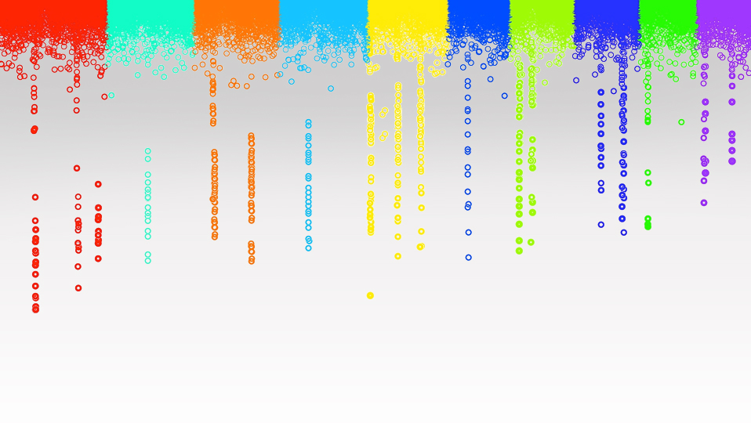

Statistical Genomics
MAS and gBLUP
Zhiwu Zhang
Washington State University

Slide 2
Outline
MAS
MAS in GAPIT
gBLUP
gBLUP in GAPIT

Slide 3
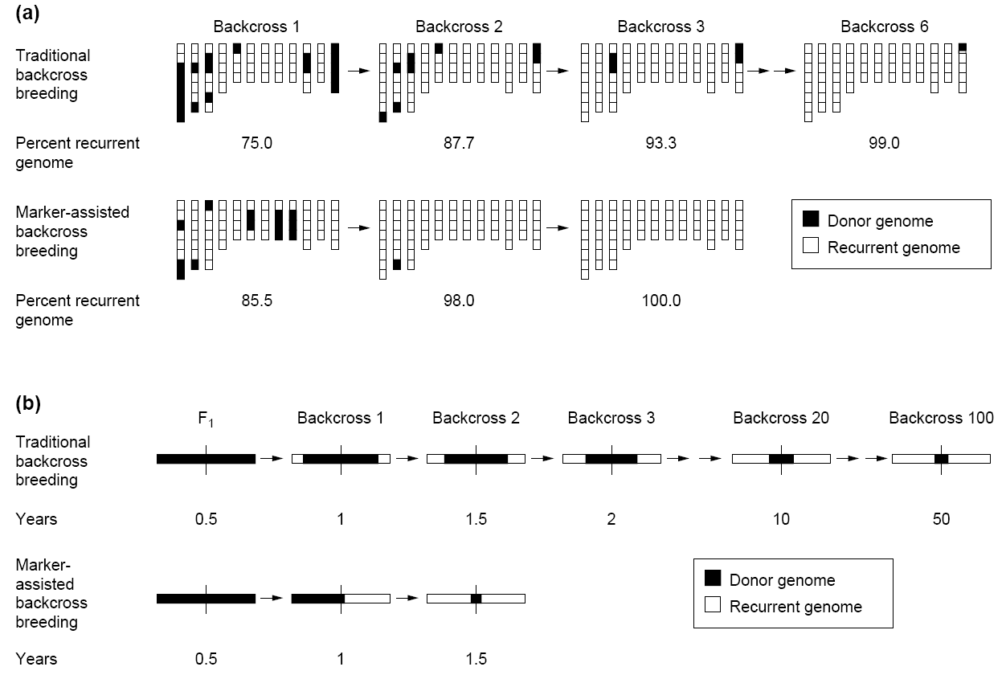

Recurrent genome recovery
30 progeny per backcross
Backcross 100
Traditional method achieve only 99% in 6 generations
100% can be achieved in only three generations by MAS
Tanksley et al. Biotechnology 1989

Slide 4
MLM for GWAS
Phenotype
MAS
Population
structure
Unequal
relatedness
Y = SNP + Q (or PCs) + Kinship + e
(fixed effect)
(fixed effect)
(random effect)
General Linear Model (GLM)
Breeding value (gBLUP)
Mixed Linear Model (MLM)
(Yu et al. 2005, Nature Genetics)

Slide 5
Marker Assisted Selection (MAS)
Current population
(Training, Reference)
Future population
(Testing, Inference)
Gene mapping
(Linkage analysis and GWAS)
QTN₁xEffect₁ + … + QTN_{t}xEffect_{t}
Breeding value
SNPs QTN₁, QTN₂, …, QTN_{t}
Effect₁, Effect₂, …, Effect_{t}

Slide 6

Simulation with GAPIT
source("http://zzlab.net/GAPIT/gapit_functions.txt")
myGD=read.table(file="http://zzlab.net/GAPIT/data/mdp_numeric.txt",head=T)
myGM=read.table(file="http://zzlab.net/GAPIT/data/mdp_SNP_information.txt",head=T)
set.seed(99164)
n=nrow(myGD)
testing=sample(n,round(n/5),replace=F)
training=-testing
set.seed(99164)
mySim=GAPIT.Phenotype.Simulation(GD=myGD, GM=myGM,
h2=.7,
NQTN=20,
QTNDist="normal")

Slide 7
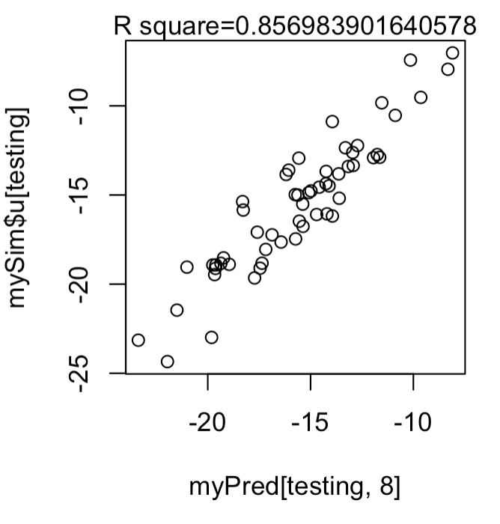
GWAS and MAS (20 QTNs)
#Gene mapping (GWAS)
myGAPIT3 <- GAPIT(
Y=mySim$Y[training,],
GD=myGD,GM=myGM, PCA.total=3,
model="BLINK",
QTN.position=mySim$QTN.position,
memo="GWAS")
index=myGAPIT3$GWAS[,4]<0.05/length(myGAPIT3$GWAS[,4])
QTN.order=order(abs(mySim$effect),decreasing =T)
index= mySim$QTN.position[QTN.order]+1
myQTN=cbind(myGAPIT3$PCA,myGD[,c(FALSE,index[1:15])])
#MAS
myGAPIT4 <- GAPIT(
Y=mySim$Y[training,],
CV=myQTN,
model="GLM",
SNP.test=FALSE,
memo="MAS")
order=match(mySim$Y[,1],myGAPIT4$Pred[,1])
myPred=myGAPIT4$Pred[order,]
ru2=cor(myPred[testing,8],mySim$u[testing])^2
plot(myPred[testing,8],mySim$u[testing])
mtext(paste("R square=",ru2,sep=""), side = 3)

Slide 8
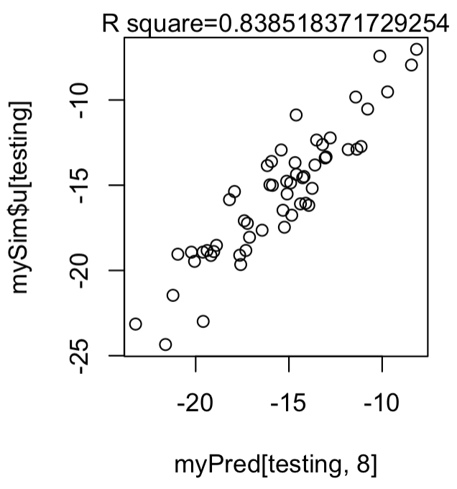
MAS + gBLUP
myGAPIT44<- GAPIT(
Y=mySim$Y[training,],
GD=myGD, GM=myGM,
CV=myQTN,
model="gBLUP",
SNP.test=FALSE,
memo="MAS+gBLUP")
order=match(mySim$Y[,1],myGAPIT44$Pred[,1])
myPred=myGAPIT44$Pred[order,]
ru2=cor(as.numeric(myPred[testing,8]),mySim$u[testing])^2
plot(as.numeric(myPred[testing,8]),mySim$u[testing])
mtext(paste("R square=",ru2,sep=""), side = 3)

Slide 9
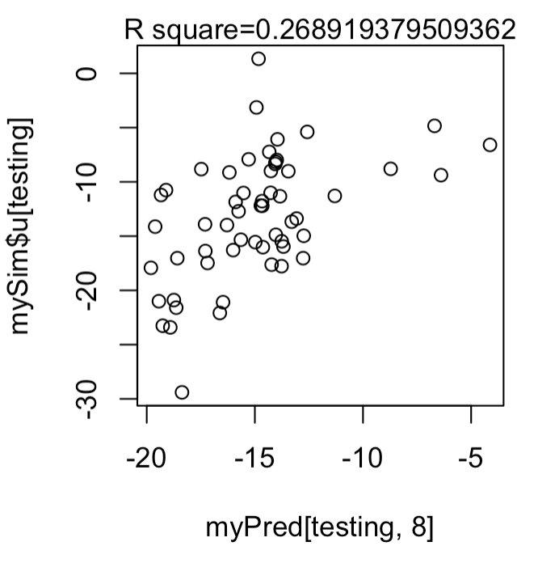
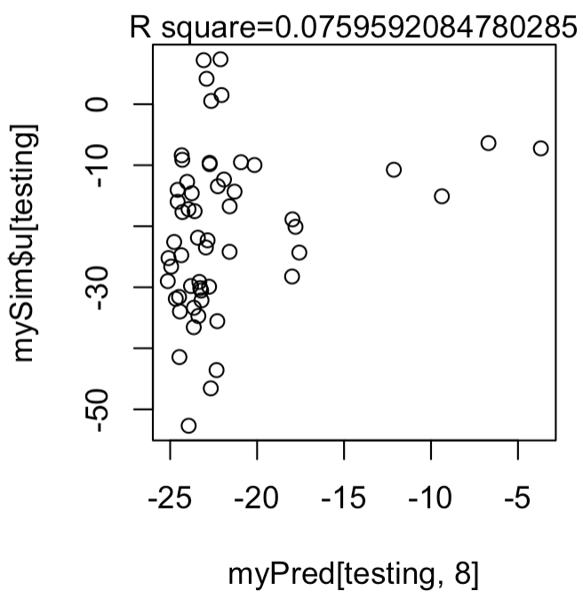
MAS do not work when GWAS does not have power
20 QTNs
Heritability=70%
50 QTNs
200 QTNs

Slide 10
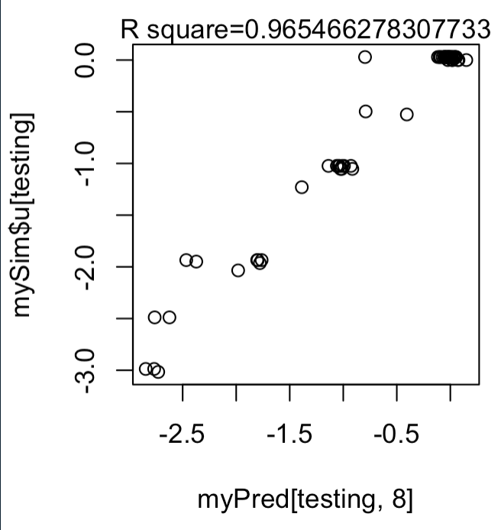
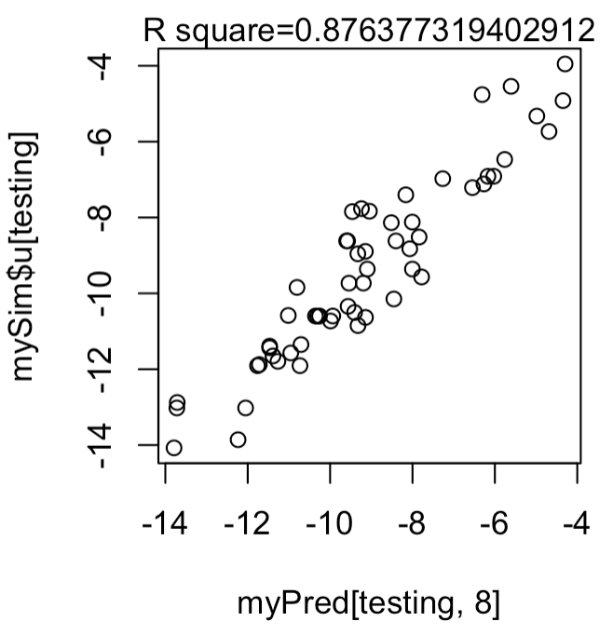
MAS works the best for Mendelian traits
5 QTNs
Heritability=70%
10 QTNs
20 QTNs

Slide 11
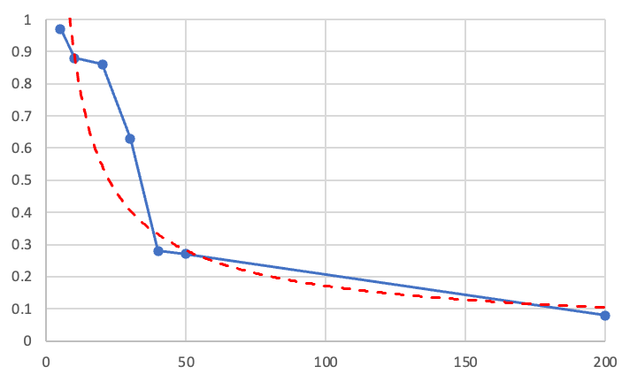
MAS do not work when GWAS does not have power
Accuracy (R2)
Number of QTNs

Slide 12
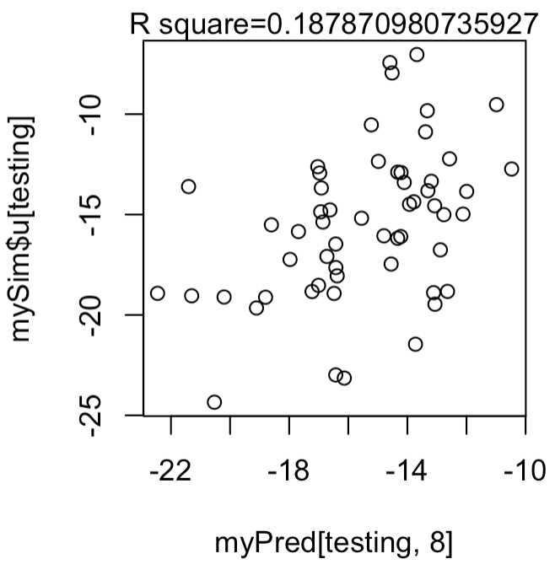
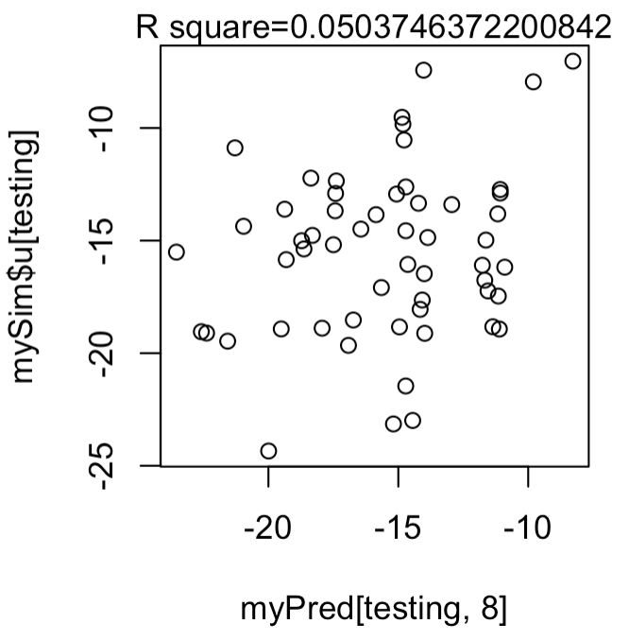
The lower heritability, the lower accuracy
H2=70%
20 QTNs
H2=50%
H2=30%

Slide 13
MLM for GWAS
Phenotype
MAS
Population
structure
Unequal
relatedness
Y = SNP + Q (or PCs) + Kinship + e
(fixed effect)
(fixed effect)
(random effect)
General Linear Model (GLM)
Breeding value (gBLUP)
Mixed Linear Model (MLM)
(Yu et al. 2005, Nature Genetics)

Slide 14
Mixed Model Equation
y = Xb + Zu + e
$\left[\begin{matrix}X^{′}X & X^{′}Z \\ Z^{′}X & Z^{′}Z+{\frac{σ_{e}^{2}}{σ_{a}^{2}}A}^{−1}\end{matrix}\right]\left[\begin{matrix}b \\ u\end{matrix}\right]$=$\left[\begin{matrix}X^{′}y \\ z^{′}y\end{matrix}\right]$
$$\left[\begin{matrix}b \\ u\end{matrix}\right]={\left[\begin{matrix}X^{′}X & X^{′}Z \\ Z^{′}X & Z^{′}Z+{\frac{σ_{e}^{2}}{σ_{a}^{2}}A}^{−1}\end{matrix}\right]}^{−1}\left[\begin{matrix}X^{′}y \\ Z^{′}y\end{matrix}\right]$$

Slide 15
Mixed Model Equation
Estimation of $σ_{a}^{2}$ and $σ_{e}^{2}$: Maximum Likelihood (EMMA)
Var($\left[\begin{matrix}b \\ u\end{matrix}\right])={\left[\begin{matrix}X^{′}X & X^{′}Z \\ Z^{′}X & Z^{′}Z+{\frac{σ_{e}^{2}}{σ_{a}^{2}}A}^{−1}\end{matrix}\right]}^{−1}σ_{e}^{2}$
$$t=\hat{b}/\sqrt{Var\left(\hat{b}\right)}$$
$$\sim t(n−1)$$

Slide 16
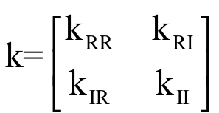
Henderson's formula

Slide 17
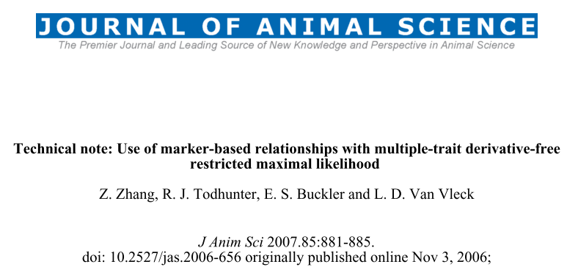
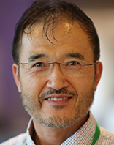
gBLUP reinvent

Slide 18
Multiple Trait Derivative Free REML (MTDFREML)
Welcome to the Multiple Trait Derivative Free REML (MTDFREML) home page. The programs were developed by Keith Boldman and Dale Van Vleck. Evolutionary development and debugging support have also been provided by by Lisa Kriese and Curt Van Tassell.
Please contact Curt Van Tassell (e-mail curtvt@aipl.arsusda.gov) or Dale Van Vleck. (e-mail lvanvleck@unlnotes.unl.edu) with any problems with the programs or discovered bugs.
Obtaining the MTDFREML programs
Get the manual
Sample analyses
Enter user information using web browser that handles forms
FTP the userinfo.txt file to enter user information (then mail completed form)
Get the Microsoft Powerstation fix for Windows 95 (compressed)
Get the Microsoft 5.1 fix for insufficient file handles (compressed)

Slide 19
Marker based kinship in MTDFREML
Pedigree
Marker
MTDF-NRM
MTDF-ARM
Arbitrary
Relationship
Matrix
kinship
MTDF-PREP
Equations
MTDF-RUN
BLUP and variance
Zhang et al., J. Anim Sci., 2007

Slide 20

Efficient kinship algorithm
M: n individual by m SNPs
M: -1, 0 and 1
Pi: frequency of 2nd allele for SNP i
P: Column of i is 2(pi-.5)
Z=M-P
J. Dairy Sci. 2008. 91 (11) 4414-4423. Efficient Methods to Compute Genomic Predictions P. M. VanRaden
MM^{t}, Efficient
gBLUP=Ridge Regression
Paul VanRaden: Image Number K7168-6

Slide 21
gBLUP
Prediction of maize single-cross performance using RFLPs and information related hybrids
Rex Bernardo
Crop Science, 1994
Y_{M} = C V⁻¹ Y_{p}
y_{M} = m × 1 vector of predicted yields of missing single crosses;
C = m × n matrix of genetic covariances between the missing and predictor hybrids;
V = n × n matrix of phenotypic variances and covariances among predictor hybrids;
y_{P} = nn × 1 vector of predictor hybrid yields corrected for trial effects.

Slide 22
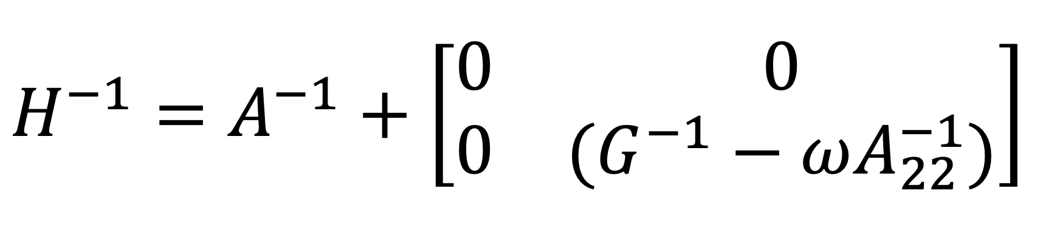
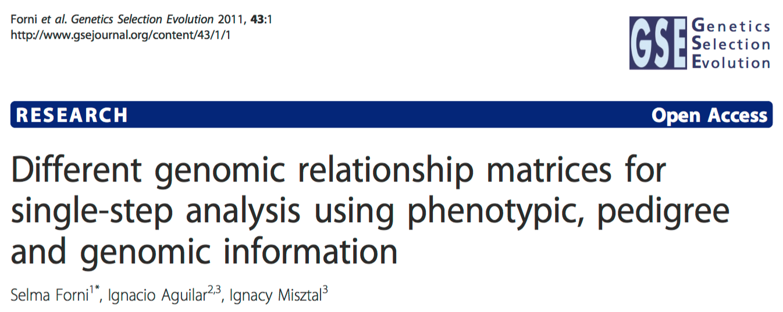
Pedigree + Marker
Non genotyped
Pedigree kinship of non genotyped
Pedigree kinship
Marker kinship
Arbitrary weight

Slide 23


RFLP kinship in maize
Crop Science
1994
MAS
Use of Marker Based Relationships with MTDFREML
J. Animal Sci., 2007
R. Bernardo
D. Van Vleck
Efficient kinship
J. Dairy Science
2008
Prediction of total genetic value using genome wide dense marker maps
Genetics, 2001
P. VanRaden
gBLUP
RR, Bayes A, B, Cpi, …
T. Meuwissen
B. Hayes
M. Goddard
I. Misztal
ssBLUP
Pedigree & Marker kinship
single step
GES, 2011
sBLUP
cBLUP
Super and compression
Heredity
2018
Z. Zhang
Genomic prediction

Slide 24
Simulation with GAPIT
source("http://zzlab.net/GAPIT/gapit_functions.txt")
myGD=read.table(file="http://zzlab.net/GAPIT/data/mdp_numeric.txt",head=T)
myGM=read.table(file="http://zzlab.net/GAPIT/data/mdp_SNP_information.txt",head=T)
set.seed(99164)
n=nrow(myGD)
testing=sample(n,round(n/5),replace=F)
training=-testing
set.seed(99164)
mySim=GAPIT.Phenotype.Simulation(GD=myGD, GM=myGM,
h2=.7,
NQTN=100,
QTNDist="normal")

Slide 25
Simulation with GAPIT
source("http://zzlab.net/GAPIT/gapit_functions.txt")
myGD=read.table(file="http://zzlab.net/GAPIT/data/mdp_numeric.txt",head=T)
myGM=read.table(file="http://zzlab.net/GAPIT/data/mdp_SNP_information.txt",head=T)
set.seed(99164)
n=nrow(myGD)
testing=sample(n,round(n/5),replace=F)
training=-testing
set.seed(99164)
mySim=GAPIT.Phenotype.Simulation(GD=myGD, GM=myGM,
h2=.7,
NQTN=20,
QTNDist="normal")

Slide 26
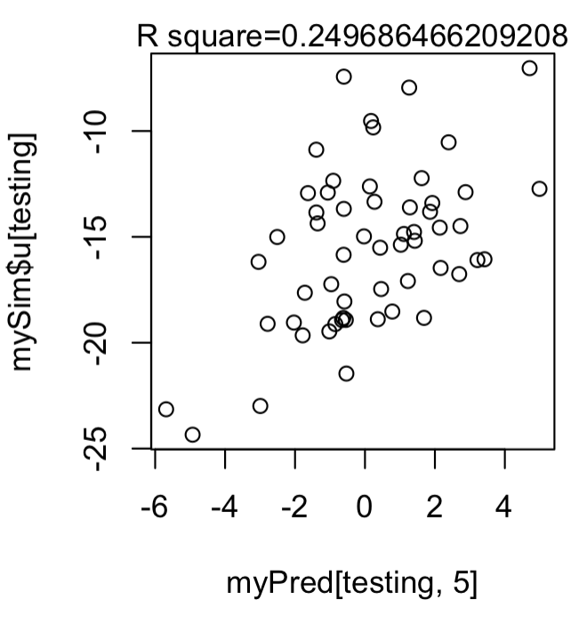
gBLUP(20 QTNs)
#gBLUP
myGAPIT5 <- GAPIT(
Y=mySim$Y[training,],
GD=myGD,
GM=myGM,
PCA.total=3,
model="gBLUP",
SNP.test=FALSE,
memo="gBLUP")
order=match(mySim$Y[,1],myGAPIT5$Pred[,1])
myPred=myGAPIT5$Pred[order,]
ru2=cor(myPred[testing,5],mySim$u[testing])^2
plot(myPred[testing,5],mySim$u[testing])
mtext(paste("R square=",ru2,sep=""), side = 3)

Slide 27
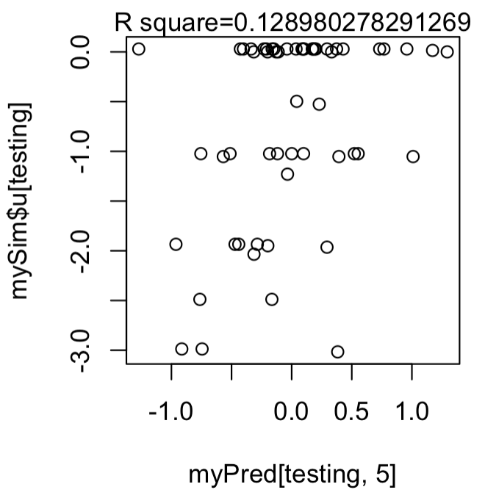
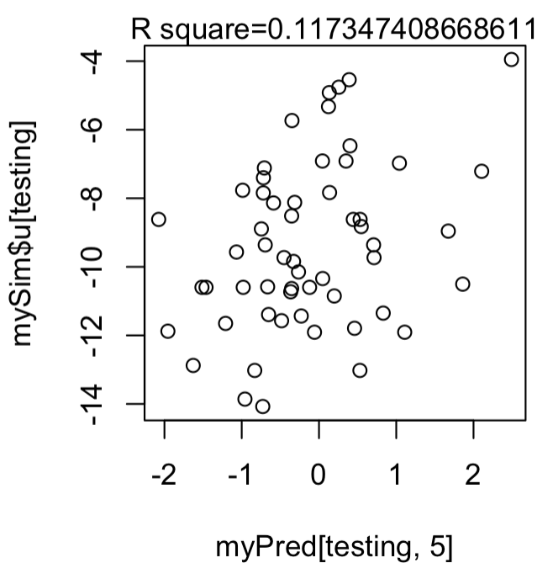
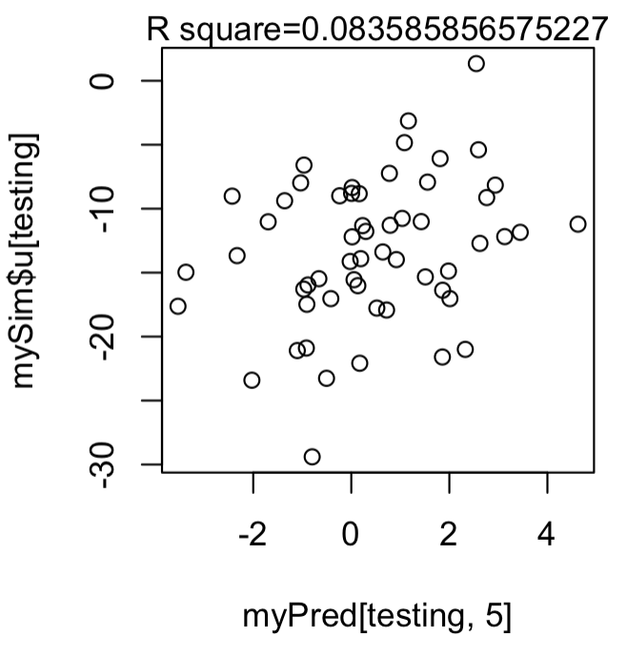
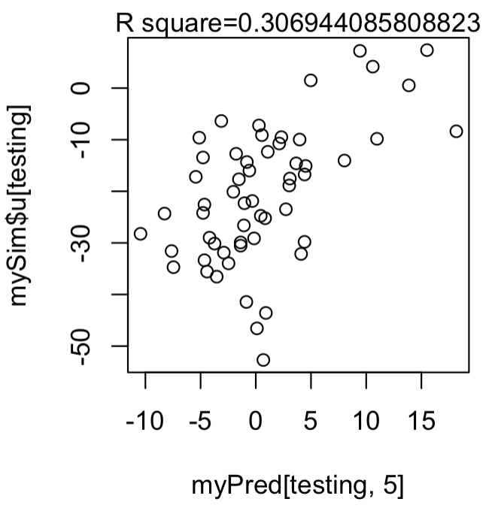
gBLUP in favor of polygene traits
5 QTNs
10 QTNs
20 QTNs
50 QTNs
200 QTNs

Slide 28
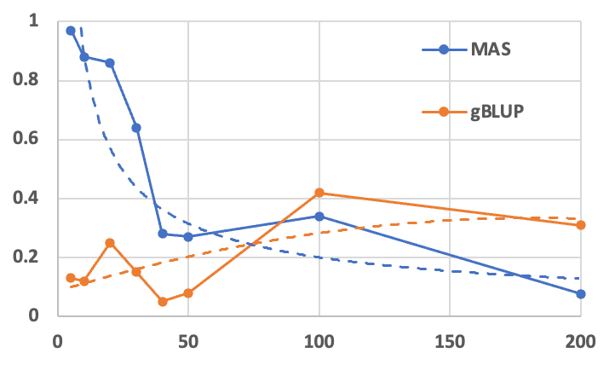
gBLUP in favor of polygene traits, but…
?
Accuracy (R2)
Number of QTNs

Slide 29
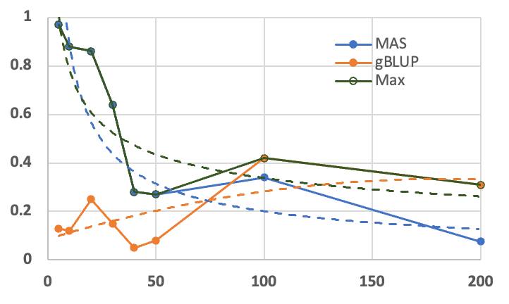
Looking for the GREEN
Accuracy (R2)
Number of QTNs

Slide 30
Outline
MAS
MAS in GAPIT
gBLUP
gBLUP in GAPIT

