Slide 1
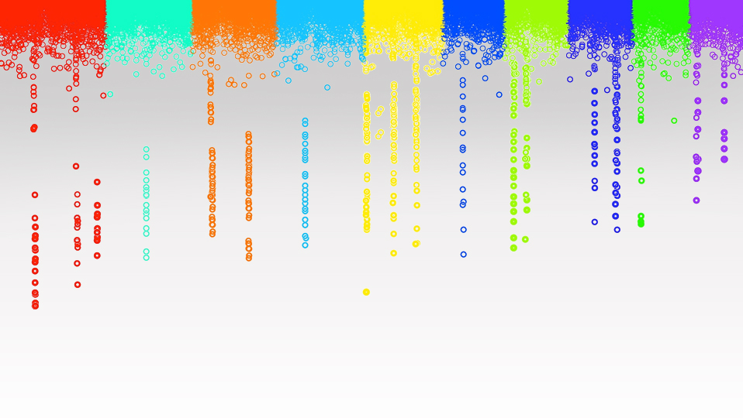

Statistical Genomics
Ridge Regression
Zhiwu Zhang
Washington State University

Slide 2
Outline
Concept development (MAS>BLUP>RR)
Ridge Regression
rrBLUP package

Slide 3



RFLP kinship in maize
Crop Science
1994
MAS
Use of Marker Based Relationships with MTDFREML
J. Animal Sci., 2007
R. Bernardo
D. Van Vleck
Efficient kinship
J. Dairy Science
2008
Prediction of total genetic value using genome wide dense marker maps
Genetics, 2001
P. VanRaden
gBLUP
RR, Bayes A, B, Cpi, …
T. Meuwissen
B. Hayes
M. Goddard
I. Misztal
ssBLUP
Pedigree & Marker kinship
single step
GES, 2011
sBLUP
cBLUP
Super and compression
Heredity
2018
Z. Zhang
Genomic prediction

Slide 4

Milestone development

Slide 5
Concept development
Over fitting
Governed by less parameters
Free fixed effects into random effects
Only regulate their distribution
Random effects = total genetic effects of individuals
Random effects = effects of markers

Slide 6
Fixed effect
Specific interest, nothing behind, e.g. a fertilizer
Limited levels, e.g. M and F only for sex
Access to any specific level
No distribution

Slide 7
Random effect
Population behind, e.g. average and variance
Many levels, e.g. individuals genetic effects
Distribution
No control to access a specific level

Slide 8
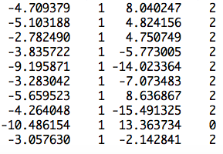
Fixed effect model
observation
mean
PC2
SNP1 | SNP2 | … | SNP4 | SNP5
S1 | S2 | … | S4 | S5
0 | 1 | … | 2 | 0
2 | 2 | … | 0 | 2
2 | 0 | … | 2 | 2
0 | 2 | … | 0 | 0
[
]
b=
b0
b1
x2
x3
x5
x6
y
1
x1
]
[
y = Xb +e

Slide 9
Fixed effect model over-fitting
observation
mean
PC2
SNP1 | SNP2 | … | SNP9 | SNP10
S1 | S2 | … | S9 | S10
0 | 1 | … | 2 | 0
2 | 2 | … | 0 | 2
2 | 0 | … | 2 | 2
0 | 2 | … | 0 | 0
[
]
b=
b0
b1
x2
x3
x9
x10
y
1
x1
]
[
y = Xb +e

Slide 10
BLUP of individuals
observation
mean
PC2
Ind1 | Ind2 | … | Ind19 | Ind20
u1 | u2 | … | u19 | u20
1 | 0 | … | 0 | 0
0 | 1 | … | 0 | 0
0 | 0 | … | 1 | 0
0 | 0 | … | 0 | 1
u=
]
[
[
b=
b0
b1
]
y
1
x1
]
=X
Z
[
y = Xb + Zu +e

Slide 11

Switch individuals to SNPs
observation
mean
PC2
SNP1 | SNP2 | … | SNPm-1 | SNPm
S1 | S2 | … | Sm-1 | Sm
0 | 1 | … | 2 | 0
2 | 2 | … | 0 | 2
2 | 0 | … | 2 | 2
0 | 2 | … | 0 | 0
s=
]
[
[
b=
b0
b1
]
1
x1
=X
M
y
[
]
y = Xb + Ms +e

Slide 12
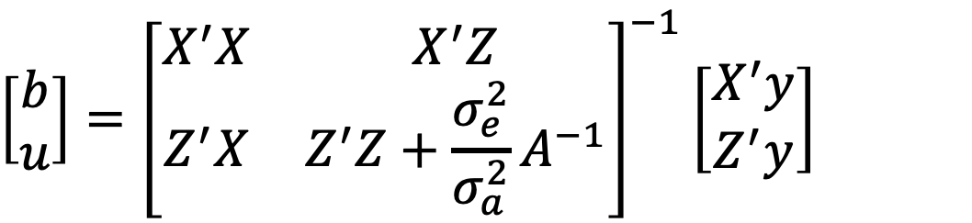
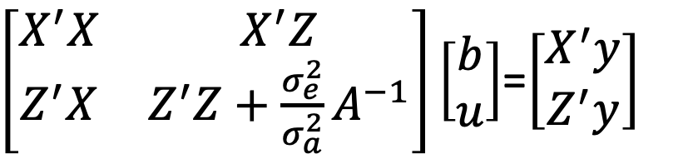
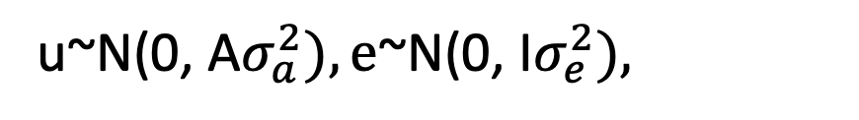
BLUP on individuals
y = Xb + Zu + e
u~N(0, A$σ_{a}^{2}),\text{e}\text{\sim }\text{N}\text{(0,} \text{I}σ_{e}^{2}),$
$\left[\begin{matrix}X^{′}X & X^{′}Z \\ Z^{′}X & Z^{′}Z+{\frac{σ_{e}^{2}}{σ_{a}^{2}}A}^{−1}\end{matrix}\right]\left[\begin{matrix}b \\ u\end{matrix}\right]$=$\left[\begin{matrix}X^{′}y \\ Z^{′}y\end{matrix}\right]$
$$\left[\begin{matrix}b \\ u\end{matrix}\right]={\left[\begin{matrix}X^{′}X & X^{′}Z \\ Z^{′}X & Z^{′}Z+{\frac{σ_{e}^{2}}{σ_{a}^{2}}A}^{−1}\end{matrix}\right]}^{−1}\left[\begin{matrix}X^{′}y \\ Z^{′}y\end{matrix}\right]$$

Slide 13
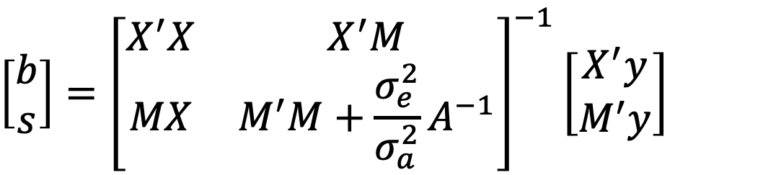
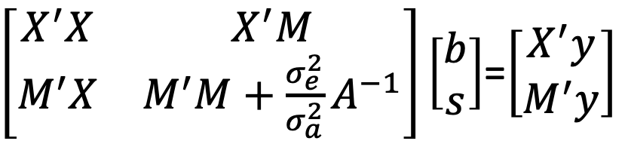
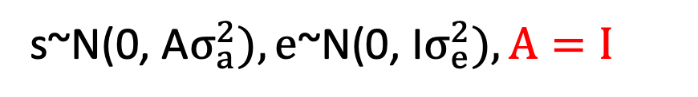
BLUP on markers
(Z to M, and u to s)
y = Xb + Ms + e
s~N(0, A$σ_{a}^{2}),\text{e}\text{\sim }\text{N}\text{(0,} \text{I}σ_{e}^{2}), A=I$
$\left[\begin{matrix}X^{′}X & X^{′}M \\ M^{′}X & M^{′}M+{\frac{σ_{e}^{2}}{σ_{a}^{2}}A}^{−1}\end{matrix}\right]\left[\begin{matrix}b \\ s\end{matrix}\right]$=$\left[\begin{matrix}X^{′}y \\ M^{′}y\end{matrix}\right]$
$$\left[\begin{matrix}b \\ s\end{matrix}\right]={\left[\begin{matrix}X^{′}X & X^{′}M \\ MX & M^{′}M+{\frac{σ_{e}^{2}}{σ_{a}^{2}}A}^{−1}\end{matrix}\right]}^{−1}\left[\begin{matrix}X^{′}y \\ M^{′}y\end{matrix}\right]$$

Slide 14
Ridge Regression
Independently invented in many contexts
Different names: e.g. Tikhonov regularization (1963), Phillips–Twomey method, and constrained linear inversion
  Tikhonov, A. N. (1963). "О решении некорректно поставленных задач и методе регуляризации". Doklady Akademii Nauk SSSR 151: 501–504.. Translated in "Solution of incorrectly formulated problems and the regularization method". Soviet Mathematics 4: 1035–1038.
  Phillips, D. L. (1962). "A Technique for the Numerical Solution of Certain Integral Equations of the First Kind". Journal of the ACM 9: 84. doi:10.1145/321105.321114.

Slide 15
rrBLUP vs. gBLUP
rrBLUP
s~N(0, I σ_{r}²)
y=x₁s₁ + x₂s₂ + … + x_{p}s_{p} + e
gBLUP
~N(0,
σ_{a}²)
U
A

Slide 16
rrBLUP vs. gBLUP
s_{i}~N(0, I σ_{r}²)
y= x₁s₁ + x₂s₂ + … + x_{p}s_{p} + e
rrBLUP
y=Ms + e
gBLUP
y=u + e
u~N(0, Aσ_{a}²)

Slide 17
How to define A to make them equivalent
u=Ms
Var(u) = Var(Ms) = Mvar(tr(s))M’
Var(u)=Aσ_{a}²
Aσ_{a}² =Mvar(tr(s))M’
A =MM’var(tr(s))/σ_{a}²
A =MM’ as var(tr(s))=σ_{a}²

Slide 18

Efficient kinship algorithm
M: n individual by m SNPs
M: -1, 0 and 1
Pi: frequency of 2nd allele for SNP i
P: Column of i is 2(pi-.5)
Z=M-P
J. Dairy Sci. 2008. 91 (11) 4414-4423. Efficient Methods to Compute Genomic Predictions P. M. VanRaden
MM^{t}, Efficient
gBLUP=Ridge Regression
Paul VanRaden: Image Number K7168-6

Slide 19
R packages for ridge regression
rrBlupMethod6
ridge
Lm.ridge (from MASS): library(MASS)
rrBLUP

Slide 20
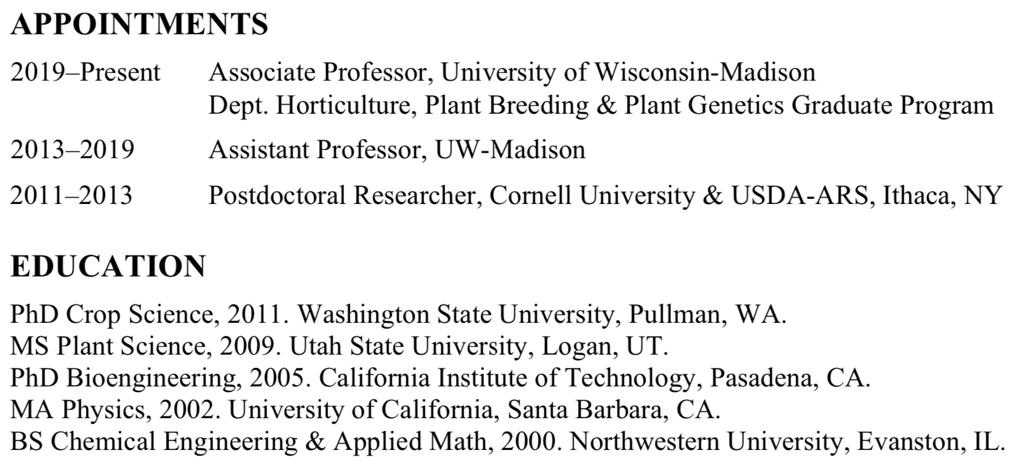
rrBLUP R package
Ridge Regression + BLUP
EMMA to estimate variance components
Jeffrey Endelman

Slide 21
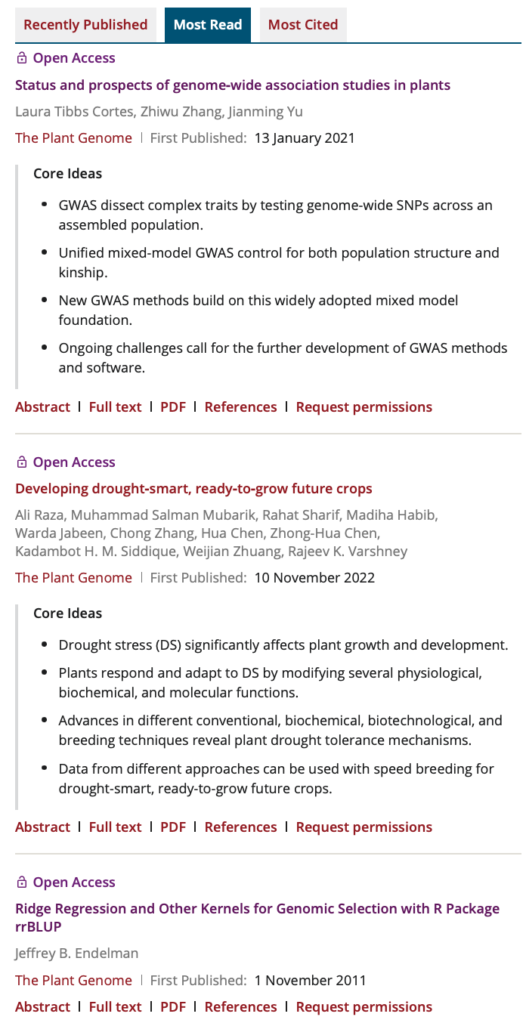
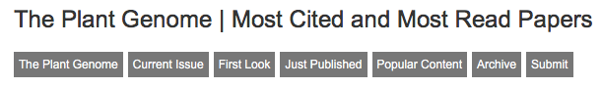
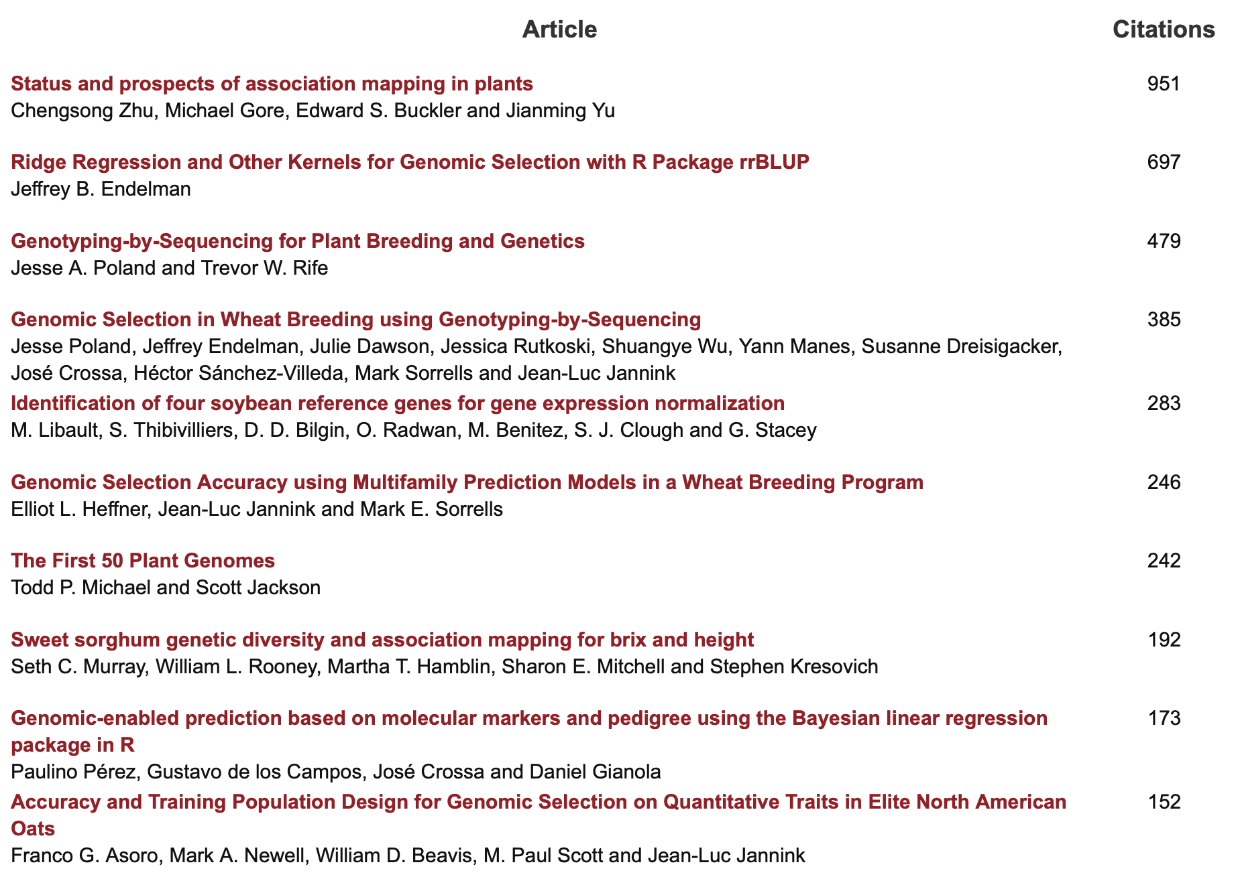

Slide 22
rrBLUP on CRAN
rrBLUP: Ridge Regression and Other Kernels for Genomic Selection
Software for genomic prediction with the RR-BLUP mixed model. One application is to estimate marker effects by ridge regression; alternatively, BLUPs can be calculated based on an additive relationship matrix or a Gaussian kernel.
Version: 4.4
Depends: R (≥ 2.14)
Suggests: parallel
Published: 2015-10-28
Author: Jeffrey Endelman
Maintainer: Jeffrey Endelman <endelman at wisc.edu>
License: GPL-3
URL: http://potatobreeding.cals.wisc.edu/software
NeedsCompilation: no
Citation: rrBLUP citation info
Materials: NEWS
CRAN checks: rrBLUP results
Downloads:
Reference manual: rrBLUP.pdf
Package source: rrBLUP_4.4.tar.gz
Windows binaries: r-devel: rrBLUP_4.4.zip, r-release: rrBLUP_4.4.zip, r-oldrel: rrBLUP_4.4.zip
OS X Snow Leopard binaries: r-release: rrBLUP_4.4.tgz, r-oldrel: rrBLUP_4.3.tgz
OS X Mavericks binaries: r-release: rrBLUP_4.4.tgz
Old sources: rrBLUP archive
Reverse dependencies:
Reverse depends: GeneticSubsetter
Reverse imports: PopVar

Slide 23

Simulation with GAPIT
source("http://zzlab.net/GAPIT/gapit_functions.txt")
myGD=read.table(file="http://zzlab.net/GAPIT/data/mdp_numeric.txt",head=T)
myGM=read.table(file="http://zzlab.net/GAPIT/data/mdp_SNP_information.txt",head=T)
taxa=myGD[,1]
X=myGD[,-1]
set.seed(99164)
mySim=GAPIT.Phenotype.Simulation(GD=myGD, GM=myGM,
h2=.7,
NQTN=100,
QTNDist="normal")

Slide 24
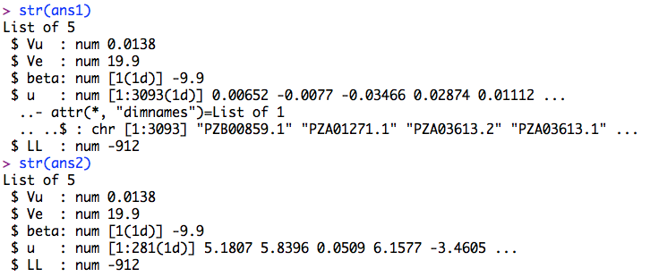
Ridge Regression vs. gBLUP
#Import rrBLUP
#install.packages("rrBLUP")
library(rrBLUP)
#prepare data
y <- mySim$Y[,2]
M=as.matrix(X)
#Ridge Regression
ans1 <- mixed.solve(y=y,Z=M)
#gBLUP
K <- tcrossprod(M) #K = MM'
ans2 <- mixed.solve(y=y,K=K)
#Compare GEBV
plot(M%*%ans1$u, ans2$u)

Slide 25
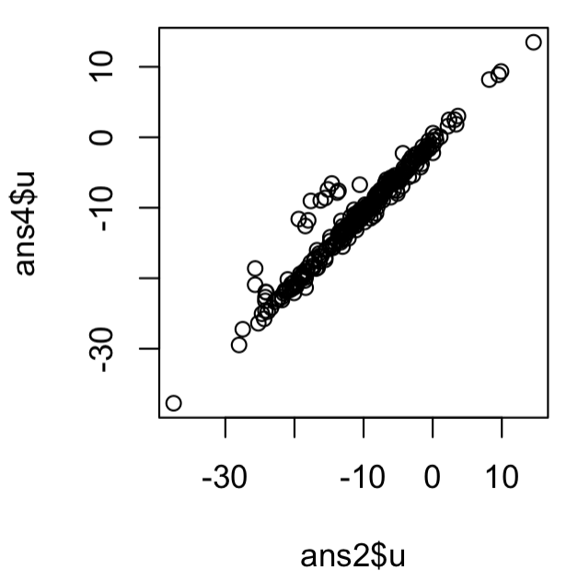
Ridge Regression with PCs
#MAS
myGAPIT5 <- GAPIT(
Y=mySim$Y[training,],
GD=myGD,
GM=myGM,
PCA.total=3,
model="gBLUP",
SNP.test=FALSE,
memo="gBLUP")
myPC= myGAPIT5$PCA[,-1]
#Import rrBLUP
#install.packages("rrBLUP")
library(rrBLUP)
#prepare data
y <- mySim$Y[,2]
M=as.matrix(X)
#Ridge Regression
ans3 <- mixed.solve(y=y,Z=M,X=myPC)
#gBLUP
K <- tcrossprod(M) #K = MM'
ans4 <- mixed.solve(y=y,K=K ,X=myPC)
#Compare GEBV
plot(ans2$u, ans4$u)

Slide 26
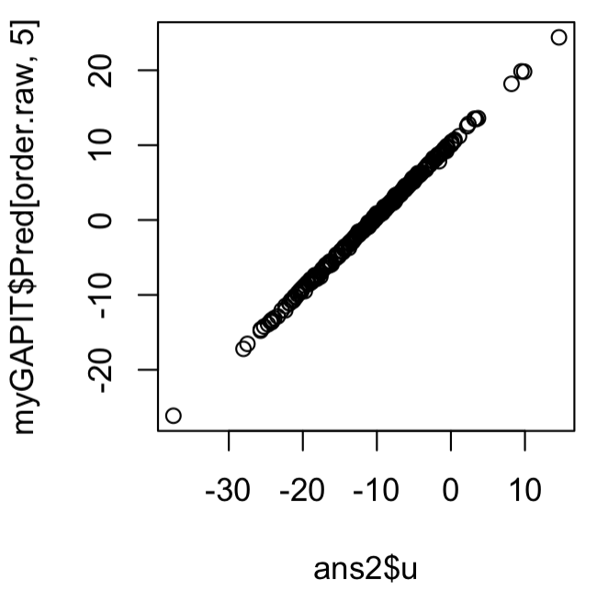
rrBLUP vs GAPIT
myGAPIT <- GAPIT(
Y=mySim$Y,
GD=myGD,
GM=myGM,
model="gBLUP",
file.output=F)
order.raw=match(taxa,myGAPIT$Pred[,1])
plot(ans2$u, myGAPIT$Pred[order.raw,5])
first=c("c","a","b","d")
second=c("a","d","c","e","f")
match(first,second)
[1] 3 1 NA 2

Slide 27
Outline
Concept development (MAS>BLUP>RR)
Ridge Regression
rrBLUP package

