Slide 1
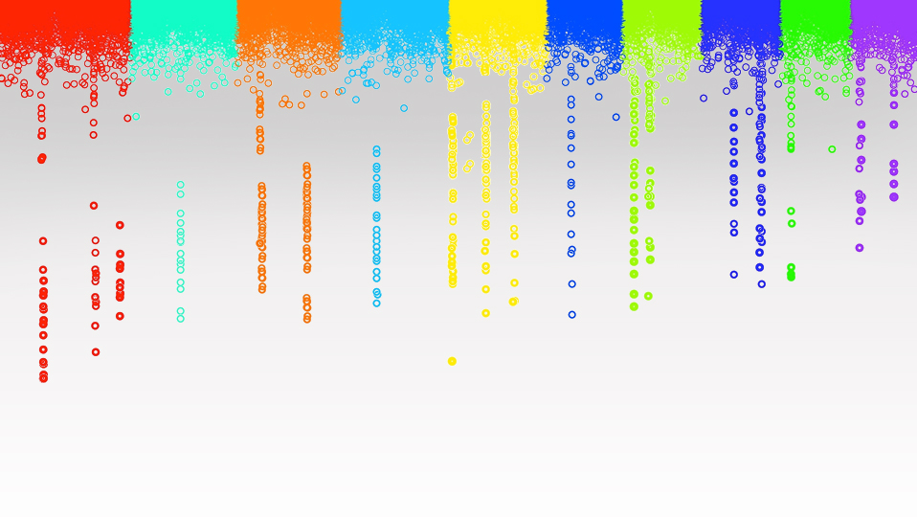

Statistical Genomics
Cross Validation
Zhiwu Zhang
Washington State University

Slide 2
Outline
Cross validation
K-fold validation
Jack knife
Re-sampling
Two ways of calculating accuracy
Bias and correction
GWAS assisted GS

Slide 3
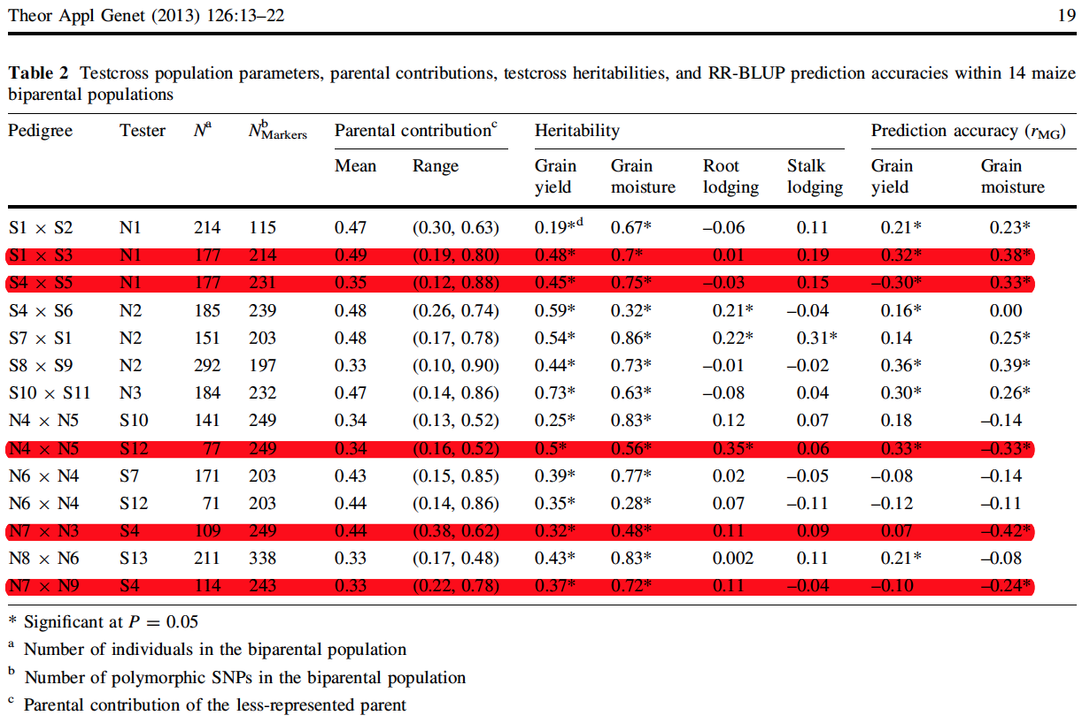
Negative prediction accuracy
Theor Appl Genet. 2013 Jan;126(1):13-22
Genomewide predictions from maize single-cross data.
Massman JM1, Gordillo A, Lorenzana RE, Bernardo R.

Slide 4
Five fold Cross validation
Inference
Reference
By Yao Zhou

Slide 5
Jack Knife
Until every individuals get predicted
Inference
Inference

Slide 6
Jack Knife: extreme case: K=N
N: number of individuals
K: number of folds
Leave-one-out cross-validation
Inference (training) contain only one individuals
Not possible to calculate correlation between observed and predicted within inference
Evaluation of accuracy must be hold until every individuals receive predictions.
Resampling is not available

Slide 7
Re-sampling: stochastic validation
Sample partial population, e.g., 20%, as inference (testing), and leave the rest as reference (Training)
Instantly evaluate accuracy of inference
Repeated for multiple times
Average accuracy across replicates
Some individuals may never be in the testing

Slide 8
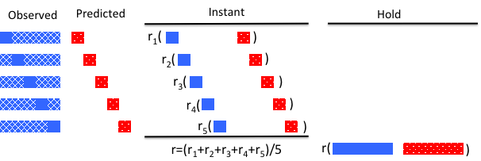
Two ways of calculating correlation

Slide 9
Generation of random phenotypes
Genotype
Phenotype
Random #
Random Phenotype

Slide 10
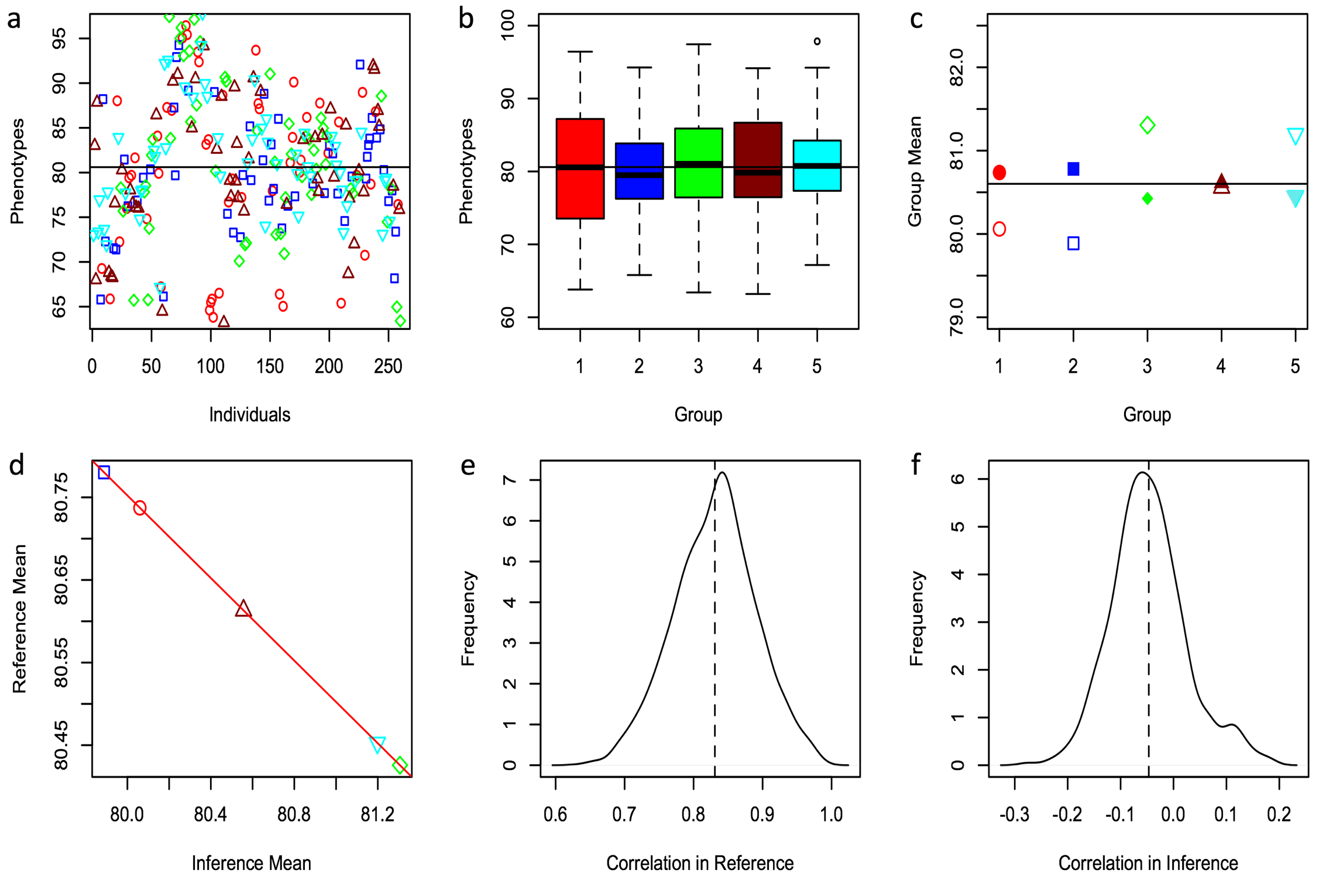
Artefactual negative hold accuracy

Slide 11
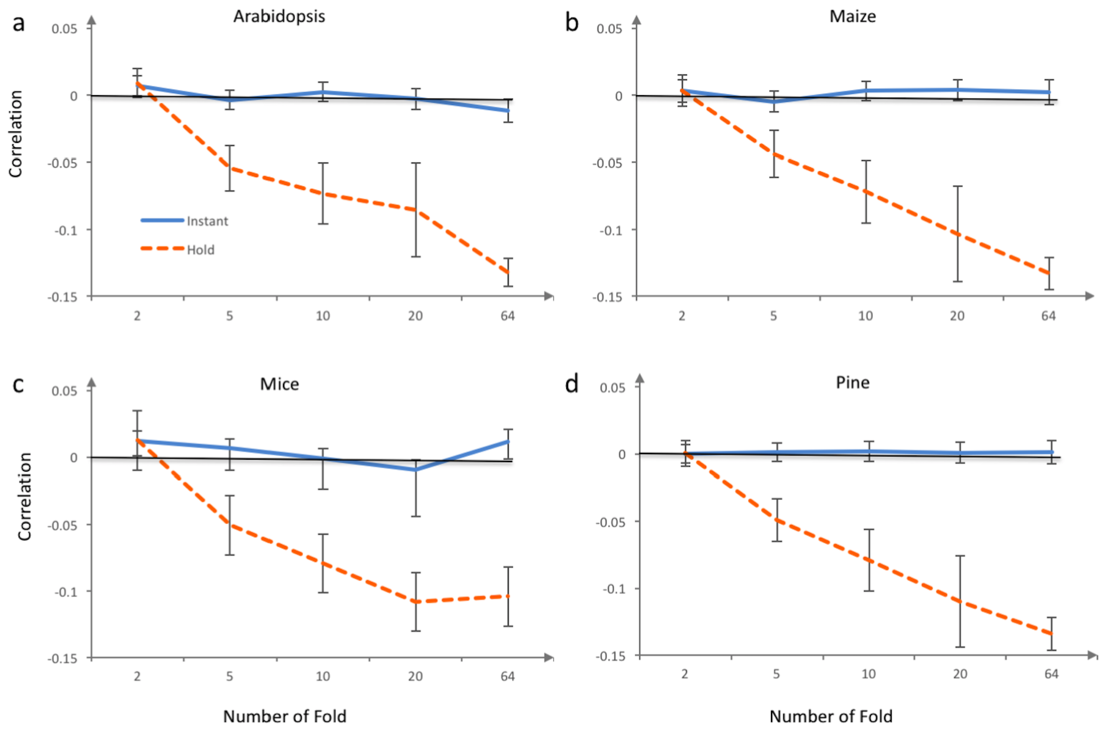
Hold bias relates to number of fold

Slide 12
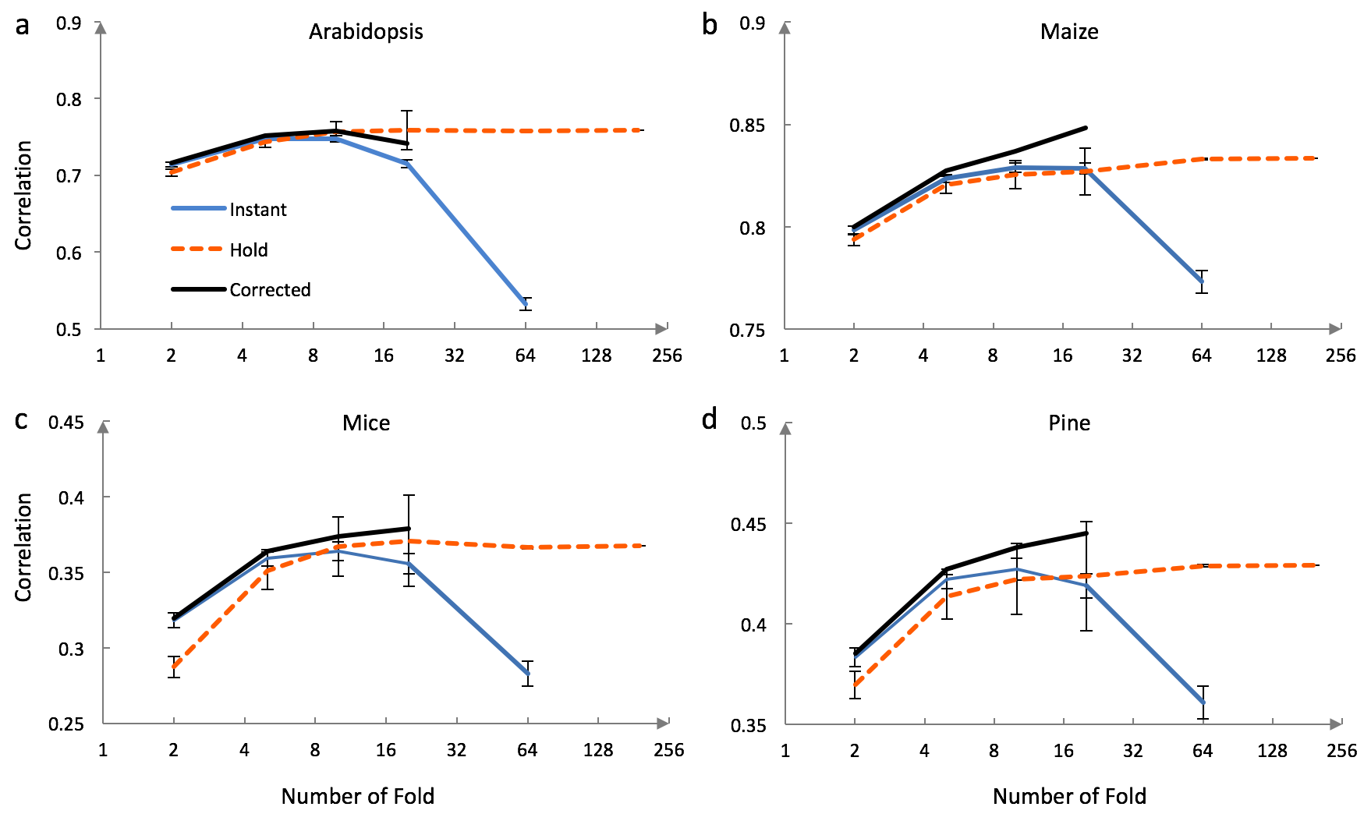
Problem of instant accuracy

Slide 13
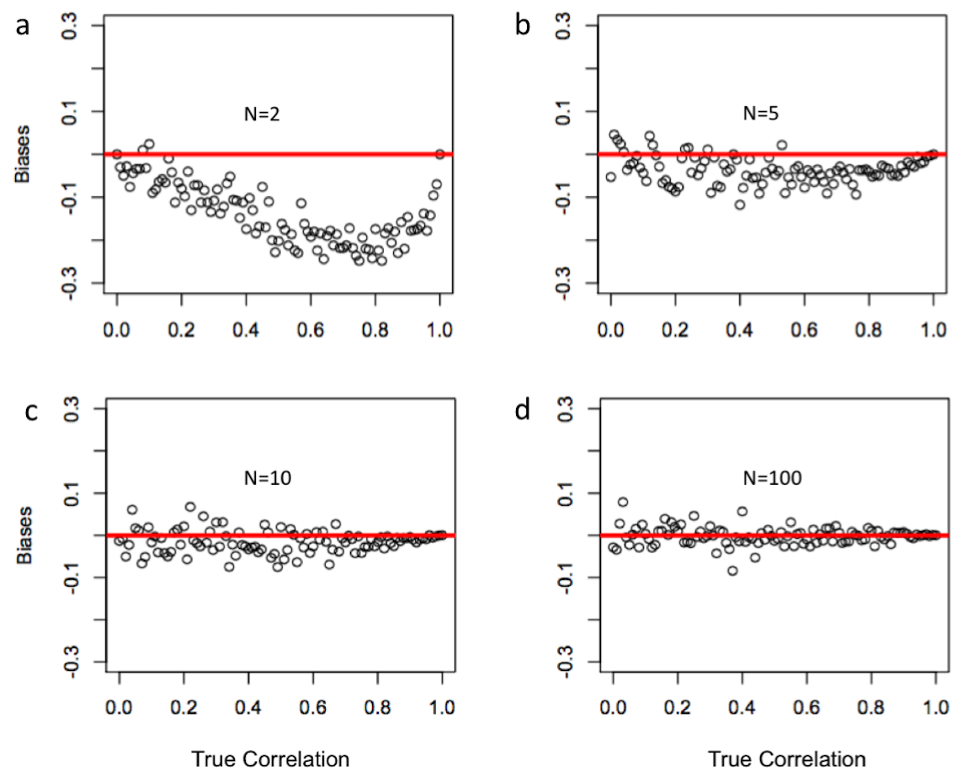
Small sample causes bias

Slide 14
Correction of instant accuracy

Slide 15
Valid procedure
Observation
GWAS
training
population
Entire
population
SNPs
Associated SNPs and effects
Valid procedure
SNPs
testing
population
Prediction
Restart
here
Observation
Accuracy

Slide 16
Invalid procedure
Observations and SNPs
GWAS
Associated SNPs
Entire
population
training
population
Observations
SNP effects
SNPs
Contaminated
Prediction
Restart
here
testing
population
Observations
Accuracy

Slide 17
Observation
GWAS
training
population
Entire
population
SNPs
Associated SNPs and effects
Valid procedure
SNPs
testing
population
Prediction
Restart
here
Observation
Accuracy
Observations and SNPs
GWAS
Associated SNPs
Invalid procedure
Observations
Entire
population
training
population
SNP effects
SNPs
Contaminated
Prediction
Restart
here
testing
population
Observations
Accuracy

Slide 18
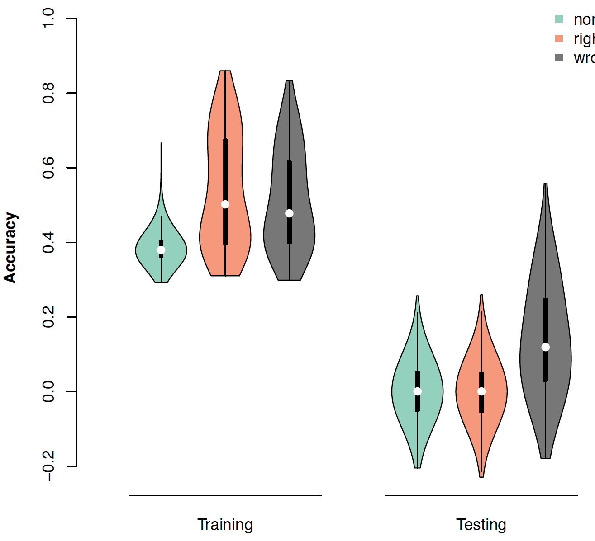

Invalid procedure create artifact prediction accuracy
RR
GWAS-RR/Valid
GWAS-RR/Invalid
Artifact

Slide 19
Outline
Cross validation
K-fold validation
Jack knife
Re-sampling
Two ways of calculating accuracy
Bias and correction
GWAS assisted GS

