Slide 1
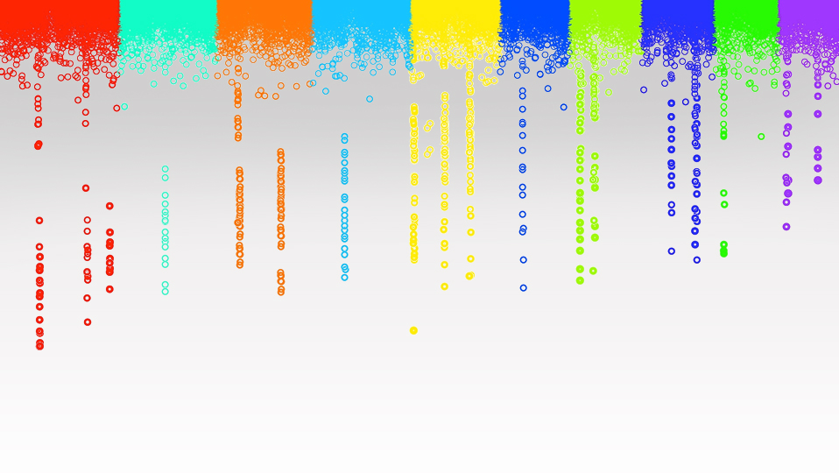

Statistical Genomics
BLUP Alphabet
Zhiwu Zhang
Washington State University

Slide 2
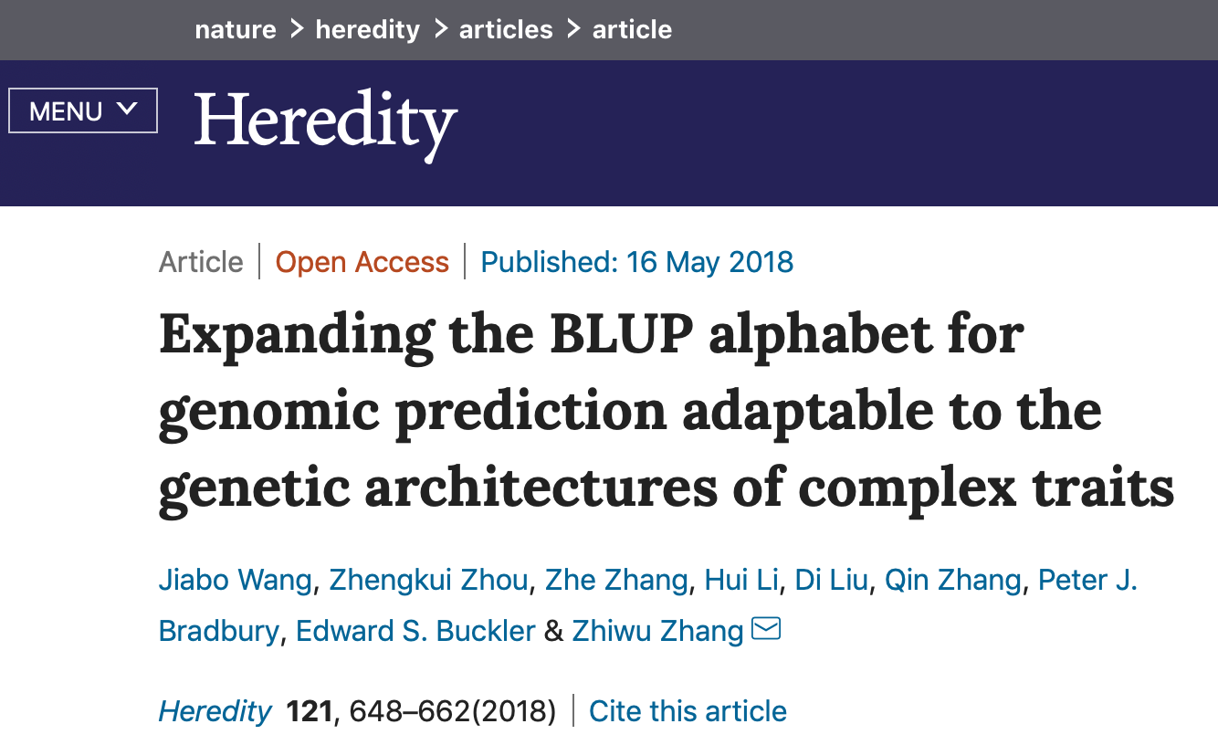
Outline
Method comparison
cBLUP
sBLUP
Domain of genetic architecture

Slide 3
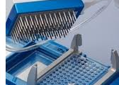
Genome prediction
Based on markers
Based on individuals
Y1, Y2, …, Y_{thousands}
1980~90s
MAS
Rex Bernardo
Crop Sci, 1994
Y = Xb + Zu
Kinship
_{among individuals}
Ridge regression
Bayes (A, B…)
Ys = S1, + S2, + …, + S _{millions}
Mewwissen et al,
Genetics, 2001
S1, S2, …, S_{millions}

Slide 4
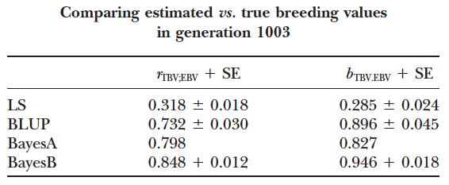
Simulated data
(10 CHR, 100cM, 1 QTN per half cM)
rr
Meuwissen et al., Genetics 2001

Slide 5
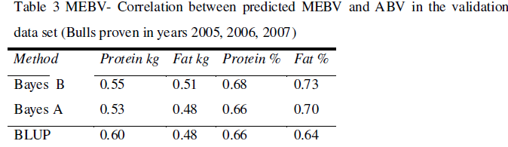
Real data
rr
Verbyla K. L., Hayes B. J., Bowman P. J., Goddard M. E., 2009 Accuracy of genomic selection using stochastic search variable selection in Australian Holstein Friesian dairy cattle. Genet Res 91: 307–311.

Slide 6
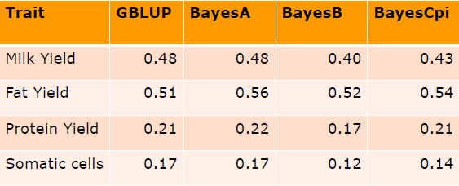
(Habier et al 2011)
– Accuracy in German Holstein Friesian data set

Slide 7
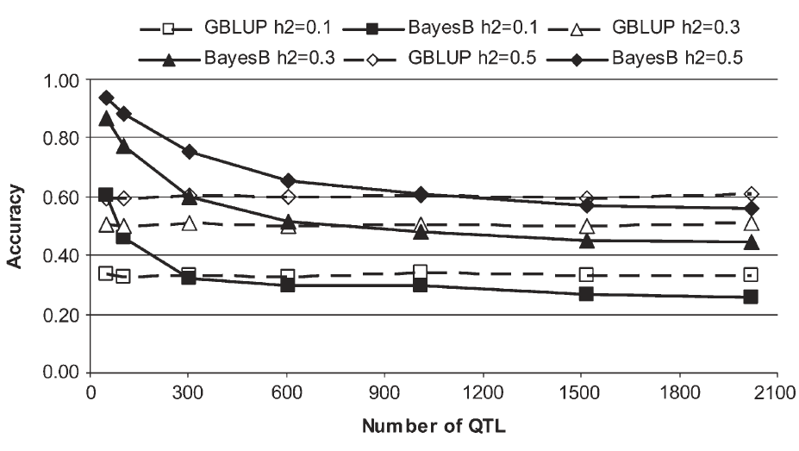
gBLUP: more QTN, Bayes: less
Daetwyler et al., 2010 Genetics, 185 (3) 1021-1031

Slide 8
Bayesian alphabet vs. BLUP alfabet
Random
rrBLUP, Bayes A, B, Cpi, LASSO…
y=x₁b₁ + x₂b₂ + … + x_{p}b_{p} + e
~N(0,
σ_{a}²)
gBLUP, ssBLUP, what else?
U
K

Slide 9
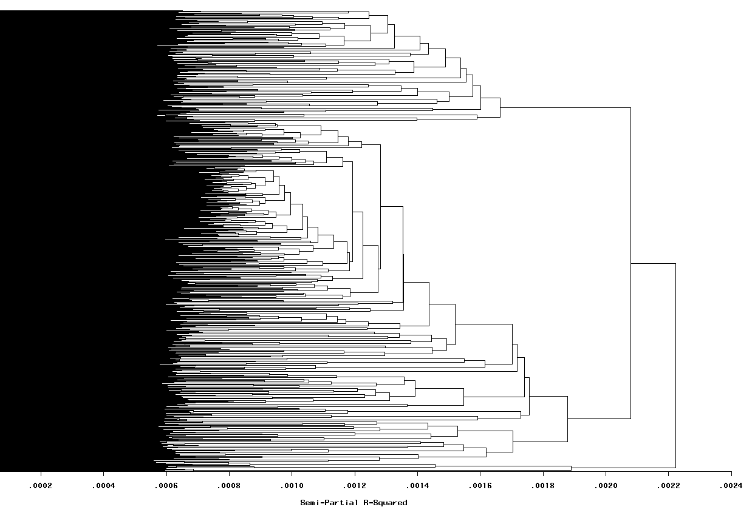
Group by kinship

Slide 10
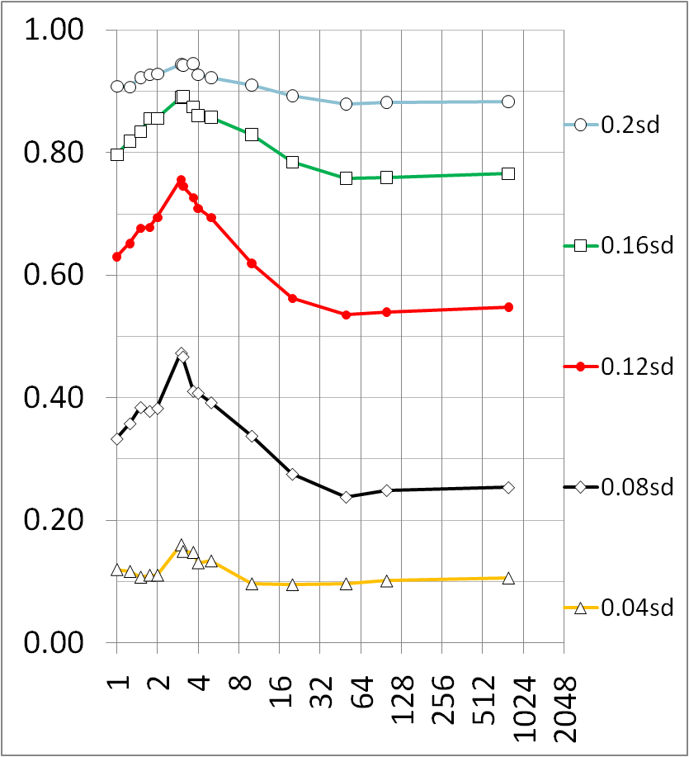
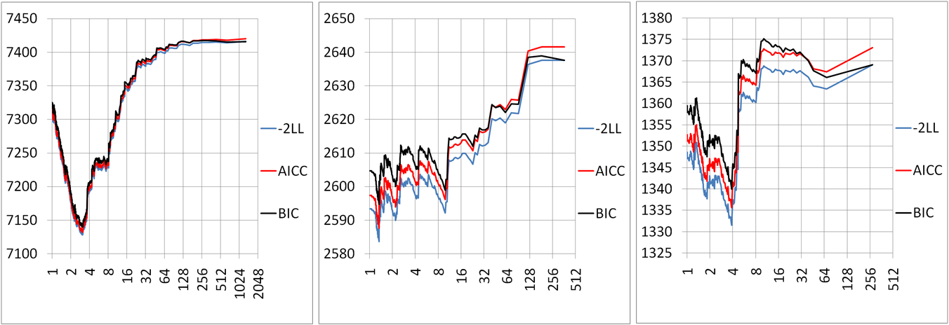
Compressed MLM improves power
Zhang et al, Nature Genetics, 2010
Average number of individuals per group

Slide 11
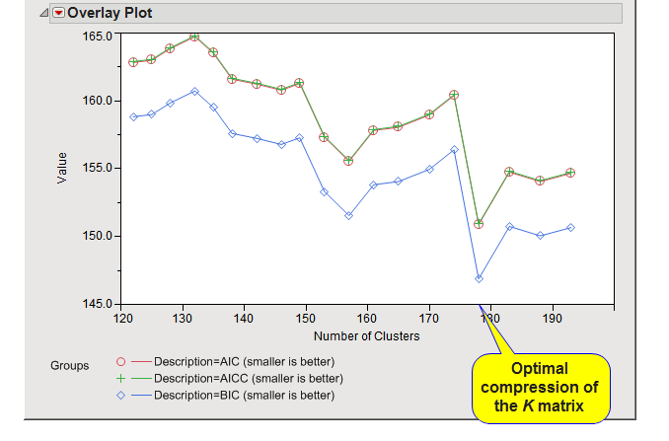
Zhang's method used by JMP (SAS)
This plot shows the output of the Optimized K matrix compression algorithm. The mixed model for trait association is fit without the SNP marker in the model at varying levels of K matrix compression (performed by hierarchical clustering of the K matrix between all samples). The resolution of the intervals of K matrix compression/clustering can be controlled by options on the process dialog . At each level, the model is evaluated for performance with metrics such as AIC, AICC, and BIC (smaller values indicate a better fitting model). The plot on the Results tab displays these model performance criteria on the y -axis versus the levels of compression of the K matrix on the x -axis. The optimized compression method (as described by Zhang et al . Nature Genetics. 2010) chooses the level of compression at the minimum value of the chosen metric for the Criterion for Optimal Compression Level parameter.
https://www.jmp.com/support/downloads/JMPG81_documentation/wwhelp/wwhimpl/js/html/wwhelp.htm#href=genetics2.46.67.html

Slide 12
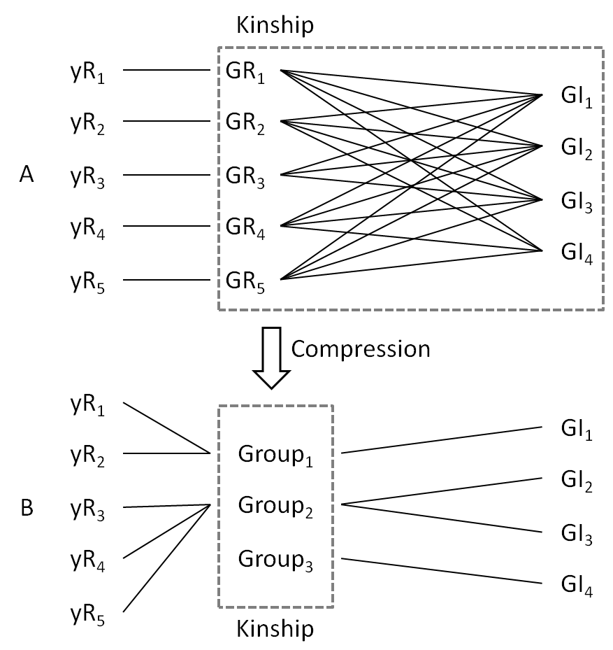
The base of gBLUP

Slide 13
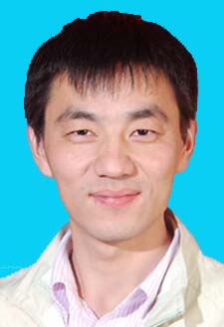
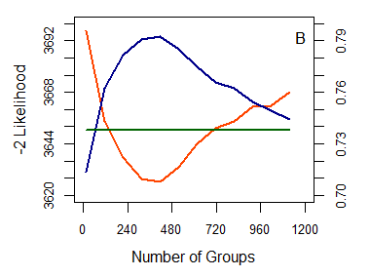
Same trend for prediction accuracy
Zhengkui Zhou

Slide 14

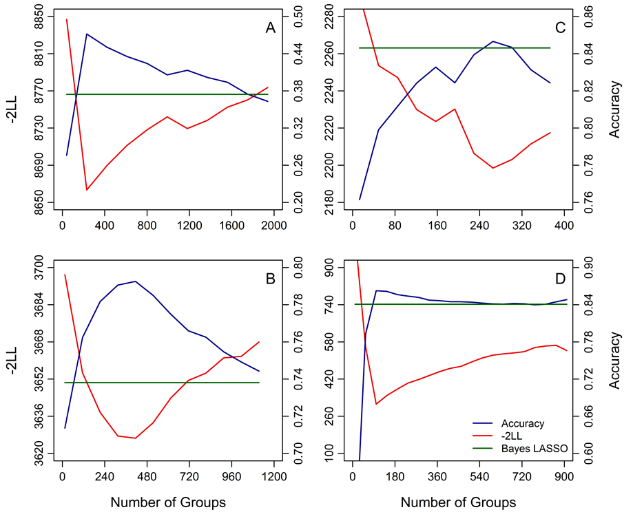
Same trend for other species
Jiabo Wang

Slide 15
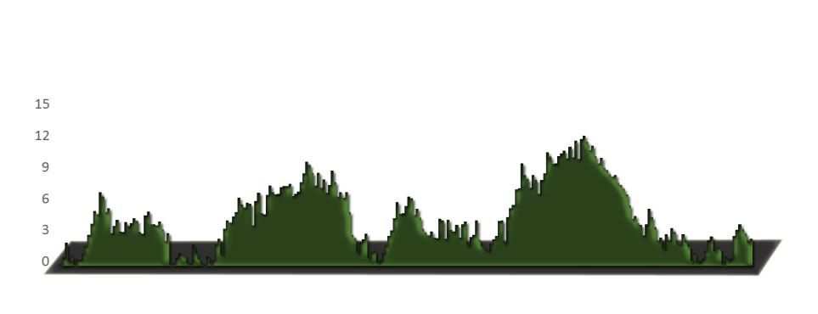
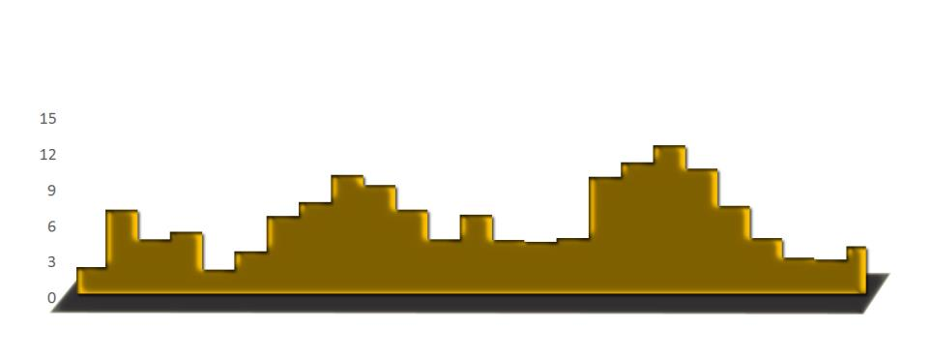
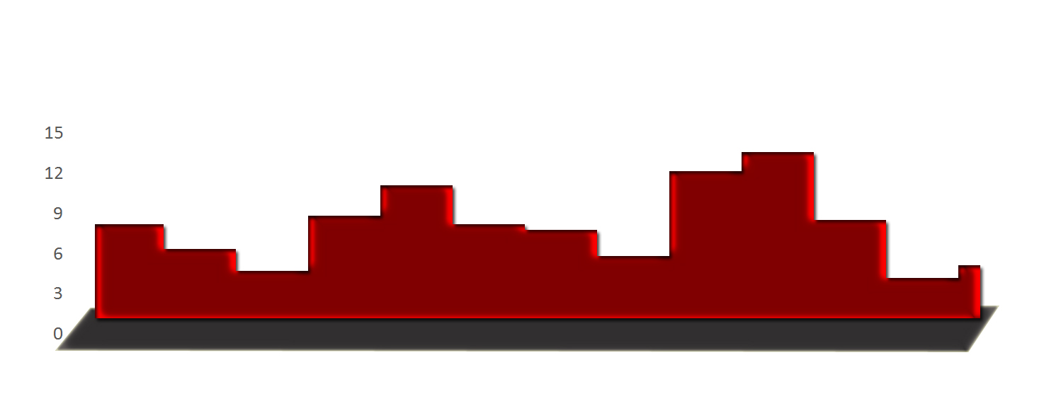
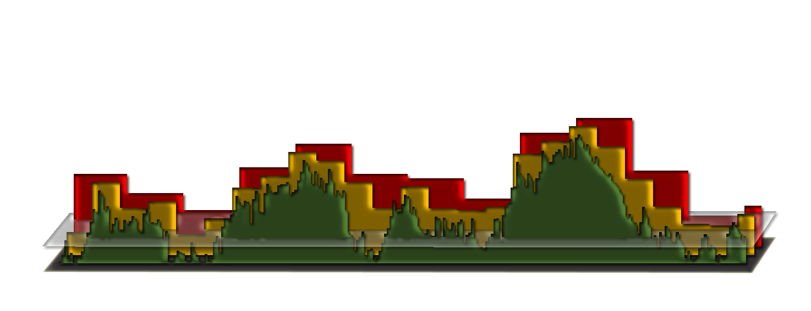
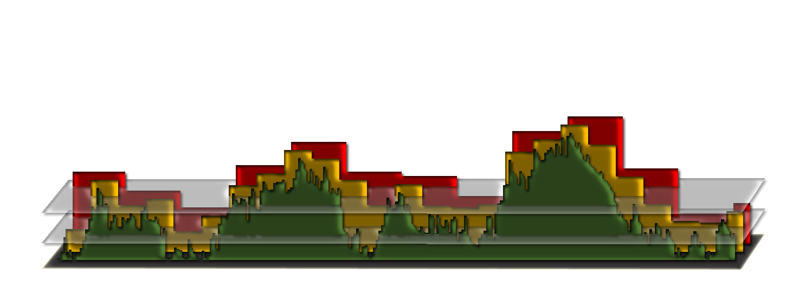
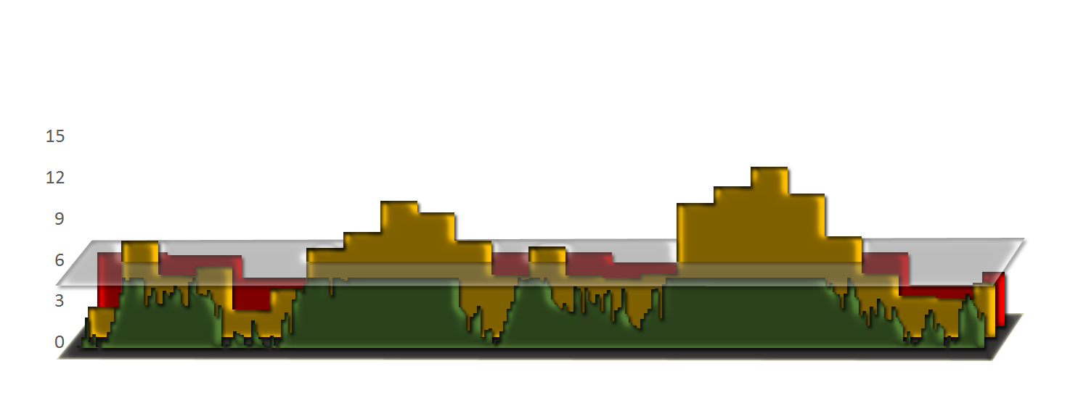
SUPER BLUP

Slide 16
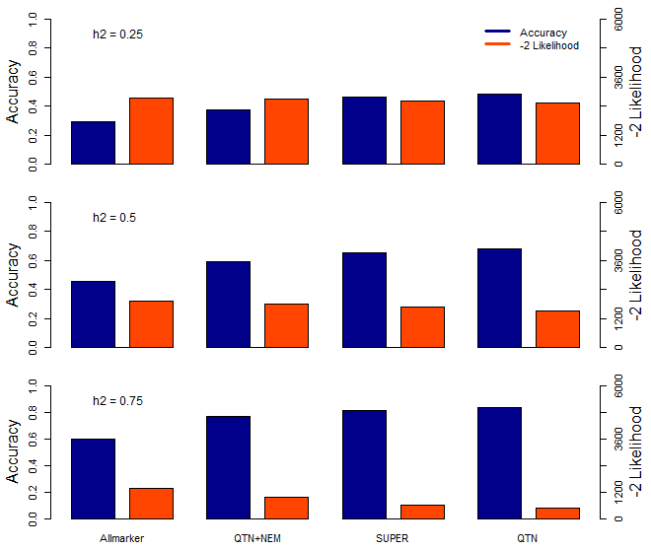
Notes:
Figure 2. The relationship between different kinships built with different number of causative mutations.
The plot show the distribution of the accuracy and -2 fold likelihood were calculated from different kinships which were used to predict which were build with all marker, QTN plus 1000 No Effect Markers (NEM), SUPER select pseudo QTNs and real QTNs.
The experiments were repeated 40 times and simulated with 10 QTNs and different heritability(0.25, 0.5 and 0.75)

Slide 17
BLUP alphabet
Bins
sBLUP
Kinship
Markers
gBLUP
cBLUP
Individual
Group
Random effects

Slide 18
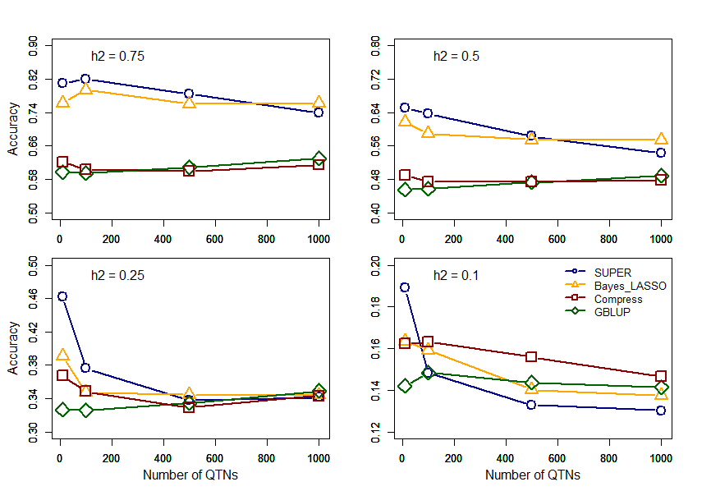
Notes:
Figure 5. The relationship between different methods and number of causative mutations.
The phenotypes were simulated with different number of causative mutations (QTNs). The heritability of the phenotype was 0.25, 0.5 and 0.75. Prediction methods (SUPER (blue), Bayes LASSO (orange), Compress (red) and gBLUP (green))were tested with 5 folds cross validation. These phenotypes were simulated by mouse data.

Slide 19
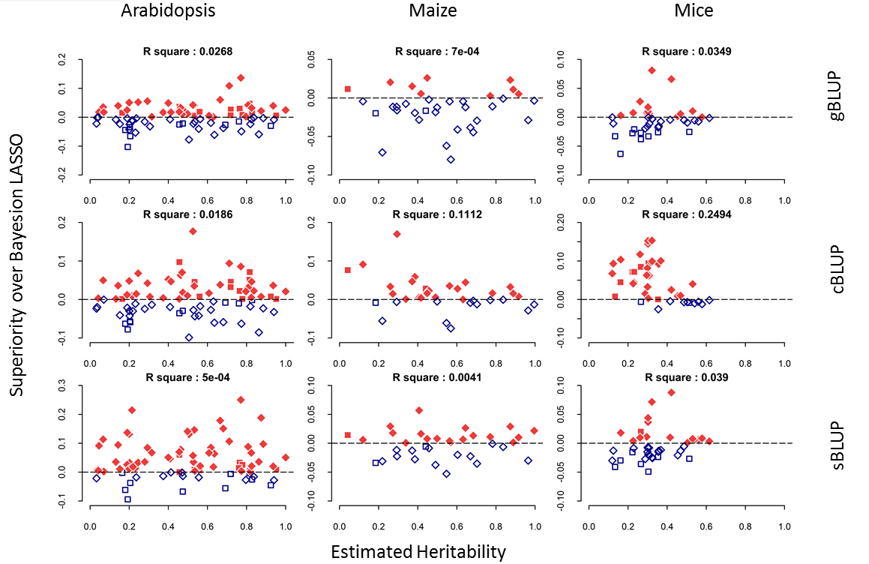
Arabidopsis with sBLUP
Superiority to Bayess
Rest
Flowering time
Estimated heritability

Slide 21
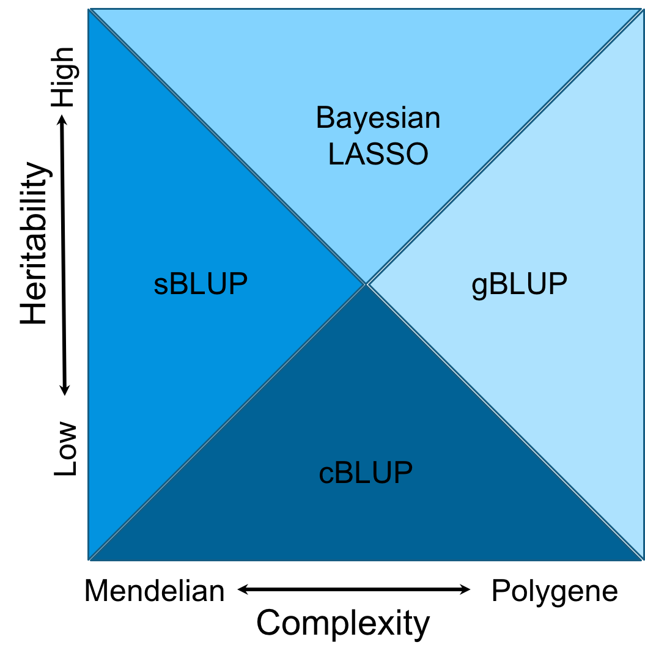
Domains
Notes:
Figure 6.The cost time of computing genomic prediction in three method.
Bayesion method (green) cost most time than other methods, and gBLUP (blue) is the least. The cost time of scBLUP (orange) computing genomic prediction depend on the number of individuals of population (compression) and the number of markers (SUPER). The computing time is calculated by CPU computing time.

Slide 22
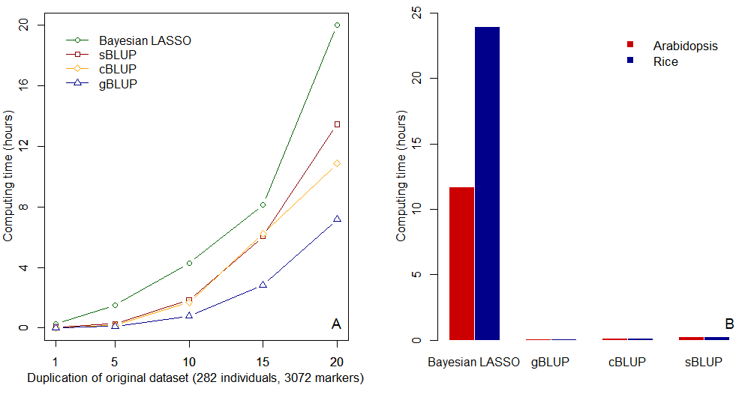
Computing time
Notes:
Figure 6.The cost time of computing genomic prediction in three method.
Bayesion method (green) cost most time than other methods, and gBLUP (blue) is the least. The cost time of scBLUP (orange) computing genomic prediction depend on the number of individuals of population (compression) and the number of markers (SUPER). The computing time is calculated by CPU computing time.

Slide 23
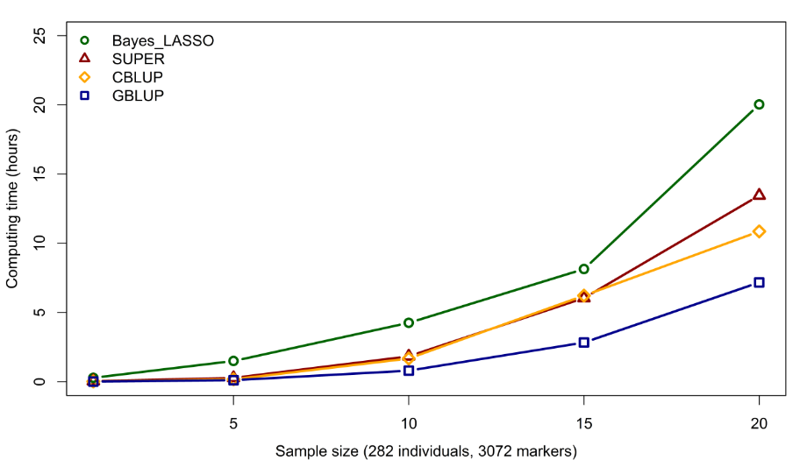
Computing time
Notes:
Figure 6.The cost time of computing genomic prediction in three method.
Bayesion method (green) cost most time than other methods, and gBLUP (blue) is the least. The cost time of scBLUP (orange) computing genomic prediction depend on the number of individuals of population (compression) and the number of markers (SUPER). The computing time is calculated by CPU computing time.

Slide 24
Import data and simulate phenotype
source("http://zzlab.net/GAPIT/gapit_functions.txt")
myGD=read.table(file="http://zzlab.net/GAPIT/data/mdp_numeric.txt",head=T)
myGM=read.table(file="http://zzlab.net/GAPIT/data/mdp_SNP_information.txt",head=T)
set.seed(99164)
n=nrow(myGD)
testing=sample(n,round(n/5),replace=F)
training=-testing
set.seed(99164)
mySim=GAPIT.Phenotype.Simulation(GD=myGD, GM=myGM,
h2=.7,
NQTN=20,
QTNDist="normal")

Slide 25
Mask QTNs
#Mask QTNs
#myGD[, mySim$QTN.position+1] =0
myGD=myGD[, -(mySim$QTN.position+1)]
myGM=myGM[-mySim$QTN.position,]

Slide 26
BLUP Alphabet
gBLUP
cBLUP
sBLUP
myGAPIT5 <- GAPIT(
Y=mySim$Y[training,],
GD=myGD,
GM=myGM,
PCA.total=3,
model="gBLUP",
file.output=F)
myGAPIT6 <- GAPIT(
Y=mySim$Y[training,],
GD=myGD,
GM=myGM,
PCA.total=3,
model="cBLUP",
group.from=100,
group.to=1000,
group.by=20,
file.output=F)
myGAPIT7 <- GAPIT(
Y=mySim$Y[training,],
GD=myGD,
GM=myGM,
PCA.total=3,
model="sBLUP",
file.output=F)

Slide 27
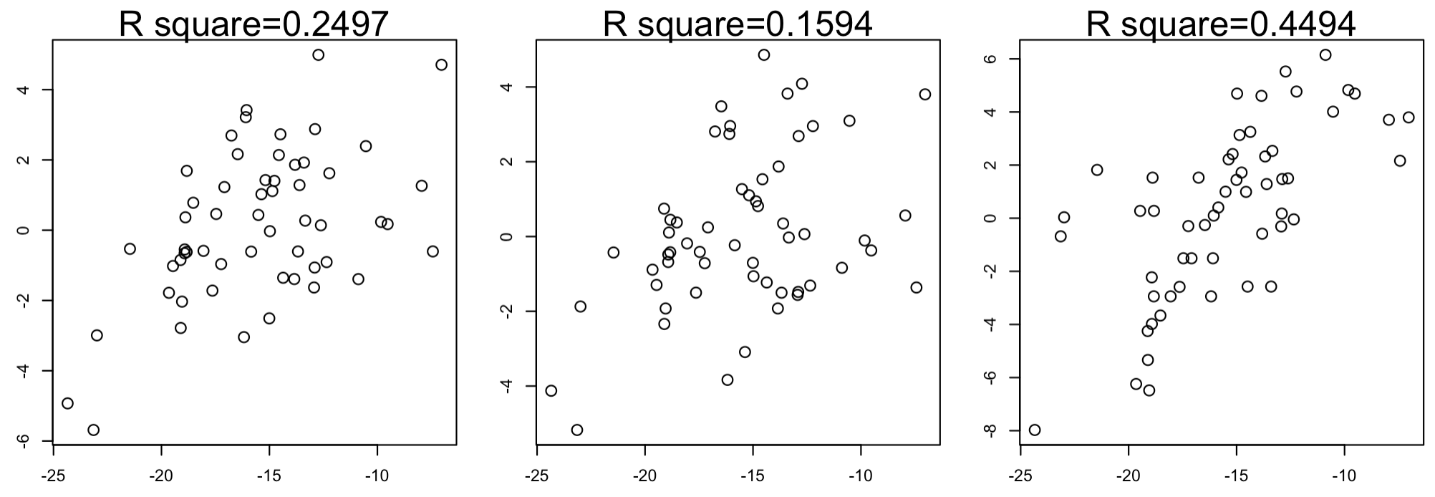
testingYU=cbind(mySim$Y[testing,c(1,2)], mySim$u[testing])
gapit5=merge(testingYU,myGAPIT5$Pred[,c(1,3,5,8)],by.x="Taxa",by.y="Taxa")
gapit6=merge(testingYU,myGAPIT6$Pred[,c(1,3,5,8)],by.x="Taxa",by.y="Taxa")
gapit7=merge(testingYU,myGAPIT7$Pred[,c(1,3,5,8)],by.x="Taxa",by.y="Taxa")
par(mfrow=c(1,3), mar = c(3,4,1,1))
par(mar=c(3,3,3,1))
plot(gapit5[,3],gapit5[,5],cex=1.4)
mtext(paste("R square=",round(cor(gapit5[,3],gapit5[,5])^2,4),sep=""),cex=1.4, side = 3)
plot(gapit6[,3],gapit6[,5],cex=1.4)
mtext(paste("R square=",round(cor(gapit6[,3],gapit6[,5])^2,4),sep=""),cex=1.4, side = 3)
plot(gapit7[,3],gapit7[,5],cex=1.4)
mtext(paste("R square=",round(cor(gapit7[,3],gapit7[,5])^2,4),sep=""),cex=1.4, side = 3)
gBLUP
cBLUP
sBLUP
Breeding values
EBV

Slide 28
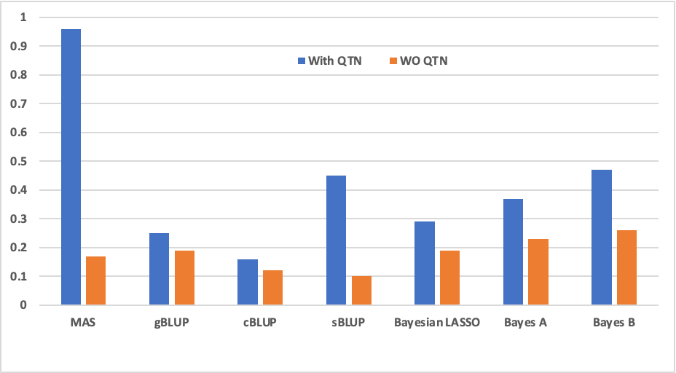
Impact of marker density
gBLUP is robust when markers are not informative

Slide 29
Outline
Method comparison
cBLUP
sBLUP
Domain of genetic architecture

