Slide 1
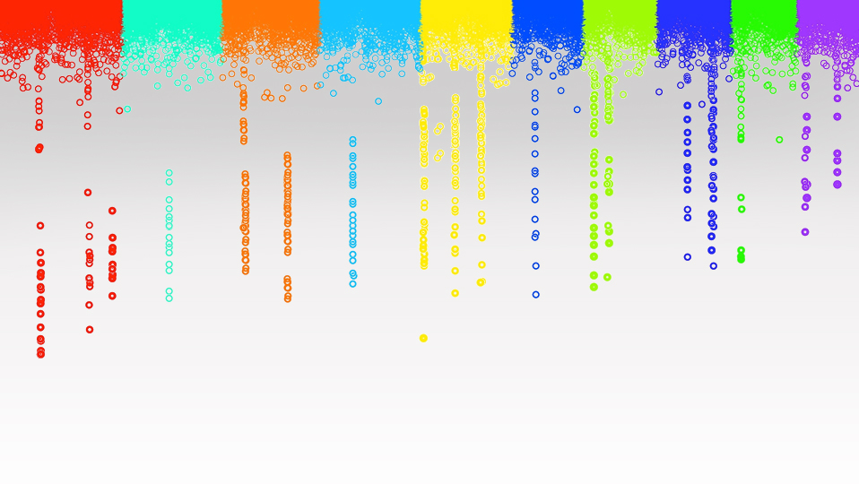

Statistical Genomics
Machine Learning
Zhiwu Zhang
Washington State University

Slide 2
Administration
Final HW due on Friday (April 28) at 3:10PM
Final exam: May 3, 4:30-6:30pm, open book, 50 questions
Grade submission: May 4 to students and May 5 to university
Course evaluation target: 100% responses by Friday (April 28)
Group pictures: Wednesday (April 26)

Slide 3
Outline
Challenges in finding the best method.
Machine learning
Knowledge mining
MMAP algorithm
Cloud computing
MMAP performances

Slide 4
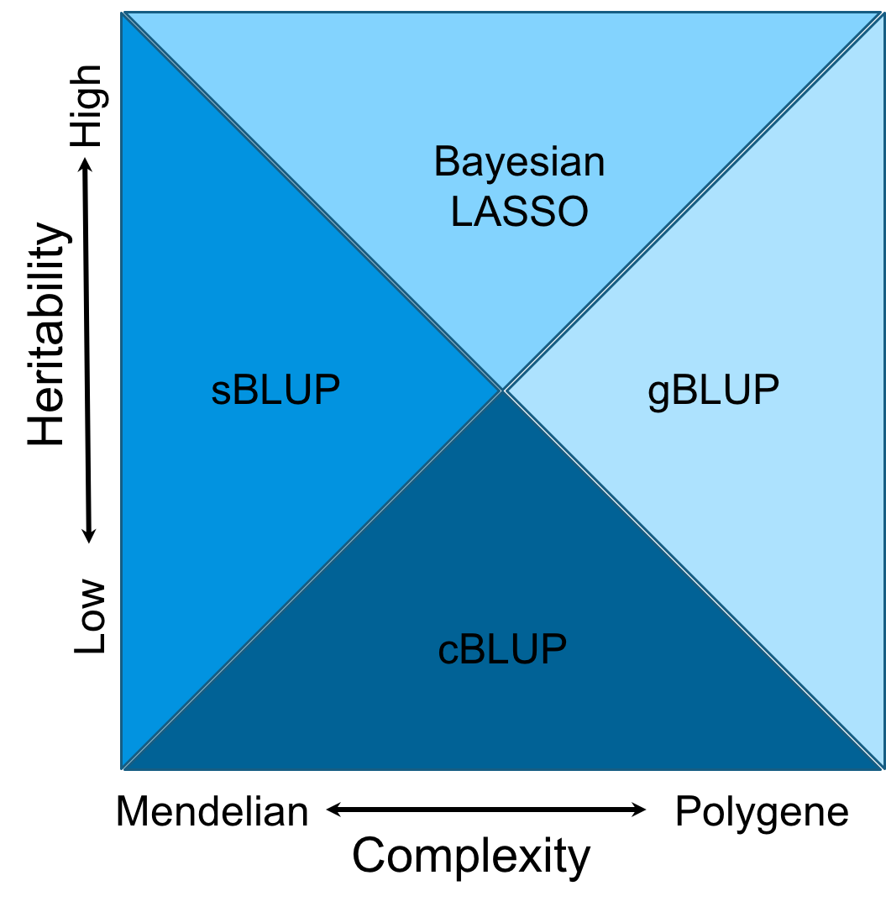
Domains
Notes:
Figure 6.The cost time of computing genomic prediction in three method.
Bayesion method (green) cost most time than other methods, and gBLUP (blue) is the least. The cost time of scBLUP (orange) computing genomic prediction depend on the number of individuals of population (compression) and the number of markers (SUPER). The computing time is calculated by CPU computing time.

Slide 5

Hard coded multiple players' moves won the champion
1996: Garry Kasparov vs IBM Deep Blue

Slide 6
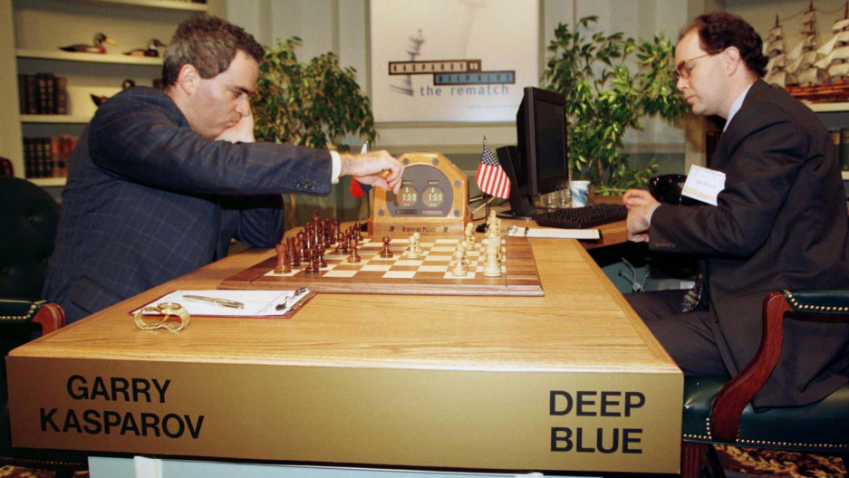
IF…
IF…
IF…
IF…
IF…
IF…
IF…
IF…
IF…
IF…
IF…
IF…
IF…
IF…
IF…
IF…
IF…
IF…
IF…
IF…
IF…

Slide 7
Machine learning
Machine learning is a type of artificial intelligence (AI) that provides computers with the ability to learn without being explicitly programmed.
https://engineering.jhu.edu/ams/research/statistics-and-machine-learning

Slide 8

DEEP BLUE (Sum only, no ability to learn)
"Machine learning is a computer system that gets better over new data without reprogramming"
-Zhiwu Zhang

Slide 9
Statistical learning methods with ML features
Linear Regression
Cluster Analysis
Decision Tree

Slide 10
Knowledge Mining
Knowledge
Data
Prediction

Slide 11
Genomic Prediction
Input data
Sample size
Marker density
LD decade
h²
PCA
Prediction
accuracy
Impute missing accuracy
K-Mean Cluster Analysis
Mining the best method: Find the nearest neighbor from the cluster analysis based on existing features, including heritability, and newly gained prediction accuracies. Choose the method that gave the highest prediction accuracy for the nearest neighbor as the candidate to examine in next iteration.
Yes
No
Output
Examined?

Slide 12
Knowledge and expansion
Next
Data | rrBLUP | gBLUP | cBLUP
Start.Weight | 0.41 | 0.41 | 0.50
FN.Age | 0.57 | 0.58 | 0.74
FN.PctWtLoss | 0.25 | 0.25 | 0.28
FN.postWeight | 0.40 | 0.40 | 0.49
FN.preWeight | 0.39 | 0.39 | 0.49
Weight.Growth Intercept | 0.37 | 0.37 | 0.48
Weight.Growth Slope | 0.31 | 0.32 | 0.34
HTLC | 0.43 | 0.43 | 0.39
BA | 0.49 | 0.49 | 0.47
BD | 0.25 | 0.25 | 0.24
BLC | 0.47 | 0.47 | 0.44
CWAC | 0.45 | 0.44 | 0.43
CWAL | 0.36 | 0.35 | 0.34
DBH | 0.43 | 0.42 | 0.39
HT | 0.36 | 0.35 | 0.34
rootnum | 0.23 | 0.23 | 0.21
rootnumbin | 0.26 | 0.26 | 0.26
gall | 0.23 | 0.22 | 0.22
rustbin | 0.27 | 0.27 | 0.28
c5c6 | 0.26 | 0.25 | 0.23
density | 0.20 | 0.21 | 0.18
lateWood.4 | 0.23 | 0.24 | 0.24
lignin | 0.16 | 0.17 | 0.16
stiffnessTree | 0.37 | 0.38 | 0.37
New
Imputed
Nearest
Highest

Slide 13
New data
Impute missing accuracy
Cluster analysis
Let M be the best method for the old data that is the closest to the new data
If M is applied for the new data?
No
Apply M to the new data
Yes
Stop: output the best

Slide 14
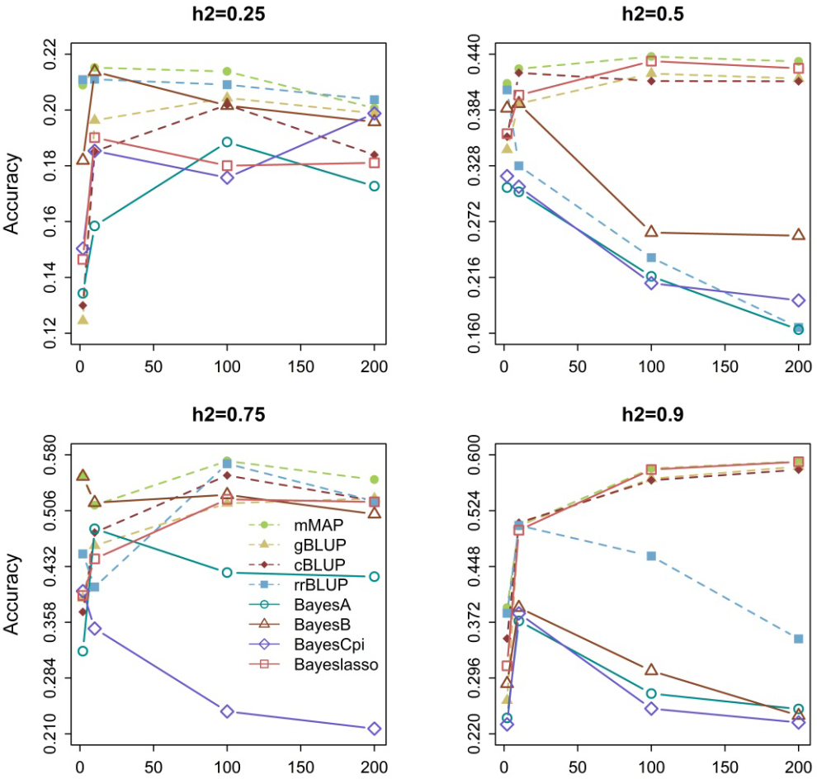
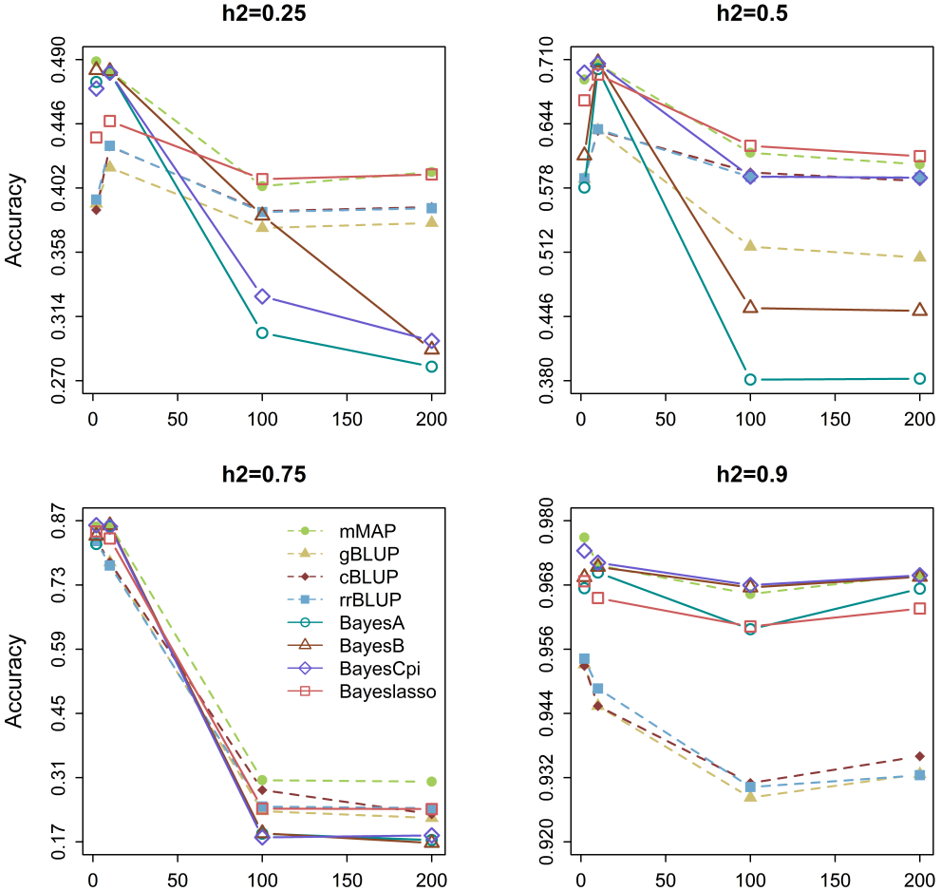
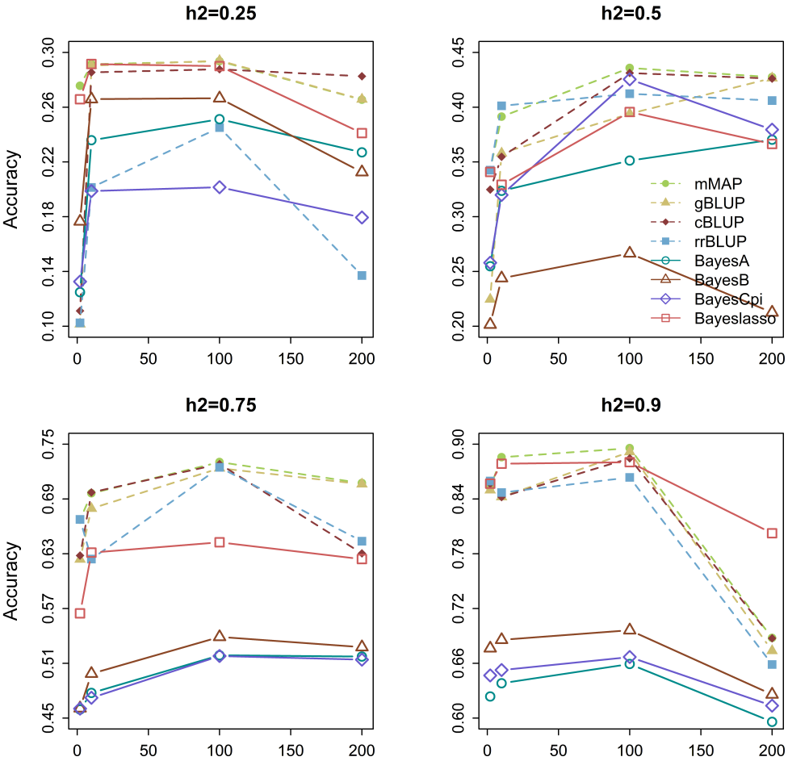
mMAP stays on the top
Maize
Mice
Pine
Number of genes

Slide 15
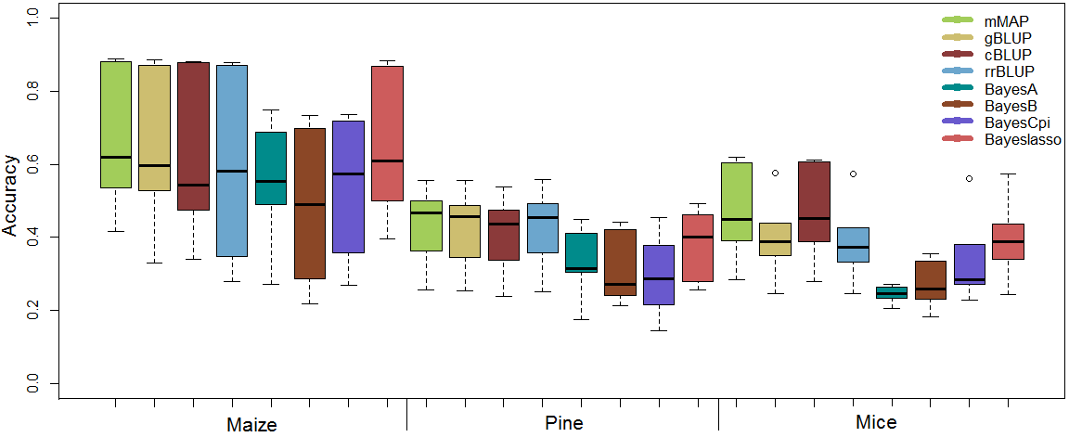
Real traits

Slide 16
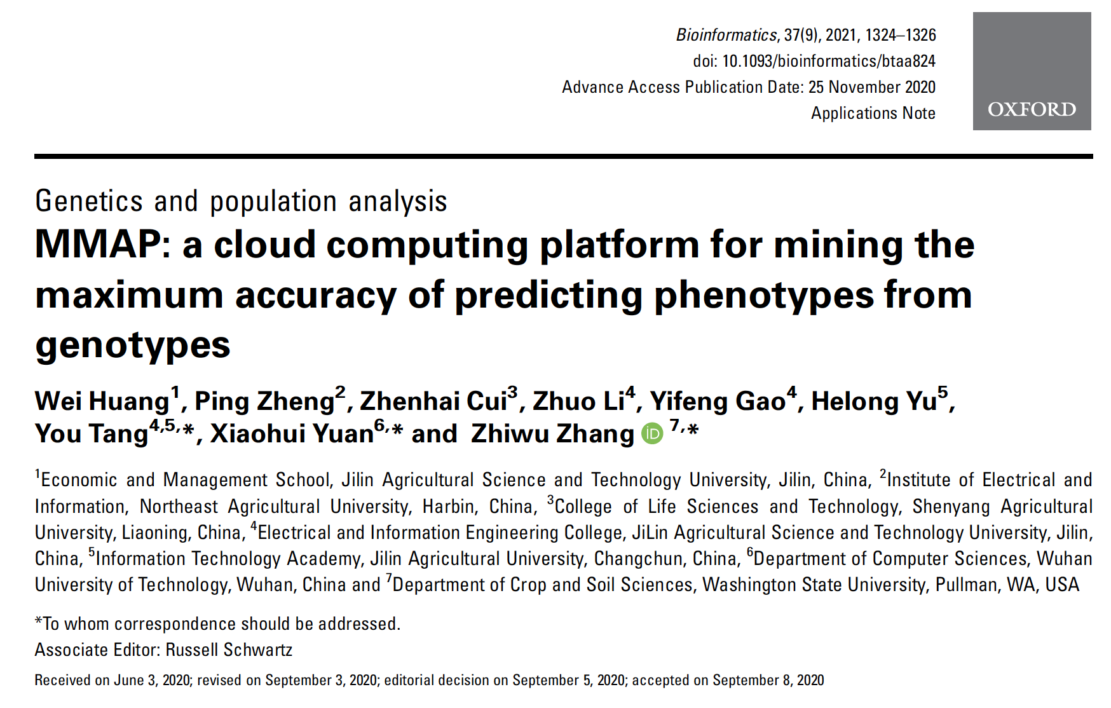

Slide 17
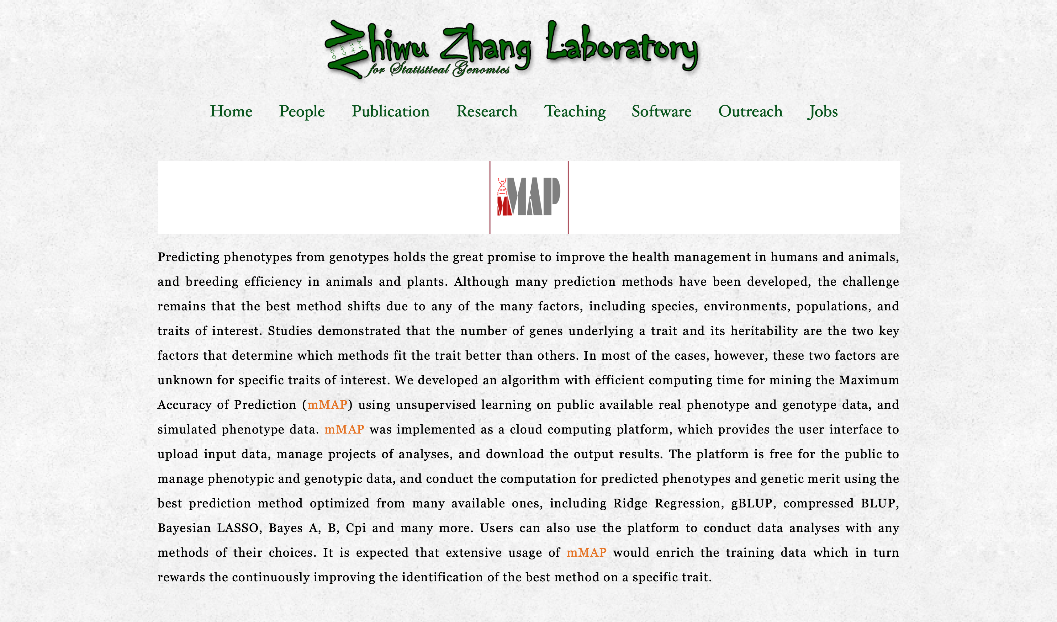

Slide 18



mMap: An Online Computing Platform to Transform Genotypes to Phenotypes by Mining the Maximum Accuracy of Prediction
You Tang
mMAP website: http://zzlab.net/mMAP

Slide 19
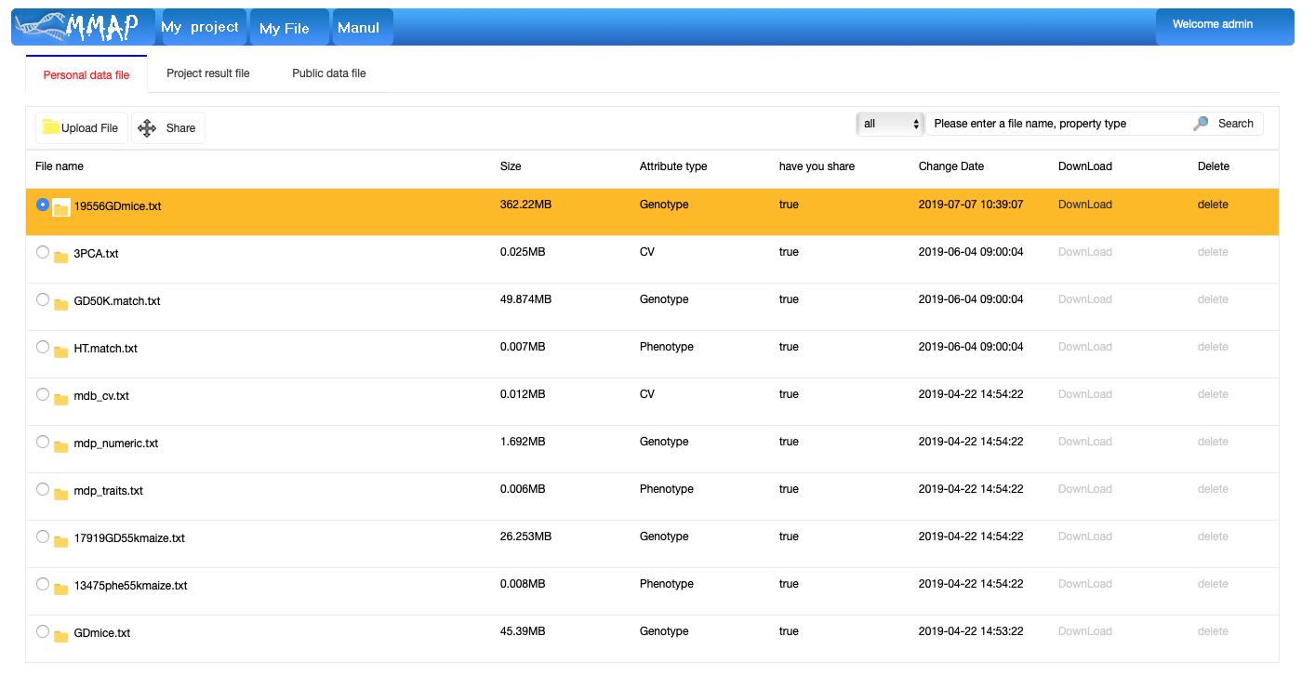
Upload Files

Slide 20
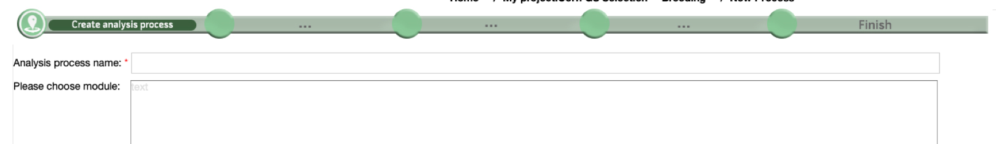
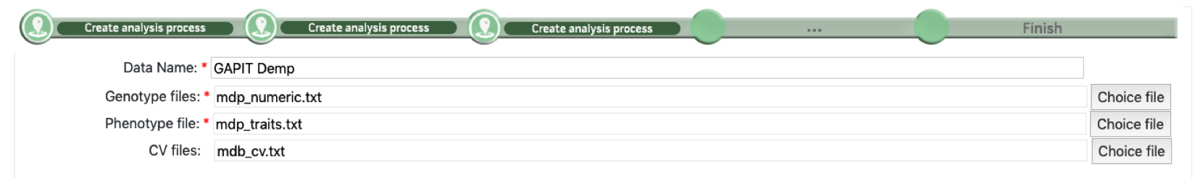
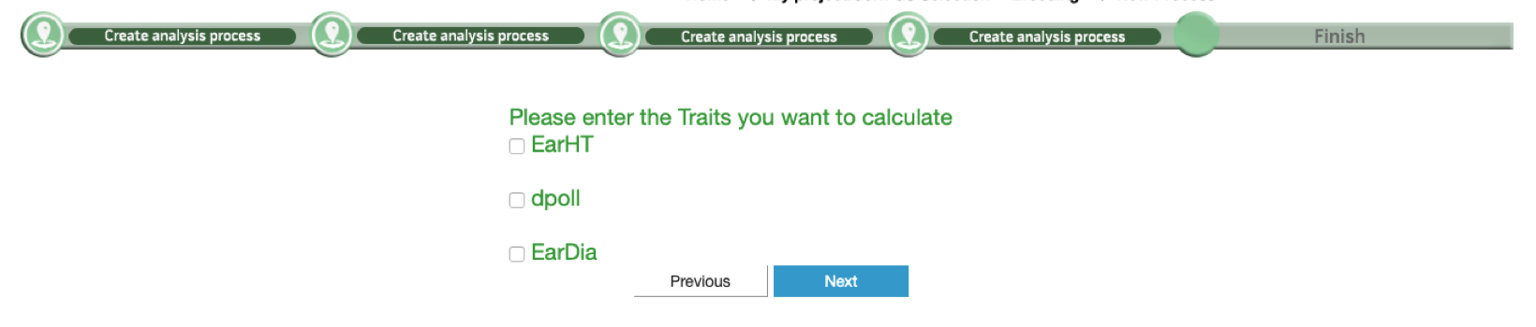
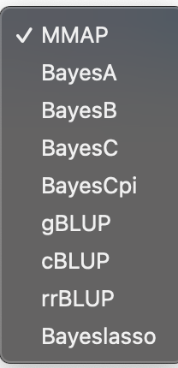

Create New Project

Slide 21
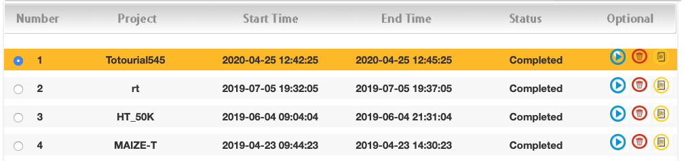
Check status and download results

Slide 22
Simulation with GAPIT
source("http://zzlab.net/GAPIT/gapit_functions.txt")
myGD=read.table(file="http://zzlab.net/GAPIT/data/mdp_numeric.txt",head=T)
myGM=read.table(file="http://zzlab.net/GAPIT/data/mdp_SNP_information.txt",head=T)
set.seed(99164)
n=nrow(myGD)
testing=sample(n,round(n/5),replace=F)
training=-testing
set.seed(99164)
mySim=GAPIT.Phenotype.Simulation(GD=myGD, GM=myGM,
h2=.7,
NQTN=20,
QTNDist="normal")

Slide 23

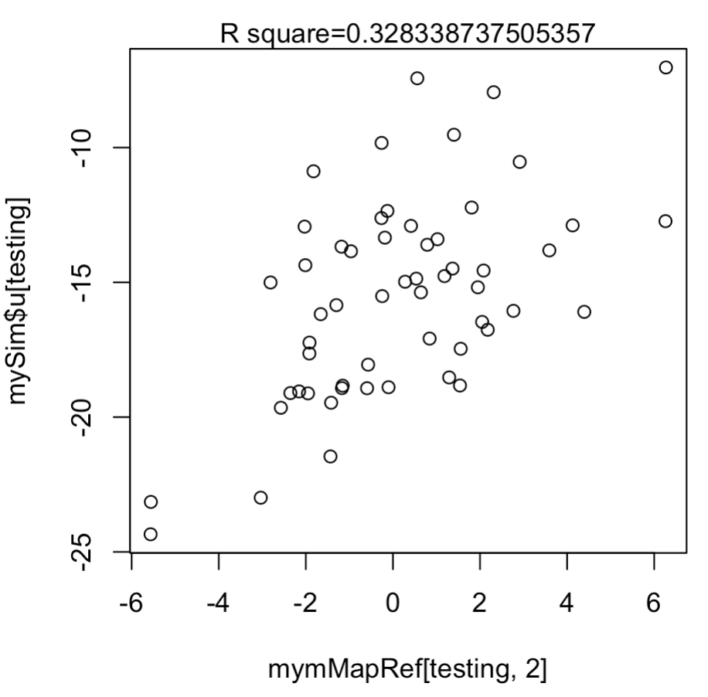
#MMAP
names(mySim$Y)=c("Taxa", "SimTrait")
write.table(mySim$Y[training,], file="mdp_YRef.txt", sep="\t",quote=F,row.names=F)
#upload mdp_numeric.txt and mdp_YRef.txt to MMAP
http://zzlab.net/mMAP
#Analysis
mymMapRef=read.csv("public820.csv")
accuracy <- cor(mySim$u[testing], mymMapRef[testing,2] )^2
plot(mymMapRef[testing,2] ,mySim$u[testing])
mtext(paste("R square=", accuracy,sep=""), side = 3)

Slide 24
Outline
Challenges in finding the best method.
Machine learning
Knowledge mining
MMAP algorithm
Cloud computing
MMAP performances

