Slide 1
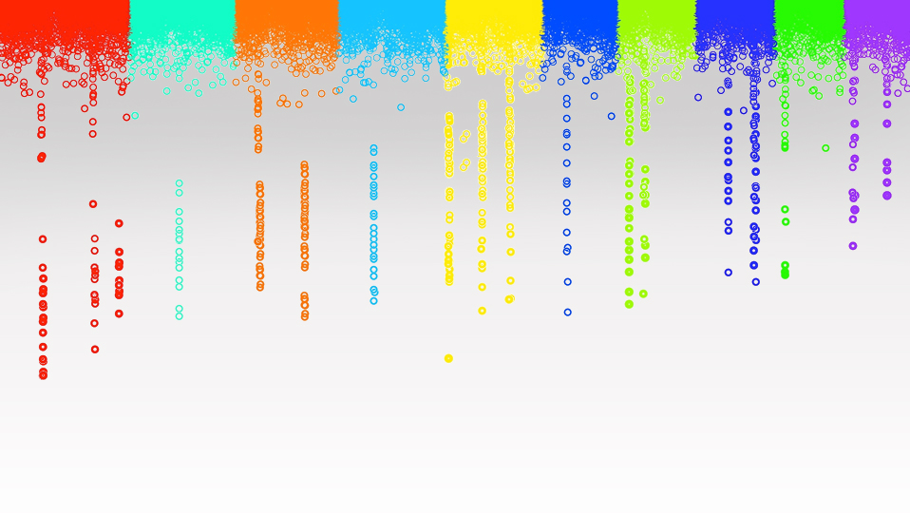
Statistical Genomics
AI GS
Zhiwu Zhang
Washington State University

Slide 2
Outline
Statistics, statistical learning, machine learning, and artificial intelligence
Modeling genomic prediction
Machine learning
Mathematic foundation of deep learning (neural network)

Slide 3
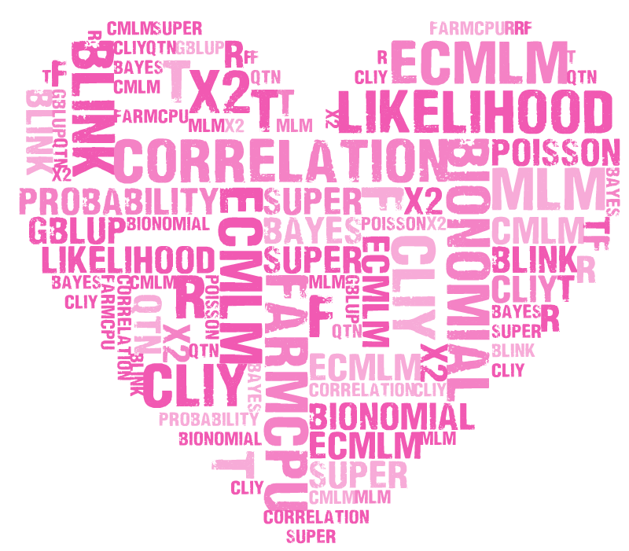
Keywords
MLM cMLM ecMLM SUPER FarmCPUPU BLINK GWASbyCor correlation QTN gBLUP Bayes likelihood probability R t f x2 Bionomial Poisson distribution statistics phenotype genotype MAF GAPIT rrBLUP BLR MLMM LASSO Gibbs PCA Structure Population Kinship EMMA Matrix inverse Transpose if loop function type1&2 error FDR threshold coverage depth simulation linkage disequilibrium power P3D MAS gBLUP ssBLUP cBLUP sBLUP Bayes A B Cpi Prior Posterior Exponential Kernel Ridge Regression
545

Slide 4
By GWAS&GS!

Slide 5
Remains in Statistical Genomics (545)
Critical thinking
Innovation
Perfection

