Slide 1
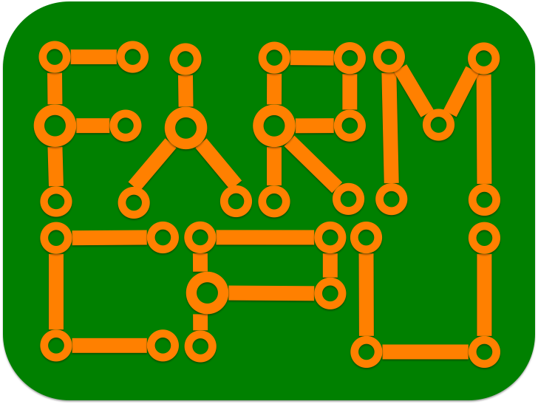
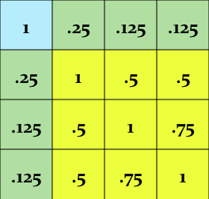
Genomic
prediction
SUPER
ECMLM
CMLM
MLM
GLM
GWAS

Slide 2
MAS
BLUP
Alphabets
SUPER
ECMLM
CMLM
MLM
GLM

